Slide 1
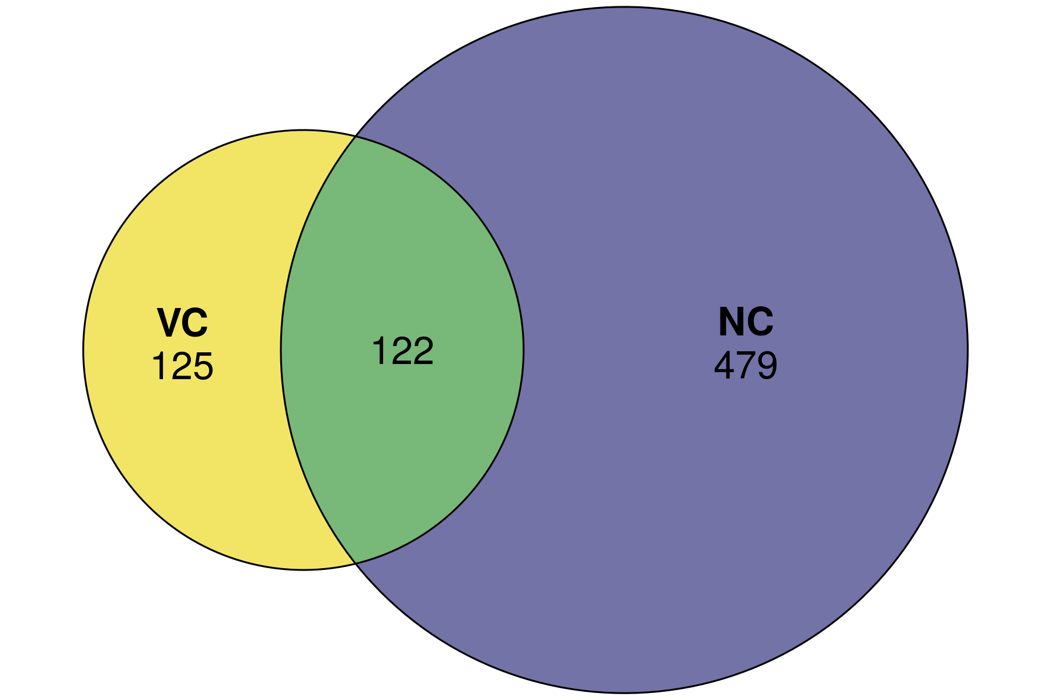
Resistance: Turned on by good diet only after viral infection
(VC vs. VR)
(NC vs. NR)
Resilience: Turned on by good diet regardless of viral infection status

Slide 2
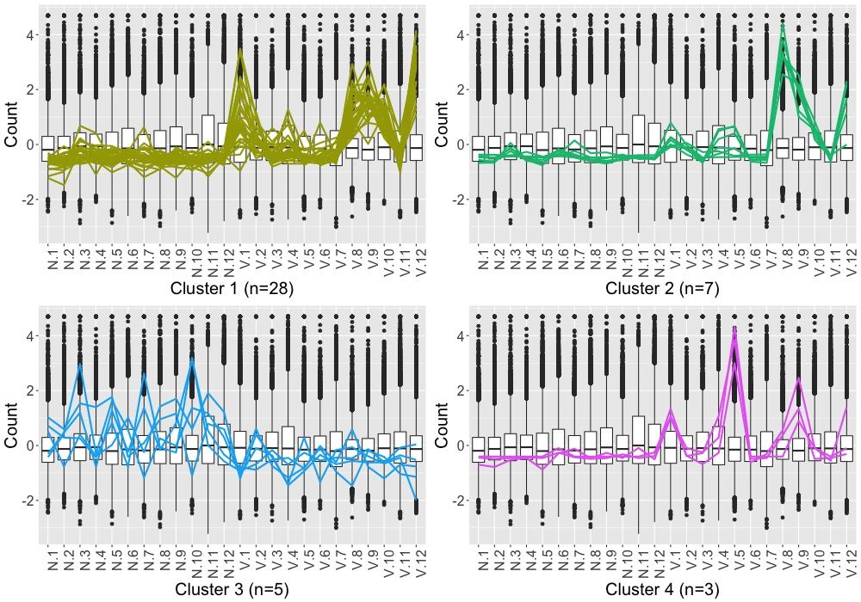

Slide 3
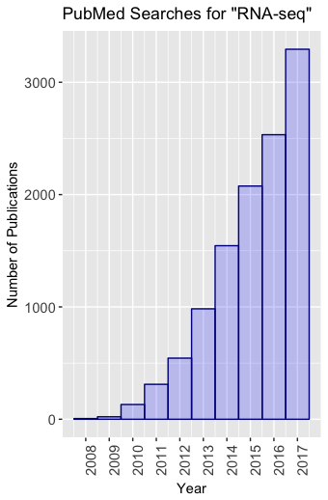

Slide 4
Wang, Z., Gerstein, M., and Snyder, M. (2009) RNA-Seq: A revolutionary tool for transcriptomics. Nature Reviews Genetics, 10, 57–63.
“RNA-Seq has also been shown to be highly accurate”
“Results of RNA-Seq also show high levels of reproducibility, for both technical and biological replicates”
“One particularly powerful advantage of RNA-Seq is that it can capture transcriptome dynamics across different tissues or conditions without sophisticated normalization of data sets”

Slide 5

Wang, Z., Gerstein, M., and Snyder, M. (2009) RNA-Seq: A revolutionary tool for transcriptomics. Nature Reviews Genetics, 10, 57–63.
“RNA-Seq has also been shown to be highly accurate”
“Results of RNA-Seq also show high levels of reproducibility, for both technical and biological replicates”
“One particularly powerful advantage of RNA-Seq is that it can capture transcriptome dynamics across different tissues or conditions without sophisticated normalization of data sets”
edgeR
DESeq2
Limma
EDASeq

Slide 6

Case of GC-Content Bias
Risso, D., Schwartz, K., Sherlock, G., Dudoit, S. (2011) GC-Content normalization for RNA-Seq data. BMC Bioinformatics, 12, 480.

Slide 7
Case of Sample Switching
Baggerly, K.A. and Coombes, K.R. (2009) Deriving chemosensitivity from cell lines: Forensic bioinformatics and reproducible research in high-throughput biology. The Annals of Applied Statistics, 3, 1309–1334.

Slide 8
Case of Replicate Structures
Moran Lauter, A.N. and Graham, M.A. (2016) NCBI SRA bioproject accession:PRJNA318409

Slide 9
Case of Lopsided Outliers
Robinson, M.D. and Oshlack, A. (2010) A scaling normalization method for differential expression analysis of RNA-seq data. Genome Biology, 11, R25

Slide 10
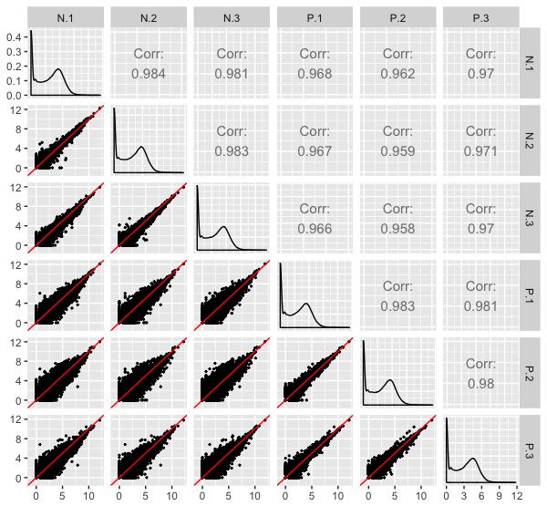

Slide 12
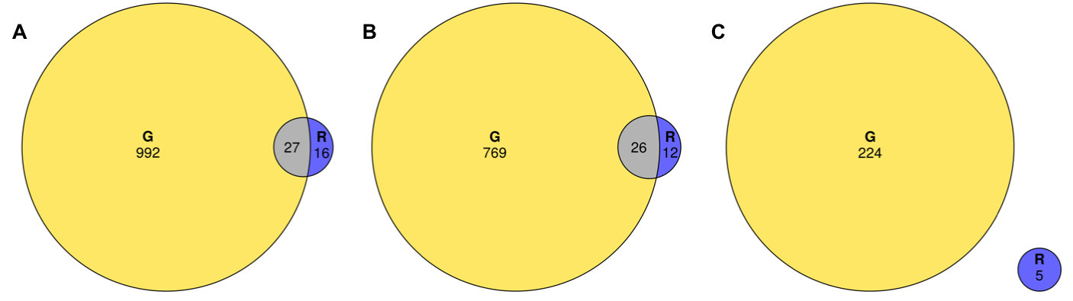
Virus-related DEGs
Virus DEGs
Non-virus DEGs

