Slide 1
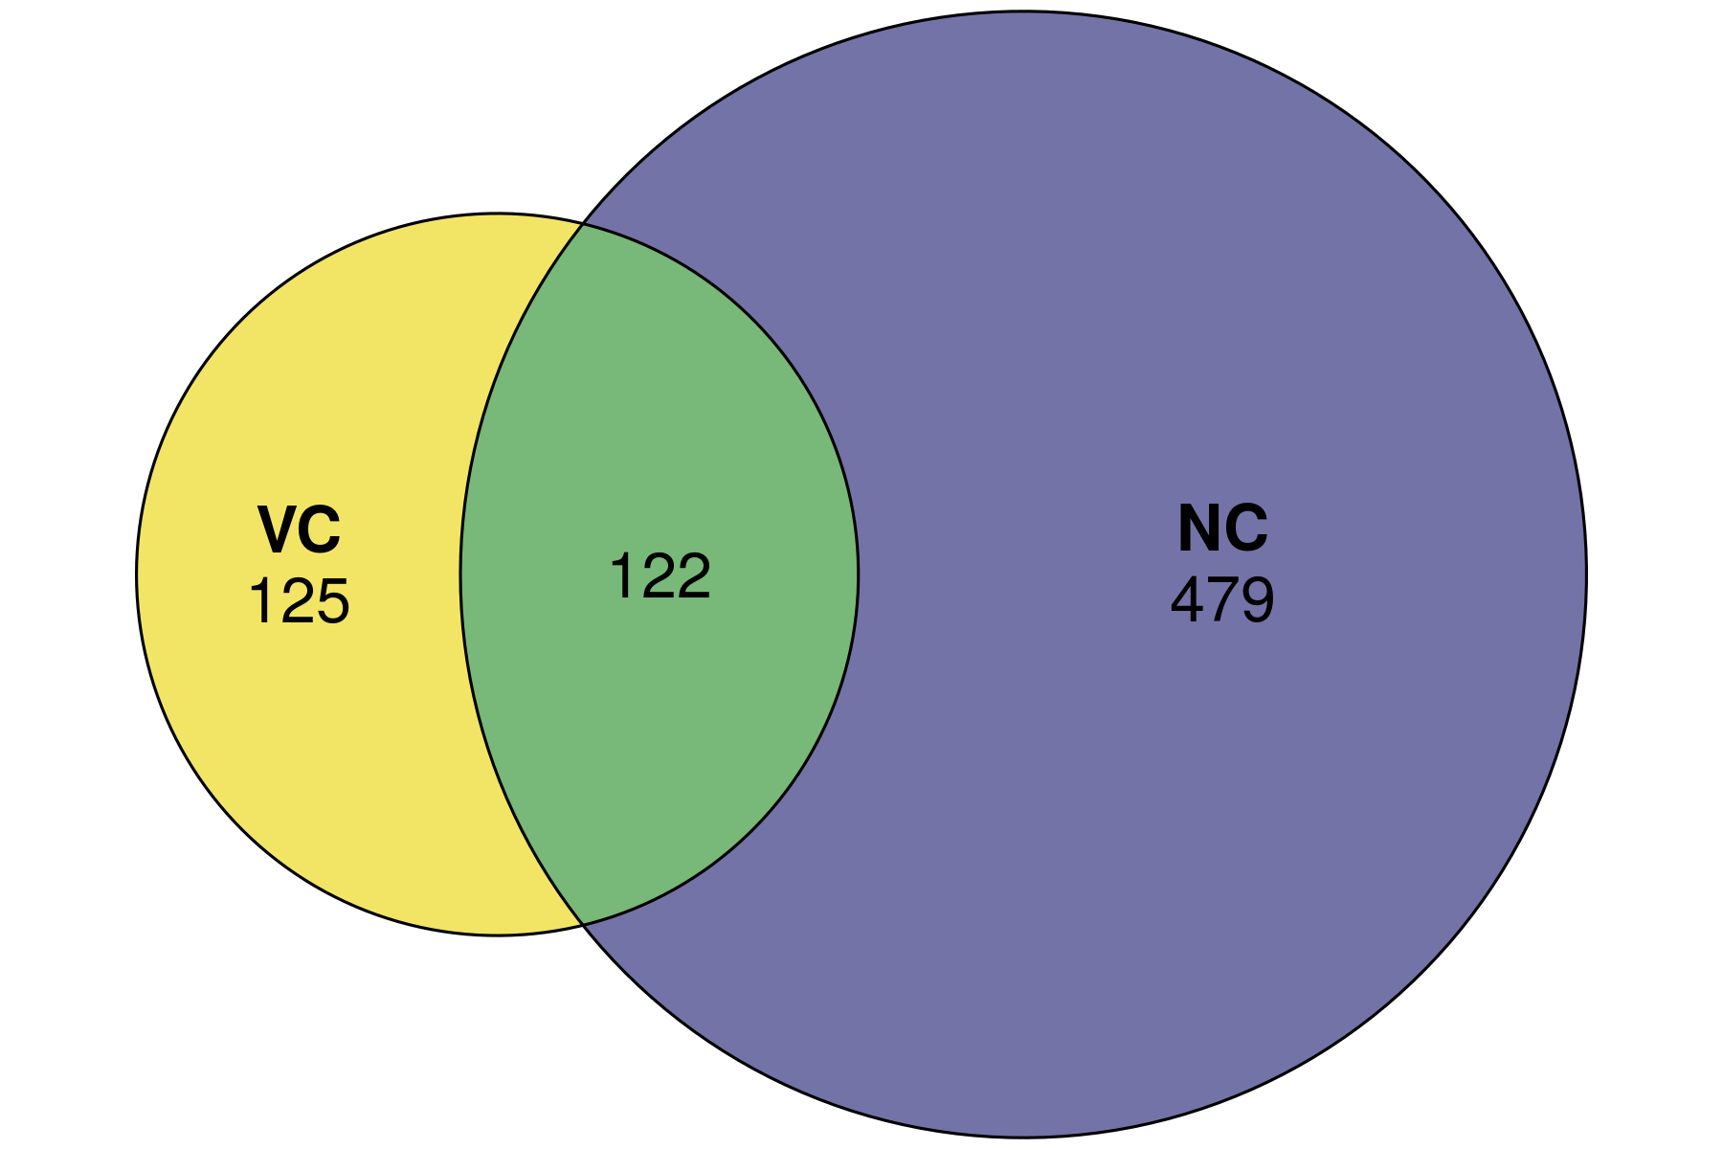
Resistance: Turned on by good diet only after viral infection
(VC vs. VR)
(NC vs. NR)
Resilience: Turned on by good diet regardless of viral infection status

Slide 2
