Slide 1
Planning Breeding Programs for Impact
Breeding for Resistance to Diseases
Bacterial blight
Blast

Slide 2

Learning Objectives
To predict durability of R genes
To explain pathogen population structure
To discuss breeding strategies for diseases where major genes are effective
To associate known sequences of candidate genes to phenotypes of germplasm and breeding pedigrees
To discuss the possibility to relate QTLs to candidate genes and metabolic pathways

Slide 3

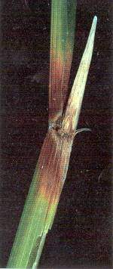
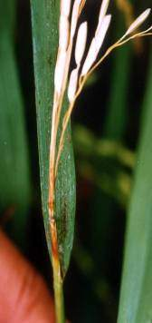
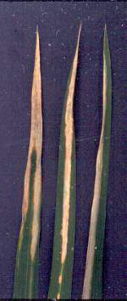
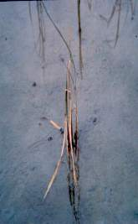

Aim for durable and broad-spectrum disease resistance
Blast
Bacterial blight

Slide 4
Overall Strategy & Target
Understand genetic variability
and population structure
of the pathogen
Identify effective R-gene
combinations against
local populations
Study pathogen adaptation
& epidemiological
consequences
Determine quality of
resistance genes
Incorporation of resistance genes into
high-yielding local cultivars
Gene deployment
  quality
  geographic area
  time
Stabilize pathogen evolution in
agronomic time frame (5-10 yrs)
  sustain productivity
  reduce pesticide use

Slide 5
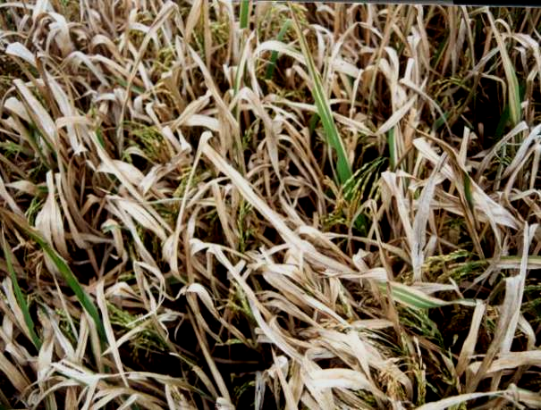
Bacterial blight of rice

Slide 6

Bacterial blight of rice
Reduction in photosynthetic area
Reduction in 1000 grain weight
Empty grains
20 – 50% yield loss reported

Slide 7
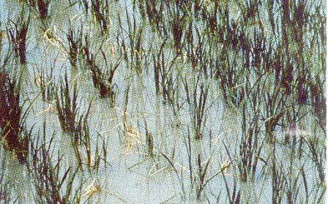
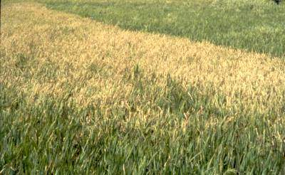
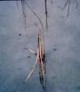
Bacterial blight syndrome
‘Kresek’ or wilting
‘Leaf blight’ phase
‘Pale yellow’ leaf

Slide 8

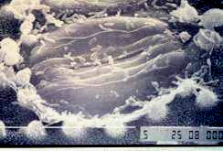
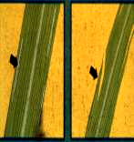
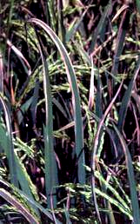
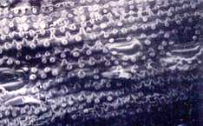

The Infection Process
Bacteria multiply
rapidly, 10⁸-10⁹ cfu/ml 24 hrs after inoculation.

Slide 9
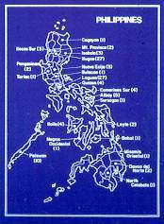
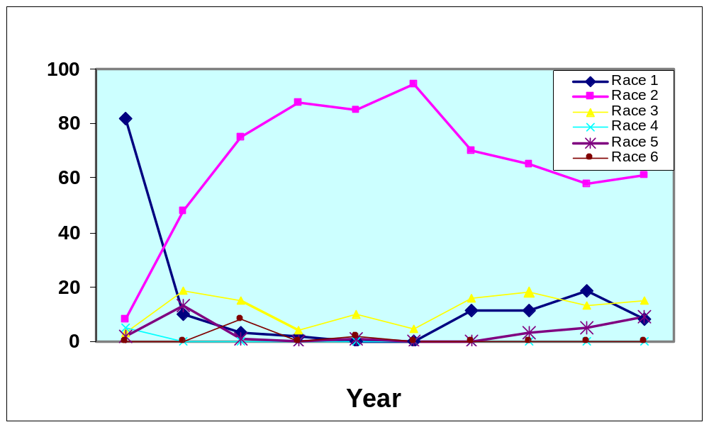
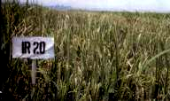
Distribution and frequency of Xoo races
Virulence frequency (%)
1972-74
1975-79
1980
1981
1982
1983
1984
1985
1986
1988
Virulence frequency of Xoo races from 1972-1988

Slide 10
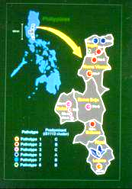
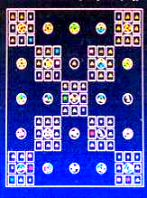
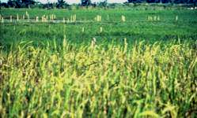
Distribution and frequency of Xoo races

Slide 11
Proposed evolutionary pathways among races 1, 3, and 9 of X. oryzae pv. oryzae
Race 9a
S on Xa7
lacks 4.2 kb
BamHI fragment
Race 3
R on Xa7
S on Xa4
XorI -
PCR type C-01
Races 9b & c
have 4.2 kb
BamHI fragment
Race 9b
MS on Xa7
Race 9c
S on Xa7
Race 1
MS on Xa7
R on Xa4
XorI +
PCR type C-05
Race 9d
MS on Xa7
S on Xa4
lacks 4.2 kb
BamHI fragment
R = resistant
MS = moderately
susceptible
S = susceptible

Slide 12
Interaction between rice and Xoo
R-Gene | Race
 | 1 | 2 | 3 | 4 | 5 | 6 | 7 | 8 | 9 | 10
IR24 | S | S | S | S | S | S | S | S | S | S
Xa4 | R | S | S | I | R | S | R | R | S | R
Xa10 | S | R | S | S | R | S | R | S | S | S
xa5 | R | R | R | S | R | S | R | R | R | R
Xa14 | S | S | S | S | R | S | S | R | S | S
Xa7 | I | R | R | S | R | S | R | R | S | I
Xa 21 | R | R | R | R | R | R | R | R | I | S
R = resistant (<5 cm); S = susceptible (>10 cm); I = intermediate (5-10 cm)

Slide 13
Gene-for-gene interaction between host and pathogen
One pair of loci |  | Pathogen genotypes
 |  | AA | Aa | aa
Host genotypes | rr
 | Rr
 | RR
= R (incompatible)
= S (compatible)

Slide 14
Classification of cultivar-pathogen interactions
Class
C1 C2
C1 C2
Result
P1
Uniform
1
P2
P1
P-differential
2
P2
P1
3
C-differential
P2
4
P1
Strongly interactive
P2

Slide 15
Classification of cultivar-pathogen interactions
Class
C1 C2
C1 C2
C1 C2
C1 C2
P1
P1
5
P2
P2
Weakly
interactive
5
P1
P1
P2
P2
= R (incompatible)
= S (compatible)
Zadoks & Schein (1979)

Slide 16
HR versus VR
Maritta
Resistant
Higher HR
Susceptible
Kennebec
Resistant
Susceptible
Blight (P. infestans) races
(Van der Plank, 1963)
Notes:
HR= Horizontal Resistance; VR=Vertical resistance

Slide 17
Host-Pathogen Interactions
Plant
cell wall
Pathogen
Receptor
Lignin
signal
cascade
Gene product
‘Elicitor’
R’O
R’OH
avr gene
Activate Defense
Peroxidase
Genes
(peroxidase, chitinase
glucanases, phytoalexins,
lignin enzymes, etc.)
H O
H O
2
oxidase
O
2
membrane
(adapted from Leach & White, 1996
Annu Rev Phytopathol)

Slide 18
Bacterial blight R genes, their donor cultivars, and chromosome location
R-gene | Donor | Chrom |  | R-gene | Donor | Chrom
Xa1 | Kogyoku | 4 |  | Xa16 | Te-tep | -
Xa2 | Tetep | 4 |  | Xa17 | Asominori | -
Xa3 | Wase Aikoku | 11 |  | Xa18 | IR24, Toynishiki | -
Xa4 | TKM6 | 11 |  | xa19 | XM5 | -
Xa5 | DZ192 | 5 |  | xa20 | XM6 | -
Xa7 | DV85 | 6 |  | Xa21 | O. longistaminata | 11
xa8 | PI231129 | 7 |  | Xa22(t) | Zhachanglong | -
Xa10 | CAS 209 | 11 |  | Xa23 | Oryza rufipogon | -
Xa11 | IR8 | - |  | xa24(t) | DV86 | -
Xa12 | Kogyoku | 4 |  | xa25 | Nep Bha Bong To | -
xa13 | BJ1 | 8 |  | Xa26 | Arai Raj | -
Xa14 | TN1 | - |  | xa27 | Lota Sail | -
xa15 | XM41 | - |  | Xa? | Oryza minuta | -

Slide 19
INGER
Nurseries
IRRI Germplasm
(GRC)
Improved Germplasm
from IRRI & National
Programs
Breeding scheme to develop varieties resistant to BB
Initial Screening
for BB Resistance
BB-GSN
(re-testing of selected entries)
Hybridization
(Plant Breeding)
Types/Forms
of resistance
(Plant Pathology)
Single or Multiple
crosses for different
ecosystems
(Plant Breeding)
Resistance
to
specific races
Resistance at
different growth
stages
F2 Populations in field
screening for BB Resistance
(Plt Breeding & Plt Path)
Genetic studies for
BB resistance
(Plt. Breeding & Plt. Path)
Pedigree Nurseries Screening
for R to BB & other diseases
(Plt Breeding & Plt Path)
Improved Sources
of BB Resistance
Screening RYT & OYT
for R to BB & other diseases
(Plt Breeding & Plt Path)
INGER Nurseries for Disease
Resistance in Field or GH
(Plant Pathology)
Evaluation of
improved materials
from Nat’l Program

Slide 20
Improved Germplasm/
NILs/IRRI Germplasm/
Wild rice accessions
Resistance to BB & Blast (EPPD)
Hybridization
(Indica & NPTs)
(PBGB)
Genetic studies
(PBGB & EPPD)
IRRI Scheme for screening resistance to bacterial blight and blast
Single or multiple
crosses for different
ecosystems
(PBGB)
Transgenics/
Parents for Hybrids/
Alien Introgression
Lines
(PBGB)
F2 populations
field screening
(PBGB & EPPD)
Resistance to
specific diseases
(EPPD)
Pedigree nurseries
screening
(PBGB & EPPD)
Improved sources of
disease resistance or
elite lines for release by NARES
RYT & OYT screening
(PBGB & EPPD)
Improved classical plant types/NPTs

Slide 21
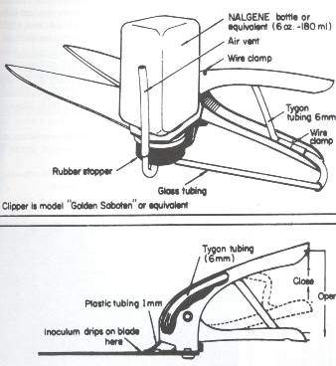
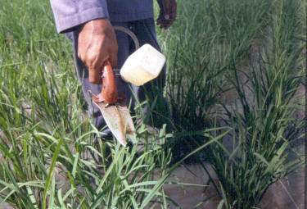
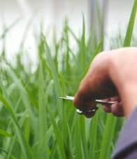
Clippers & clipping inoculation
Clippers
Field inoculation with clippers
Greenhouse/
screenhouse inc’n

Slide 22
Scoring system for BB
Greenhouse test |  |  | Field test (Breeding lines)
Lesion length (cm) | Description |  | Scale | % DLA | Desciption
0-5 | R |  | 1 | 1-5 | R
>5-10 | MR |  | 3 | 6-12 | MR
>10-15 | MS |  | 5 | 13-25 | MS
>15-20 | S |  | 7 | 26-50 | S
>20 | HS |  | 9 | >50 | HS

Slide 23
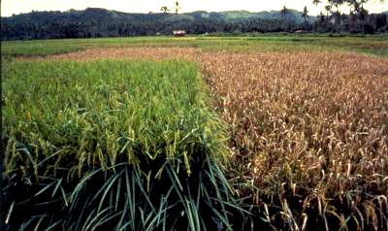
Types of resistance
Seedling resistance
Partial resistance
Moderate susceptibility
High susceptibility
Adult plant resistance

Slide 24
Resistance of BB NILs and pyramids to contemporary Xoo from IRBB7 and IRBB21
NIL/ Pyramid | Race
 | 1 | 3 | 9 | 10
IR24 | S | S | S | S
Xa4 | R | S | S | R
xa5 | R | R | R | R
xa13 | S | S | S | S
Xa 21 | R | R | R | R
Xa4/xa5 | R | R | R | R
Xa4/Xa21 | R | R | R | R
xa5/Xa21 | R | R | R | R
xa13/Xa21 | R | M | R | S
Xa4/xa5/xa13/Xa21 | R | R | R | R
Ogawa et al., 1990; Huang et al., 1995

Slide 25
Markers available for BB Xa-genes
Gene | Chrom | Linked marker | Distance (cM) | References
Xa3 | 11 | RM144 | - | Carrillo et al
Xa4 | 11 | Npb181 | 1.7 | Ma Bo-Jun et al, 1999
xa5 | 5 | RG556 | 0-1 | McCouch et al, 1991
Xa7 | 6 | P5 | 0 | Porter et al.
xa13 | 8 | RG136 | 3.8 | Zhang et al, 1996
Xa21 | 11 | pTA248, Kinase domain | 0-1, 0 | Ronald et al, 1992

Slide 26
BB near-isogenic lines (NILs) and pyramids and reactions to races of Xanthomonas oryzae pv. oryzae
NILs
Xa
-
gene(s)
Race 1
Race 2
Race 3B
Race 3C
Race 4
Race 5
Race 6
Race 7
Race 8
Race 9a
Race 10
PXO61
PXO86
PXO79
PXO340
PXO71
PXO112
PXO99
PXO145
PXO280
PXO339
PXO341
IRBB1
Xa1
S
S
S
S
S
S
S
S
S
S
S
IRBB2
Xa2
S
S
S
S
S
S
S
S
S
S
S
IRBB3
Xa3
S
S
S
S
S
S
S
S
S
S
S
IRBB4
Xa4
R
S
S
S
MR
-
MS
R
S
R
R
S
R
IRBB5
xa5
R
R
R
R
S
R
S
R
R
R
R
IRBB7
Xa7
MS
R
R
R
S
R
S
R
R
S
R
IRBB8
xa8
S
S
S
S
S
MR
S
S
S
S
S
IRBB10
Xa10
S
R
S
S
S
R
S
R
S
S
S
IRBB11
Xa11
S
S
S
S
S
S
S
S
S
S
S
IRBB13
xa13
S
S
S
S
S
S
R
S
S
S
S
IRBB14
Xa14
S
S
S
S
S
R
S
S
R
S
S
IRBB21
Xa21
R
R
R
MR
R
R
MR
MR
MR
MR
S
IRBB50
Xa4
+x
a5
R
R
R
R
R
R
S
R
R
R
R
IRBB51
Xa4
+
xa13
R
S
S
S
MS
R
R
R
MR
S
R
IRBB52
Xa4
+
Xa21
R
R
R
MR
MR
R
MR
R
R
M
R
R
IRBB54
xa5
+
Xa21
R
R
R
R
R
R
R
R
R
R
R
IRBB55
xa13
+
Xa21
R
R
R
MR
R
R
R
MR
MR
MR
S
IRBB56
Xa4
+
x
a5+
xa13
R
R
R
R
R
R
MR
R
R
R
R
IRBB57
Xa4
+
xa5
+
Xa21
R
R
R
R
R
R
R
R
R
R
R
IRBB59
xa5
+
xa13
+
Xa21
R
R
R
R
R
R
R
R
R
R
R
IRBB60
Xa4
+
xa5
+
xa13
+
Xa21
R
R
R
R
R
R
R
R
R
R
R
IRBB61
Xa4
+
xa5
+
Xa7
R
R
R
R
MR
R
S
R
R
R
R
IRBB62
Xa4
+
Xa7
+
Xa21
R
R
R
R
R
R
MR
R
R
MS
R
IRBB63
xa5
+
Xa7
+
xa13
R
R
R
R
R
R
R
R
R
R
R
IRBB64
Xa4
+
xa5
+
Xa7
+
Xa21
R
R
R
R
R
R
R
R
R
R
R
IRBB65
Xa4
+
Xa7
+
xa13
+
Xa21
R
R
R
R
R
R
R
R
R
MR
R
IRBB66
Xa4
+
xa5
+ Xa4/xa5/
Xa7/xa13/Xa21
R
R
R
R
R
R
R
R
R
R
R

Slide 27
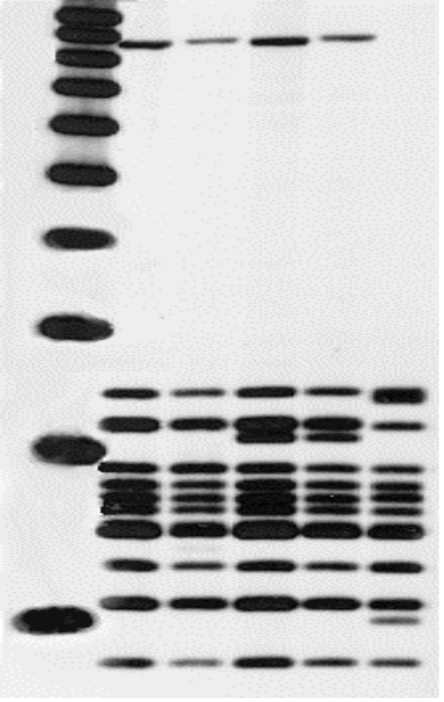
Predicting durability of R genes
S
MS
Reaction to IRBB7
S
MS
kb
9a
9b
9c
9d
10
Map of avrXa7
BamHI
BamHI
5
4
4.2 kb
1 kb
3

Slide 28
Mutations in avrXa7-fragment of PXO2684 (Race 9c)
BamHI
BamHI
NLS
AD
1 kb
WT PXO1865(r3) nt GAA TTC GAA GCC CGC TAC GGA
& PXO0314(r9b) aa E F E A R Y E
MT PXO2684(r9c) nt GAA TC GAA GCC CGC GGA
aa E E A R E
C
GGT
L
G

Slide 29

How does the pathogen adapt to Xa7?
Strain | Aggressiveness | 4.2 kb | Occurrence
9a | Low | No | Once (94)
9c | Low | Yes | Once (94)
9b | Moderate | Yes | Throughout (93-99)

Slide 30
Mutations in avrXa7 allele ranged from a single base pair change to multiple mutations spread throughout the alleles
TTSS secretion signal
Repeat region
LZ
NLS
AAD
AvrXa7 APAEWDEVQ
PXO0314 . . . . . . . . .
PXO348 . . . . C . . . .
PXO441 . . . . C . . . .
PXO448 . . . . C . . . .
PXO356 . . . . . . . . .
PXO357 . . . . . . . . .
PXO557 . . . . . . . . .
Homolog . . . . . . . . A
TVAVKYQHIITALPE
. . . . . . . . . . . . . . .
. . . .T. . D . . R . . . .
. . . .T. . D . . R . . . .
. . . .T. . D . . R . . . .
. . . .T. . D . . R . . . .
. . . .T. . D . . R . . . .
. . . .T. . D . . R . . . .
. . . .T. . . . . . . . . .
LTEARELRG
. . . . . . . . .
. . . . . . . . .
. . . . . . . . .
. . . . . . . . .
. . . . G . . . .
. . . . G . . . .
. . . . G . . . .
. . D. G. . . .
MTQFEMSRH
. . . . . . . . .
. . . . . . . . .
. . . . . . . . .
. . . . . . . . .
. . . . G . . . .
. . . . G . . . .
. . . . G . . . .
. . . . G . . . N
STVMWEQD
. . . L . . . .
. . . . . . . .
. . . . . . . .
. . . . . . . .
. . . . . . . .
. . . . . . . .
. . . . . . . .
avrXa7 mutant allele
Xoo Strain
Central repeats structure
PXO0314
M1 (25.5)
PXO348 PXO441 PXO448
M2 (22.5)
PXO356 PXO357
M3 (26.5)
PXO557
M4 (25.5)
Adaptation of Xoo to Xa7 rice fields may be more complex than just alteration at the avrXa7 allele.
Ponciano et al., 2004

Slide 31
R gene pyramids
NIL/ Pyramid | Race
 | 1 | 3 | 9 | 10
IR24 | S | S | S | S
Xa4 | R | S | S | R
xa5 | R | R | R | R
Xa7 | I | R | I | R
Xa 21 | R | R | R | R
Xa4/xa5/Xa7 | R | R | R | R
Xa4/Xa7/Xa21 | R | R | R | R
xa5/Xa7/Xa21 | R | R | R | R
Xa4/xa5/Xa7/xa13/Xa21 | R | R | R | R
Multiple R genes combined into one line
Pyramids with different combinations of Xa4, Xa7, xa5, and Xa21 now available

Slide 32
Adaptation of pathogen to host resistance
Xa7 is a good gene for breeding programs
  - due to fitness penalty associated with avrXa7 mutation
Prediction of durability
  - should not be based only on detection of virulent strains
  - but should include an understanding of the consequences of adaptation
Pathogen may overcome the fitness penalty
  - by accumulating aggressiveness through recombination or mutation

Slide 33
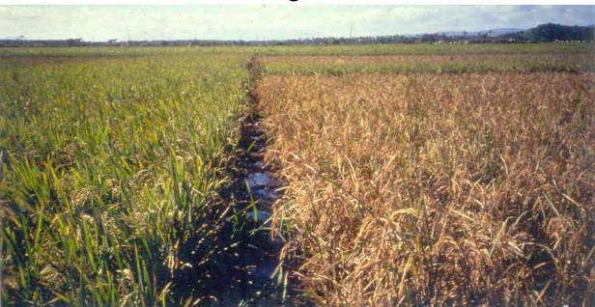
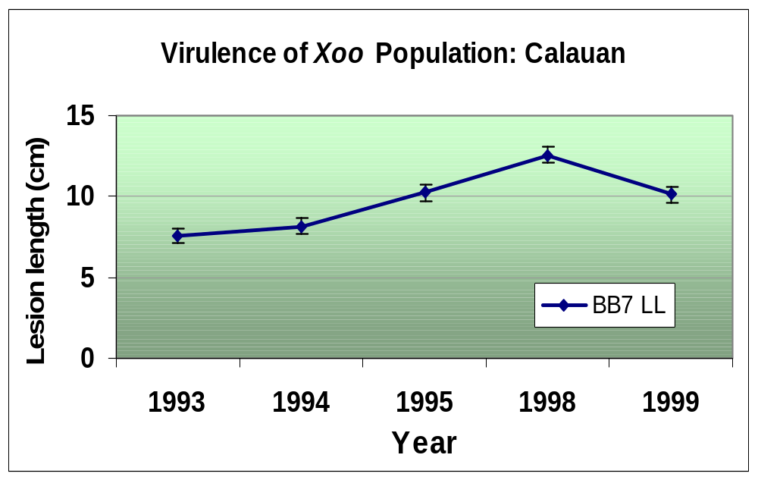
Fitness penalty associated with loss of function of avrXa7 = sufficient to prevent BB epidemics on rice lines with Xa7
6 years
later
Linholm et al.

Slide 34
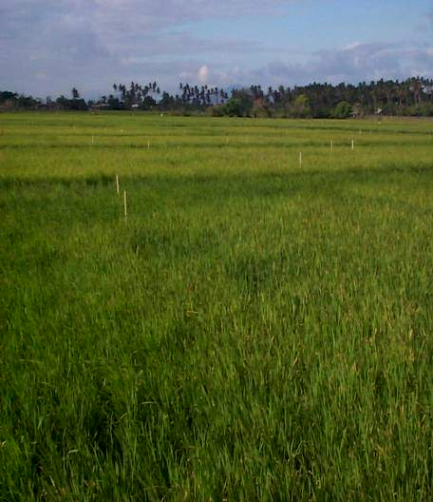
R gene pyramids developed through MAS
NIL/ Pyramid | Race
 | 1 | 3 | 9 | 10
IR24 | S | S | S | S
Xa4 | R | S | S | R
xa5 | R | R | R | R
Xa7 | I | R | I | R
Xa 21 | R | R | R | R
Xa4/xa5/Xa7 | R | R | R | R
Xa4/Xa7/Xa21 | R | R | R | R
xa5/Xa7/Xa21 | R | R | R | R
Xa4/xa5/Xa7/xa13/Xa21 | R | R | R | R
Multiple R genes combined into 1 line
Pyramids with different combinations of Xa4, xa5, Xa7, xa13, and Xa21 also available
Donors for disease R breeding program
Tool to evaluate predictability R gene durability for development & deployment of cultivars carrying single & multiple genes
Multiple R genes combined into one line
Pyramids with different combinations of Xa4, xa5, Xa7, xa13, and Xa21 also available
Donors for disease R breeding program
Tool to evaluate the predictability of R gene durability for development and deployment of cultivars carrying single and multiple genes

Slide 35
Do rice lines containing combinations of R genes confer more resistance and are more durable than rice lines with single R gene?
Xa4/5/7
IRBB4
IR24
Xa4/7/5/21
IRBB7
Xa4/7/21
IRBB21
60
Sta. Cruz
50
40
30
20
10
0
% Diseaed Leaf Area
10-03-02
10-09-02
10-17-02
6.0
Calauan
5.0
4.0
3.0
East
2.0
1.0
0.0
11-13-02
Linholm et al.
10-29-02
11-05-02
11-21-02
Scoring Date

Slide 36
Application in breeding programs
Via integration of pathogen population analysis & microbial genetics
+ efficient plant breeding
a sustainable manipulation of host resistance in disease control
towards

Slide 37
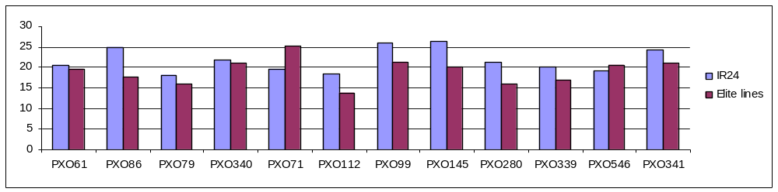
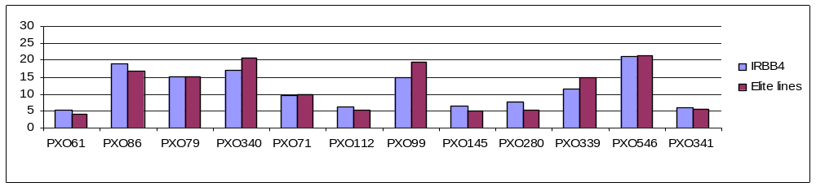
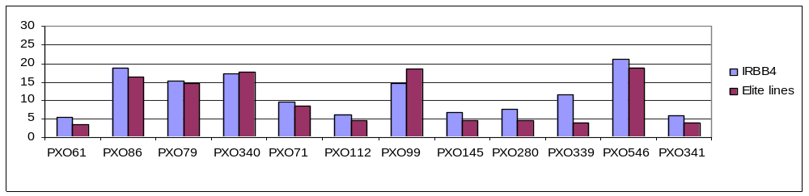
Resistance of Classical Elite Lines to Xoo
Lesion length (cm)
0
4 lines
Xa4
289 lines
Xa + ?
67 lines
Bacterial blight races

Slide 38
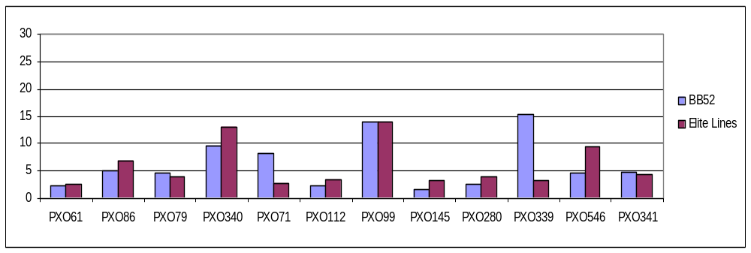
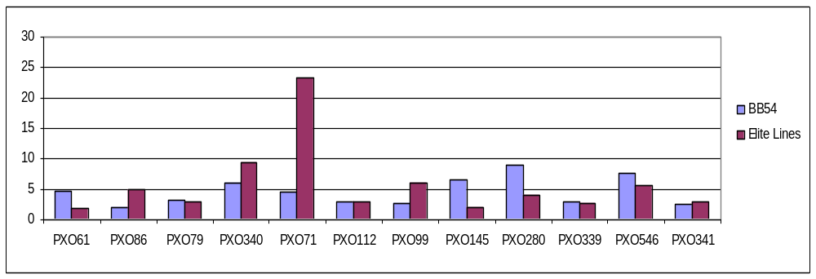
Resistance of Classical Elite Lines to Xoo
Lesion length (cm)
X4/Xa21
6 lines
xa5/Xa21
1 line
Bacterial blight races

Slide 39
Pedigree analysis (ICIS)
Xa4 | IR747 (TKM6)
xa5 | IR1545-339
Xa7 | IRBB7
Xa21 | O. barthii
(O. barthii is the progenitor of O. longistaminata and the O. barthii allele is synonymous to Xa21)

Slide 40
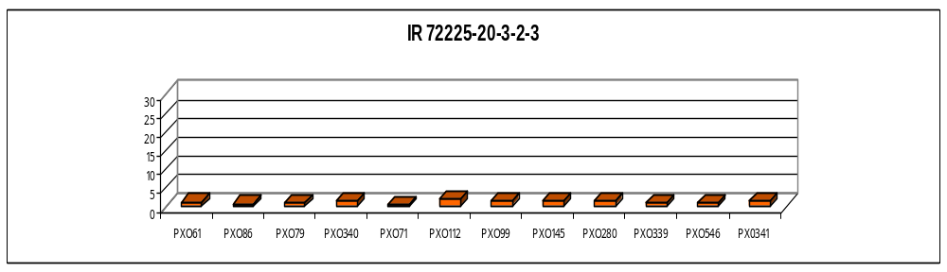
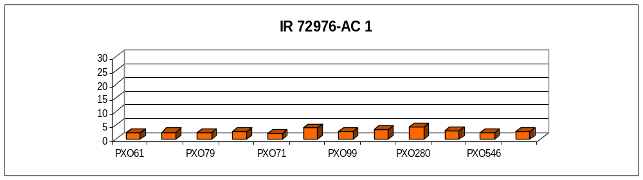
Reaction of selected NPTs to Xoo
Lines with Xa4/xa5/Xa7/xa13
Lesion length (cm)
Bacterial blight races

Slide 41
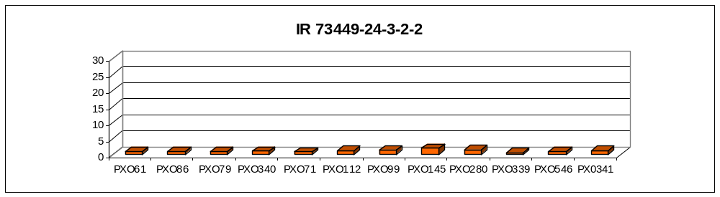
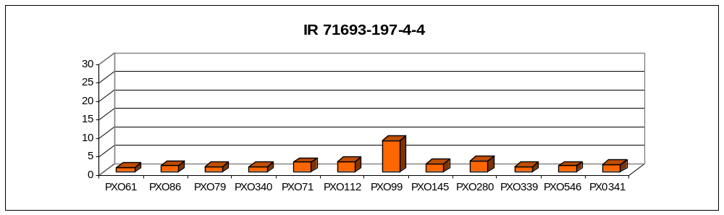
Reaction of selected NPTs to Xoo
Lesion length (cm)
Xa4/Xa7/xa13
Xa4/xa5/Xa7

Slide 42
Reaction of selected NPTs to 10 Xoo races and their genotypes
Line
Genotype
Reaction to Xoo
Genetic Background
IR 72164
-
348
-
6
-
2
-
2
-
2
Xa4
RSSSRRSRRSSR
IR44962, Shen Nung 89-
366,Ketan Lumbu, Sengkeu
Xa4
SSRRSSSSSRSS
Shen Nung 89
IR 70559
-
AC 5
-
366, Jimbrug,
Ketan Lumbu
Shen Nung 89
IR 71698
-
193
-
3
-
2
-
1
Xa4 + ?
RSSSRRSRRRSR
-
366, Bali
Ontjer, IR64
IR76905-8-1
Xa4/Xa7
RRRRRSSRRRRR
Shen
Nung 89-366,
Ketan
Lumbu, IRBB59
IR 69125-35-3-1-1
Xa4/Xa7
SSRSSSSSSRSR
Shen
Nung 89-366,
Ketan
Lumbu,
Gundil
Kuning
IR76907
-
12
-
20
xa5/Xa7
SSRSSSSSSRSR
Shen Nung 89
-
366, Genjah
Wangkal, IRBB59
IR76909
-
15
-
1
Xa7
SSRSSSSSSRSS
Shen Nung 89
366, Genjah
Wangkal, IRBB59

Slide 43
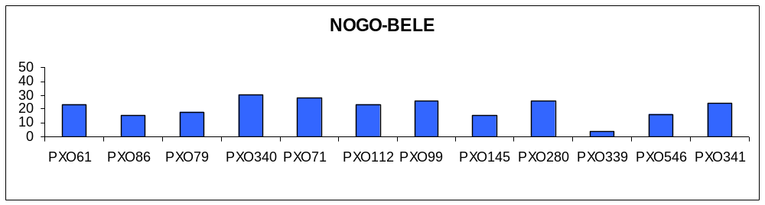
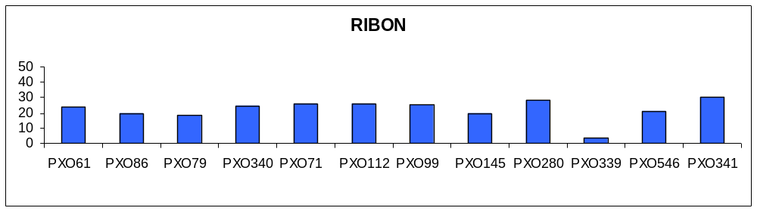
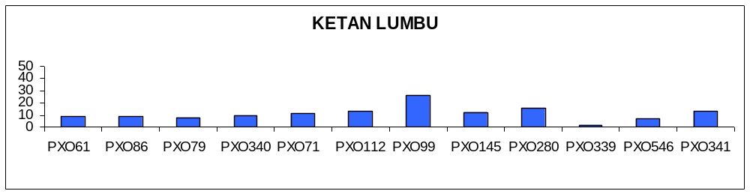
Reaction of tropical japonica cultivars to Xoo
Xa4/Xa7
Lesion length (cm)
xa5/Xa7
Xa4/xa5/Xa7
Bacterial blight races

Slide 44
Possible mechanisms for variations
1. Gene expression
2. Allelic diversity among LRR-domains of R genes
  Xa21 gene family consist of 6 genes
  Xa21D has same spectrum of resistance but confer partial resistance only (Wang et al., 1998)

Slide 45
Possible mechanisms for variations
3. Modifier genes
  Modifier gene - a gene that modifies the phenotype of another gene (Weaver et al., 1992)
  Arabidopsis RPS2 function in Col-1 variety but not in Po-1
  Po-1 has RPS2 that function in other genetic background (Banerjee et al., 2001)
4. Quantitative traits
  Traits usually affected by many genes and many
  environmental factors

Slide 46
Basmati-derived lines
IR 67017-13-3-3
Basmati 370
IR 71730-51-2
x
IRBB60
Season 1
(Xa4, xa5,xa13, Xa21)
Season 2
F1
Season 3
F2
MAS and phenotype
Season 4
F3
Phenotype
Season 5
F4
Phenotype
Season 6
F5
MAS and phenotype
Season 7
F6
Phenotype
Season 8
F7
MAS and phenotype
Season 9
F8
Aroma evaluation, 2AP tests and QTL analysis

Slide 47
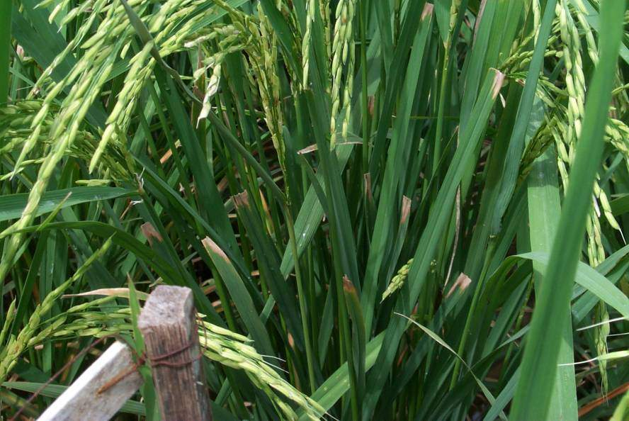
F5 Basmati-derived line (IR71730-51-2 x IRBB60) carrying Xa4, xa5, xa13 and Xa21 using MAS
Begum, Virk, et al.

Slide 48
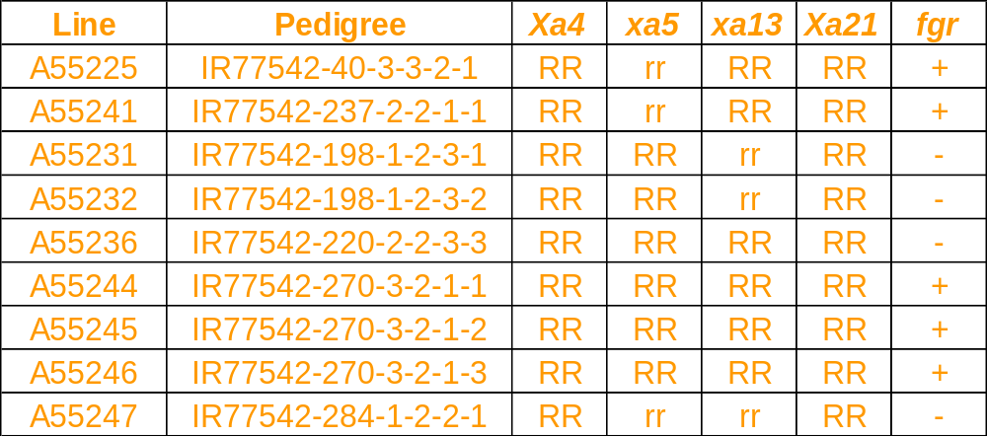
Basmati-derived lines carrying two to four combinations of BB R-genes with and without fgr gene for aroma using MAS
Begum, Virk, et al.

Slide 49
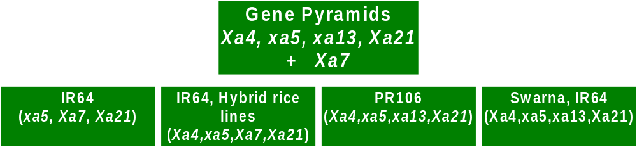
Cultivar development incorporating BB R genes using Marker–Aided Selection
Asian Rice Biotechnology Network
RIFCB
Indonesia
PhilRice
Philippines
PAU
India
CRRI
India
Released in 2002
Angke (Bio-1)
= IR64 (Xa4+xa5)
Conde (Bio-2)
= IR64 (Xa4+Xa7)
Released stop gap var
AR32-19-3-3
AR32-19-3-4
= IR64 (Xa4+xa5+Xa21)

Slide 50
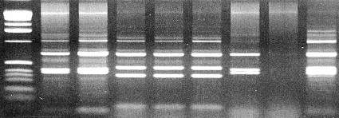
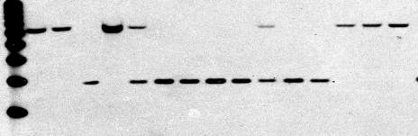
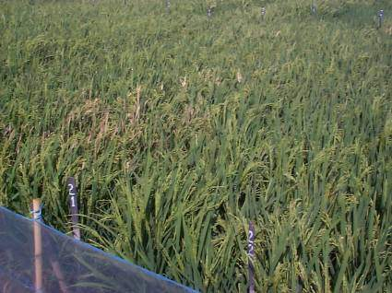
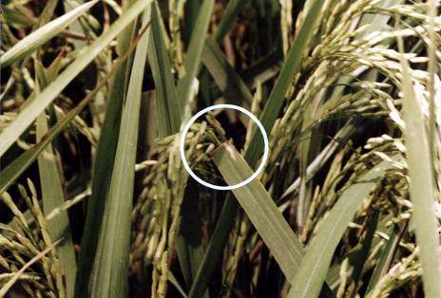
Development of IR64 MAS elite lines with BB R-genes in Indonesia, CRIFC, 1999
”Angke”
IRBB5
IRBB24
IRBB7
R/S
R/
S
1 kb
IR64
IR24
IRBB7
S1033
CBB7
1 kb
IR64
IRBB5
R
R
R
R
R
R
S
S
S
IR64
IR64
IR64(Xa4+xa5)
“Bio-1”
IR64 (Xa4+Xa7)
“Bio-2”

Slide 51
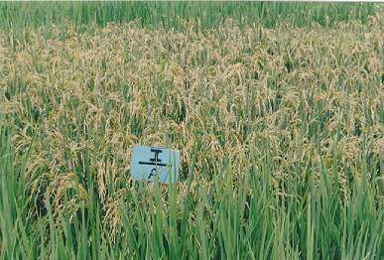
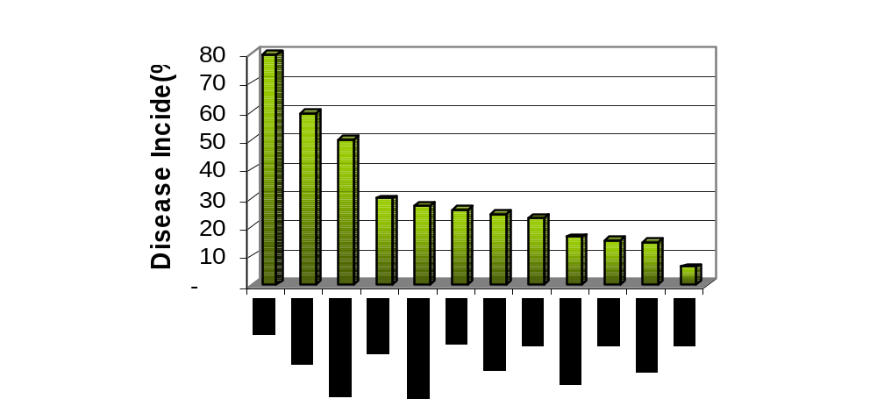
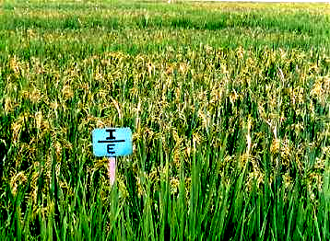
IR64 MAS elite lines with bacterial blight R-genes released in Indonesia in 2002, CRIFC & RIFCB
Cianjur, West Java, 2001
Angke
IR64+xa5 (Bio-1)
Bustamam et al.
Conde
IR64+Xa7 (Bio-2)

Slide 52
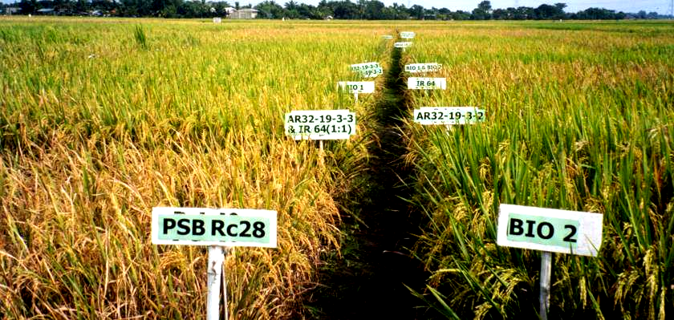
MAS-improved pyramided IR64 with xa5, Xa7 and Xa21
Asian Rice Biotechnology Network

Slide 53
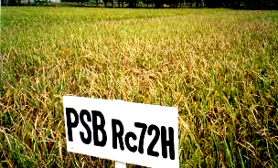
Maintainer (B) lines and the different Xa genes or gene combinations developed via MAS (PhilRice)
Xa gene(s) combination
B Lines
Xa4 Xa7 Xa21 Xa4/7 Xa4/21 Xa7/21 Xa4/7/21
913B ✓ ✓ ✓ ✓ ✓ ✓ ✓
IR58025B ✓ ✓ ✓ ✓ ✓
IR62829B ✓ ✓ ✓ ✓ ✓
Mestizo, PhilRice 2002 WS
LianB ✓ ✓ ✓
BoB ✓ ✓ ✓
Borines et al., 2003

Slide 54

Marker-aided selection (MAS)-improved varieties developed by NARES teams from Philippines, Indonesia, India and China, 2002-2003
Asian Rice Biotechnology Network

Slide 55

Can anyone share how bacterial blight is being treated in their breeding program?

Slide 56
Rice Blast
Pyricularia oryzae
Pyricularia grisea
(anamorph)
Magnaporthe grisea
(teleomorph)

Slide 57






Yield losses up to 50-85% reported
Leaf blast
Collar blast
Neck blast
Node blast

Slide 58



Blast infection structures
Sporulating lesion
Conidia

Slide 59


Structure of blast pathogen populations in three different ecologies in India
HAZARIBAG
(rainfed upland)

Slide 60
Requirements in breeding for resistance to rice blast
Diverse resistant sources
Systematic evaluation schemes
Suitable test environments

Slide 61

Blast Nursery layout
spreader rows
test materials
spreader rows

Slide 62
Scoring system for blast
Scale | Description
1 | Small brown specks of pin-point size
2 | Small roundish to slightly elongated, necrotic gray spots, about 1-2 mm in diameter, with a distinct brown margin. Lesions are mostly found on lower leaves
3 | Lesion type is the same as in 2,but significant number of lesion are on upper leaves
4 | Typical susceptible blast lesions, 3 mm or longer, infecting less than 4% of leaf area
5 | Typical susceptible blast lesions, 3 mm or longer, infecting less than 4-10% of leaf area
6 | Typical susceptible blast lesions, 3 mm or longer, infecting less than 11-25% of leaf area
7 | Typical susceptible blast lesions, 3 mm or longer, infecting less than 26-50% of leaf area
8 | Typical susceptible blast lesions, 3 mm or longer, infecting less than 51-75% of leaf area, many leaves dead
9 | Typical susceptible blast lesions, 3 mm or longer, infecting more than 75% of the leaf area

Slide 63
Blast R genes and their chromosomal locations in rice
Locus
Phenotype /
Chromosome
product
Pi
-
a
P.o
. resistance
-
a
11
Pi
-
b (pi
-
s_
P.o.
resistance
-
b
2
Pi
-
f
P.o.
resistance
-
f
11
Pi
-
I
P.o.
resistance
-
i
6
Pi
-
k (Pi
-
k, Pi
-
km, Pi
-
kk, Pi
-
P.o.
resistance
-
k
11
kp)
Pi
-
ta (=sl)
P.o.
resistance
-
ta
9 or 12?
M
-
Pi
-
z
P.
o.
resistance
-
z
11
Pi
-
z
P.o
resistance
-
z
6
Pi
-
is
-
I
(Rb
-
4)
P.o.
resistance
-
is
11
Pi
-
se
-
1
(Rb
-
1)
P.o. resistance
-
se
11
Pi(t)
P.o.
resistance
4
Pi
-
?(t)
P.o.
resistance
4
Pi
-
1(t)
P.o.
resistance
-
1
11
Pi
-
2(t)
P.o.
resistance
-
2
6
Pi
-
3(t)
P.o
. resistanc
e
-
3
6
Pi
-
4(t)
P.o.
resistance
-
4
12
Pi
-
5(t)
P.o.
resistance
-
5
4
Pi
-
6(t)
P.o.
resistance
-
6
12
Pi
-
7(t)
P.o.
resistance
-
7
11
(McCouch et al., 1994)
Pi
-
zh(t)
P.o.
resistance
-
zh
8

Slide 64
Monogenic lines developed for blast resistance (Y. Fukuta)
Entry | Designation | Target | Gen. | Donors | Similar gene name
No. |  | Gene
IRBL 1 | IRBLa-A | Pia | BC₁F₁₄ | AICHI ASAHI
2 | IRBLa-C | Pia | BC₁F₁₄ | CO 39
3 | IRBLi-F5 | Pii | BC₁F₁₄ | FUJISAKA 5
4 | IRBLks-F5 | Pik-s | BC₁F₁₄ | FUJISAKA 5
5 | IRBLks-S | Pik-s | BC₁F₁₄ | SHIN 2
6 | IRBLk-ka | Pik | BC₁F₁₃ | KANTO 51
7 | IRBLkp-K60 | Pik-p | BC₁F₁₂ | K 60
8 | IRBLkh-K3 | Pik-h | BC₁F₉ | K 3
9 | IRBLz-Fu | Piz | BC₁F₁₄ | FUKUNISHIKI
10 | IRBLz5-CA | Piz5 | BC₃F₁₂ | C101A51 | = Pi 2(t)
11 | IRBLzt-T | Piz-t | BC₁F₁₄ | TORIDE 1
12 | IRBLta-K1 | Pita | BC₂F₁₂ | K1 | = Pi 4(t)
13 | IRBLta-CT2 | Pita | BC₃F₁₂ | C105TTP2L9
14 | IRBLb-B | Pib | BC₁F₉ | BL 1
15 | IRBLt-K59 | Pit | BC₂F9 | K 59
16 | IRBLsh-S | Pish | BC₁F₁₄ | SHIN 2
17 | IRBLsh-B | Pish | BC₁F₁₂ | BL 1

Slide 65
Cont’d…
Entry No. | Designation | Target Gene | Gen. | Donors | Similar gene name
18 | IRBL1-CL | Pi1 | BC₃F₁₂ | C101LAC
19 | IRBL3-CP4 | Pi3 | BC₂F₁₂ | C104PKT
20 | IRBL5-M | Pi5(t) | BC₃F₁₂ | RIL 249 (Moro.)
21 | IRBL7-M | Pi7(t) | BC₃F₁₂ | RIL 29 (Moro.)
22 | IRBL9-W | Pi9 | BC₃F₁₂ | WHD-1S-75-1-127
23 | IRBL12-M | Pi12(t) | BC₂F₁₂ | RIL 10
24 | IRBL19-A | Pi19 | BC₁F₁₁ | AICHI ASAHI
25 | IRBLkm-Ts | Pik-m | BC₁F₁₀ | TSUYUAKE
26 | IRBL20-IR24 | Pi20 | BC₁F₁₀ | ARL 24
27 | IRBLta2-Pi | Pita2 | BC₁F₈ | Pi No. 4
28 | IRBLta2-Re | Pita2 | BC₁F₁₀ | REIHO
29 | IRBLta-CP1 | Pita | BC₅F₁₀ | C101PKT
30 | IRBL11-Zh | Pi11(t) | BC₂F₁₂ | ZHAIYEQING
31 | IRBLz5-CA(R) | Piz5 | BC₅F₁₀ | C101A51
LTH

Slide 66
Markers available for blast Pi- genes
R-gene tagged | Chromosome | Linked marker | Distance (cM)
Pi1 | 11 | r10 | -
Pi2 | 6 | RG64 P to kinase | 2.8 -
Pi9 | 6 | RG16 | -

Slide 67






Development of blast resistant rice cultivars by Asian Rice Biotechnology Network via MAS
RR
ss
A B C D E F G H I J K L M N O P Q
400
300
I
400
300
200
100
II
150
III
Pto-Kinase motif
Pi 1
Pi 2
Kalinga III
CR203
KDML 105
WayRarem
CRRI
India
AGI
Vietnam
DOA
Thailand
CRIFC
Indonesia

Slide 68
HR versus VR
Maritta
Resistant
Higher HR
Susceptible
Kennebec
Resistant
Susceptible
Blight (P. infestans) races
(Van der Plank, 1963)
Notes:
HR= Horizontal Resistance; VR=Vertical resistance

Slide 69



Rice-M. grisea rice interactions
H₂O₂
accumulation
24 h resistant
48 h susceptible
M. Yang

Slide 70

Will major R genes work for blast?
High degree of pathogen variability
Even though some good genes (e.g., Pi-2/Pi-1 combination), major R genes alone too risky
Preferred strategies:
  strong “layer” of quantitative resistance
  Add quality major genes on top
  Diversify the use of resistance

Slide 71
Candidate genes
Definition:
DNA sequences that likely correspond to a specific trait based on a known biochemical pathway or DNA similarity to other functional genes
Approaches:
Relate sequences to known mapped phenotypes
Relate sequences to mutations
Associate sequences to phenotypes of germplasm and breeding pedigrees

Slide 72
Candidate gene analysis of quantitative disease resistance in wheat
Disease | Candidate gene | Chromo-some | Phenotypic effect (%)
Tan spot | Oxalate oxidase, ion channel regulator | 1A | 58
Leaf rust | Peroxidase 2B DR gene clusters: catalase, thaumatin, chitinase | 2BS | 31
Powdery mildew, karnal bunt, stem rust | Oxalate oxidase, thaumatin, chalcone synthase, chitinase |  | Minor QTL
Faris et al., 1999 TAG 98:219-225

Slide 73
Candidate genes, clone designation, source & predicted function or pathways used in study (partial list) (http://www.ksu.edu/ksudgc)
Gene categories Accession Clone Predicted function Plant source number designation or pathway
NBS-LRR AF 032688- R1-R15 Resistance gene analog Rice
AF 032702
rNBS 1-69
Rp1 RP1 a-d Resistance gene analog Maize
Peroxidase AF014467 POX22.3 Multiple Rice
Aldose reductase X 57526 pg2269 Phenylpropanoid pathway Barley
Dihydrofolate reductase AF 013488 ZmDRTs Amino acid metabolism Maize
Oxalate oxidase Y 14203 PHvOXOa Generation of active oxygen species Barley
Oxalate oxidase-like X 93171 pBH6-903 Generation of active oxygen species Barley
hsp-70-like mRRI11 mRRI11 PR Protein Maize
Hv14-3-3a X 62388 pHv1433a PR Protein Barley
Chitinase Type ll X 78671 HvCht2a PR Protein Barley

Slide 74
2
3
7
8
11
12
143.9 cM
204.5 cM
163.1 cM
118.5 cM
153.9 cM
M-Pi z
Pi-se-1
Pi-is-1
114.9 cM
XLRin12A1
RG104
RG769
S1AS1A3
CDO127
RG574
RG348
A18A1120
RZ638
RZ816
RG437
RG511
Oxalate Oxidase-Like
RZ400
XLRfrI7
RZ329
A5J560
PK1K2I1
RZ892
TGMS12
RG118
NLRfrA6
RG544
RG100
RG773
A10K250
Pi-11(t)
Adh1
b9
RG191
AG8-Aro
S2AS3A1
S2AS3A2
RG171, NLRin12I3
RZ678
RZ617
rNBS8
RG341
Pi-6(t)
Thaumatin1
RG978
S2AS3I1
rNBS63b
Pi-ta
RG157
RZ488
XLRfrI1
RG1094
PK1K2A2
ChitinaseII
RZ574
rNBS53
r6b
Pi-a
AF6
Hv1433c
XLRin12I1
rNBS52
RG247
ZmDRTSb
rNBS28
Npb44
S2AS3A5
PalI
RG1
XLRin12A4
RZ318
RG477
S1AS1I2
RG167
PK1K2I4
XLRin12I2
Amy3DE
NLRfrA2
Bph9
XLRin12A5
NLRin12I2
ZmDRTSc
rNBS14
bph2
RZ284
NLRin12I5
r11
Pi-7(t)
RG457
Bph1
RZ394
PGMS07
S2AS3I4
r4
Sdh1
PK1K2A3
PK1K2A1
RZ66
r12
mRGH
r9
XLRin12A6
r6a
Xa21
CDO344
rNBS37
S2AS3A3
AC5
Rp1d
RG901
rNBS17
rNBS23
RG418B
Rp1e
RG463
RZ58
RG179
r7
RG103
RZ403
Amp2
rNBS10
RG958
CDO686
pRD10A
rNBS36
rNBS35
ZmDRTSd
Xa10
XLRfrI2
Amy1AC
Oxalate oxidase
CDO59
ZmDRTSe
RG181
RG95
CDO337
RG711
Pi-17(t)
CDO99
RG1109
RG654
RZ519
Est9
rNBS55
RG256
RZ448
RZ337B
QTL for disease resistance
r2, r3, r5, r10
PCR markers: R gene analogs
XLRfrI5
rNBS54
Npb186
Xa4
RZ123
PK1K2I5
Putative for BB resistance
rNBS38
Xa3
RZ213
Pi-b
CDO497
OS-JAMyb
Pi-1
RG520
CDO418
Blast DLA
RZ536
RFLP markers: R gene analogs
Peroxidase
POX22.3
XLRfrA6
Pi-k, Pi-f
S2AS3I2
RZ978
Blast lesion number
BBphen
Pgi1
CDO38
RFLP markers: Defense response genes
CDO87
RG351
Blast lesion size
RG910
DH map (IR64
x Azucena)
PLD5
Neck blast resistance
rNBS61
RG418A
Sheath blight resistance
Ramalingam et al., MPMI

Slide 75






“Four Steps” to move useful alleles from a durably-blast resistant variety SHZ-2 to a popular variety
SHZ-2
LTH
Chr 2
Chr 7
Chr 8
Chr 10
Chr 12
0.0
b2(NBS-LRR)
PK1K2-6
RZ143
6.7
RM333
4.2
RGH
11.1
r4(NBS-LRR)
21.4
2.3
XLRfr-13
CDO459
RG634
43.6
15.5
XLRfr-10
12.2
9.7
XLRfr-18
9.0
RZ811
RM19-A
35.0
RG214-A
3.7
CDO98
26.5
7.2
PK1K2-12
4.3
RZ625
XLRfr-6
RG511
7.9
r14-A (NBS-LRR)
RZ400
0.0
RG235
RG574-A
4.1
RM324
22.3
12.4
17.1
RZ892
7.9
RM19-C
9.4
NLRinv-6
XLRfr-12
14.5
4.7
RM341
3.5
RG30
15.2
1.0
XLRfr-5
0.0
9.5
XLRfr-8
PR-1
RM247
PK1K2-5
0.3
0.5
0.5
7.3
XLRfr-11
5.2
XLRfr-2
6.3
PK1K2-2
12.0
RG81
1.1
5.0
3.3
Oxalate oxidase
3.8
r6-C (NBS-LRR)
Rp1-C
14-3-3 protein-A
RG678
13.5
2.8
11.3
Pi-GD-1(t)
3.8
RM216
6.5
PK1K2-7
2.6
3.5
4.5
RZ397
3.5
Chitinase 2a-A
1.9
PK1K2-8
RG1034
PK1K2-17
RG869
RG139
3.3
XLRfr-14
0.3
r8 (NBS-LRR)
2.4
XLRfr-9
RM263
12.6
RG978
4.5
XLRfr-17
8.6
18.6
Dehydrin
Chitinase 2a-B
RM179
30.4
4.2
RG650
4.1
RG1
19.9
XLRfr-19
(RM222)
4.8
Pi-GD-3(t)
1. Identify donor with non-race-specific resistance
18.2
PK1K2-16
17.9
23.8
NLRinv-5
1.7
XLRfr-15
NLRinv-8
1.2
XLRfr-21
1.2
XLRfr-16
11.9
37.8
1.4
XLRfr-20
18.9
1.5
r7 (NBS-LRR)
RM208
Peroxidase
0.7
NLRinv-1
r6-A (NBS-LRR)
RG598
0.0
3.3
RM277
2.8
b4-A (NBS-LRR)
PK1K2-13
6.2
Chitinase 2b
2.7
RM260
19.1
NLRinv-3
5.9
7.1
RZ76
3.9
r16 (NBS-LRR)
7.7
Pi-GD-2(t)
6.1
RG413
r14-B (NBS-LRR)
RM313
3. Candidate defense genes associated with QTL
Similarity
A
B
C
2. Assay quantitative resistance without major R genes
4. Candidate gene-aided backcrossing and validation in the field
Liu et al. 2004 Mol Plant-Microbe Interact

Slide 76
Five defense related (DR) genes associated with blast resistance QTL in SHZ-2 X LTH recombinant inbred lines
 |  | Phenotypic effects in disease nurseries in 3 locations
DR Gene | Chr. | Guangdong | IRRI | Cavinti, Phil.
Chitinase 2a | 2 | 6.7* | 5.0* | 5.0*
14-3-3 protein | 2 | 7.1* | 5.0* | 4.0*
Dehydrin (Esi 18.5) | 7 | 14.9**** | 25.6* | 16.7*
Oxalete oxidase | 8 | 41.2**** | 12.1* | 27.0*
PR-1 | 10 | 13.8**** | 10.7* | 16.9*
Liu Bin et al. 2004 MPMI

Slide 77
Candidate defense response (DR) genes contribute to quantitative resistance against rice blast
100
More DR genes →
Less disease
80
% DLA
60
40
20
GD-GH
IRRI-BN
0
GD-BN
Location
0
IRRI-BN
1
2
3
Ca-BN
4
5
Number of Defense Response
Genes in 101 RI Lines
Liu et al., 2004, MPMI

Slide 78



Advanced backcross lines selected by candidate genes: broad-spectrum quantitative resistance to blast disease
SHZ
Susceptible recurrent parent Texianzhan-13, 90% neck blast
donor
Dendrogram from
SSR fingerprints
BC3 lines
Elite backcross line (#116)
Favorable alleles at five candidate defense gene loci (chitinase, PR-1,oxalate oxidase, dehydrin, 14-3-3 protein)
Quantitative resistance to leaf and neck blast disease
High quality rice
Resistant BC3 -line (#116)
Bin Liu et al.

Slide 79
Vandana x Moroberekan:
Putative QTL for blast partial resistance to PO6-6 in BC3F3 lines
Trait | Marker | Candidate Gene | Source | R² ^{(%)} | F | P | TV (%)
DLA (%) | RGA8-4 | NBS-LRR | Flax | 11.79 | 9.36 | 0.0030
 | RM215 | SSR | Rice | 9.19 | 7.09 | 0.0096
 | CG10d | Oxalate oxidase | Barley | 28.65 | 27.7 | 0.0001
LN | CG17 | Hv1433 | Barley | 14.07 | 11.3 | 0.0013 | 59.49
 | RGA1-10 | LRR | Rice | 9.39 | 7.25 | 0.0089
 | RM21 | SSR | Rice | 9.09 | 6.90 | 0.0100
 | RM168 | SSR | Rice | 10.73 | 8.42 | 0.0050
LS | RM250 | SSR | Rice | 9.55 | 7.39 | 0.0082 | 34.54
ª DLA = % Diseased Leaf Area, LN = Lesion Number, LS = Lesion Size
^{b}Total variation explained by the traits
^{c}The model included 7 markers at P = 0.05
J. Wu et al., 2004

Slide 80



Distribution of % DLA(A), lesion number(B) and lesion size(C) in the VxM BC3F3 lines inoculated with PO 6-6
A
No. of lines
% Diseased Leaf Area
B
C
No. of lines
No. of lines
Susceptible lesion size
Number of lesion size

Slide 81


Progress of percent DLA in selected lines of BC₃F₃ in blast nursery
Relationship between % DLA of BC₃F₃ VxM lines in GH (PO6-6) & Blast nursery

Slide 82

Phenotypic selection of BC3F5 Vandana x Moroberekan, IRRI & Cavinti
Seedling blast*
(%DLA)
Neckblast**
(% Incidence)
Line
Cavinti
Blast Nursery
GH
(PO6-6)
V4M-5-3-B*
3.7
21.9
33.0
V4M-6-1-B*
3.1
13.9
26.0
V4M-10-1-B
6.1
53.9
67.0
V4M-14-1-B
0.7
4.2
4.8
S
V4M-15-3-B
1.0
9.2
36.8
R
S
S
S
S
P
S
P
R
R
S
R
R
P
S
V4M-19-1-B
1.4
17.2
52.4
V4M-42-2-B
0.7
6.4
28.6
V4M-52-2-B
9.2
30.9
20.0
V4M-53-1-B
1.2
15.5
42.9
BC3F4 lines, IRRI Blast Nursery
V4M-60-2-B
1.8
25.3
42.9
V4M-63-1-B
9.6
47.8
30.0
*In India, have partial R across screening sites; V4M-5-3-B has good phenotypic acceptability
V4M-70-1-B
5.6
31.1
71.4
V4M-74-1-B
8.4
31.5
76.2
V4M-75-1-B
8.1
36.6
47.6
V4M-82-2-B
8.5
17.0
23.8
M. Variar
V4M-83-2-B
9.2
35.9
19.0
* BC3F4 gen
** BC3F5 gen

Slide 83



Phenotypic selection of BC3F5 Vandana x Moroberekan, IRRI & Cavinti
Selected F4 lines from intermated BC3F5 V x M lines, WS 2003
F2
F4
S
R
S
S
S
S
P
S
P
R
R
S
P
S
R
BC3F5 intermated V x M partially R lines
Moroberekan

Slide 84

Seedling blast severity of selected 60 F4 lines of BC3F5 Vandana x Moroberekan lines in Almora, India and Cavinti, Phil.

Slide 85
Identify “consensus” candidate genes
Upland rice Vandana x Moroberekan: blast (Wu et al., 2004,TAG)
Irrigated rice SHZ-2: blast
(Liu et al., 2004, MPMI)
NBS-LRR (rice, barley)
NBS-LRR
(rice)
Chitinase
Ion channel
Regulator
PR1
Aldose reductase
NBS-LRR
(maize, barley)
Dihydrofolate reductase-thymidylate synthase
Oxalate
Oxidase
Thaumatin
Catalase
SOD
PAL
Peroxidase
DH Rice IR64 x Azucena: BB, blast, ShB (Ramalingam et al., 2003, MPMI)
Wheat: tan spot and/or leaf rust (Faris et al. 1999, TAG)

Slide 86

1st generation stress response array containing rice and maize cDNA clones
350 X. oryzae-induced cDNAs
(J. Leach, KSU)
100 rice NBS-LRR sequences
(JEL, KSU)
215 blast- or JA-induced cDNAs (Yinong Yang, U. Arkansas)
460 cDNAs from maize suppression subtractive hybridization libraries
(Scot Hulbert, KSU)
→Control sequences from rice and human
Microarray hybridization, scanning, & analysis

Slide 87

Candidate genes potentially involved in disease resistance

Slide 88



Genome scan of Vandana/Moroberekan intercross progenies using SSRs
Oxalate oxidase-like proteins
Eukaryotic aspartyl protease
Putative oxalate oxidases
Chromosome 3
Chromosome 7
Chromosome 8
Legend: 1= Moroberekan; 2= Vandana; 3= IR78221-19-6-56; 4= IR78222-20-7148; 5= IR78222-20-1A-7; 6= IR78224-22-2-59; 7= IR78224-22-2-114; 8= IR78222-20-1A-18NB; 9= IR78222-20-2-7NB Heterozygous loci are colored green

Slide 89










3: IR78221-19-6-56
(R)
4: IR78222-20-7-148
(R)
5: IR78222-20-1A-7
(S)
6: IR78224-22-2-59
(HS)
7:IR78224-22-2-114
(HS)
Leaf blast in Almora, India, Sept 2004
Putative oxalate oxidase
Chromosome 3
Genome scan of Vandana-Moroberekan intercross progenies using SSRs for oxalate oxidases (OsGLPs)
3: IR78221-19-6-56
4: IR78222-20-7-148
2: Vandana
Co39 (S ck)
Local check wilting under 10 d without rain
Crop stand in Hazaribag, India under drought condition (10 d no rain). Blast pressure lower than in Almora, Sept 2004

Slide 90

Yield during DS drought condition at IRRI and seedling blast infection at 2 sites of selected 60 intercrossed Vandana x Moroberekan lines, 2004
Vandana
Seedling blast (SES, 0-9)
IR78221 19-6-99
IR78221 19-6-56
IR78221 19-6-7
IR78221 19-6-33
IR78221 19-6-90
IR78221 19-6-3
IR78222 20-7-128
R. Lafitte, E. Javier et al.

Slide 91




Chrom 2
Chrom 3
Oxalate oxidase
Chitinase
MR S S S R S S S S S S S S S S S R S S S S S S S S S S S S S R R R R R R R R R R R S R S R R R R
MR S S S R S S S S S S S S S S S R S S S S S S S S S S S S S R R R R R R R R R R R S R S R R R R
Oxalate oxidase-like protein
Thaumatin
Peroxidase
MR S S S R S S S S S S S S S S S R S S S S S S S S S S S S S R R R R R R R R R R R S R S R R R R
MR S S S R S S S S S S S S S S S R S S S S S S S S S S S S S R R R R R R R R R R R S R S R R R R
Chrom 7
Chrom 8

Slide 92
Candidate gene alleles contrib by Moroberekan (+) in blast resistant F5 V x M intercrosses
Candidate Gene | IR78221-19-6-3-B | IR78221-19-6-7-B | IR78221-19-6-33-B | IR78221-19-6-56-B | IR78221-19-6-90-B | IR78221-19-6-99-B | IR78222-20-7-128-B | IR78222-20-7-148-1-B | IR78222-20-7-148-2-B | IR78222-20-7-148-3-B | IR78222-20-7-47-B | Vandana
Chitinase | - | - | - | + | - | - | + | + | + | + | - | -
Oxalate Oxidase | + | + | + | + | -/+ | + | - | + | + | + | - | -
Aldose reductase | - | - | - | - | - | - | - | - | - | + | - | -
Thaumatin (Chr6) | - | - | - | - | - | - | - | - | - | - | - | -
HSP90 | + | + | - | - | - | - | - | - | + | + | - | -
Thaumatin (Chr7) | - | - | - | - | - | - | - | - | - | - | - | -
Eukaryotic aspartyl protease | - | - | - | - | - | - | - | - | - | - | - | -
Deoxyphosphoheptonate aldolase | - | - | - | - | - | - | - | -/+ | -/+ | - | - | -
Peroxidase | - | + | + | + | + | + | + | - | - | - | + | -
Oxalate Oxidase-like | - | + | -/+ | + | + | - | + | + | + | + | - | -
PR1 | - | - | - | - | - | - | + | - | + | - | + | -
PBZ | - | - | - | - | - | - | - | - | - | - | - | -
Seedling blast (Philippines) | 1 | 1 | 1 | 1 | 1 | 1 | 1 | 2 | 2 | 2 | 5 | 7
Seedling blast ( Almora, India) | 4 | 2 | 4 | 3 | 4 | 3 | 4 | 4 | 4 | 4 | 5 | 8.5

Slide 93
Evidence for the role of oxalate oxidase in resistance to plant pathogens
3
8
RG104
RG348
S1AS1A3
Increased oxalate oxidase activity in barley infected with powdery mildew (Zhou et al., 1995)
Induction of germin gene expression in wheat infected with powdery mildew (Hurkman and Tanaka, 1996)
Association of oxalate oxidase to partial blast resistance in Vandana x Moroberekan population
(Wu et al., 2004)
RZ329
A18A1120
RZ892
Oxalate Oxidase-Like
RG100
A5J560
RG191
TGMS12
RZ678
A10K250
AG8-Aro
Pi 11(t)
RZ574
RZ617
RG978
XLRfrI1
LP53
LP52
LP28
RZ284
RG1
S1AS1I2
RZ394
Amy3DE
PK1K2A3
R9
LP37
LP17
RG179
S2AS3I4
RZ403
pRD10A
RZ66
Oxalate oxidase
AC5
CDO337
RZ519
RG418B
RZ448
Amp2
LP35
CDO99
S2AS3I2
Pgi1
CDO87
RG910
PLD5
Ramalingam et al, 2003
LP61
RG418A

Slide 94

Enzymatic role of germin-like proteins

Slide 95
Identifying oxalate oxidases in rice
The TIGR Whole Rice Genome Annotation DB was searched for sequences similar to barley mRNA sequence for oxalate oxidase Y14203
All the sequences related to oxalate oxidase (e.g. germin-like proteins, cupins) were extracted from the database
A phylogenetic tree of rice oxalate oxidase sequences was constructed using ClustalX

Slide 96


adenosine diphosphate glucose pyrophosphatase
Putative Nectarin1 precursor
Transposon insertion
Germin-like proteins in plants
Chr 8 OsGLP
Phylogenetic relationships of rice germin-like proteins (GLP). Alignment of protein sequences and phylogenetic analyses were done using ClustalX. The tree was rooted with spherulin1A (AAA29982) and spherulin1b (P09351).

Slide 97
Pairwise alignment of OsGLP11 vs OsGLP13
OsGLP11 MEHSFKTITAGVVFVVLLLQQAPVLIRATDADPLQDFCVADLDSKVTVNGHACKPASAAG
OsGLP13 MEHSFKTIAAGVVIVVLLLQQAPVLIRATDADPLQDFCVADLDSKVTVNGHACKPASAAG
OsGLP11 DEFLFSSKIATGGDVNANPNGSNVTELDVAEWPGVNTLGVSMNRVDFAPGGTNPPHVHPR
OsGLP13 DEFLFSSKIATGGDVNANPNGSNVTELDVAEWPGVNTLGVSMNRVDFAPGGTNPPHVHPR
OsGLP11 ATEVGIVLRGELLVGIIGTLDMGNRYYSKVVRAGETFVIPRGLMHFQFNVGKTEATMVVS
OsGLP13 ATEVGIVLRGELLVGIIGTLDTGNRYYSKVVRAGETFVIPRGLMHFQFNVGKTEATMVVS
OsGLP11 FNSQNPGIVFVPLTLFGSNPPIPTPVLVKALRVDTGVVELLKSKFTGGY
OsGLP13 FNSQNPGIVFVPLTLFGSNPPIPTPVLVKALRVDAGVVELLKSKFTGGY
Cis-acting elements in OsGLP11 and OsGLP13
Cis element | OsGLP11 | OsGLP 13
ASF1MOTIFCAMV | 1 | 0
WBOXATNPR1 | 1 | 1
WBOXHVISO1 | 3 | 0

Slide 98


Detailed marker analysis of chromosome 3 loci with four putative oxalate oxidases (OsGLPs)
PCR primers designed from the coding region of each gene.
OsGLP10UP, OsGLP11UP, and OsGLP13UP primers designed
from the 1000b upstream region of each gene.
1: Moroberekan 6: IR78224-22-2-59
2: Vandana 7: IR78224-22-2-114
3: IR78221-19-6-56 8: IR78222-20-1A-18NB
4: IR78222-20-7-148 9: IR78222-20-2-7NB
5: IR78222-20-1A-7
OsGLPs
Heterozygous loci
Monomorphic markers
1 2 3 4 5 6 7 8 9
Almora, India: R S R R S HS HS - -
Chromosome 3
Cavinti, Phil : R R R R R R R S S

Slide 99

Glazebrook, 1999, Current Opinion in Plant Biology, 2:280-286
Lesion mimic
genes
HR
SA
Ethylene
JA
PR genes (e.g. PR1),
SAR

Slide 100
Resistance to rice blast and sheath blight of TXZ x SHZ2, CIAT
 | Rice Blast |  |  |  |  |  | Sh Blight
BC Line | Lineage 4 |  | Lineage 5 |  | Lineage 6 |  | Isol 1
 | LT | % | LT | % | LT | % | %PAA
Shan Huang Zhan | 3,4 | 50 | 3,4 | 48 | 3,2,4 | 39 | 30
TXZ/SHZ2 Bc10-46 | 4 | 30 | 4 | 38 | 4 | 59 | 21
TXZ/SHZ2 Bc10-10 | 4 | 19 | 4,3 | 12 | 4,3 | 37 | 8
TXZ/SHZ2 Bc116 | 4 | 50 | 4,3 | 16 | 4 | 26 | 14
Blast: Lesion Type (1-2 = R, 3 = I, 4 = S); % Lesion Area Affected
Sheath Blight: % PAA (% Plant area affected)

Slide 101

Are candidate defense related genes identified in elite germplasm with quantitative R in common with candidate genes shown in advanced breeding lines?
Moroberekan or Shan huangzhan (SHZ) with partial R to blast
Backcross to high quality rice Vandana or Way Rarem or Ilpumbyeo
X
BC3 lines in elite background
Validate field performance of different candidate gene combinations
VARIETAL RELEASE

Slide 102


Extending to other breeding populations
BC₂F₃ lines of Oryzica Llanos 5 crossed to Way Rarem showing blast resistance used to diversify the varieties planted in farmers’ fields in Indonesia
Susceptible lines in the same field were highly diseased in comparison to the BC2F3 lines

Slide 103
Can anyone share how bacterial blight is being treated in their breeding program?
Can anyone describe some breeding strategies for diseases where major genes are effective?

Slide 104
Summary . . .
By using known genes to predict functional diversity in the pathogen and how the pathogen responds to host genotypes, we were able to predict durability of R genes
We are currently field testing combinations of R genes predicted to be durable (Xa7, xa5) and others (Xa4, Xa21, xa13)
NARS breeding programs have developed and are beginning to release pyramided genes for disease resistance

Slide 105
Summary . . .
Breeding for disease resistance should be complemented by knowledge of pathogen population structure:
  allows to identify tester strains for screening breeding lines;
  (b) prerequisite for any gene deployment strategy
Breeding strategies for diseases where major genes are effective, e.g. BB: gene pyramiding, or gene rotation (spatial & temporal deployment)

Slide 106
Summary . . .
We have associated known sequences of candidate genes to phenotypes of germplasm and breeding pedigrees
Breeding strategies being adopted to develop varieties with broad spectrum resistance to blast:
  combining different mechanisms of quantitative R,
  pyramiding effective major genes
Using the available genetic and bioinformatic resources for rice coupled with efficient phenotyping tools, it is possible to relate QTLs to candidate genes and metabolic pathways

Slide 107

Future prospects
Further analysis of gene expressions of functional candidate genes (USAID Linkage project)
  Northern analysis/RT-PCR
  expression analysis of candidate genes in rice by RNAi
Recurrent selection to increase the resistance of the lines to biotic stresses (GenCP)
Development of NILs for blast QTL (GenCP)

Slide 108
Future prospects
SNP analysis of effective candidate genes in resistant donors (RDA-IRRI)
Combining blast resistance and phosphorus tolerance (GenCP, A. Ismail & M. Wissuwa)
Combining blast resistance and drought tolerance (R. Lafitte, E. Javier)
Technology development for MAS application (G-CP)

Slide 109
Contributors
IRRI: I. Oña, M. Reveche, G. Carrillo, J. Wu, B. Liu, S. Begum, N. Sugiyama, R. Mauleon, M. Bernardo, M. Laza, E. Javier, B. Courtois (CIRAD), H. Leung
CRURRS & VPKAS, India: M. Variar, J.C. Bhatt, R. Babu
RDA: S.S. Han, J. Rho, Y.C. Cho,
CRIFC: Suwarno, E. Soenarjo, M. Bustamam
Kansas State U: S. Hulbert, J. Bai
Colorado State U: J.E. Leach
University of Guelph: P.H. Goodwin
ARBN Members: PhilRice, ICABGRRD, PAU, CRRI, AGI NIPP, DOA, CNRRI

