Slide 1
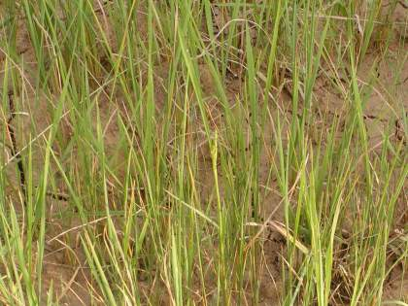
Drought tolerance and aerobic rice breeding at IRRI
International Rice Research Institute

Slide 2

Learning objectives
Describe effective kinds of drought screening in rice
Clarify structure of breeding programs serving drought-prone environments
Describe IRRI’s actions for drought tolerance breeding
Define aerobic rice
Describe how aerobic rice technology can contribute to stabilizing and increasing yields in drought-prone regions

Slide 3

What is the problem?
Stress is intermittent and unpredictable
Crop sensitivity is stage-specific
Drought means different things in different systems

Slide 4

INCORRECT ideas about drought tolerance breeding:
Little genetic variability for drought tolerance in rice
Not possible to select directly for improved yield under stress
Selection for secondary traits = more effective than direct selection for yield
Not possible to combine drought tolerance with high yield potential
Progress in improving drought tolerance = only made through molecular methods

Slide 5
Drought-prone lowlands
“Drought” may mean physical water scarcity that constrains growth …
Rainfed field near Raipur,Chhattisgarh: WS 2003

Slide 6
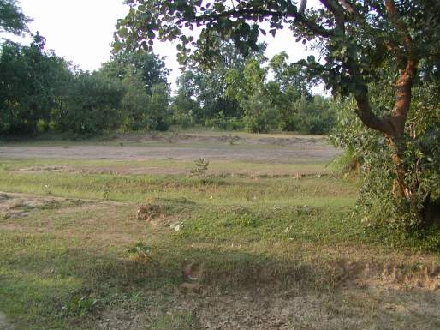
Severe season-long drought destroyed plantings in upper fields at Raipur (2002)

Slide 7
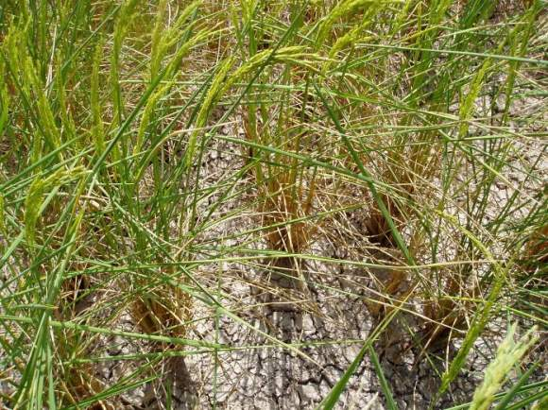
KDML 105 under severe late-season stress in upper field at Roi Et, Thailand (Oct. 26, 2004)

Slide 8
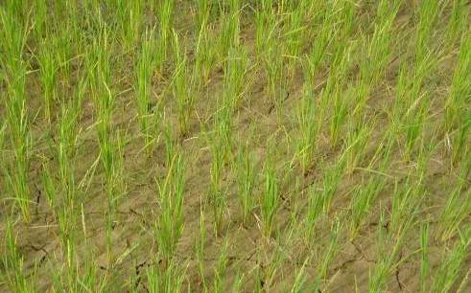
Lack of standing water often obstructs critical management operations
  → Early drought delays transplanting
  (transplanting 50-60 day old seedlings was common in Jarkhand this year)

Slide 9
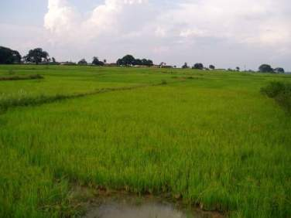
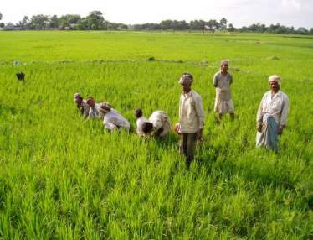
  →Biasi frequently can’t be undertaken due to lack of standing water, resulting in severe weed pressure
  →Lack of water in transplanted fields may require large investments in hand weeding

Slide 10
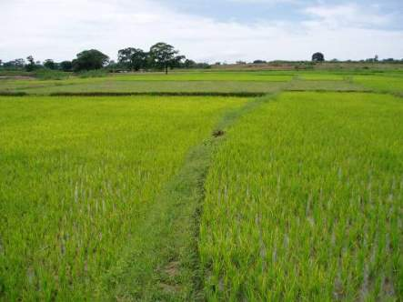
Common problems across sites
→Farmers often don’t topdress, when no water in field

Slide 11
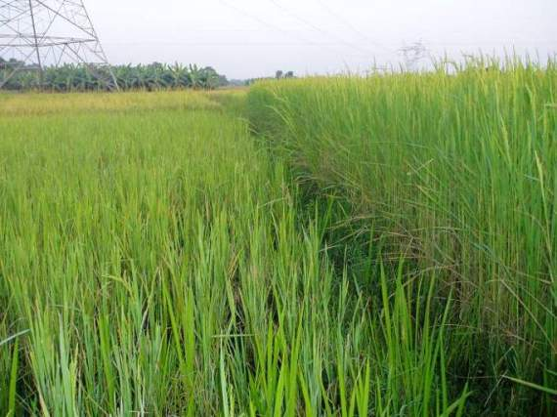
Adjacent drought & submergence-prone fields, West Bengal

Slide 12

What problems related to drought do you encounter?

Slide 13
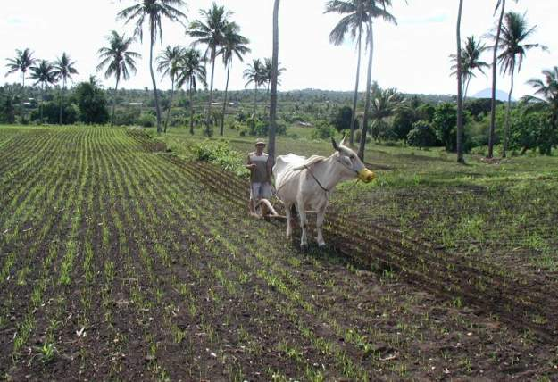
Target environments:
Permanently cultivated uplands in Asia

Slide 14
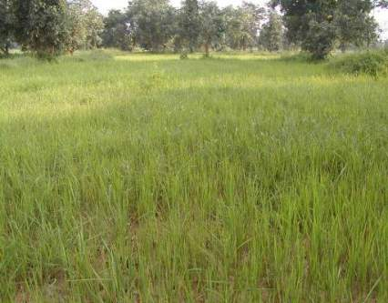
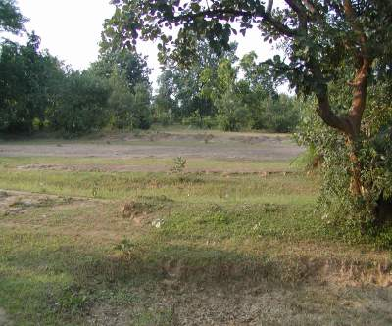
Target environments:
Shallow, drought-prone lowlands in eastern India and NE Thailand

Slide 15
Lowland drought tolerance = tolerance to long periods without standing water
Yield versus days without standing water:
(Indonesia, 2000-2002)
7000
6000
Meg 00
Jad 00
5000
Sid 00
-1
4000
Pel 00
Yield, kg ha
Meg 02
3000
Jad 02
2000
Sid 02
y = -0.24x
2
- 7.07x + 5762
PelO 02
1000
PelN 02
R
2
= 0.59
0
0
20
40
60
80
100
120
Days w/o standing water
(T.P. Tuong, IRRI)
Notes:
About 60% of variation in yield across toposequence can be explained by number of days without standing water in the field.

Slide 16
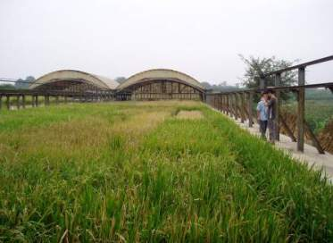
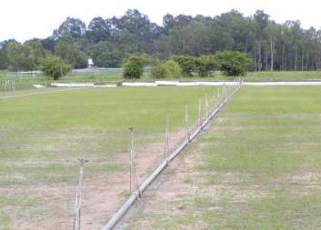
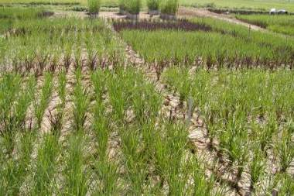
Possible rice drought tolerance screens….

Slide 17
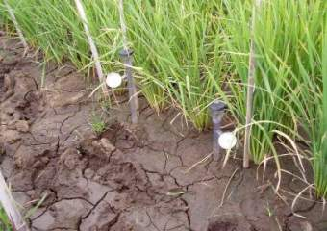
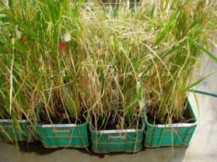
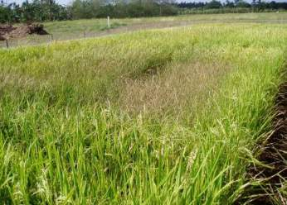
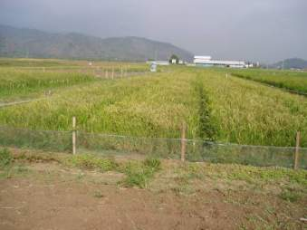
And a few more…

Slide 18
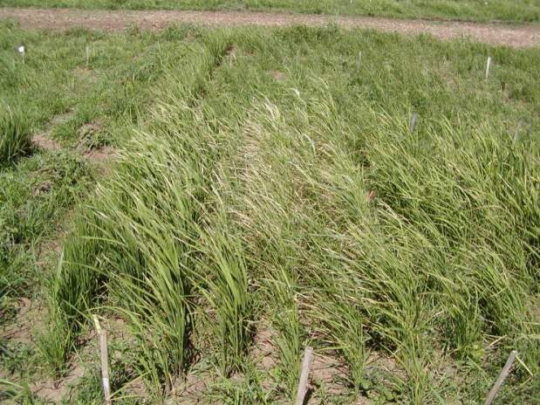
IRRI: Severe upland drought screening- stress around flowering

Slide 19
To make progress from indirect selection
→H in screen must be higher than H for direct selection
OR
→Higher selection intensity must be achievable in screen
AND
→r_{G} must be close to 1

Slide 20
Steps in making the link between managed stress screens and performance in the TPE
r_{G}
Selection environment
Drought TPE
H

Slide 21
H estimates for drought-related traits in three QTL mapping populations
Trait | Population | Test environment | H for means from 1 trial
Relative water content | IR64/Azucena | IRRI field trial | 0.04
Root length at 35 DAP: stressed | Azucena/Bala | U.K. greenhouse trial | 0.12
Root length at 35 DAP: non-stressed | Azucena/Bala | U.K. greenhouse trial | 0.35
Osmotic adjustment | IR62266-42-6-2/4*IR60080-46A | IRRI screenhouse trial | 0.31
Grain yield: stressed | IR64/Azucena | IRRI field trial | 0.46

Slide 22
Heritability within stress levels: unselected populations
Location | Year | Population | Relative yield | H control | H stress
Israel (upl.) | 1997 | CT/IR | 0.26 | 0.63 | 0.81
Coimbatore (upl.) | 1999 | CT/IR | 0.31 | 0.56 | 0.60
Paramakudi (upl.) | 2000 | CTIR | 0.41 | 0.23 | 0.76
Ubon (line-source) | 2000 | CT/IR | 0.30 | 0.54 | 0.50
Raipur, India (lowl.) | 2000-2 | CT/IR | 0.21 | 0.45 | 0.37
Los Banos (upl./lowl.) | 2003 | Van/IR64 | 0.67 | 0.27 | 0.42
Los Banos (upl./lowl.) | 2003 | Apo/IR64 | 0.13 | 0.45 | 0.24
Los Banos (upl./lowl.) | 2003 | Apo/IR72 | 0.29 | 0.30 | 0.67
Los Banos (upl./lowl.) | 2003 | Van/IR72 | 0.31 | 0.42 | 0.07
Los Banos (upl.) | 1998-9 | IR64/Az | 0.56 | 0.74 | 0.68
Mean |  |  | 0.35 | 0.46 | 0.51
(Thanks to: A. Blum, R. Chandra Babu, G. Pantuwan, R. Kumar, R. Venuprasad, B. Courtois)

Slide 23
Genetic correlations across stress levels: unselected populations
Location | Year | Population | Relative yield | r_{G}
Israel (upl.) | 1997 | CT/IR | 0.26 | 0.35
Coimbatore (upl.) | 1999 | CT/IR | 0.31 | 0.86
Paramakudi (upl.) | 2000 | CTIR | 0.41 | 0.91
Ubon (line-source) | 2000 | CT/IR | 0.30 | 0.71
Raipur, India (lowl.) | 2000-2 | CT/IR | 0.21 | 0.80
Los Banos (upl./lowl.) | 2003 | Van/IR64 | 0.67 | 0.69
Los Banos (upl./lowl.) | 2003 | Apo/IR64 | 0.13 | 0.35
Los Banos (upl./lowl.) | 2003 | Apo/IR72 | 0.29 | 0.64
Los Banos (upl./lowl.) | 2003 | Van/IR72 | 0.31 | 0.78
Los Banos (upl.) | 1998-9 | IR64/Az | 0.56 | 0.62
Mean |  |  | 0.35 | 0.67
(Thanks to A. Blum, R. Chandra Babu, G. Pantuwan, R. Kumar, R. Venuprasad, B. Courtois)

Slide 24
Correlations among 49 upland cultivar means across stress treatments imposed at different phenological stages or continuously: 1997-8
 | Stress at PI + 20 days | Flowering ±10 | Furrow 1x Per week | Sprinkler 2x
Nonstress | .74 | .66 | .44 | .60
Stress at PI + 20 days |  | .66 | .53 | .75
Flowering ±10 |  |  | .49 | .54
Furrow 1x |  |  |  | .74

Slide 25

Direct selection for yield under severe, intermittent upland stress at IRRI: a selection experiment
Populations of 225 F₂-derived lines were developed from Vandana/IR64 and Apo/IR64
Lines were screened in DS 2003 under:
  Severe upland stress initiated at PI
  Lowland conditions with continuous flood
25 lines per population were selected on the basis of yield in each environment.
The upland-selected set, lowland-selected set, and a random set of 25 were evaluated in 2004

Slide 26
Selection experiment:
DS 2003 (selection year) yields (g m-2) of parents and checks under upland stress
Variety | N | Mean
IR64 | 42 | 44 ± 1
Apo | 48 | 110 ± 2
Vandana | 48 | 86 ± 1
Azucena | 37 | 46 ± 1

Slide 27
Selection experiment:
Yield (g m⁻²) of parents at IRRI, DS 2004 (evaluation year)
Check | Upland | Lowland
IR64 | 4.7 | 286
Apo | 16.3 | 240
Vandana | 104.6 | 146

Slide 28
Selection experiment:
Yield (g m⁻²) of upland and lowland-selected tails evaluated at IRRI, DS 2004
Selection protocol | Vandana/IR64 |  | Apo/IR64
 | Selection environment
 | Upland | Lowland | Upland | Lowland
Upland stress | 68.9* | 57.8 | 16.7 | 12.8
Lowland irrigated | 182 | 214* | 191 | 224*

Slide 29
Conclusions from direct selection experiment
Direct selection gave 20% yield gain under severe stress in population having 1highly tolerant parent
Effect of introducing highly tolerant donor germplasm = much greater than effect of selection

Slide 30
Summary of results from IRRI’s drought screening research 1
Direct selection for yield under stress is effective
H for both component traits and yield under stress is low
H for yield under stress is not lower than for non-stress yield
H for yield under stress is usually higher than H for related physiological traits
Yield under stress is positively correlated with yield under non-stress conditions, so combining tolerance and yield potential is possible

Slide 31
Summary of results from IRRI’s drought screening research 2
6. Because H is low, replicated trials are needed
7. Intermittent stress throughout the season is effective for screening large, heterogeneous populations
8. Farmers usually will not sacrifice yield potential for drought tolerance
9. Screening should usually be done under managed stress, on fixed lines previously screened for disease, quality, and yield potential

Slide 32
Line means under intermittent lowland stress: IRRI DS 2004
LINE | Control yield | Stress yield
IR77843H | 3159 | 3037
IR71700-247-1-1 | 3386 | 2578
PSBRC80 | 3555 | 2309
IR74371-3-1-1 | 2818 | 2173
IR64 | 3003 | 1604
IR75298-59-3-1 | 3975 | 1346
IR73014-59-2-2 | 3192 | 648
IR72894-35-2-2 | 3890 | 608
Mean | 3197 | 1719
SED | 637 | 424
H | 0.47 | 0.81

Slide 33
Yield of drought-selected aerobic rice lines under severe natural stress: WS 2004
Designation | Days to 50% flower | Yield under severe natural stress at flowering (t/ha)
IR 74371-54-1-1 | 80 | 1.76
IR77298-14-1-2 | 82 | 1.04
IR 72 | 82 | 0.47

Slide 34
Can anyone define aerobic rice?
A system for producing high yields of rice with less water than is used in conventional lowland production

Slide 35
Aerobic rice
Key elements:
Upland hydrology (unpuddled, not flooded)
Input-responsive, upland-adapted varieties
Intensive crop management

Slide 36
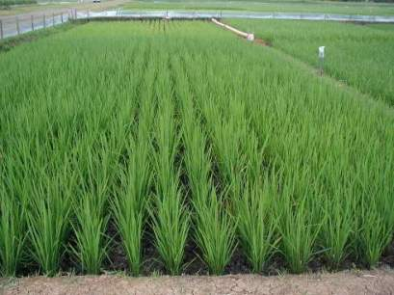
Hydrological target environments
1. Near-saturated environments
  Soils kept between saturation and field capacity, with water potentials usually > -10 kPA
IRRI 2003

Slide 37
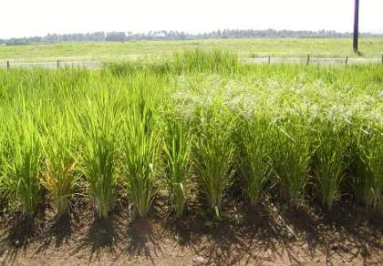
2. True aerobic environments
  Soils rarely saturated
  Soil water potentials can fall below -30 kPA at 15 cm.
  Periods of moderate stress often occur
IRRI WS 2002

Slide 38
Aerobic rice management
Usually dry direct-seeded
Soil fertility managed for at least a 5 t/ha yield target (usually > 100 kg/ha N)
Weed management usually via herbicides or inter-row cultivation

Slide 39

What are problems addressed by aerobic rice?
Water savings in irrigated lowlands
Management intensification in rainfed uplands
Drought tolerance and avoidance in rainfed lowlands

Slide 40
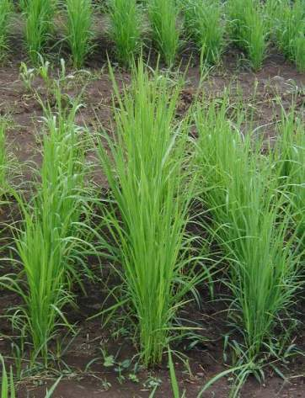
Aerobic rice cultivars
Vigorous seedlings
Rapid biomass development
Deep roots
Erect leaves

Slide 41
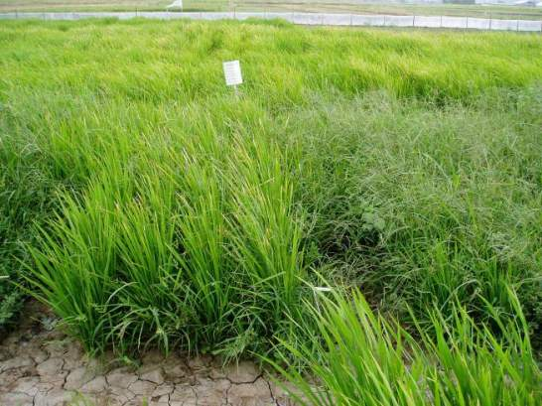
Aerobic rices are highly weed-competitive due to vegetative vigor
UPL RI-7
IR 72

Slide 42
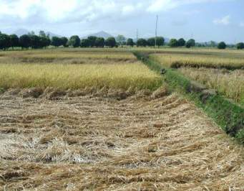
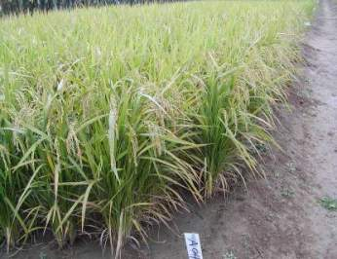
Aerobic rice cultivars
→Input-responsive and lodging-resistant
→High harvest index, even under moderate stress

Slide 43
Yield of irrigated, aerobic, improved upland, and traditional upland cultivars in four environment types: IRRI 2000-2003
Variety type | Environment type
 | Irrigated lowland | Favorable upland | Water-stressed uplands |  | Infertile uplands
Irrigated lowland | 4.04 | 2.12 | 0.84 |  | 0.91
Aerobic | 3.62 | 3.56 | 1.47 |  | 1.26
Improved upland | 3.31 | 2.89 | 1.10 |  | 1.14
Traditional upland | 2.29 | 1.63 | 0.81 |  | 0.76
LSD_{.05} | 0.82 | 0.47 | 0.30 |  | 0.38

Slide 44
Harvest index of irrigated, aerobic, improved upland, and traditional upland cultivar groups in 4 environment types: IRRI 2001-2003
Variety type | Environment type
 | Irrigated lowland | Favorable upland | Water-stressed uplands |  | Infertile uplands
Irrigated lowland | 0.47 | 0.27 | 0.21 |  | 0.25
Aerobic | 0.48 | 0.37 | 0.28 |  | 0.28
Improved upland | 0.39 | 0.31 | 0.21 |  | 0.25
Traditional upland | 0.34 | 0.22 | 0.16 |  | 0.20
LSD_{.05} | 0.07 | 0.05 | 0.03 |  | 0.09

Slide 45
How to improve tropical aerobic rice varieties?
Use indica HYV parents crossed with improved upland parents
Select for high grain yield under:
  Favorable, high-input conditions
  Moderate water stress

Slide 46
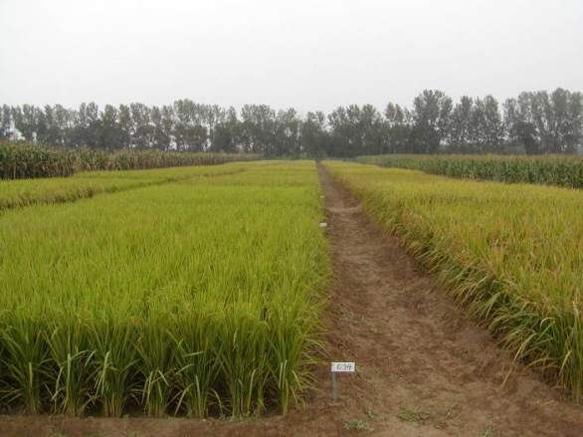
Target 1:
Water savings in irrigated systems
Beijing, Sept. 2002

Slide 47
Average water savings from aerobic vs flooded rice: IRRI 2001-2003
Land preparation: 190 mm
Seepage and percolation: 250-300 mm
Evaporation: 90 mm
Transpiration: 20-30 mm
Total: ca. 500 mm
Source: Bouman et al., in press

Slide 48
Aerobic versus flooded yields of IR55423-01 at IRRI, 2001-2003
Flooded WS | Aerobic WS | Flooded DS | Aerobic DS
5.37 | 3.96 | 6.40 | 4.67
Bouman et al., in press

Slide 49

Target 2:
Upland productivity improvement in rainfed uplands through a “Green Revolution strategy
Improved varieties plus increased N can greatly increase rainfed upland rice yields
3 t/ha achieved now on-farm in Yunnan, Brazil, and Philippines with improved varieties, 50-100 kg N
Available germplasm has potential rainfed yield of 6 t/ha

Slide 50
Grain yield (t ha⁻¹) of improved upland cultivars under aerobic management
Cultivar | Location and season | Yield
B6144F-MR-6 | 4 favorable Yunnan upland sites, 1998-2000 | 4.2
IR71525-19-1-1 | South Luzon upland WS 2002: mean of 16 farms | 3.8
Apo | North Luzon lowland WS 2002: mean of 4 farms | 5.5

Slide 51
3. Aerobic rice for drought-prone lowlands
Many drought-prone lowland areas depend on establishment and weed control technologies that increase drought risk
Dry direct seeding can move the cropping season earlier in the monsoon period
Dry direct seeding reduces risk associated with transplanting and bushening
Aerobic rice yields (3-5 t/ha) are already adequate for drought-prone rainfed lowlands

Slide 52
Can anyone share their experiences with aerobic rice?
Questions or comments?

Slide 53
Conclusions
Aerobic rice varieties are:
  vigorous
  medium-height
  maintain high biomass & harvest index under upland conditions
Aerobic management saves up to 50% of water used in rice production (usually 30-40%)

Slide 54
Conclusions
25% yield penalty is paid relative to fully flooded irrigation
Aerobic rices = highly weed-competitive
  →better-adapted to direct-seeded systems than lowland cultivars
Aerobic rice yields = high enough for use in drought-prone lowlands

