Slide 1
Planning Breeding Programs for Impact
Farmer participation and breeding rice for
rainfed rice environments
Thelma R. Paris and Gary Atlin
Social Sciences & PBGB
IRRI

Slide 2

Learning objectives
Describe need for participatory approaches in rice breeding
Clarify the social science component and the plant breeding component in participatory plant breeding (PPB)
Describe farmers’ criteria for selecting rice varieties
Explaining how to use attitude, skills and knowledge to obtain quality information and effective cooperation from farmers
Describe appropriate interview techniques to facilitate group discussions or individual interviews

Slide 3

Why is there a need for participatory approaches in rice breeding?
Notes:
Gauge interest of class

Slide 4

Why participatory approaches in rice breeding?
Classical breeding has been successful in favorable rice environments
Limited impact in unfavorable rainfed environment
Uncertainty about predictive power of researcher-managed trials
Adoption rates in rainfed rice environments are low

Slide 5
POOR ADOPTION
Good varieties exist but farmers don’t have access to seeds & information
New varieties are not better than farmers’ varieties
INSTITUTIONAL PROBLEMS
Policy and Institutional changes
BREEDING PROBLEMS
Solutions:
More farmer participation
More testing in farmers’
environment
Possible reasons for poor adoption of modern varieties in rainfed environments

Slide 6
Why is technology adoption low?
Often we did not understand farmers’ needs
We assume improved productivity was enough to ensure adoption
Huge variability in rainfed areas
Farmers seldom adopt developed tech packages
They ADAPT rather than ADOPT technologies
Farmers = experimenters → they often lack access to new technology & info about benefits & limitations of the options
Notes:
Ask for participant’s opinion

Slide 7
What is the goal of Participatory Plant Breeding? (PPB)
To increase adoption of improved rice varieties suitable for rainfed ecosystem
Increase food (rice) security of the resource poor households and communities
Notes:
PPB= Participatory Plant Breeding

Slide 8
RESEARCH DESIGN
Social science component
Plant breeding component

Slide 9
Social science component in PPB
Select and characterize the target research site (biophysical, social and economic) and typologies of farmers, gender roles
Understand how rice fits into farmers’ cropping/farming systems and its importance in the livelihood systems
Identify past and current rice varieties grown by farmers according to specific land types

Slide 10
Social science component in PPB
Identify farmers’ constraints in adopting released varieties and understand selection criteria of farmers (gender, social groups, ethnicity)
Facilitate and assess farmer participation in “mother-baby” trials
Facilitate diffusion of PVS lines in the community (scaling up)
Assess the impact of “farmer/community participatory approach” and adoption of lines evaluated through PVS

Slide 11
What are criteria for selecting research sites?
Represent the ecosystem with problem of concern (submergence, drought, flood, saline- prone) for breeding program
Have extensive rice area
Accessible from research station

Slide 12
Variety type, diversity
preference, user needs
Setting goals
Variety release
and diffusion
Generating variability
Strengthen community networks
Breeder crosses
Farmers’ crosses
Testing exp, variety
Selecting exp. variety
Farmer evaluation on
his/her field
Farmers select
on-station, on-farm
Cycle of plant breeding stages,
where farmers can participate

Slide 13
At what stage of the breeding process are farmers involved?
1. Participatory Varietal selection (PVS)
“Mother” trial – Researchers test advanced lines (15-25 fixed) on-farm and on-station. Groups of farmers rank rice lines
“Baby trial” – Farmers test lines from “Mother” trials on their fields using their level of management and rate performance

Slide 14
2. Participatory Plant Breeding (PPB)
Farmers and breeders select plants from segregating materials – not uniform maturity,
Materials evaluated when fixed
3. Sensory Evaluation
Farmers’ ranking according to taste and cooking quality

Slide 15
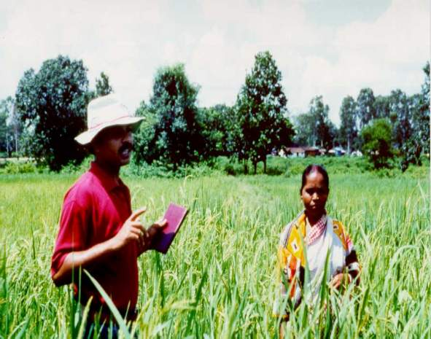
Eliciting farmers’ selection criteria of rice lines managed by farmers on their own fields –”Baby” trials

Slide 16
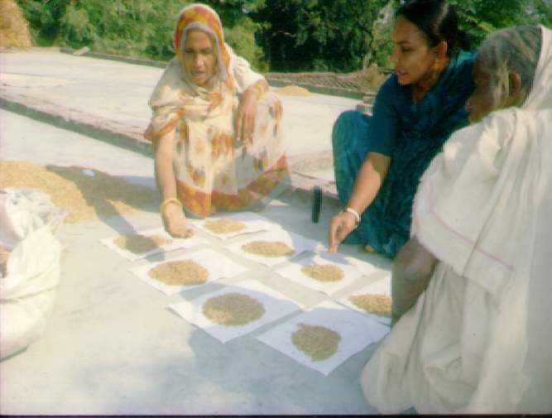
Assessing the post harvest qualities of PVS lines by farmer cooperators

Slide 17
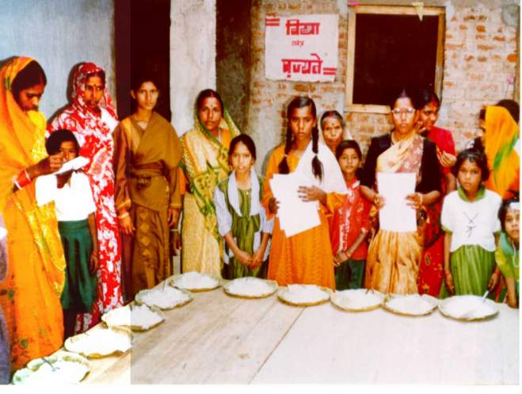
Assessment of cooking quality of rice

Slide 18
Farmers’ Assessment of New Rice Lines, 1999 Kharif season
Lines (Location) | Name | Positive traits
PVS9 | NDR9730015 | Medium plant height Suitable to land type Submergence-tolerant Medium/bold grain size Good straw Good tillering capacity Good for puffed rice
PVS10 | NDR9730020 | High yield—more grains per panicle than PVS1 (NDR-40032) Suitable to land type Medium plant height Resistant to lodging (hardy stem) Resistant to pests and diseases Longer panicles Grains are long and cylindrical and finer than PVS9 (NDR9730013) Higher milling recovery Good taste Remains soft after cooking Good for special social occasions Easy to harvest and thresh

Slide 19
Farmers’ Assessment of New Rice Lines, 1999 Kharif Season
Lines (Location) | Name | Positive traits
PVS1 | NDR-40032 | Good yield Medium plant height Good straw (quantity and quality) Has regeneration capacity (faster recovery after submergence) Short, bold, heavy grains Best for puffed rice
PVS3 | NDR-973004 | Medium plant height Submergence-tolerant Good tillering capacity Long panicles Remains soft after cooking Good eating quality Good milling recovery
PVS7 | 9830102 | Short duration (110 d) which makes rice available during the lean period Good yield (4 t/ha) Good straw (quantity and quality) Medium plant height Better for early rabi crops Good taste

Slide 20
Farmers’ criteria for selecting rice varieties
Suitable or adapted to their land types and rainfall patterns
  lowlands - long duration photosensitive varieties
  uplands - early and medium duration, photo-insensitive
Can withstand drought, submergence, floods, problem soils (salinity)
Yield (stable or higher than varieties farmers use)

Slide 21
Farmers’ criteria for selecting rice varieties
Quality (size, color, shape and texture of grain, eating, cooking, aromatic, glutinous, color); left-over rice stays soft, good for rice wine, good for making other rice products (puffed rice)
Good for livelihood uses (straw for animal feed, roof)
Should fit into their cropping/farming systems
Requires low inputs
Demands high price in the market

Slide 22
Farmers criteria may differ by socio-economic groups, gender, ethnicity
Social groups
Large/Upper caste farmers – fine grains for the market
Small/marginal/Lower caste farmers –coarse grains which stays longer in the stomach; left over rice remains soft

Slide 23
Farmers criteria may differ by socio-economic groups, gender, ethnicity
Gender – determined by gender roles
Men – high yields, resistant to pests and disease
Women – suitable for rice products, easy to thresh can compete with weeds, quality and quantity of straw for animal feed, high milling recovery, expands after cooking; quality traits
Ethnicity
Good for making rice wine, aromatic and glutinous, black rice, good quality for special occasions, gifts

Slide 24
Diffusion of promising PVS lines
District | No of rice lines | No of villages | No of farmers | Total Area (ha)
Faizabad | 1, 7, 10 | 2 | 22 | 2.20
Siddathnagar | 1, 2, 3, 7, 10, 13 | 6 | 48 | 9.00
Notes:
Participatory Varietal selection (PVS)

Slide 25
Impact assessment
Evaluate resulting rice diversity in farmers’ fields
Assess changes in no. of farmers growing specific varieties, area grown to different varieties by land type, rice productivity, rice income
Assess adoption rate of introduced rice varieties
Assess attitude changes of farmers, extension workers and researchers
Document farmers’ perceptions on PVS and impact on their livelihood and well-being

Slide 26
Impact assessment
Access to quality seeds and establishment of community efforts e.g. seed banks, self-help groups
No. of released lines under PVS
Benefit cost analysis of conventional vs. participatory approach
Empowerment of farmer/communities/women farmers
Institutionalization of participatory approaches in plant breeding in universities, research institutions

Slide 27
How can non-social scientists obtain quality information and effective cooperation from farmers?
ATTITUDE
SKILLS
KNOWLEDGE

Slide 28

ATTITUDE
Be willing to learn and not to preach
Observe local protocol and norms (consider gender, ethnicity, caste, wealth) groups
Develop and show interest in farmers’ farming practices
Communicate to express and not to impress
Build trust and a mutually beneficial working relationship
Avoid non-verbal messages
Be respectful with farmers’ time

Slide 29

SKILLS
Listen actively
Observe closely and systematically
Learn and use the local language
Probe to add depth to farmers’ response
Inquire and record as neutrally and value-free as possible
Make documentation recording as systematic and unobtrusive as possible
Facilitate farmer community meetings and explain roles, decision-making, ownership, degree and type of participation, sharing of inputs

Slide 30

KNOWLEDGE
Be familiar with target sites and environment (biophysical, socio-economic, cultural, political)
Learn farmers’ indigenous knowledge, needs, criteria, and preference, varieties they used to grow and prefer to grow
Understand farmers’ local concepts, criteria & measures
Use triangulation and gather information from diverse key informants

Slide 31
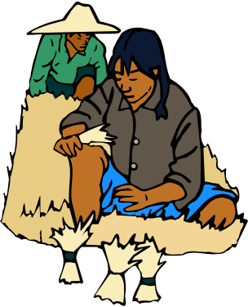
Appreciating Farmer’s Opinions
Use body language to show interest
Use encouraging words or gestures, head movements indicating assent
Use open-ended questions that invite participation
Rephrase what you’ve heard to show that you’re listening and that you understand
Request more conciseness and information on what you heard
At appropriate points, summarize what’s been said without distortion

Slide 32

Listening to the Farmer (Dos)
Give farmers time to respond
Sit comfortably, possibly on the same level with them
Make eye contact (as far as culturally acceptable)
Smile, have a sense of humor
Maintain a relaxed body position
Lean forward intently

Slide 33
Listening to the Farmer (Don’ts)
Get impatient with or interrupt the farmer
Contradict the farmer or point of finger to face
Show disapproval of farmers’ statement, even when disagree
Express judgement of what’s being said
Completely ignore women
Give the farmer advice during the interview
Convey boredom, verbally or nonverbally

Slide 34

How to do group discussions or individual interviews
Pay courtesy to village leader
Explain the objectives of the project and seek permission to conduct interviews
Greet the farmers. If necessary interview key informants, separate social groups
Introduce yourself and your team
Explain to farmer why you are conducting the interviews. Build rapport.
Start with the phrase “We want to learn” from you
Avoid bringing thick questionnaires

Slide 35

How to facilitate group meetings
Stop any individual from dominating the meeting
Encourage contributions from all farmers, especially the women
Guide the meeting towards its goals
Manage the pace of the meeting to maintain farmers’ interest
Assign a recorder and facilitator in the meeting
If possible, provide light snacks during the meeting
Summarize the results of the discussion
→ And remember to use the open-ended and probing questions

Slide 36
Can anyone give examples of what one should do when listening to farmers?
Can anyone give examples of what one should NOT do when listening to farmers?

Slide 37

Type of Questions
Leading – normally imply the kind of response expected
Direct – aimed at obtaining specific information
Open (divergent) – give the interviewee free rein of expression by not explicitly directing his/her response

Slide 38
Interview Techniques
(examples on open ended questions)
Can you tell me more about this?
What would be an example of that?
What are some reasons for that?
Could you help me understand this better?
How you any other ideas about this?
How do you feel about that?
How do you think other farmers would feel about this?
How would you describe this?
What are the positive and negative traits of this variety?

Slide 39
Probing = a technique that
Combines good listening with asking questions which direct the flow of the interviewee’s spontaneous comments unobtrusively
Checks understanding of the interviewee’s point of view
Checks consistency of interviewee’s answers

Slide 40
Probing Techniques
Mirror technique (restating)
Asking questions to confirm
Repeating a comment made earlier
Asking for clarification
Paraphrasing
Admitting uncertainty
Silent probe
Uh-uh or yes probe
Key word probe

Slide 41
Interview Techniques
(Probing gives you more information than what was first offered)
Why do you prefer this variety?
What do you like/dislike in this variety?
high yield
high market demand
Consumer prefer it
happy with the duration
easy to grow
fits our cropping system

Slide 42
Interview Techniques
(Probe more when first information is not enough)
It has high/low/average yield
It has high market demand
Farm laborers prefer it
We are happy with the duration
It is easier to grow
It fits our cropping system
How high is high/low/average compared to preferred local variety
Why high market demand? What qualities do consumers look for?
Why do farm laborers like it?
Why are you happy with the duration? What is maturity period? Why do you like early varieties?
How can you tell it is easier to grow?
How does it fit in your cropping system? What crops do you grow or want to grow before and after rice?

Slide 43
Can anyone summarize what “probing” is and explain its use? Examples of “probing”?

Slide 44

Benefits from farmer participation
Adaptation of varieties on farmers field
Suitability of varieties to farmers condition and needs
Inclusion of farmer’s own innovation and local knowledge

Slide 45
Conclusions
Farmer participation in breeding can improve the selection of suitable varieties for complex rainfed environments because
  farmers’ are given the opportunity to screen new varieties on their specific environment rather in controlled experiment stations;
  farmers’ selection criteria for rice varieties are better understood by breeders
Meeting farmer needs may be better tackled by creating different varieties rather than trying to produce multi-purpose varieties

