Slide 1

Intellectual Property Rights and Germplasm Exchange: the new rules
Ruaraidh Sackville Hamilton, Genetic Resources Center,
Edwin Javier, Plant Breeding, Genetics and Biotechnology Division
www.irri.org/grc

Slide 2
Exploiting germplasm
Breeding improved varieties relies on access to suitable parental germplasm
  But are we allowed to use the parental germplasm?
  i.e. do we have “FREEDOM TO OPERATE” (FTO)?
International rules governing access are becoming more specific
  We must adhere to these rules
  What are they?
National legislation is becoming more strict
  We must adhere to the rules of each country

Slide 3
Structure of this session
Changing concepts and International Agreements
  Historical background to the new rules
Implications for germplasm exchange with IRRI
  IRRI policy and MTAs
Procedures for germplasm exchange with IRRI
(E. Javier)

Slide 4
Key issues
Who owns living things?
What are we allowed to do with a seed?
  Can we donate it to others?
  Can we use it for breeding and research?
  Can we sell it to others?
  Can we claim it as ours?
  Can we protect it from others?
How do we ensure that we do only what we are allowed?
How do we assure others that we do only what we are allowed?

Slide 5
Modern concepts of ownership
PROPERTY
TANGIBLE
PROPERTY
INTELLECTUAL
PROPERTY

Slide 6
Intellectual Property (IP): the knowledge gained to produce & market a product
Product development requires financial investment to acquire the know-how
  Industry cannot develop new products without protecting their investment in IP
Modern commercial practice is to sell the tangible products but not the associated IP
  Impose restrictions on use that prevent theft of the IP
Now standard for all products
  Software, DVDs
  Bag of rice for the consumer in the market
  Bag of rice for the farmer to grow

Slide 7
Key International Agreements
1983 International Undertaking on Plant Genetic Resources for Food and Agriculture
1993 Convention on Biological Diversity
2004 International Treaty on Plant Genetic Resources for Food and Agriculture:
2006 : Treaty mechanisms finalized

Slide 8
Development of germplasm exchange concepts
Traditional agriculture before modern breeding
Modern breeding up to 1983
1983 – 1993
1993 – 2004
The future

Slide 9
Traditional agriculture
Farmers were breeders
Ownership and rights?
  Buying, bartering, producing, collecting, or being given seed gives full rights to do anything with the seed, without restriction
The result
  Unrestricted germplasm exchange
  Unrestricted utilization of germplasm for crop improvement
  Unrestricted marketing

Slide 10


Traditional Germplasm exchange
IP & TP
Farmer A
Farmer B / Market
IP & TP

Slide 11
Modern breeding up to 1983
Ownership concepts unchanged
  Modern breeders obtained seed by buying, bartering, collecting, or being given seed
  With full rights to do anything they like with the seed, without restriction
The result
  Unrestricted germplasm exchange
  Unrestricted utilization of germplasm for crop improvement
  Unrestricted marketing
  Global agriculture improved
  → The Green Revolution

Slide 12
Plant Genetic Resources in the 1960s-1980s
Global collaboration on conservation and utilization of PGR
  Shared vision of the importance of PGR for the sustainable alleviation of poverty and conservation of biodiversity
  Based on cooperation and trust for mutual benefit
  PGR perceived as global public goods
  Free exchange of germplasm, information, technology
Every country gained more than it contributed

Slide 13
Plant Genetic Resources and the Green Revolution
Benefits of the Green Revolution
  National self-sufficiency in food
  National food security
  Improved economy
Enabled by international exchange of germplasm
  High-yielding varieties the result of hybridizing varieties from different countries
  → novel genotypes
Without international germplasm exchange, no green revolution

Slide 14
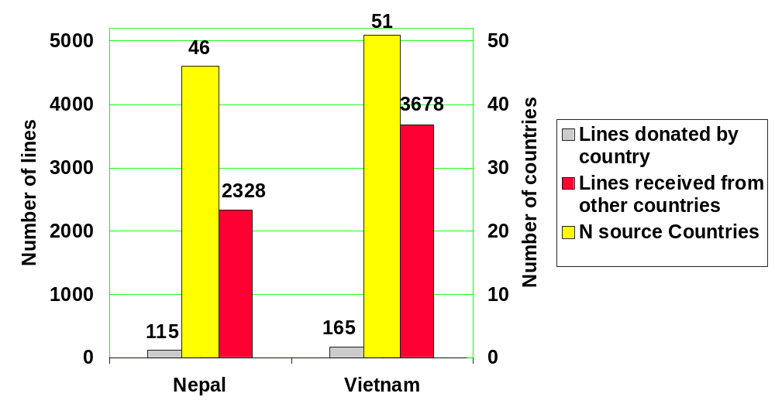
Mutual benefits of exchange

Slide 15
Release country | Variety name | N parental varieties | N source countries
CUB | ECIA 128 | 54 | 24
KOR | SUWEON 300 | 50 | 16
KOR | SUWEON 312 | 50 | 16
PHL | IR 42 | 48 | 18
VEN | CT 8240-1-3-9P-M | 47 | 16
VEN | FONAIAP 2000 | 47 | 16
COL | FEDEARROZ 275 | 46 | 15
VEN | FUNDARROZ PN 1 | 46 | 17
PHL | IR 72 | 44 | 18
PHL | MATATAG 9 | 44 | 22
COL | FEDEARROZ LA VICTORIA 2 | 43 | 16
IND | BHUDEB | 43 | 17
COL | COPROSEM 1 | 42 | 15
COL | FEDEARROZ 2000 | 42 | 14
GTM | OASIS | 42 | 17
JPN | NATSUHIKARI | 42 | 6
PHL | IR 66 | 42 | 22
PHL | IR 70 | 42 | 16
PHL | IR 74 | 42 | 16
COL | PROGRESO 4-25 | 41 | 13
USA | M 301 | 40 | 20

Slide 16
Plant Genetic Resources and the Green Revolution
Problems of the Green Revolution
  Loss of crop diversity
  Emphasis on yield
  → loss of quality, stress tolerance
  Environmental damage
  Rich farmers may benefit more than poor
Mitigated by international exchange of germplasm
  Safe conservation of valuable genes that would have been lost
Without international germplasm exchange, green revolution not sustainable

Slide 17
1983 International Undertaking on PGRFA
113 countries
Aims to “ensure that plant genetic resources of economic and/or social interest, particularly for agriculture, will be explored, preserved, evaluated and made available for plant breeding and scientific purposes”
= Global Public Good for the benefit of humanity, especially in the poorest countries
Status quo against rising contrary feeling

Slide 18
Post-traditional germplasm exchange
IP & TP
Wrong?
Farmer
Collector
TP
Seed company
Retains IP
Breeder
Retains IP

Slide 19
Benefit sharing before 1993
Genebank
Low-yielding traditional varieties collected from farmer
Farmer
High-yielding modern varieties returned to farmer
Breeder
Benefits returned:
1° target = poor farmer

Slide 20
Doubts about benefit sharing before 1993
Genebank
Need to share benefits?
CBD: This is wrong
Farmer
Restrictive PVP laws to protect breeder
Privatisation of plant breeding industry
Breeder
Appropriate benefits?
The right farmers? Farmer’s rights?

Slide 21
Convention on Biological Diversity (CBD: 1993)
A KEY MOMENT IN HISTORY
redefining concepts of exploiting biodiversity
188 nations are Party to the agreement
  All except 7, including USA, Somalia, Iraq, E. Timor
  Most widely adopted UN agreement ever
3 key components. Each nation has:
  Sovereignty over its own biodiversity
  A right to an equitable share of benefits arising from exploitation
  Responsibility to conserve its biodiversity

Slide 22
Each nation has sovereignty over its own biodiversity
For all life found in a nation, the nation’s government has the right to define:
  Who owns it
  Who may use it
  Who may benefit
  How it is governed
  How it may be used
  How it may be protected
    Protection of the tangible life form for conservation
    Protection of associated IP for profit

Slide 23
Each nation has a right to an equitable share of benefit
Country A
has germplasm
Germplasm
transferred
Country B
exploits germplasm
If Country B profits, Country A has a right to share the benefits
What is an equitable share?
  Decided by negotiation
  between governments of A and B

Slide 24
The CBD and PGR
Mutual agreement between governments needed for germplasm exchange
  Mutual agreement between scientists & other network members is not sufficient
  Appropriate agreements not yet reached
  Existing mechanisms not acceptable
PGR network functionality reduced
  Germplasm exchange largely stopped
  Cooperation, sharing and trust replaced with competition, ownership and mistrust
  Sustainable progress in agriculture slowed

Slide 25
The CBD and PGR
What sort of mutual agreement between governments for PGR partnerships
  Bilateral or multilateral?
  CBD allows either
  Existing attempts under CBD are mostly bilateral
  Multilateral necessary for networks

Slide 26
Bilateral Agreements
Country A
Country B
Country C
Country D

Slide 27
Bilateral Agreements
Country A
Country B
IRRI

Slide 28
Bilateral Agreements
Country A
Country B
Country C
Country D
IRRI

Slide 29
Multilateral Agreements
Country B
Country A
Network
Country D
Country C
Each country gains more than it contributes
Simple administration
IRRI

Slide 30
Solving CBD problems with PGR
CBD secretariat and parties
  Recognized CBD does not address the “problem” of PGR
  Requested FAO to solve the problem through intergovernmental negotiation
FAO Commission on Genetic Resources for Food and Agriculture
  Facilitated series of intergovernmental negotiations
  International Treaty on PGRFA was the result

Slide 31
International Treaty on
Plant Genetic Resources for Food and Agriculture
Legally binding agreement, aiming to achieve:
Mutually agreed terms for exchange of PGRFA
For listed crops
  Including all wild and cultivated species of Oryza
Global multilateral system
  All Contracting Parties agree to the same set of terms for all included species
To mutual benefit of all parties

Slide 32
International Treaty on
Plant Genetic Resources for Food and Agriculture
Features
Facilitated international germplasm exchange
Enforced equitable sharing of benefits
  Financial and other benefits
  Fund for obligatory payment to country of origin
Directly addresses concerns that lead to current problems

Slide 33
ITPGRFA and the CBD
ITPGRFA is in harmony with the CBD
ITPGRFA works through inter-governmental agreement as required by CBD
Promoted by CBD e.g. COP-6
  “Decides to establish and maintain cooperation with the CGRFA, and, upon the entry into force of the Treaty, with the Governing Body”
  “Appeals to Parties and other Governments to give priority consideration to the signature and ratification of the ITPGRFA, so that it may enter expeditiously into force”

Slide 34
ITPGRFA
Progress and governance
Adopted November 2001
Came into force June 2004
Currently (2006 Apr 21) has 98 countries as Parties
Parties join Governing Body 90 days after ratifying
Governing Body will establish detailed rules for germplasm exchange and benefit sharing
  1st meeting 2006 June 12-17
  Deadline for participation: 2006 March 14
  New rules in force late 2006

Slide 35
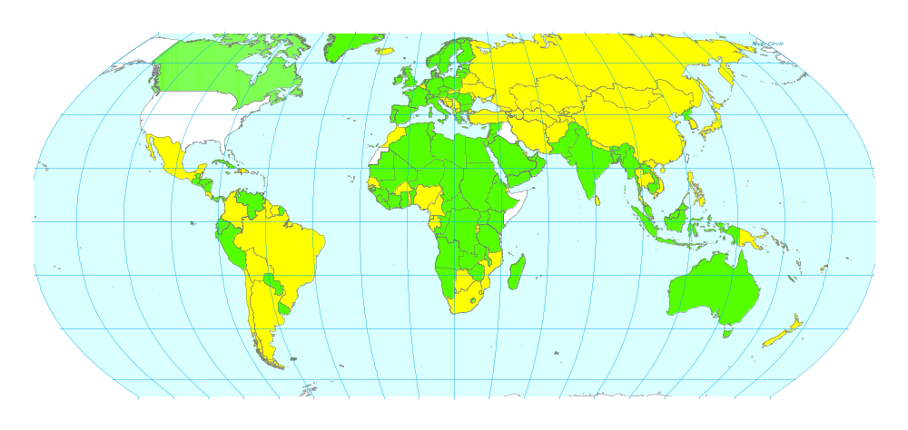
Parties to ITPGRFA and CBD
(ITPGRFA: final membership of Governing Body at 1st meeting)
= ITPGRFA GB
= not CBD not ITPGRFA
= CBD not ITPGRFA
www.fao.org/Legal/TREATIES/033s-e.htm

Slide 36
Reasons for ratifying
Parties to CBD should ratify ITPGRFA
  ITPGRFA is in harmony with CBD
  CBD COP encourages ratification
Improve germplasm exchange and benefit sharing
  Each party will gain more than it contributes
Ready-made agreement by governments’ recognized representatives
  No need to seek alternative government-level agreements
Advanced state of negotiations

Slide 37
Countries that ratified before 2006 March 14
Will participate in 1st meeting of Governing Body
Will participate in decisions on:
  mechanism for benefit sharing
  mechanism for germplasm and data exchange
  how comprehensive the ITPGRFA is
    Treatment of non-parties
      Financial benefits
      Access to germplasm
    What germplasm is covered?
      “Essential derivation”

Slide 38
Countries that did not ratify before 2006 March 14
Probably excluded from
benefit-sharing mechanism
May be excluded from
germplasm-sharing mechanism
(donor country’s choice)
Will need to seek alternative
government-level agreements
Will not participate in Treaty decisions

Slide 39
End of Part 1
THANK YOU!
Any questions?

Slide 40
Part 2
Implications for
germplasm exchange with IRRI

Slide 41
IRRI’s objectives
Simple free germplasm exchange
  To promote sustainable improvement
Conforming with all relevant
  international agreements
  national legislation
Respecting rights of IP owners
  Where rights are defined by sovereign governments,
  not by IRRI

Slide 42
Key issues
How do we ensure that germplasm is used legally, and not misused or stolen?
  With a
  MATERIAL TRANSFER AGREEMENT (MTA)
  An MTA sets legally binding terms and conditions that specify how the recipient may use it

Slide 43
Material Transfer Agreements
An appropriate MTA must be used for EVERY transfer of germplasm into or out of IRRI
  To ensure that IRRI and its partners know what they can and cannot do with the germplasm
  To ensure that we all comply with all relevant national and international law
  To demonstrate to others that we comply with all relevant national and international law

Slide 44
Key issues
Sending germplasm to IRRI
  Who has authority to determine whether IRRI’s partners can send us germplasm?
  Under what conditions can they do so?
Sending germplasm to partners from IRRI
  Who has authority to determine whether we can send germplasm?
  Under what conditions can we do so?

Slide 45
Sending germplasm to IRRI
Categories:
  Germplasm governed by the ITPGRFA
  Germplasm governed by the CBD
  Germplasm outside ITPGRFA and CBD

Slide 46
Sending rice germplasm to IRRI
1. Germplasm governed by the ITPGRFA
= Germplasm that is:
  In the public domain and
  Under the management of Parties to the ITPGRFA and
  Listed in Annex 1 of the ITPGRFA
  (includes all species of Oryza)
Country must “facilitate access” under the
multilateral system (MLS) of the ITPGRFA

Slide 47
Sending rice germplasm to IRRI
2. Germplasm governed by the CBD
= germplasm that is:
  Traditional unimproved varieties or wild relatives
  In a country that:
    Is Party to the CBD but not the ITPGRFA and
    EITHER is the country of origin of the germplasm
    OR obtained the germplasm from country of origin under CBD
CBD encourages country to “facilitate access”
  Terms & conditions of “facilitated access” to be agreed with CBD authorities in the government of the donor

Slide 48
Sending rice germplasm to IRRI
3. Germplasm not governed by CBD or ITPGRFA
From countries not party to ITPGRFA or CBD
  USA, Somalia, Iraq, E. Timor
Privately-owned germplasm
  Commercial varieties with PVP
  Improved lines and other breeding materials
  From ITPGRFA Party not in public domain
  Traditional varieties in situ in some countries
Germplasm outside its country of origin, in
non-ITPGRFA country obtained from country of origin before CBD

Slide 49
Sending rice germplasm to IRRI
3. Germplasm not governed by CBD or ITPGRFA
The breeder / institution / organization / farmer who owns / developed the germplasm
  Owns the IP rights
  i.e. may have full “Freedom To Operate”
  May have authority to define the conditions of
  transfer to IRRI without governmental participation
  National legislation may restrict options

Slide 50
Distributing germplasm from IRRI
Four categories:
  In Trust germplasm
  Germplasm developed by IRRI scientists, alone or in partnership with non-IRRI scientists
  Germplasm developed by non-IRRI scientists
  GM germplasm

Slide 51
(1) In Trust germplasm now
Was legally obtained under conditions that allow it to be placed under the auspices of the FAO for the benefit of the international community
Does not belong to IRRI
By agreement with FAO, IRRI must conserve it and make it freely available
Conditions of distribution set by FAO CGRFA
  Intergovernmental commission of 167 countries
  Text of MTA written by CGRFA

Slide 52
(1) In Trust germplasm in future
Agreement with FAO CGRFA to be replaced by new agreement with the
Governing Body (GB) of the International Treaty on PGRFA
  between 17 June and 26 October 2006
  GB = all countries that ratify the ITPGRFA
GB will set terms and conditions for exchange
in new Standard MTA (SMTA)

Slide 53
(2) Germplasm developed by
IRRI (and partners)
Now:
  IRRI (and partners) have authority to set conditions
  IRRI chooses to make its germplasm as freely available as possible
    IRRI MTA
    Don’t allow recipients to claim restrictive ownership
Future:
  IRRI (and partners) plan to simplify and improve distribution by using the SMTA

Slide 54
(3) Germplasm developed by non-IRRI scientists, and sent to IRRI for distribution not In Trust
Germplasm donor has authority to set conditions
IRRI has “3rd party” MTA which has been found to be acceptable to most donors of non-GM germplasm
  Some may change to SMTA

Slide 55
(4) GM Germplasm
Germplasm donor has authority to set conditions
Specific MTA for each case

Slide 56
Distributing germplasm from IRRI to third parties
Is the
germplasm held
In Trust?
Yes
Distribute with FAO MTA
No
Was the
germplasm bred
by IRRI?
Yes
Distribute with IRRI MTA
No
Has the
owner allowed us to distribute it?
Yes
Distribute with “3rd party MTA”
No / don’t know
Do not distribute
http://www.irri.org/grc/requests/Distribution_policy.htm

Slide 57
End of Part 2
THANK YOU!
Any questions?

