Slide 1


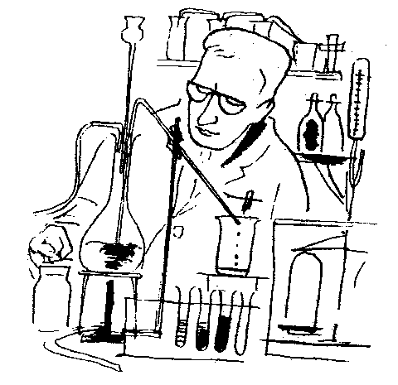
1 Quality

Slide 2



Program
1
Evaluation of Physical Quality
Eyes vs Instruments
2
Understanding bits of Cooking Quality
Associating genes with results
3
Discussion and questions

Slide 3
Quality Evaluation
F1
F2
F3
F4
F5
F8
Cross
5g for chalk, GT and amylose
125g paddy for physical and cooking tests

Slide 4
Quality is Defined in Sensory Terms by Each Market

Slide 5


Eyes look for white, translucent, uniform, not-chalky, not cracked, glossy
Nose smells for popcorn, ammonia, watery, grassy, vanillary
Mouth munches for texture, springiness, stickiness, chewiness, creaminess, Vit A, Fe, Zn...

Slide 6

How do we measure
all of these things??

Slide 7
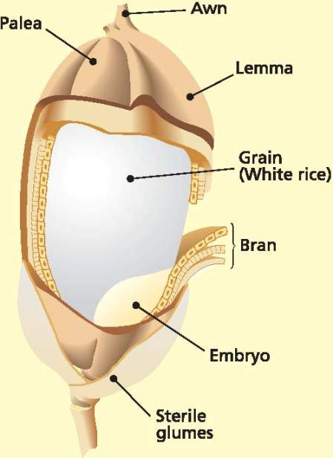
There is not much in a rice grain:
Starch (~94%)
Protein (~5%)
Lipids (~1%)
But, different levels of structure affect physical and cooking properties.

Slide 9
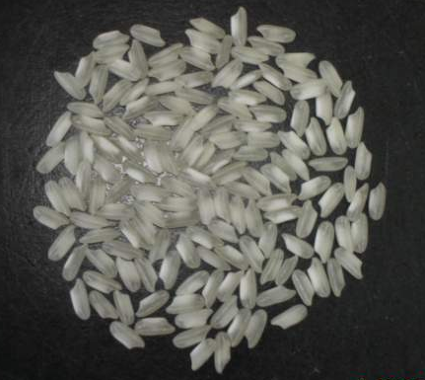
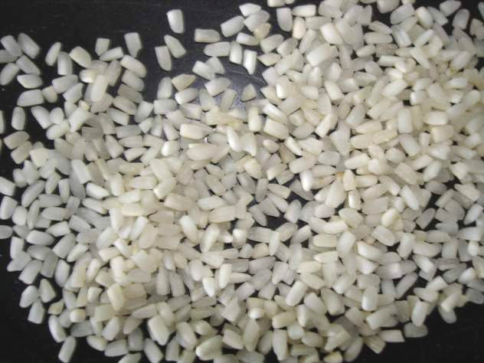
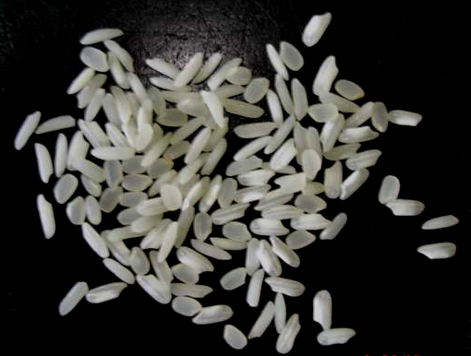
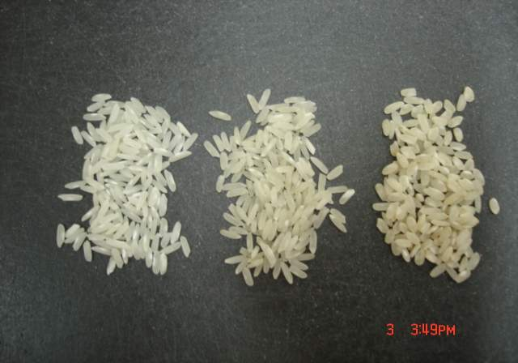
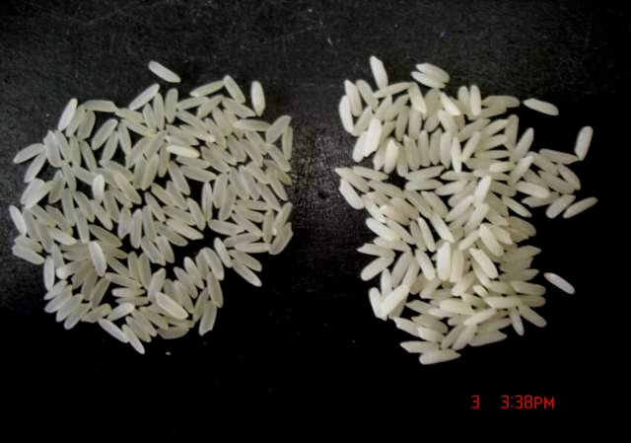

Slide 10
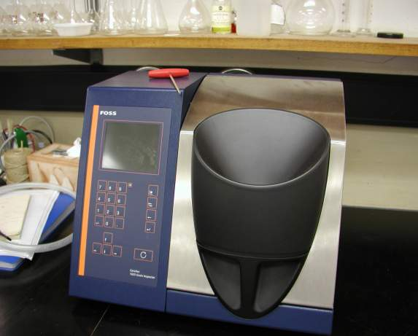
The Cervitec
FOSS

Slide 11
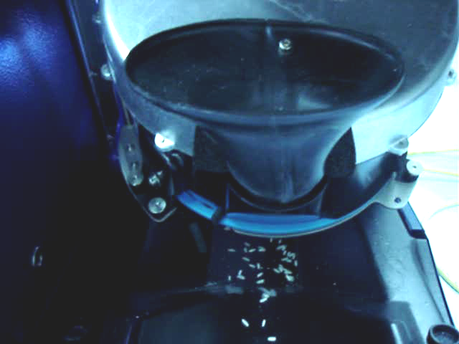
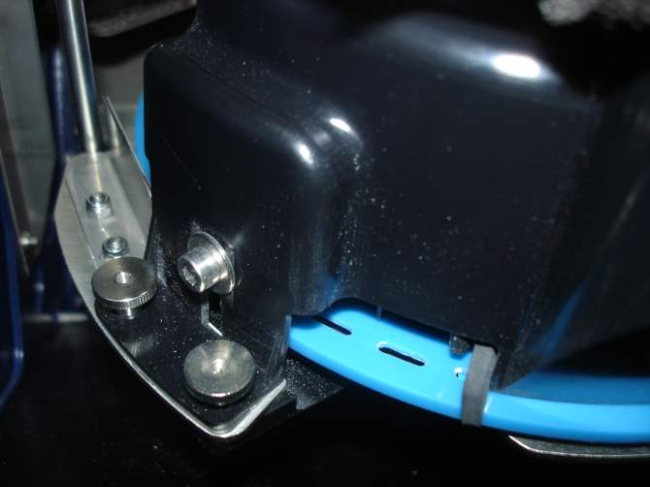

Slide 12
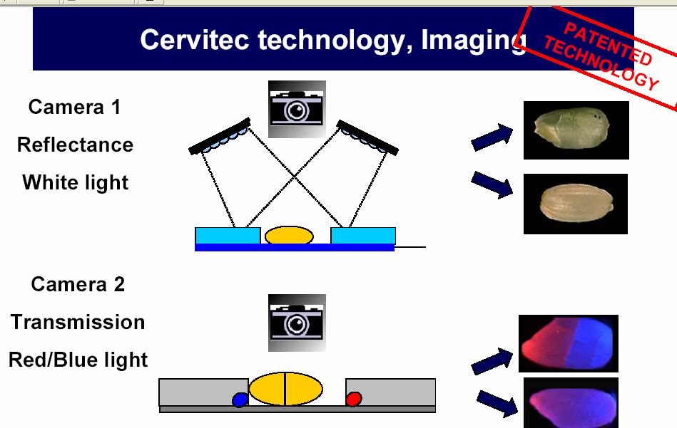

Slide 13
Cervitec gives us:
Chalk
Length
Width
Cracks
HRY

Slide 14
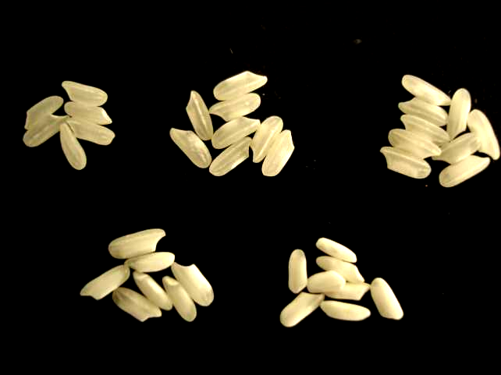
Chalk
0-10%
10-25%
25-50%
50-75%
>75%

Slide 15
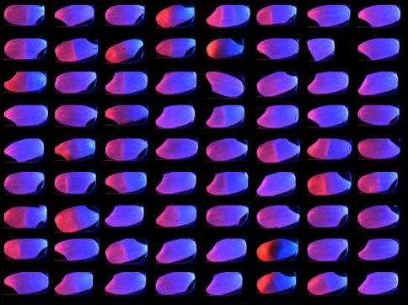
Cracks

Slide 16
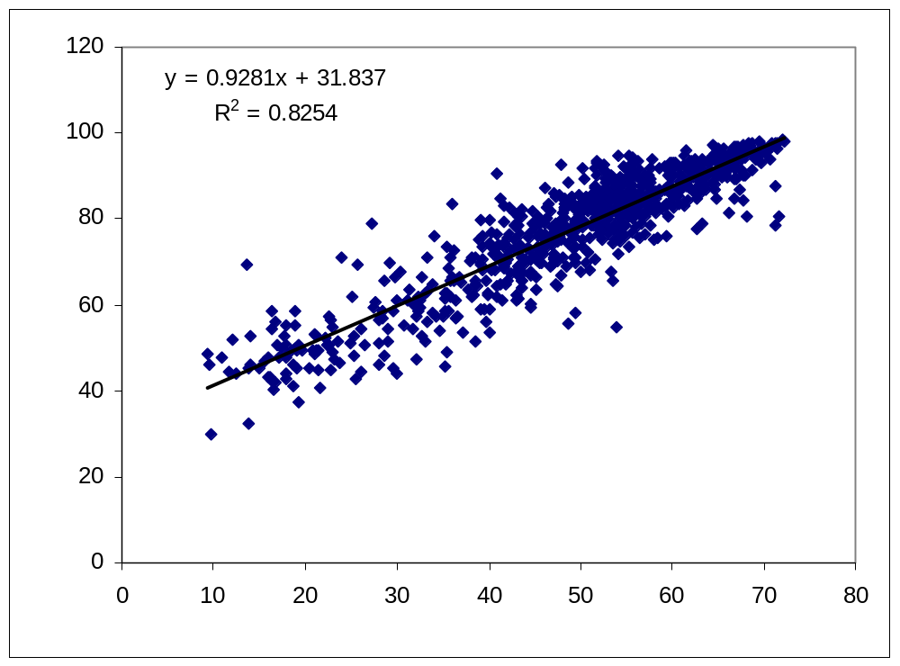
Head Rice Yield
Head Rice Yield (%) cervitec
Head Rice Yield (%) traditional

Slide 17
The Data
Direct to IRIS

Slide 18

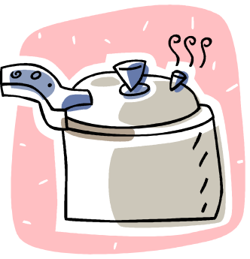


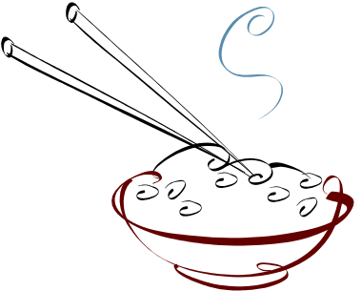
2 Eating Quality

Slide 19
Quality is Defined in Sensory Terms by Each Market

Slide 20
Mouth munches for firmness, softness springiness, stickiness, chewiness

Slide 21
There is not much in a rice grain:
Starch (~94%)
Protein (~5%)
Lipids (~1%)
But, different levels of structure affect physical and cooking properties.

Slide 22
How do we measure it?
Amylose content
Gelatinisation Temperature
Gel consistency
Viscosity

Slide 23
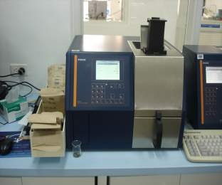
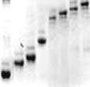
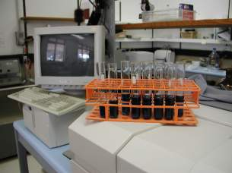
Amylose Content
Amylose Allele
20
18
19
FRR
GBSS
FRL
14
17
11
10
8
CT_{n}
Varieties of the same amylose content DO NOT always have similar cooking properties…..
Varieties of the same amylose allele often DO have similar cooking properties…..

Slide 24
Gelatinisation Temperature
The temperature at which the
starch melts irreversibly
High GT = long cooking time
= not nice rice
Low GT = short cooking time
= lovely rice

Slide 25
Melting of Starch
100
80
60
40
20

Slide 26
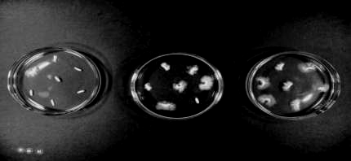
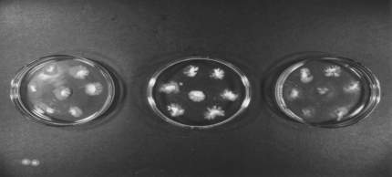
Gelatinisation Temperature
1
3
2
5
6
4
7

Slide 27
Amylose and GT don’t always say a lot....
Laos
Indonesia
Indonesia
No. rices
Amylose
Content
Gelatinisation
Temperature
20
30
30
0
20.4 ± 0.7
19.8 ± 0.8
69.5 ± 3.1
79.1 ± 2.7
79.3 ± 3.1

Slide 28
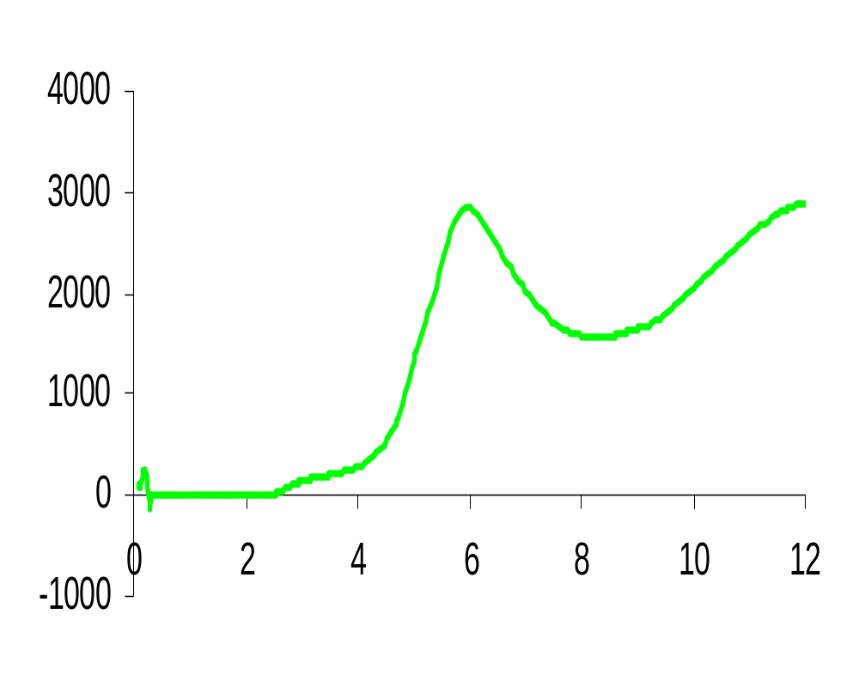
Cooking Quality by RVA
4000
PV
TV
FV
Viscosity (cP)
3000
2000
1000
0
2
4
6
8
10
12
Time (min)

Slide 29
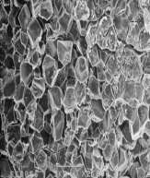
What Makes a Viscosity Curve?
Proteins hydrate and become sticky
Amylopectin melts and hydrates
Starch granules swell and amylose leaches
Amylose aggregates and forms a gel

Slide 30
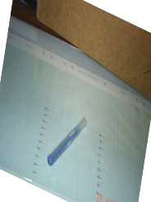
Gel Consistency
The METHOD
GC was developed to discriminated between high amylose rices with soft and firm cooking properties.
The scientific basis for its predictive ability, or its extent of prediction is not fully known.
A population to determine this.
Time (min)
Flour (100 mg)
1
+ 0.2 ml ETOH
2
+ 2.0 ml 0.2N KOH
+ thymol blue
10
Boil
30
Cool with ice
31
Lie flat on graph paper
91
Read migration of gel = GC

Slide 31
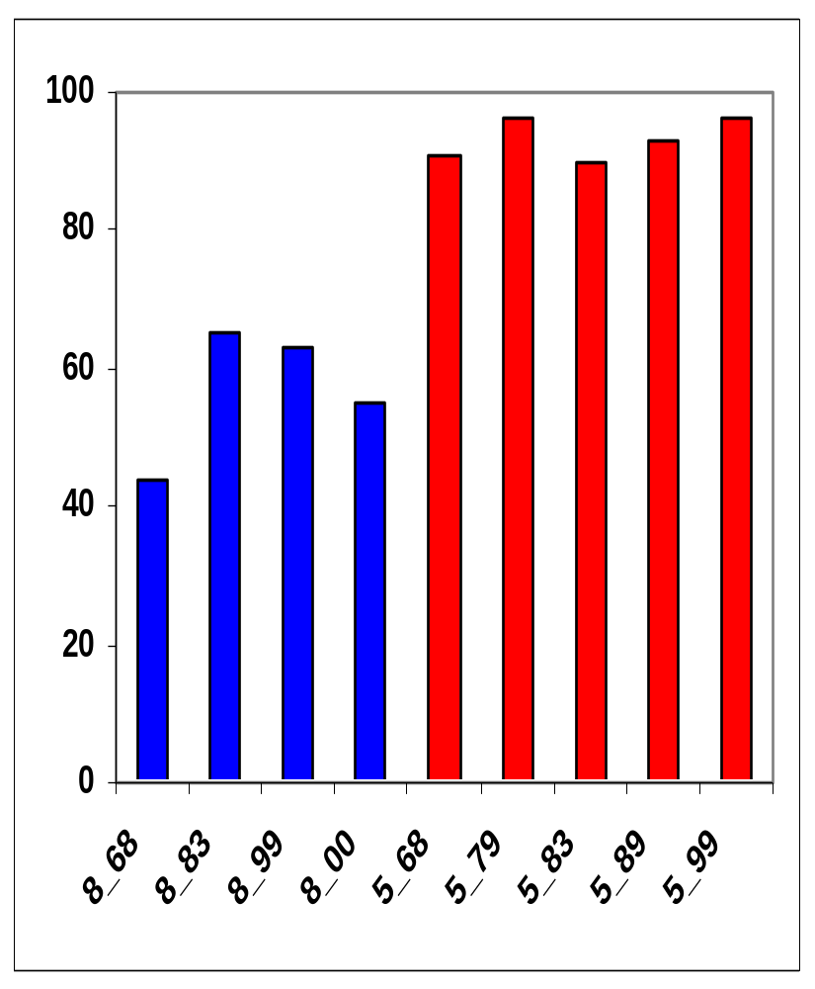
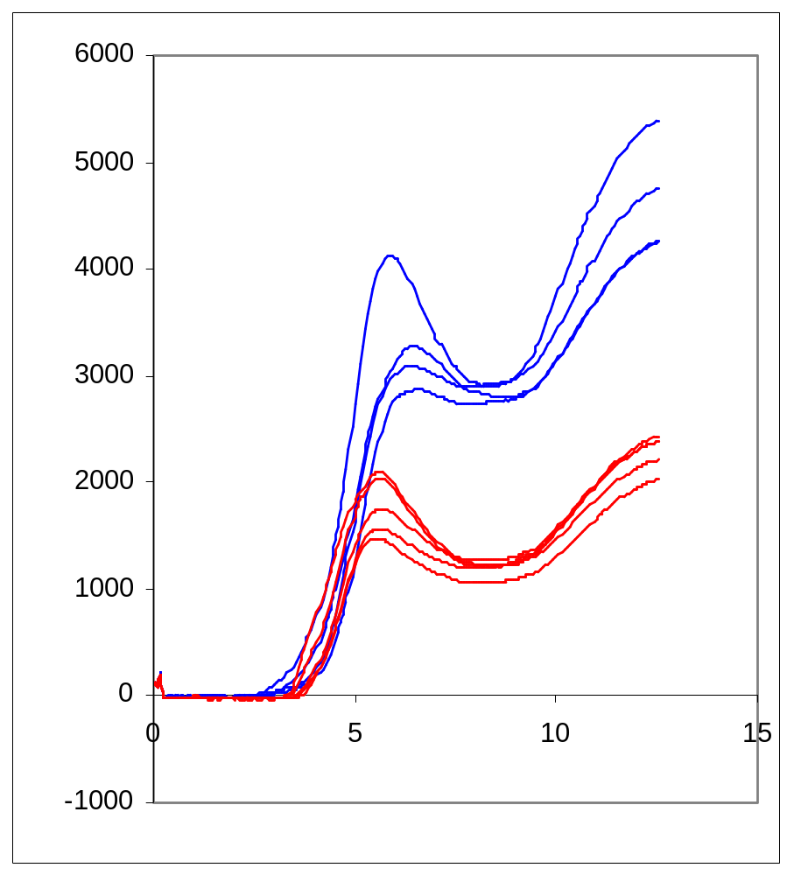
What is GC? – IR5 and IR8 – 29%am
Migration of gel (mm)

Slide 32
What is GC? – IR5 and IR8 – 29%am
Think of gelatinised starch as a collection of different lengths of mobile polymer...
As the polymer chains (amylose) entangle with each other and with protein, and embed, they form a gel. Does that gel get harder on cooling?

Slide 33
Let us revise…..
Amylose is measured with iodine and does not always predict quality.
Gelatinisation temperature is measured with alkali spreading value and is an important character, but again does not explain quality always.
Gel consistency is a fast method and gives some information about the texture of the cooked rice.
RVA traces of breeding lines compared with standards give data on cooking properties.
Infratec measures amylose, protein, moisture and lipids

Slide 34
Exercises – In the lab…. 4 groups
1
2 groups compare chalk values by eye with chalk values by the instrument.
2
2 groups do gel consistency and try to associate with amylose allele (data provided)
3
Eat the parents of the GC experiment freshly cooked and retrograded and discuss texture and the GC method.
ENJOY!!!!

