Slide 1
Hybrid Rice Breeding & Seed Production
FANGMING XIE
International Rice Research Institute
DAPO BOX 7777
Metro Manila, Philippines
f.xie@cgiar.org

Slide 2
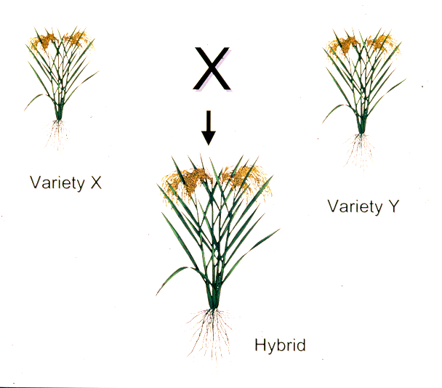
What is Hybrid Rice?
The first generation offspring of a rice cross between two genetically diverse parents

Slide 3
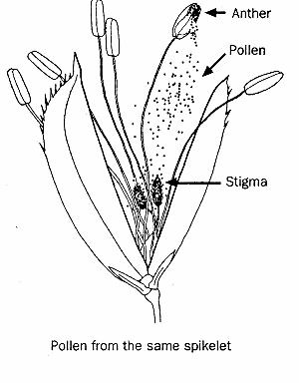
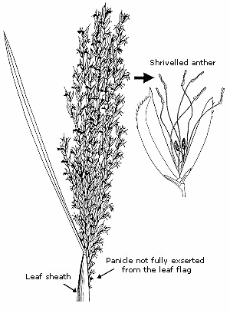
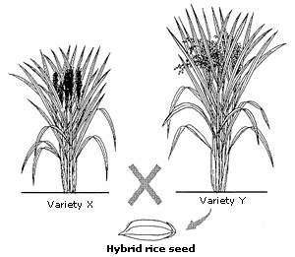
How Hybrid Rice?
Normal Rice Spikelet
(self pollinated crop)
Sterile Rice Spikelet
(Male Sterility)
Hybrid Seed Production
(Male Sterile x Normal Rice)

Slide 4
Why Hybrid Rice?
Heterosis (Hybrid vigor) Application to Increase:
  Productivity (yield/unit/time, 15-20% of yield advantage), and
  Economic returns
Heterosis
  A universal phenomenon that F1 generation shows superiority to both parents in agronomic traits or yield
  It presents in all biological systems and has been exploited commercially in many agricultural crops.

Slide 5
How to Measure heterosis?
Mid-Parent (MP) heterosis
(F1 performs better than mean of two parents):
F1-MP
MP
X100
Better Parent (BP) heterosis
(F1 performs better than better parent):
F1-BP
BP
X100
Standard heterosis*
(F1 performs better than the check variety):
F1-CK
CK
X100
* Standard heterosis is the most useful term in commercial crop production

Slide 6
Male Sterility Systems in Rice
Male sterility: a condition in which the pollen grain is unviable or cannot germinate and fertilize normally to set seeds.
Male Sterility Systems (genetic and non-genetic):
  Cytoplasmic genetic male sterility (CMS)
  Male sterility is controlled by the interaction of a genetic factor (S) present in the cytoplasm and nuclear gene (s).
  Environment-sensitive genic male sterility (EGMS)
  Male sterility system is controlled by nuclear gene expression, which is influenced by environmental factors such as temperature (TGMS), daylength (PGMS), or both (TPGMS).
  Chemically induced male sterility
  Male sterility is induced by some chemicals (gametocides)

Slide 7
Brief history of hybrid rice
1926 - Heterosis in rice reported
1964 - China started hybrid rice research
1970 - China discovered a commercially usable genetic tool for hybrid rice (male sterility in a wild rice = Wide Abortive )
1973 - PTGMS rice was found in China
1974 - First commercial three-line rice hybrid released in China
1976 - Large scale hybrid rice commercialization began in China
1979 - IRRI revived research on hybrid rice
1981 - PTGMS rice genetics and application was confirmed
1982 - Yield superiority of rice hybrids in the tropics confirmed (IRRI)
1990s - India and Vietnam started hybrid rice programs with IRRI
1991 - More than 50% of China’s riceland planted to hybrids
1994 - First commercial two-line rice hybrid released in China
1994 - 1998 - Commercial rice hybrids released in India, Philippines Vietnam

Slide 8
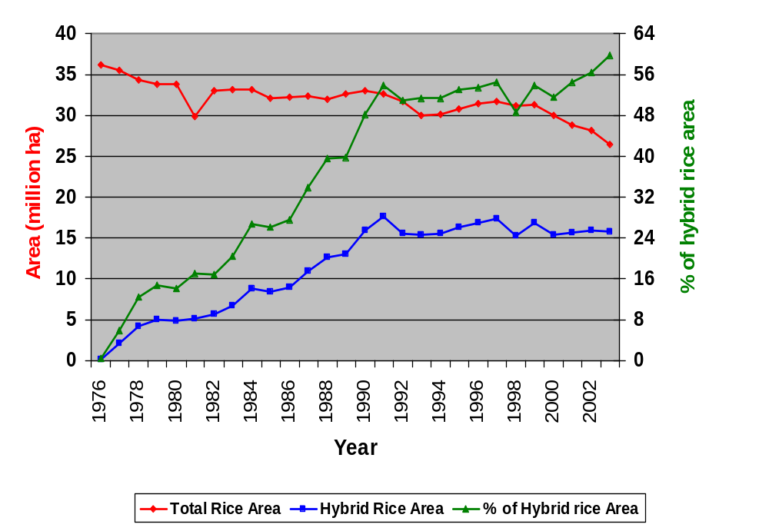
Rice and Hybrid Rice Production in China

Slide 9
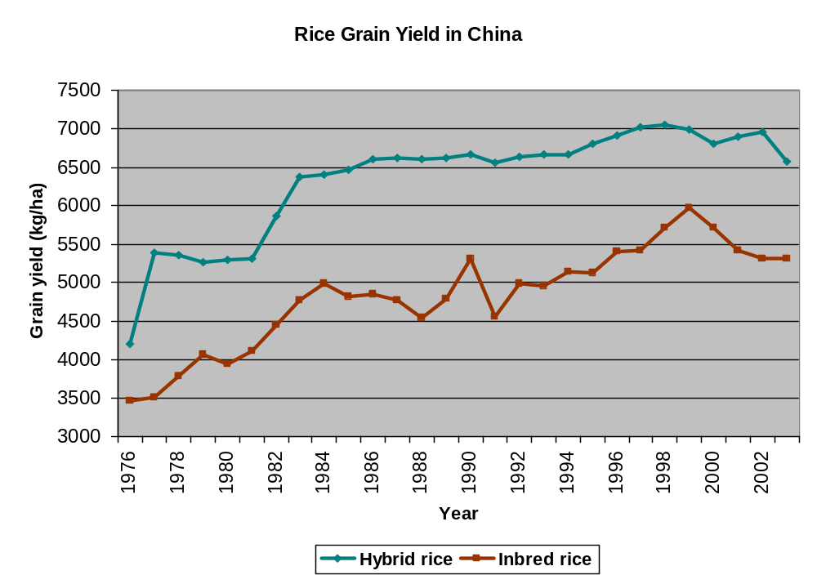
Rice Grain Yield in China

Slide 10
Hybrid Rice Area in other Asia Countries
Country | Hybrid Rice Area (1,000 ha)
 | 1997 | 2001 | 2004 | 2005 | 2006
Bangladesh |  | 15 | 50 | 90 | 150 (Exp)
India | 100 | 200 | 560 | NA
Indonesia |  |  | 10 | NA
Myanmar |  | 2 | 42 | NA
Philippines |  | 13 | 189 | 367 | 300(DS)
Vietnam | 188 | 480 | 650 | NA
Total | 288 | 710 | 1,445

Slide 11
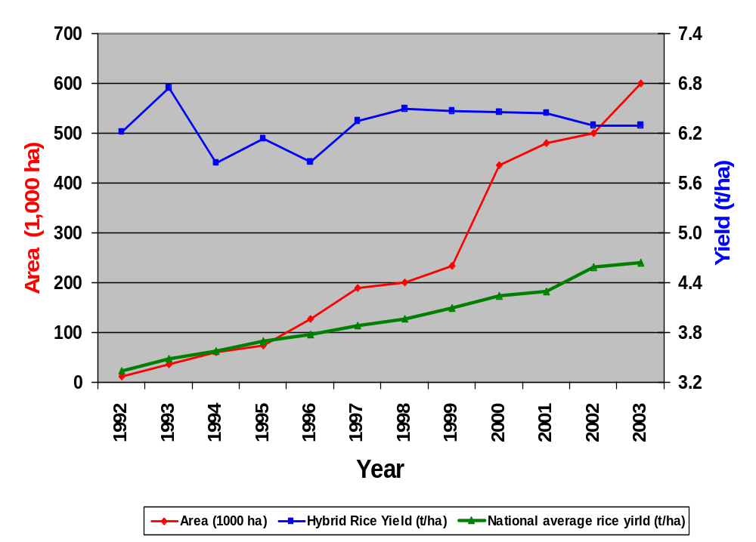
Hybrid Rice Production in Vietnam

Slide 12
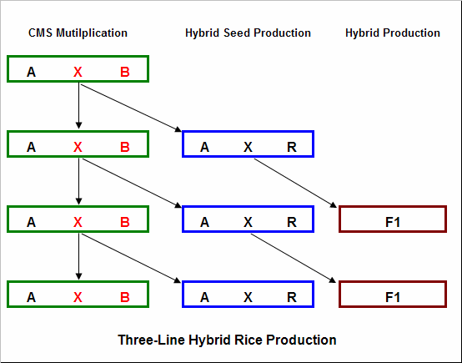
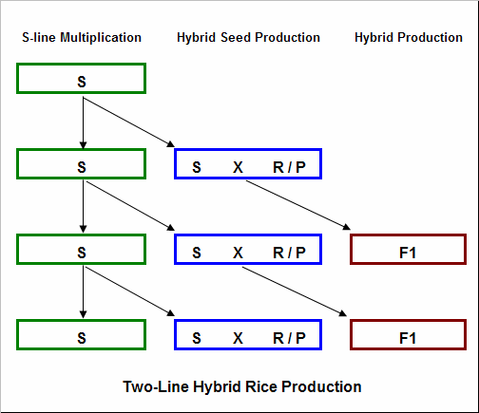
Two Commercial Systems for Hybrid Rice

Slide 13
Requirements for 3 Lines in CMS System
A-line
  Stable Sterility
  Well developed floral traits for outcrossing
  Easily, wide-spectum, & strongly to be restored
B-line
  Well developed floral traits with large pollen load
  Good combining ability
R-line
  Strong restore ability
  Good combining ability
  Taller than A-line
  Large pollen load, normal flowering traits and timing

Slide 14
TGMS and two-line hybrid
Temperature
high
Reproductive Upper Limit
Based on the discovery of P(T)GMS mutant
Male sterility controlled by 1 or 2 pairs of recessive gene(s)
Sterile
F1 Seed
Production
Critical Sterility Point
Partial Sterility
Critical Fertility Point
Fertile
S-line
Multiplication
Reproductive Lower Limit
low
Model of Sterility / Fertility Expression for TGMS Rice

Slide 15
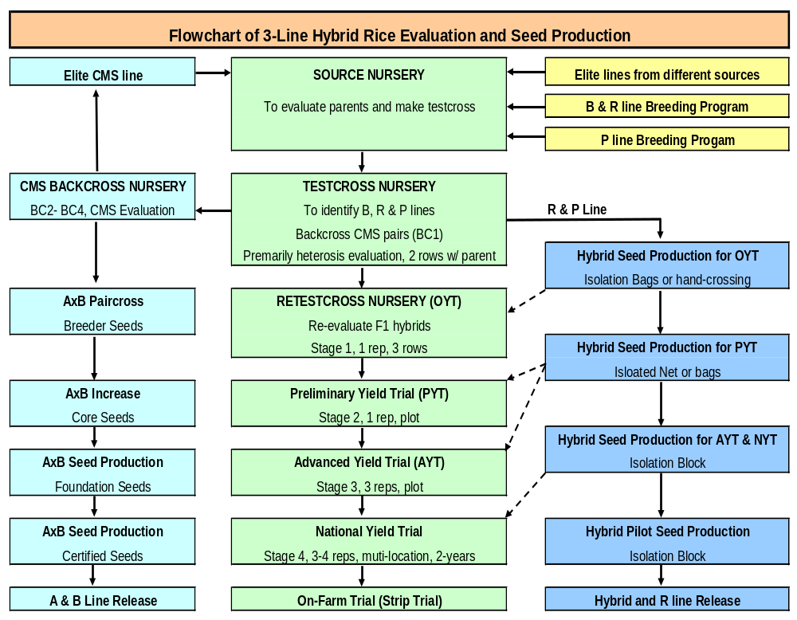

Slide 16
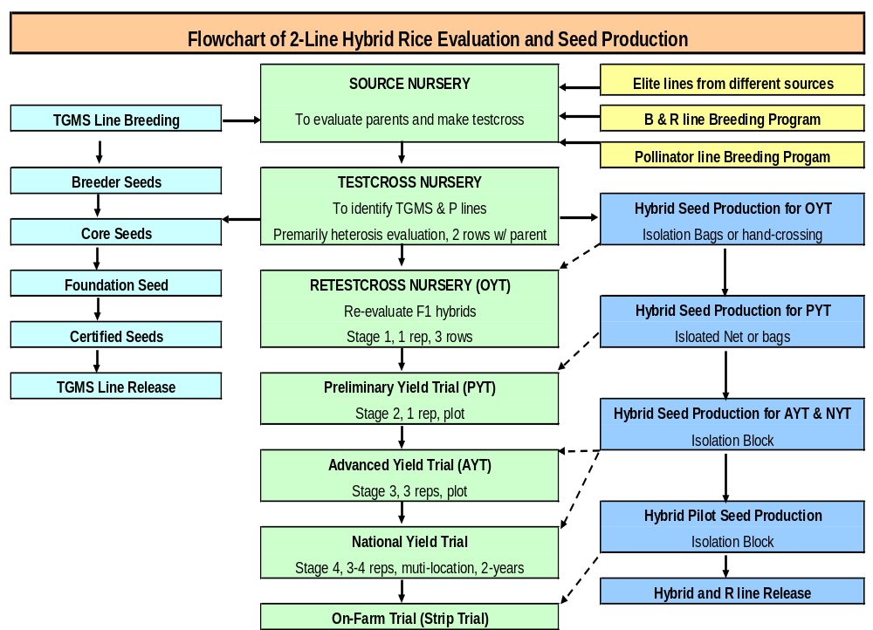

Slide 17
Advantage & Disadvantage of 3-line hybrid rice system
Advantages
  Stable male sterility
Disadvantages
  Limit germplasm source (CMS, Restorer)
  Dominant CMS cytoplasm in large area (WA)
  One more step for parental seed production
  Time consuming of CMS breeding

Slide 18
Advantage & Disadvantage of 2-line hybrid rice system
Advantages
  Simplified procedure of hybrid seed production
  Multiple and diverse germplasm available as parents
    Any line could be bred as female
    97% (2-line) vs 5% (3-line) of germplasm as male
  Increased chance of developing desirable & heterotic hybrids
  Multiple cytoplasm courses as female parents
Disadvantages
  Environmental effect on sterility could cause seed purity problem

Slide 19
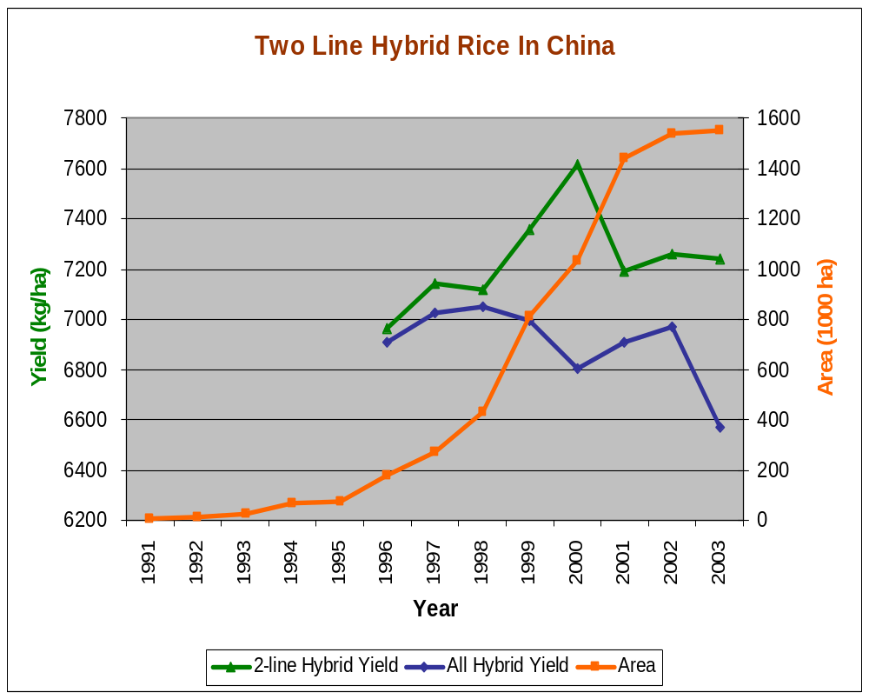
Two-line hybrid production in China

Slide 20
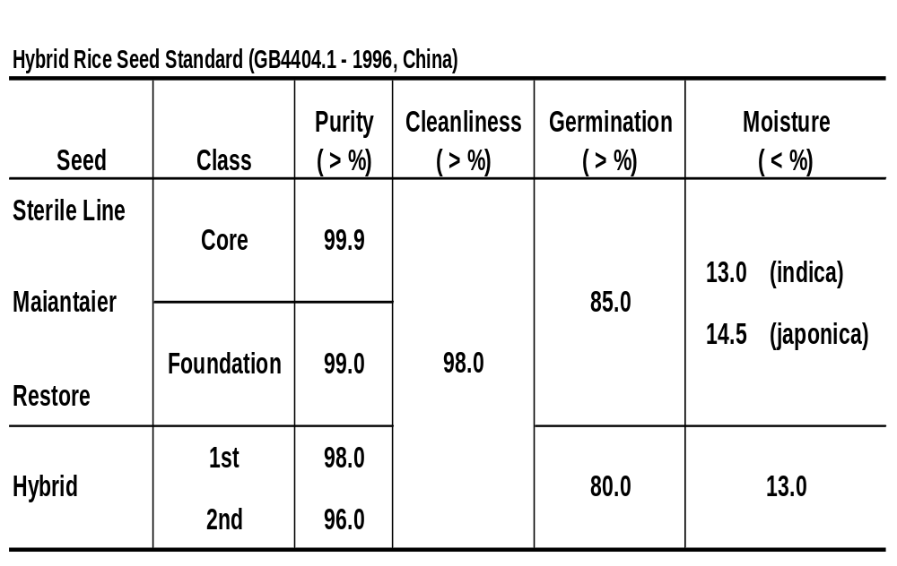
Hybrid Rice Seed Standard

Slide 21
Mission of IRRI Hybrid Rice Program
Developing germplasm, parents and hybrids as internationally public goods
Research new technology for breeding and seed production
Collaboration with NARS and private sectors in hybrid rice research and production
Promotion of exchange of information, technology, scientist and germplasm

Slide 22
Strategy of IRRI Hybrid Rice Program
Focusing on conventional tools and integrate them with proven non-conventional methods to develop the technology
Developing parental lines, especially female parents with high outcrossing and high quality, to promote hybrid rice spreading
Facilitating development of close partnership between public and private sectors in national programs
Intensifying agronomic research to get maximized manifestation of heterosis in hybrids

Slide 23
Release of IRRI Hybrids in Different Countries (1994-2005)
IRRI Hybrid | Released as | Country | Year released
IR64610H | MGR-1 | India | 1994
IR64611H | KRH-1 | India | 1994
IR64616H | Magat | Philippines | 1994
IR65489H | DRRH-1 | India | 1996
IR68284H | Mestizo 1 | Philippines | 1997
IR69690H | Sahyadri | India | 1998
IR69690H | HYT-57 | Vietnam | 1999
IR69690H | BRRI Dhan Hybrid 1 | Bangladesh | 2001
IR69690H | Rokan | Indonesia | 2002
IR75207H | Mestizo 2 | Philippines | 2002
IR75217H | Mestizo 3 | Philippines | 2002
IR78386H | Mestizo 7 | Philippines | 2005

Slide 24
Release of Hybrids by using IRRI Germplasm in Different Countries (1994-2004)
Hybrids released by NARS using IRRI-bred CMS lines
Hybrids derived from IRRI-bred parental lines and commercialized by private sector
Hybrid name | Country | Year released
APHR-1 | India | 1994
APHR-2 | India | 1994
CNRH-3 | India | 1995
KRH-2 | India | 1996
Pant Sankar Dhan-1 | India | 1997
ADTRH-1 | India | 1998
CORH-2 | India | 1998
Narendra Sankar Dhan-2 | India | 1998
Rokan | Indonesia | 2002
Maro | Indonesia | 2002
Hipa 3 | Indonesia | 2004
Hipa 4 | Indonesia | 2004
Hybrid name | Country | Year released
Biganti | Philippines | 2004
Intani 1 | Indonesia | 2001
Intani 2 | Indonesia | 2001
PHB-71 | India | 1997
Proagro 6201 | India | 2000
HR 120 (6444) | India | 2001

Slide 25
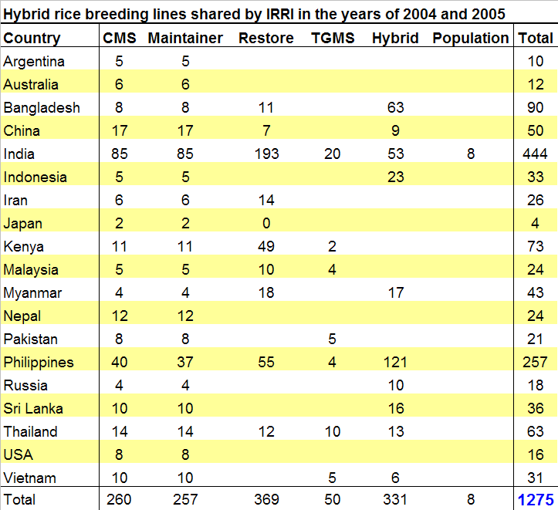
Germplasm Shared

Slide 26
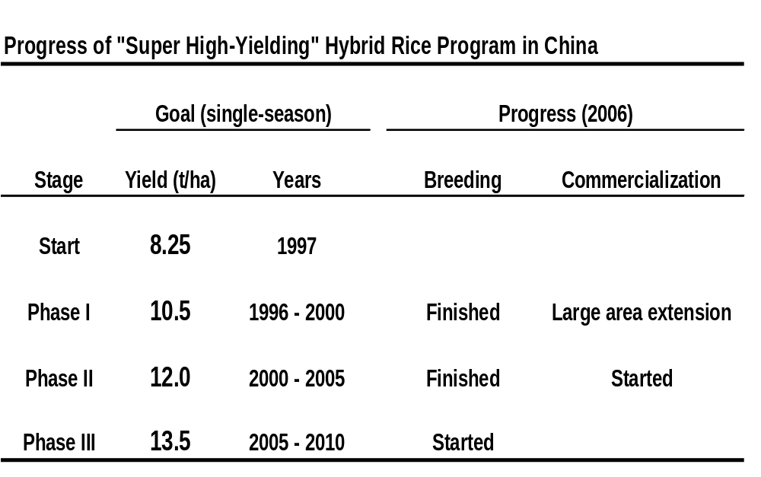
“Super high-yielding” hybrid rice breeding in China

Slide 27
Morphological Model of Super High-yielding Hybrid Rice
Plant height = 100 cm, with culm length = 70 cm
Uppermost three leaves:
  Flag leaf, long, 50 cm, higher than the panicle top 20 cm. The 2nd leaf from the top: 10% longer than the flag leaf, and over the top of the panicle. The 3rd leaf = the middle position of the panicle
  Erect: the leaf angles of the flag, 2nd and 3rd leaves are around 5, 10, 20 degrees, till mature
  Narrow, V-shape and thick: narrow with 2 cm when flattened.
Plant type: moderate compact with moderate tillering capacity; drooping panicles after filled, above ground ~ 60 cm, erect-leaved canopy without appearance of the panicles
Panicle weight and number: grain weight per panicle = 5 g, 2.7 million panicles per hectare.
Leaf area index (LAI) and ratio of leaf area to grains: the LAI is ~ 6.5 based on the uppermost three leaves, the ratio of leaf area to grain weight is 100 : 2.2-2.3, meaning that to produce 2.2-2.3 grams of rice, 100 cm2 of the upper three functional leaves are needed.
Harvest index > 0.55

Slide 28
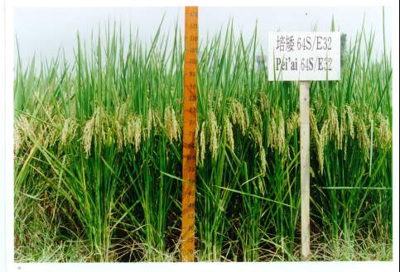
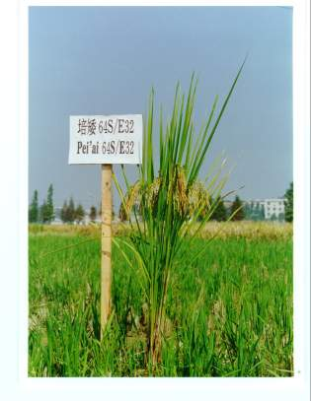
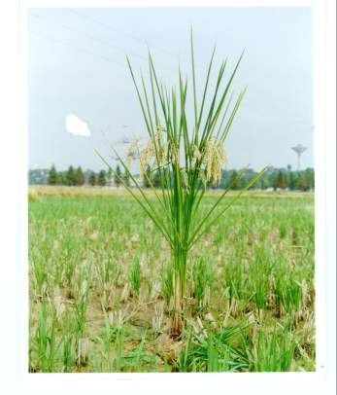

Slide 29
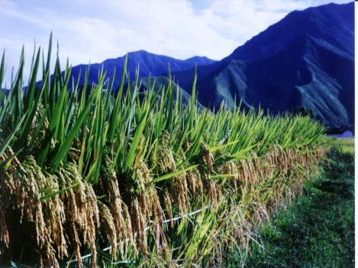
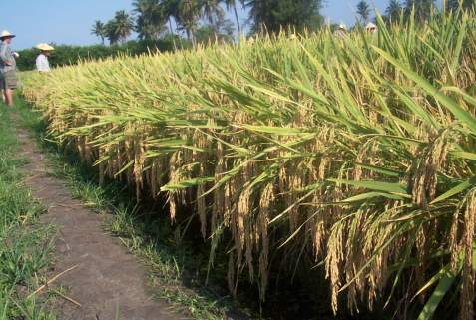
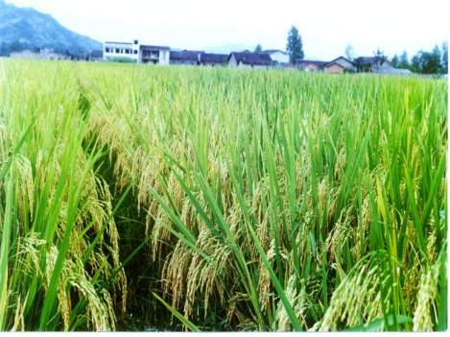
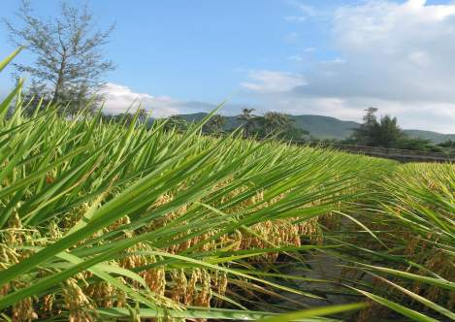

Slide 30
Hybrid Heterosis in Rice
Indica x japonica
Indica x javanica
japonica x javanica
indica x indica
japonica x japonica

Slide 31
Inter-subspecific hybrid rice breeding
Difficult in breeding inter-subspecific hybrid rice
  Low seed set
  Tall plant height
  Poor grain-filling
  Late maturity
  Grain quality market
Solution for breeding of inter-subspecific hybrid rice
  wide compatibility (WC) genes
  allelic dwarf gene
  indica/javanica hybrids in indica rice growing region
  japonica/javanica hybrids in japonica rice growing

Slide 32
Future Opportunity: Enhance yield heterosis
Exploiting subspecies heterosis
Applying biotechnology for parent selection (heterotic groups and/or heterotic gene blocks
Enhanced yield heterosis in indica / NPT hybrids compared to indica / indica hybrids (retestcross, IRRI, 2004WS)
Hybrid | # of heterotic hybrids | Total # of hybrids | % of heterotic hybrids | Yield advantage (%) over best inbred check
 |  |  |  | Range | Mean
indica / indica | 34 | 85 | 40 | 1-80 | 29
Indica / NPT | 20 | 40 | 50 | 6-131 | 42

Slide 33
Future Opportunity:
Increase yield of hybrid seed production
Performance of hybrid seed production in tropical countries (2003-2004)
 | Yield (kg/ha)
Country | Mean | Range
India | 1,600 | 1,000 – 4,500
Vietnam | 2,000 | 1,500 – 3,500
Philippines | 810 (04DS) | 600 – 2,000
Bangladesh | 800 | 600 – 2,000
Indonesia | 500 | 300 – 1,600
China | 2,750 | 1,500 – 6,000
Developing high outcrossing parents
  Improving seed production technology
  Training seed growers
  Selecting adequate location / season

Slide 34
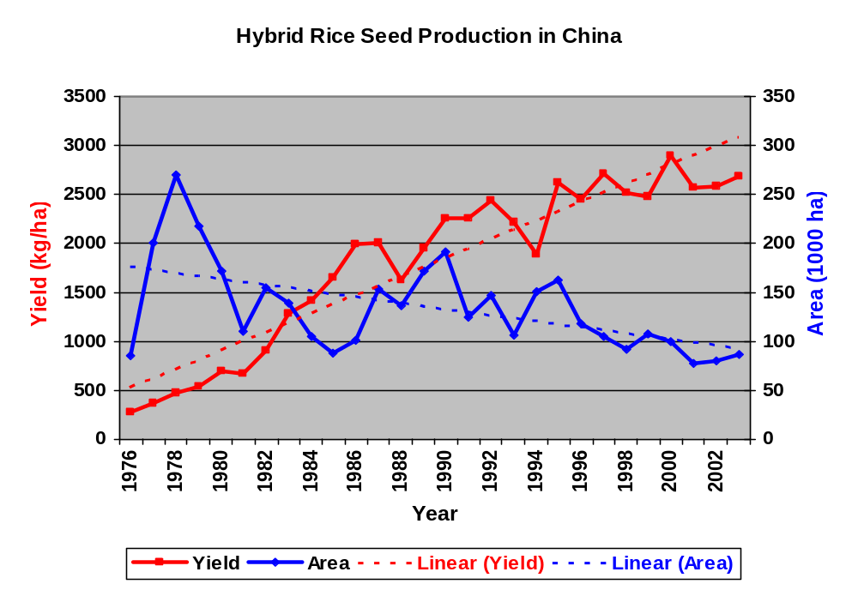
Hybrid Rice Seed Production in China

Slide 35
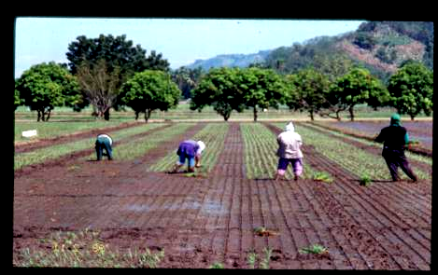
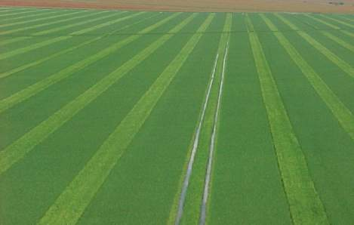
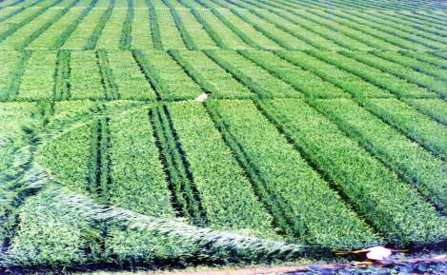
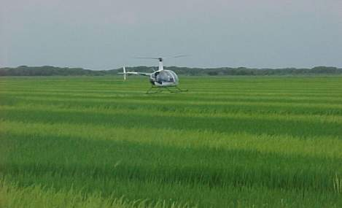
Hybrid Rice Seed Production
In Asia
In United Sates

Slide 36
Future Opportunity:
Improve hybrid rice grain quality
Measurements of Rice Grain Quality:
Milling yield
    Total milling yield
    Whole milling yield
Chalk
Amylose content
Gel Temperature (ASV)
Length, width, L/W
Protein
Aroma

Slide 37
Future Opportunity:
Improve hybrid rice grain quality
Rice grain quality of inbreds and hybrids*
Trait | Inbred | Hybrid
Total Milling (%) | 69.1 | 68.2
Whole Milling (%) | 48.7 | 45.4
Chalk (%) | 13.5 | 20.6
Amylose (% | 19.8 | 20.6
GT | 4.3 | 5.5
Length | 6.9 | 7.1
L/W | 3.2 | 3.3
Data from National Cooperative Testing (NCT), Philippines, 2004-2005

Slide 38
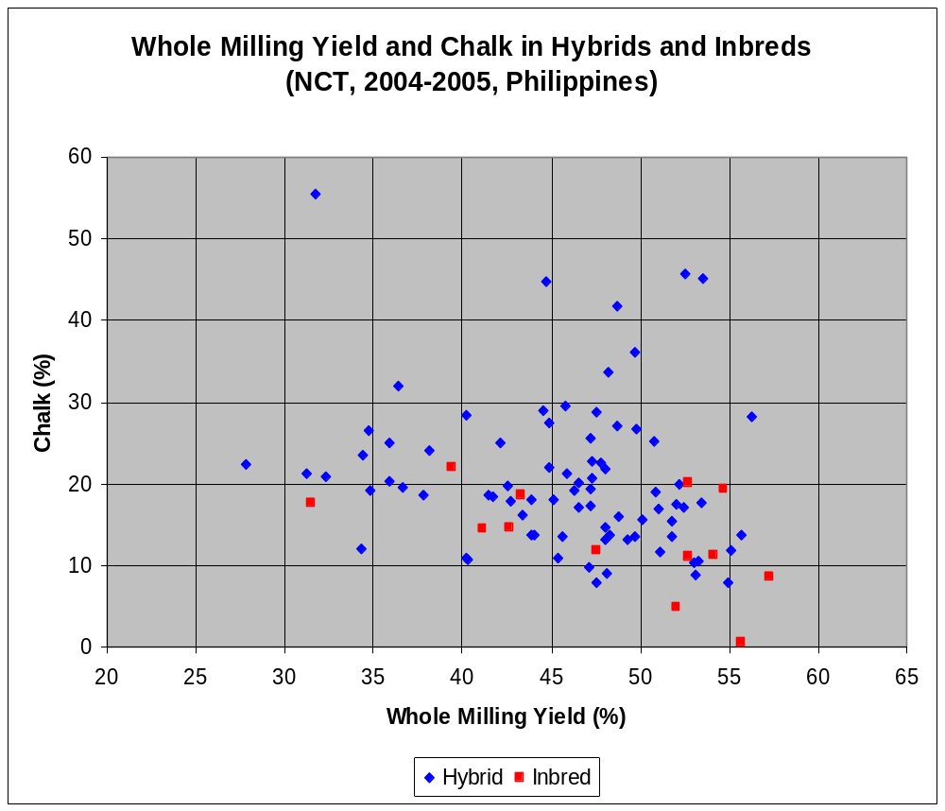
Difference of Whole Milling Yield and Chalk between Inbreds and Hybrids
Average
Whole Milling (%)
Hybrid = 45.4
Inbred = 48.7
Average Chalk (%)
Hybrid = 20.6
Inbred = 13.5

Slide 39
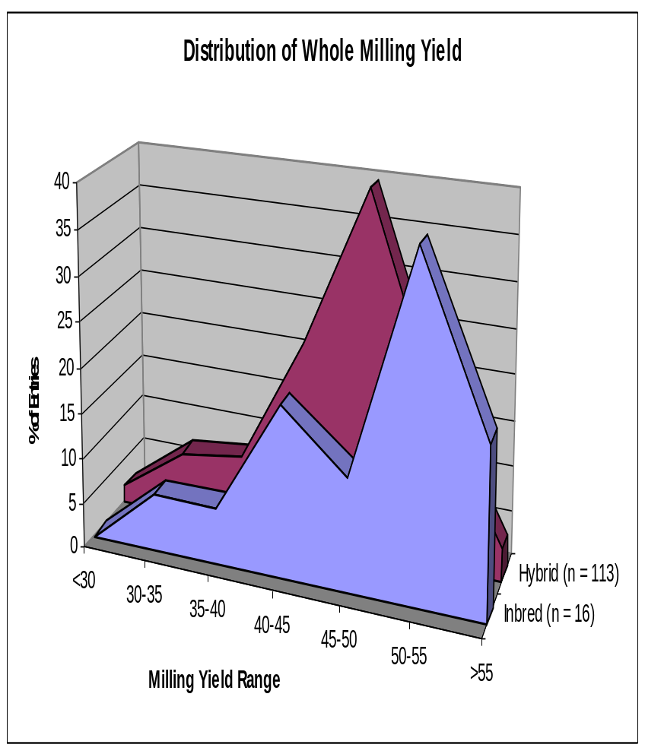
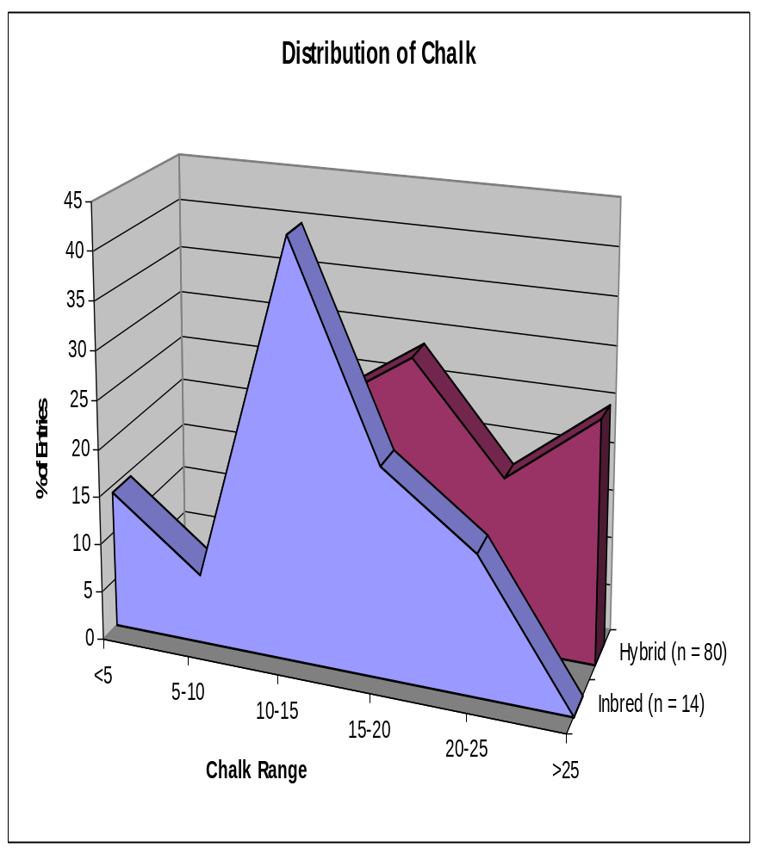
Difference of Whole Milling Yield and Chalk between Inbreds and Hybrids
Data source: 2004 and 2005 NCT, Philippines

Slide 40
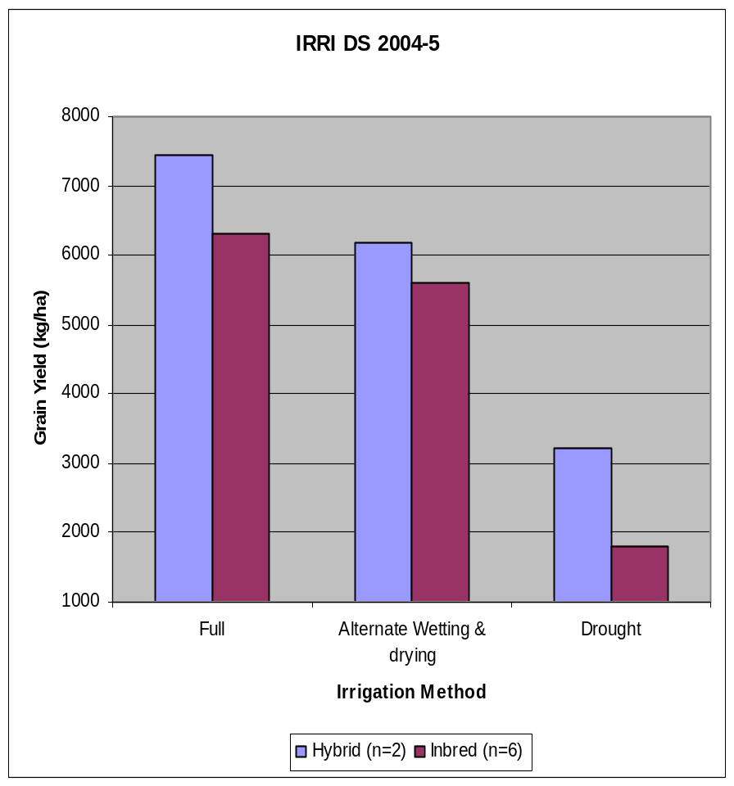
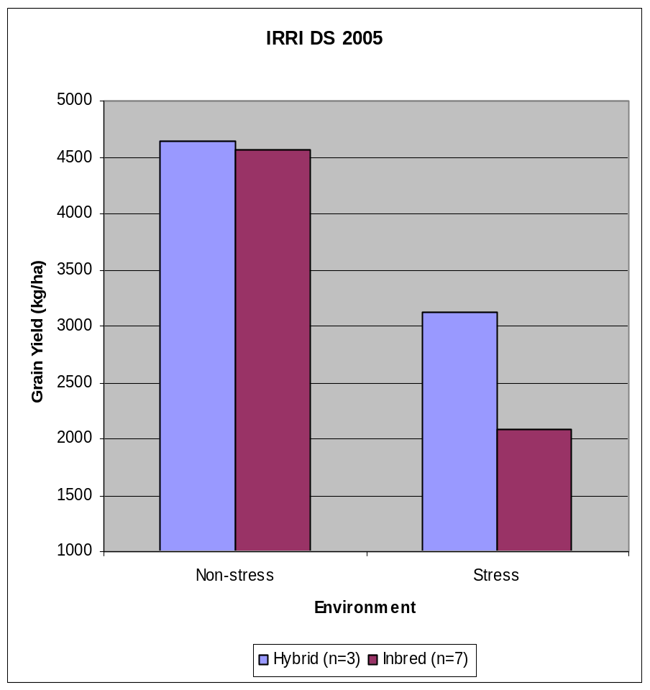
Future Opportunity:
Develop hybrids for unfavorable environments
Hybrids Have Substantially Improved Yield under Severe Lowland Stress (ca. 1 t/ha). (IRRI, G. Atlin, 2005)
18.1%
1.9%
Yield advantage
10.5%
49.8%
78.6%
100%
83%
43%
100%
67%
100%
89%
29%
46%
100%

Slide 41
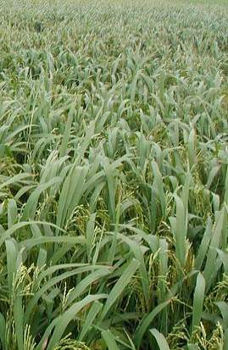
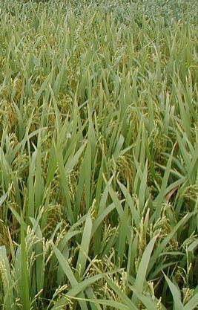
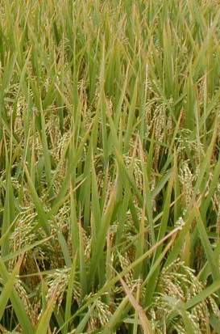
Future Opportunity:
Improve agronomic management and deployment strategy
Unhealthy
Healthy canopy
ShanYou 63 grown under different nitrogen management (S. Peng, IRRI)

