Slide 1
Planning rice breeding programs for impact
Pedigree Selection
in the IRRI Irrigated Breeding Program
Parminder S. Virk
PBGB Division

Slide 2

Can anyone define “pedigree”?
Notes:
Question to check everyone fully understands “pedigree” in the same way + create interest for the topic

Slide 3

Learning objectives
Describe the pedigree method
Describe naming of pedigree at IRRI
Describe crosses at IRRI
Describe types of crosses
Demonstrate IRRI nurseries

Slide 4
Pedigree Method
→The pedigree method owes its name to the pedigree record of selected plants maintained to trace ancestral relationship among such plants
A detailed description of present day pedigree method was outlined by Love (1927)

Slide 5
Pedigree Method
In this method individual plants are selected starting with F₂ and in the subsequent segregating generations their progenies are tested till the progenies become homozygous.
During entire operation a record of all parent-offspring relationship is kept: PEDIGREE RECORD
In this method each progeny in every generation can be traced back to the original F₂ plant
Pedigree describes parents, grandparents,
great-grandparents,...

Slide 6

How is the naming of pedigree at IRRI?
Based on cross number and serial numbers of selected plants
    →IR numbers are assigned consecutively to the crosses (now IR80389) made at IRRI just before the hybrid seeds are incubated for germination
    →When plant selections are made from F₂ and subsequent generations of an IR cross, numerical designations are given for each breeding line

Slide 7
Example:
IR2061-214-3-8-2 (IR28)
Selections from the F₂ were grown in the pedigree nursery as F₃ rows: IR2061-1, ------IR2061-214 -----and so on up to IR2061-806
From selection 214, three plants were grown as F₄ selections:
IR2061-214-1, IR2061-214-2 and IR2061-214-3
From selection IR2061-214-3, 10 plants were again selected as F₅ rows
These selections were designated as IR2061-214-3-1 up to 2061-214-3-10
From selection IR2061-214-3-8, three plant selections were made and planted in the pedigree nursery as F₆ rows IR2061-214-3-8-1, IR2061-214-3-8-2 and IR2061-214-3-8-3
At maturity selection IR2061-214-3-8-2 appeared uniform and was bulk harvested and evaluated in replicated trials

Slide 8
How is the naming of pedigree in your country/institute?
Notes:
Participants share their system of naming with the group

Slide 9
Procedure
What are the breeding objectives?
High Yield Potential
Short Growth Duration
Superior Grain Quality
Multiple disease and insect resistance
Choice of Parents?

Slide 10
Donors for various traits
(Hybridization Block)
→Staggered sown 3 times each season
→at 2-weeks interval
IRRI Varieties are donors in various programs as
  Irrigated
  Rainfed
  Flood prone and
  Hybrid rice

Slide 11
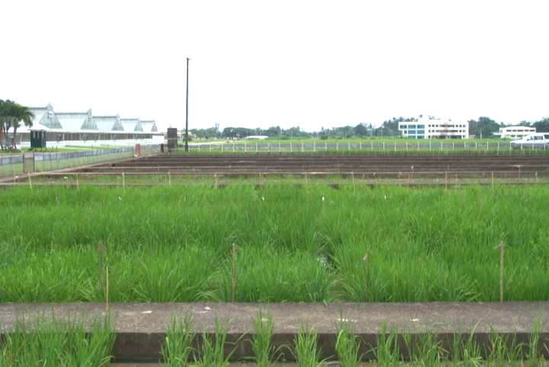
Hybridization Block
Notes:
HB: Hybridization Block

Slide 12
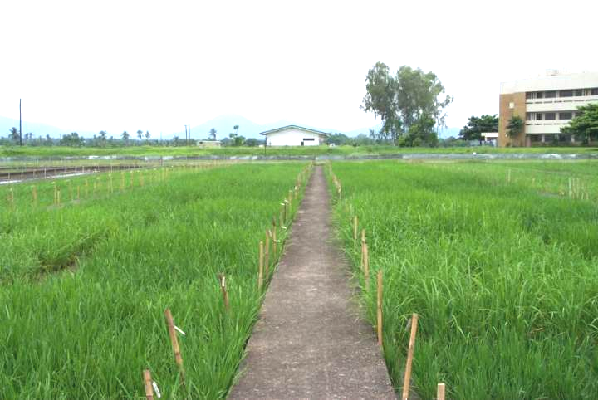
Hybridization Block

Slide 13
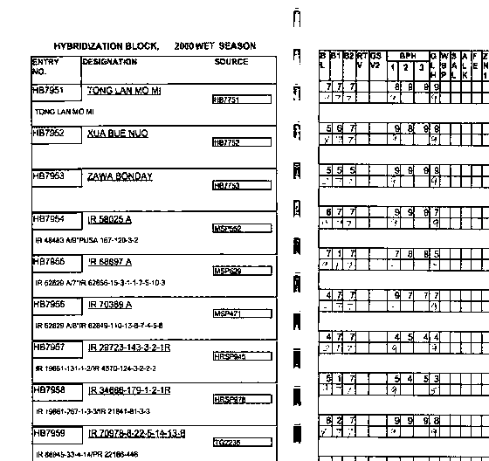
Field Book

Slide 14
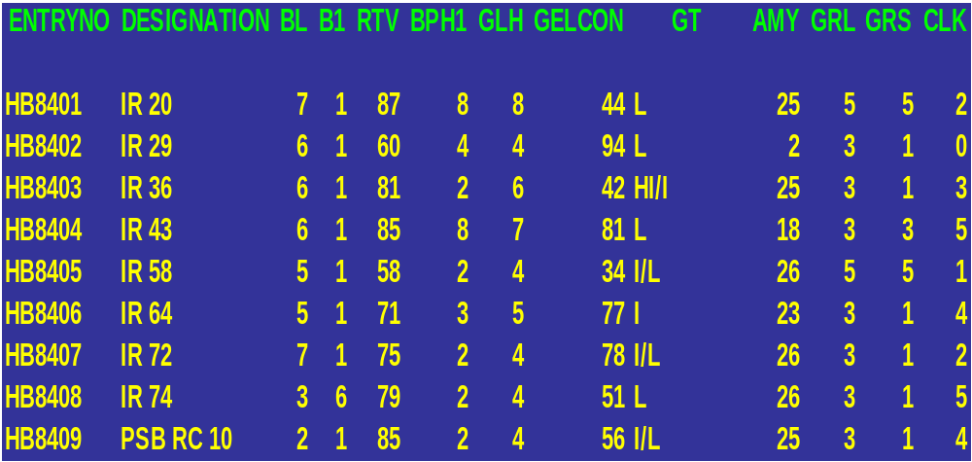
Electronic Field Book
Summary of HBs

Slide 15
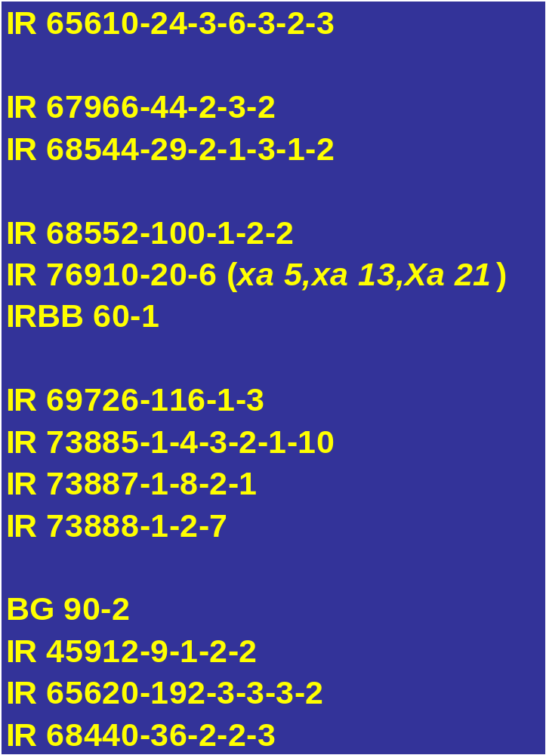
Selected Donors

Slide 16
Planning Crosses!

Slide 17
Further improvement in
Indica germplasm
→ For Yield, grain quality and incorporation of resistance to diseases and insects
Released varieties x Elite Indica Lines
Elite Indica Lines x Elite Indica Lines
Elite Indica Lines x Basmati Type Lines

Slide 18
Developing
Basmati Type Germplasm
Basmati x Elite Indica Lines
Basmati x Basmati Type Derivatives
Basmati Type Derivatives x
Basmati Type Derivatives

Slide 19
Improving Tropical Japonicas for temperate regions (Korea)
Tropical Japonica x Tropical Japonica crosses
Tropical Japonica x Korean Varieties

Slide 20
Further Improvement in NPTs
→ For Yield, grain quality and incorporation of resistance to diseases and insects
  Improved NPTs x Improved NPTs
  Improved NPTs x Released Indica Varieties
  Improved NPTs x Elite Indica Varieties
Notes:
NPT= New Plant Type

Slide 21
What crosses do you currently focus on in your institute?

Slide 22
F1 Nursery
Types of crosses:
    Single crosses
    Backcrosses
    Three way/Top crosses
→Around 900 crosses yearly (wet & dry season)
Cross designation (IR80369)

Slide 23
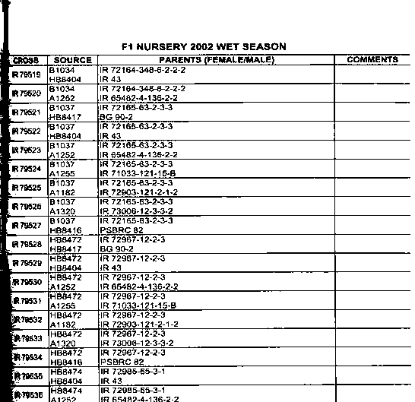

Slide 24
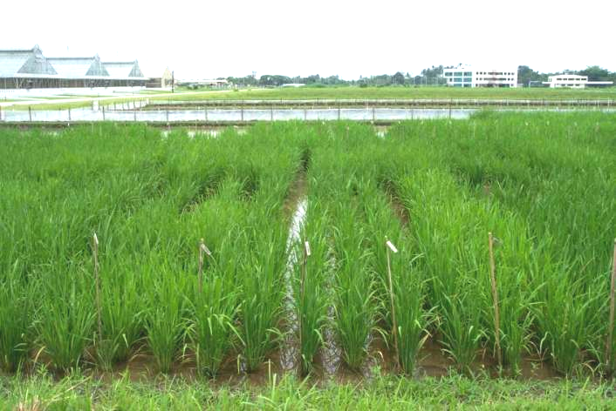
F1

Slide 25
Field Operations
Grow 2-6 rows (30 Plants) /cross
Rouge off-types
Identify accidental selfs

Slide 26
F2 Nursery
Protected:
In general susceptible to diseases and insects
Unprotected:
In general resistant to diseases and insects
    First grow in blast nursery &
    Reject Susceptible populations
    Space planted 35 x 25 cm.
    Population size from 2,500- 5,000 individuals

Slide 27
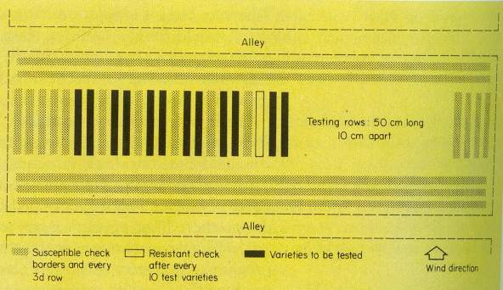
Blast Nursery

Slide 28
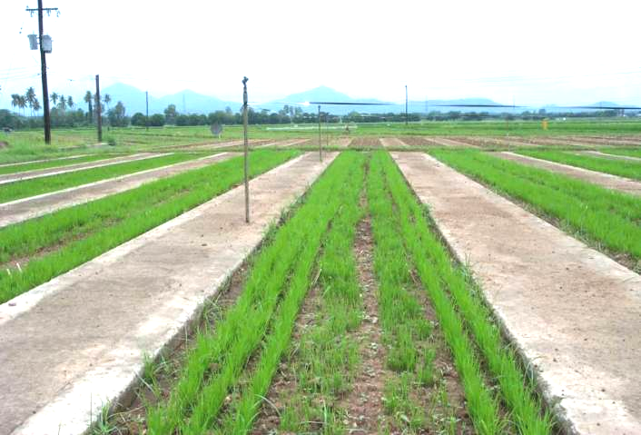
Blast Nursery

Slide 29
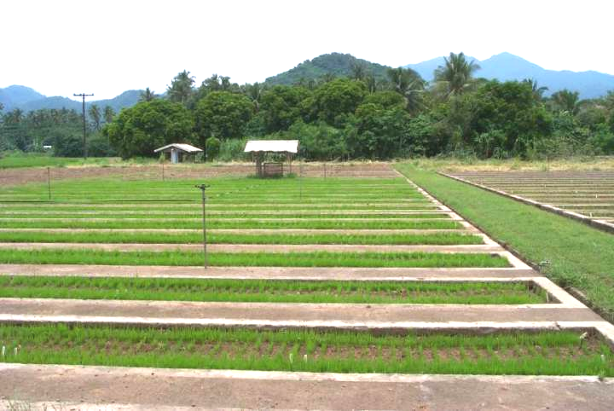
Blast Nursery

Slide 30
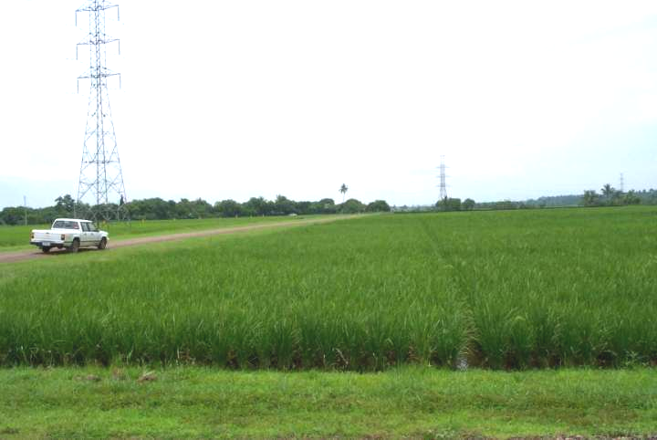
Protected F2

Slide 31
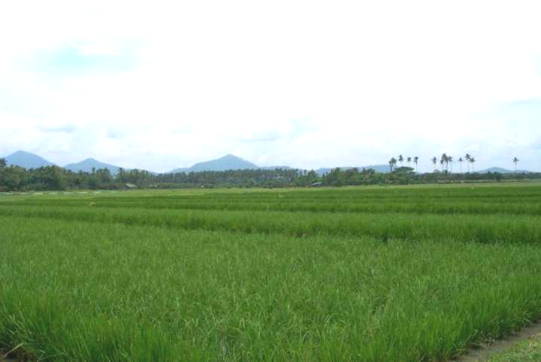
Unprotected F2

Slide 32
Field Operations
Inoculate with BB Race1/Race2
Rogue susceptible/undesirable plants
Harvest desirable plants (100-500 plants)

Slide 33
Pedigree nursery
Four nurseries/year:
    January & July (Unprotected)
    May & November (Protected)
→ Space planted 30 x 20 cm
→ Every 20th row is a check variety (4 Checks)
→ 16,000 to 20,000 rows (30 plants)
What system do you have in your institute?

Slide 34
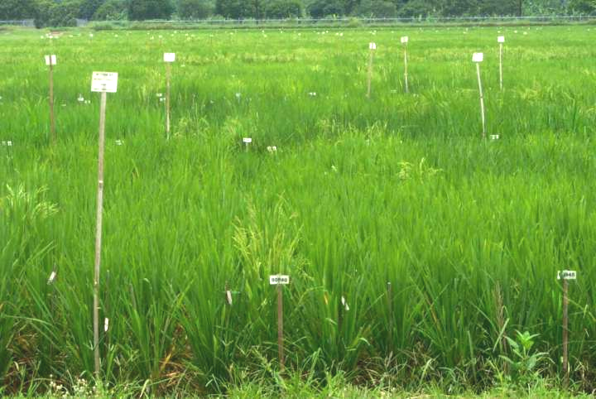
Pedigree Nursery in May

Slide 35
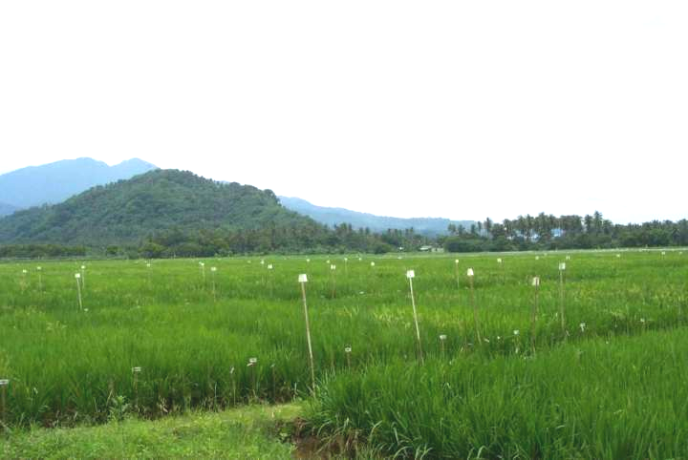
Pedigree Nursery in May

Slide 36
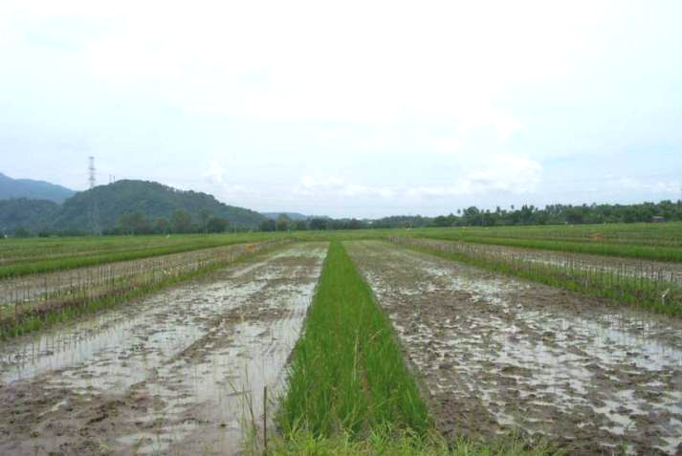
Pedigree Nursery in July

Slide 37
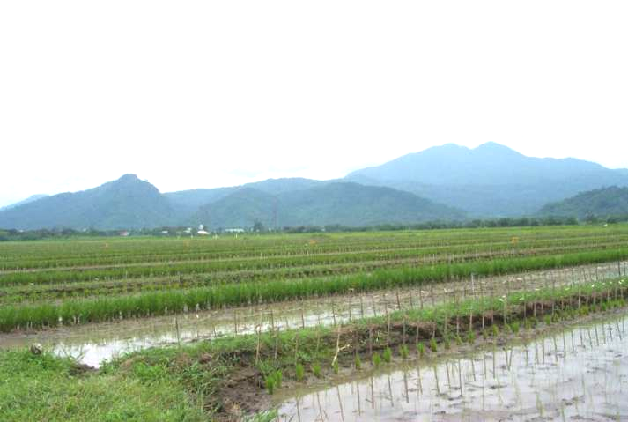
Pedigree Nursery in July

Slide 38
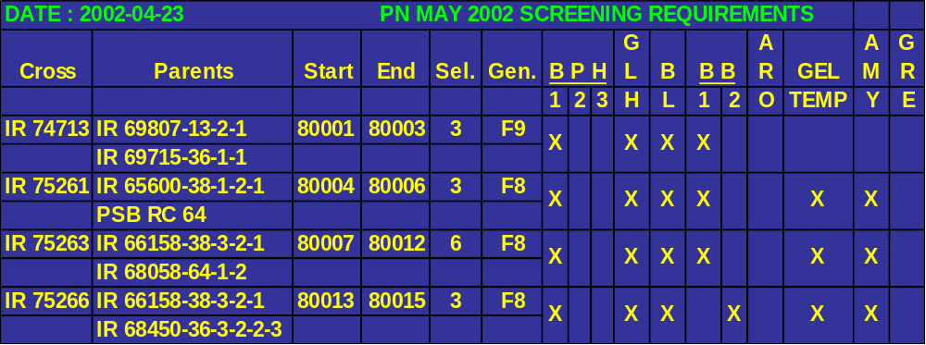
Screening requirements
Memo

Slide 39
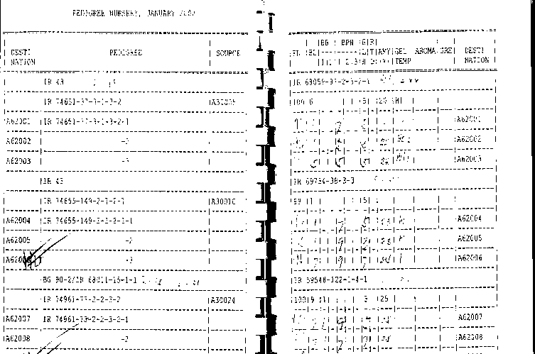
Field Book

Slide 40
F3 single rows
F4 onwards 3/6 rows
Selection between rows/within rows- at least 3 plants.

Slide 41
17811 Progeny Rows
Composition of 2004 NOV PN
Gen | Cross type | No. |  | Gen | Cross type | No.
F3 | I/I/I | 4 |  | F5 | I/I | 5
 | IND/IND | 18 |  |  | I/I/I | 2
 | IND/WH | 3 |  |  | I/J/I | 18
 | JAP/BAS/ARO | 4 |  |  | J/I | 6
 | JAP/I/I | 1 |  |  | J/J | 3
 | Jap/Korean | 10 |  |  | Micronutrient | 21
 | NPT/IND | 19 |  | F6 | I/I | 17
 | NPT/JAP/IND | 3 |  |  | NPT/I | 32
F4 | I/I | 11 |  |  | NPT/NPT | 17
 | I/I/I | 1 |  |  | J/I/I | 18
 | I/J | 31 |  |  | Micronutrient | 40
 | NPT/BAS | 6 |  | F7 | I/J | 2
 | NPT/I/I | 5 |  |  | Micronutrient | 20
 | NPT/NPT | 14
 | NPT/NPT/I | 3

Slide 42
2004 NOV PN
Cross | Parents | Start | End | Sel. | Gen. | Type
IR 79228 | IR 72903-6-2-2-1 | 46001 | 46006 | 6 | F7 | I/J
 | IR 67966-44-2-3-2
IR 79232 | IR 72905-49-3-2-2 | 46007 | 46009 | 3 | F7 | I/J
 | IR 68552-100-1-2-2
IR 79483 | IR 71700-247-1-1-2 | 46010 | 46015 | 6 | F6 | I-NPT/NPT
 | IR 68544-29-2-1-3-1-2
IR 79484 | IR 71700-247-1-1-2 | 46016 | 46018 | 3 | F6 | I-NPT/NPT
 | IR 72225-20-3-2-3
IR 79485 | IR 71700-247-1-1-2 | 46019 | 46037 | 18 | F6 | I-NPT/NPT
 | IR 73707-45-3-2-3
IR 79487 | IR 72158-11-5-2-3 | 46038 | 46050 | 12 | F6 | I-NPT/NPT
 | IR 72225-20-3-2-3
IR 79489 | IR 72967-12-2-3 | 46051 | 46053 | 3 | F6 | I-NPT/NPT
 | IR 68544-29-2-1-3-1-2
IR 79493 | IR 67961-15-1-1 | 46054 | 46072 | 18 | F6 | NPT/NPT
 | IR 68544-29-2-1-3-1-2
IR 79494 | IR 67961-15-1-1 | 46073 | 46082 | 9 | F6 | NPT/NPT
 | IR 72225-29-1-2-1

Slide 43
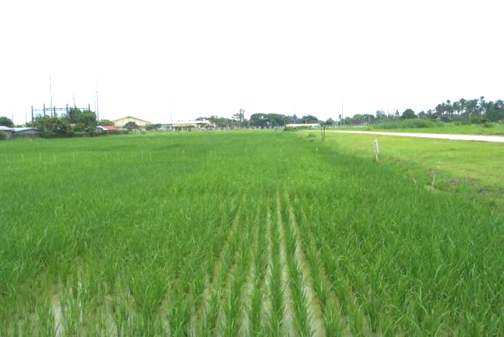
OYT
Notes:
OYT: Observational Yield Trial

Slide 44
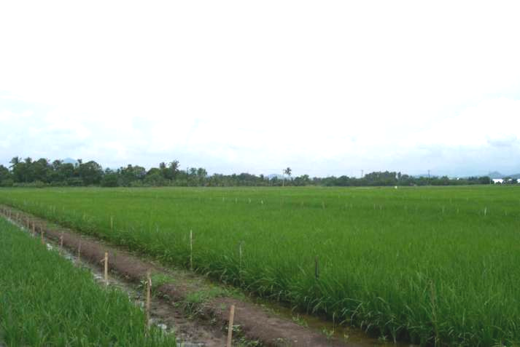
RYT
Notes:
RYT: Regular (?) Yield Trial

Slide 45
Any questions or comments?

