Slide 1

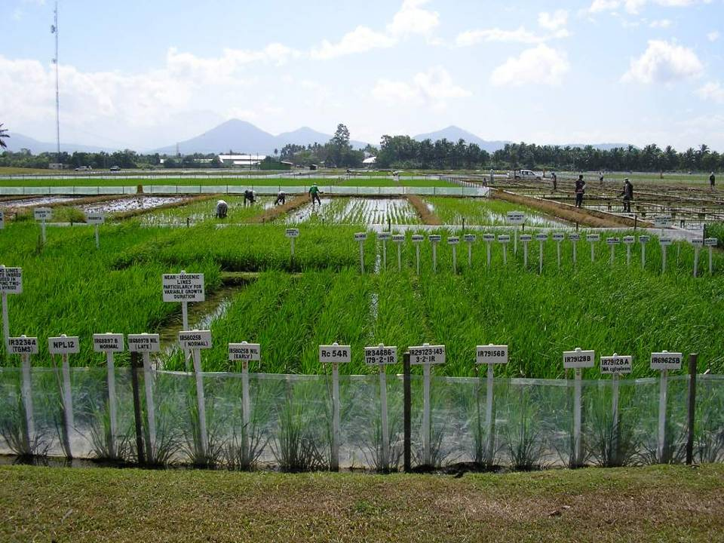
MARKER-ASSISTED BREEDING FOR RICE IMPROVEMENT
Bert Collard & David Mackill
Plant Breeding, Genetics and Biotechnology (PBGB) Division, IRRI
bcycollard@hotmail.com & d.mackill@cgiar.org

Slide 2
LECTURE OUTLINE
MARKER ASSISTED SELECTION: THEORY AND PRACTICE
MAS BREEDING SCHEMES
IRRI CASE STUDY
CURRENT STATUS OF MAS

Slide 3
SECTION 1
MARKER ASSISTED SELECTION (MAS): THEORY AND PRACTICE

Slide 4
Definition:
Marker assisted selection (MAS) refers to the use of DNA markers that are tightly-linked to target loci as a substitute for or to assist phenotypic screening
Assumption: DNA markers can reliably predict phenotype

Slide 5
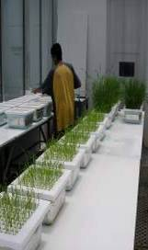
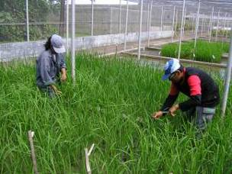
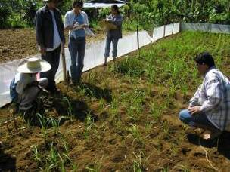
CONVENTIONAL PLANT BREEDING
P₁
x
P₂
Recipient
Donor
F₁
large populations consisting of thousands of plants
F₂
PHENOTYPIC SELECTION
Salinity screening in phytotron
Bacterial blight screening
Phosphorus deficiency plot
Glasshouse trials
Field trials

Slide 6
MARKER-ASSISTED BREEDING
P₁
x
P₂
Susceptible
Resistant
F₁
large populations consisting of thousands of plants
F₂
MARKER-ASSISTED SELECTION (MAS)
Method whereby phenotypic selection is based on DNA markers

Slide 7
Advantages of MAS
Simpler method compared to phenotypic screening
  Especially for traits with laborious screening
  May save time and resources
Selection at seedling stage
  Important for traits such as grain quality
  Can select before transplanting in rice
Increased reliability
  No environmental effects
  Can discriminate between homozygotes and heterozygotes and select single plants

Slide 8
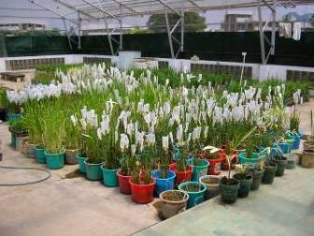
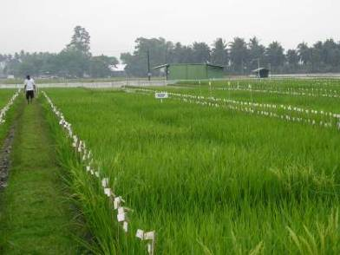
Potential benefits from MAS
more accurate and efficient selection of specific genotypes
  May lead to accelerated variety development
more efficient use of resources
  Especially field trials
Crossing house
Backcross nursery

Slide 9
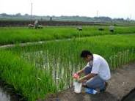
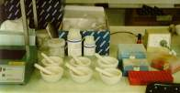
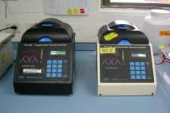
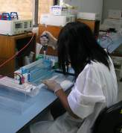
Overview of ‘marker genotyping’
(1) LEAF TISSUE SAMPLING
(2) DNA EXTRACTION
(3) PCR
(4) GEL ELECTROPHORESIS
(5) MARKER ANALYSIS

Slide 10
Considerations for using DNA markers in plant breeding
Technical methodology
  simple or complicated?
Reliability
Degree of polymorphism
DNA quality and quantity required
Cost**
Available resources
  Equipment, technical expertise

Slide 11
Markers must be tightly-linked to target loci!
Ideally markers should be <5 cM from a gene or QTL
RELIABILITY FOR SELECTION
Marker A
QTL
Using marker A only:
1 – r_{A} = ~95%
5 cM
Marker A
Marker B
Using markers A and B:
1 - 2 r_{A}r_{B} = ~99.5%
QTL
5 cM
5 cM
Using a pair of flanking markers can greatly improve reliability but increases time and cost

Slide 12

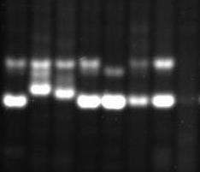
Markers must be polymorphic
RM84
RM296
1 2 3 4 5 6 7 8
1 2 3 4 5 6 7 8
P₁ P₂
P₁ P₂
Not polymorphic
Polymorphic!

Slide 13
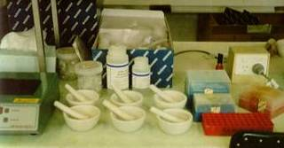
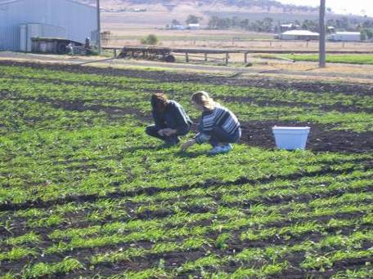


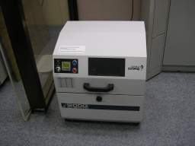
DNA extractions
Mortar and pestles
Porcelain grinding plates
LEAF SAMPLING
Wheat seedling tissue sampling in Southern Queensland, Australia.
High throughput DNA extractions “Geno-Grinder”
DNA EXTRACTIONS

Slide 14
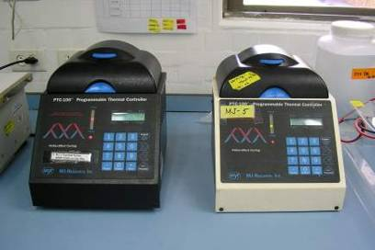
PCR-based DNA markers
Generated by using Polymerase Chain Reaction
Preferred markers due to technical simplicity and cost
PCR Buffer +
MgCl₂ +
dNTPS +
Taq +
Primers +
DNA template
PCR
THERMAL CYCLING
GEL ELECTROPHORESIS
Agarose or Acrylamide gels

Slide 15
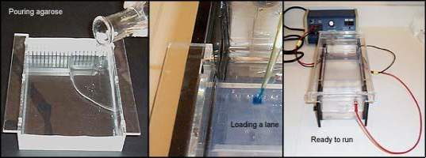
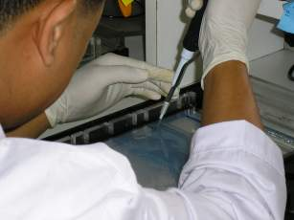
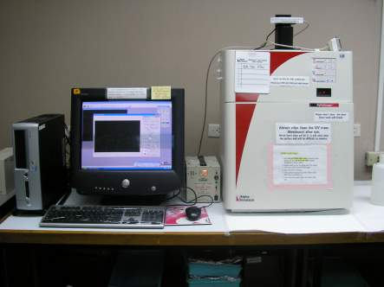
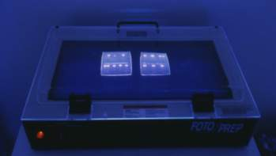
Agarose gel electrophoresis
http://arbl.cvmbs.colostate.edu/hbooks/genetics/biotech/gels/agardna.html
UV transilluminator
UV light

Slide 16
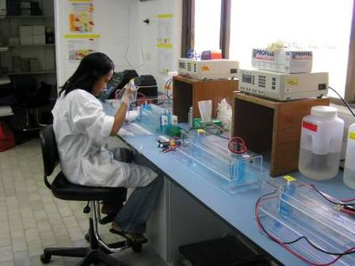
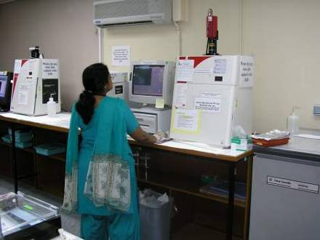

Acrylamide gel electrophoresis 1
UV transilluminator
UV light

Slide 17
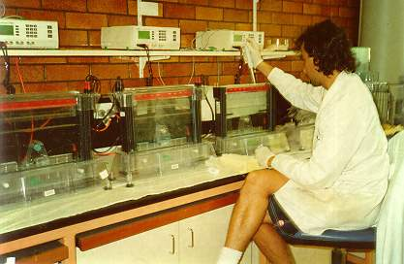
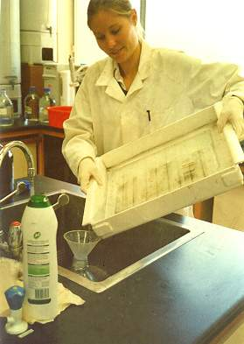
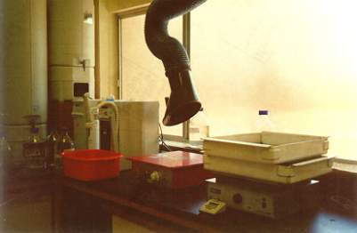
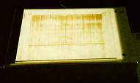
Acrylamide gel electrophoresis 2

Slide 18
SECTION 2
MAS BREEDING SCHEMES
Marker-assisted backcrossing
Pyramiding
Early generation selection
‘Combined’ approaches

Slide 19
2.1 Marker-assisted backcrossing (MAB)
MAB has several advantages over conventional backcrossing:
  Effective selection of target loci
  Minimize linkage drag
  Accelerated recovery of recurrent parent
1
2
3
4
1
2
3
4
1
2
3
4
Target locus
TARGET LOCUS SELECTION
RECOMBINANT SELECTION
BACKGROUND SELECTION
FOREGROUND SELECTION
BACKGROUND SELECTION

Slide 20
2.2 Pyramiding
Widely used for combining multiple disease resistance genes for specific races of a pathogen
Pyramiding is extremely difficult to achieve using conventional methods
  Consider: phenotyping a single plant for multiple forms of seedling resistance – almost impossible
Important to develop ‘durable’ disease resistance against different races

Slide 21
Process of combining several genes, usually from 2 different parents, together into a single genotype
Breeding plan
Genotypes
P₁
Gene A
x
P₁
Gene B
P₁: AAbb
x
P₂: aaBB
F₁
Gene A + B
F₁: AaBb
F₂
F₂ | AB | Ab | aB | ab
AB | AABB | AABb | AaBB | AaBb
Ab | AABb | AAbb | AaBb | Aabb
aB | AaBB | AaBb | aaBB | aaBb
ab | AaBb | Aabb | aaBb | aabb
MAS
Select F2 plants that have Gene A and Gene B
Hittalmani et al. (2000). Fine mapping and DNA marker-assisted pyramiding of the three major genes for blast resistance in riceTheor. Appl. Genet. 100: 1121-1128
Liu et al. (2000). Molecular marker-facilitated pyramiding of different genes for powdery mildew resistance in wheat. Plant Breeding 119: 21-24.

Slide 22
2.3 Early generation MAS
MAS conducted at F2 or F3 stage
Plants with desirable genes/QTLs are selected and alleles can be ‘fixed’ in the homozygous state
  plants with undesirable gene combinations can be discarded
Advantage for later stages of breeding program because resources can be used to focus on fewer lines
References:
Ribaut & Betran (1999). Single large-scale marker assisted selection (SLS-MAS). Mol Breeding 5: 21-24.

Slide 23
P₁
x
P₂
Susceptible
Resistant
F₁
F₂
large populations (e.g. 2000 plants)
MAS for 1 QTL – 75% elimination of (3/4) unwanted genotypes
MAS for 2 QTLs – 94% elimination of (15/16) unwanted genotypes

Slide 24
PEDIGREE METHOD
SINGLE-LARGE SCALE MARKER-ASSISTED SELECTION (SLS-MAS)
P1 x P2
P1 x P2
F1
F1
F2
Phenotypic screening
F2
MAS
Plants space-planted in rows for individual plant selection
F3
Only desirable F3 lines planted in field
F3
F4
Families grown in progeny rows for selection.
F4
Families grown in progeny rows for selection.
Pedigree selection based on local needs
F5
F5
Preliminary yield trials. Select single plants.
F6
F6
F7
Further yield trials
F7
Multi-location testing, licensing, seed increase and cultivar release
F8 – F12
Multi-location testing, licensing, seed increase and cultivar release
F8 – F12
Benefits: breeding program can be efficiently scaled down to focus on fewer lines

Slide 25
2.4 Combined approaches
In some cases, a combination of phenotypic screening and MAS approach may be useful
  To maximize genetic gain (when some QTLs have been unidentified from QTL mapping)
  Level of recombination between marker and QTL (in other words marker is not 100% accurate)
  To reduce population sizes for traits where marker genotyping is cheaper or easier than phenotypic screening

Slide 26
‘Marker-directed’ phenotyping
(Also called ‘tandem selection’)
Recurrent
Parent
P₁ (S) x P₂ (R)
Donor
Parent
Use when markers are not 100% accurate or when phenotypic screening is more expensive compared to marker genotyping
F₁ (R) x P₁ (S)
BC₁F₁ phenotypes: R and S
MARKER-ASSISTED SELECTION (MAS)
1 2 3 4 5 6 7 8 9 10 11 12 13 14 15 16 17 18 19 20 …
SAVE TIME & REDUCE COSTS
PHENOTYPIC SELECTION
*Especially for quality traits*
References:
Han et al (1997). Molecular marker-assisted selection for malting quality traits in barley. Mol Breeding 6: 427-437.

Slide 27

Any questions

Slide 28
SECTION 3
IRRI MAS CASE STUDY

Slide 29
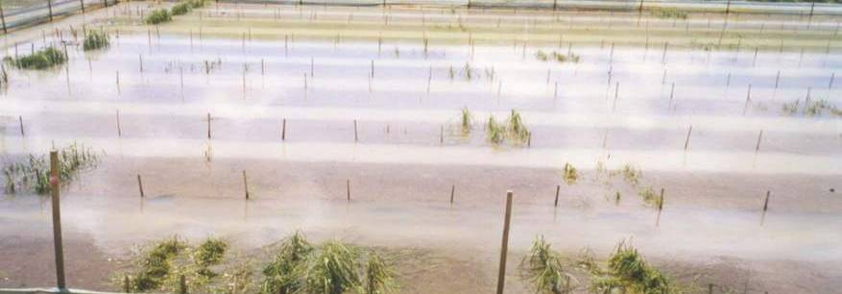
3. Marker-assisted backcrossing for submergence tolerance
Photo by Abdel Ismail
David Mackill, Reycel Mighirang-Rodrigez, Varoy Pamplona, CN Neeraja, Sigrid Heuer, Iftekhar Khandakar, Darlene Sanchez, Endang Septiningsih & Abdel Ismail

Slide 30
Abiotic stresses are major constraints to rice production in SE Asia
Rice is often grown in unfavourable environments in Asia
Major abiotic constraints include:
  Drought
  Submergence
  Salinity
  Phosphorus deficiency
High priority at IRRI
Sources of tolerance for all traits in germplasm and major QTLs and tightly-linked DNA markers have been identified for several traits

Slide 31
‘Mega varieties’
Many popular and widely-grown rice varieties - “Mega varieties”
  Extremely popular with farmers
Traditional varieties with levels of abiotic stress tolerance exist however, farmers are reluctant to use other varieties
  poor agronomic and quality characteristics
BR11 | Bangladesh
CR1009 | India
IR64 | All Asia
KDML105 | Thailand
Mahsuri | India
MTU1010 | India
RD6 | Thailand
Samba Mahsuri | India
Swarna | India, Bangladesh
1-10 Million hectares

Slide 32
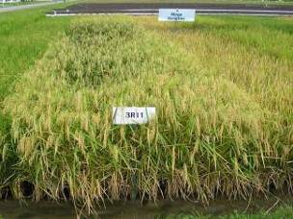
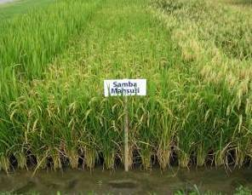
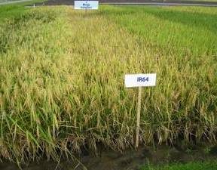
Backcrossing strategy
Adopt backcrossing strategy for incorporating genes/QTLs into ‘mega varieties’
Utilize DNA markers for backcrossing for greater efficiency – marker assisted backcrossing (MAB)

Slide 33
Conventional backcrossing
P₁
x
P₂
High yielding
Susceptible for 1 trait
Called recurrent parent (RP)
Desirable trait
e.g. disease resistance
Elite cultivar
Donor
P₁ x F₁
P₁ x BC1
Discard ~50% BC1
Visually select BC1 progeny that resemble RP
P₁ x BC2
Repeat process until BC6
P₁ x BC3
P₁ x BC4
P₁ x BC5
P₁ x BC6
Recurrent parent genome recovered
Additional backcrosses may be required due to linkage drag
BC6F2

Slide 34
MAB: 1ST LEVEL OF SELECTION – FOREGROUND SELECTION
Selection for target gene or QTL
Useful for traits that are difficult to evaluate
Also useful for recessive genes
1
2
3
4
Target locus
TARGET LOCUS SELECTION
FOREGROUND SELECTION

Slide 35
Concept of ‘linkage drag’
Large amounts of donor chromosome remain even after many backcrosses
Undesirable due to other donor genes that negatively affect agronomic performance
c
LINKED DONOR GENES
TARGET LOCUS
TARGET LOCUS
Donor/F1
BC1
BC3
BC10
RECURRENT PARENT CHROMOSOME
DONOR CHROMOSOME

Slide 36
Markers can be used to greatly minimize the amount of donor chromosome….but how?
Conventional backcrossing
c
TARGET GENE
c
F1
BC1
BC2
BC3
BC10
BC20
Marker-assisted backcrossing
c
TARGET GENE
Ribaut, J.-M. & Hoisington, D. 1998 Marker-assisted selection: new tools and strategies. Trends Plant Sci. 3, 236-239.
F1
BC1
BC2

Slide 37
MAB: 2ND LEVEL OF SELECTION - RECOMBINANT SELECTION
Use flanking markers to select recombinants between the target locus and flanking marker
Linkage drag is minimized
Require large population sizes
  depends on distance of flanking markers from target locus)
Important when donor is a traditional variety
1
2
3
4
RECOMBINANT SELECTION

Slide 38
Step 1 – select target locus
BC1
Step 2 – select recombinant on either side of target locus
OR
BC2
Step 3 – select target locus again
Step 4 – select for other recombinant on either side of target locus
*
*
OR
* Marker locus is fixed for recurrent parent (i.e. homozygous) so does not need to be selected for in BC2

Slide 39
MAB: 3RD LEVEL OF SELECTION - BACKGROUND SELECTION
Use unlinked markers to select against donor
Accelerates the recovery of the recurrent parent genome
Savings of 2, 3 or even 4 backcross generations may be possible
1
2
3
4
BACKGROUND SELECTION

Slide 40
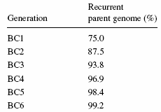
Background selection
Theoretical proportion of the recurrent parent genome is given by the formula:
2^{n+1} - 1
2^{n+1}
Where n = number of backcrosses, assuming large population sizes
Percentage of RP genome after backcrossing
Important concept: although the average percentage of the recurrent parent is 75% for BC1, some individual plants possess more or less RP than others

Slide 41
CONVENTIONAL BACKCROSSING
MARKER-ASSISTED BACKCROSSING
P₁ x P₂
P₁ x P₂
P₁ x F₁
P₁ x F₁
BC1
BC1
VISUAL SELECTION OF BC1 PLANTS THAT MOST CLOSELY RESEMBLE RECURRENT PARENT
USE ‘BACKGROUND’ MARKERS TO SELECT PLANTS THAT HAVE MOST RP MARKERS AND SMALLEST % OF DONOR GENOME
BC2
BC2

Slide 42
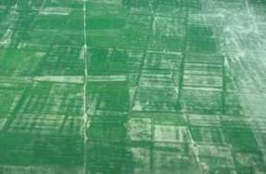
Breeding for submergence tolerance
Large areas of rainfed lowland rice have short-term submergence (eastern India to SE Asia); > 10 m ha
Even favorable areas have short-term flooding problems in some years
Distinguished from other types of flooding tolerance
  elongation ability
  anaerobic germination tolerance

Slide 43
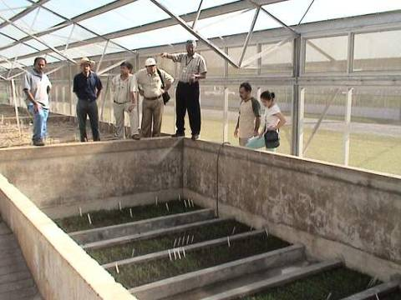
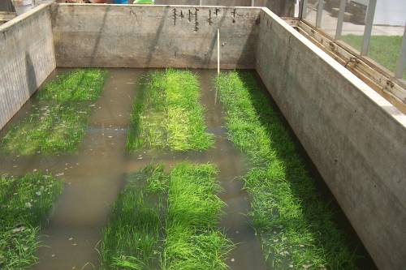
Screening for submergence tolerance

Slide 44
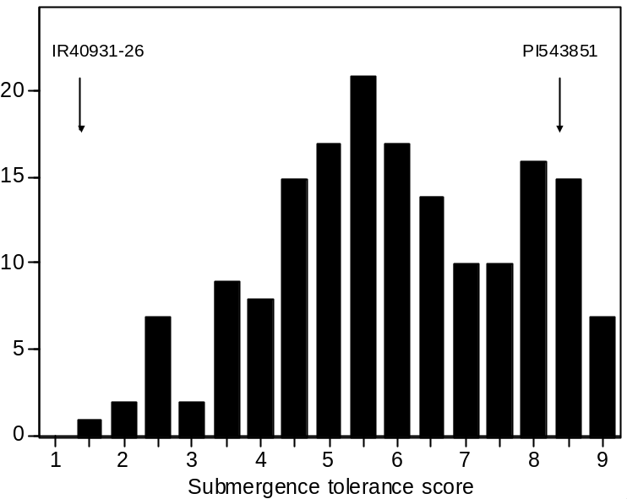
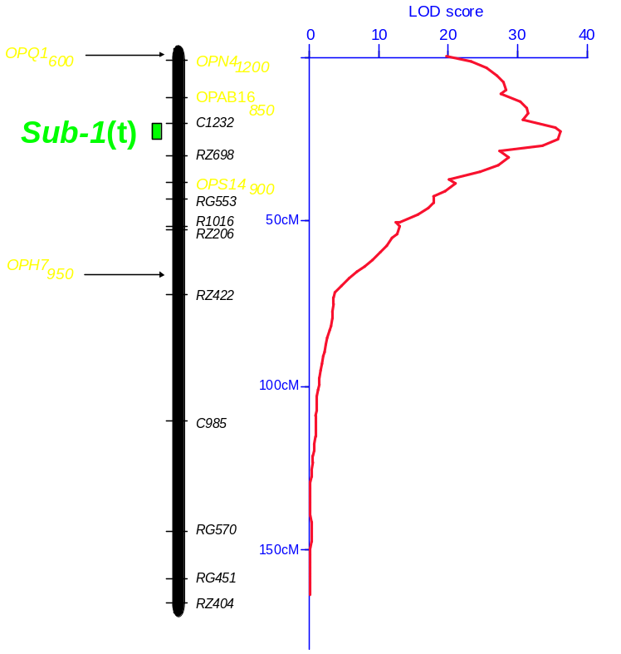
A major QTL on chrom. 9 for submergence tolerance – Sub1 QTL
Segregation in an F3 population
Xu and Mackill (1996) Mol Breed 2: 219

Slide 45


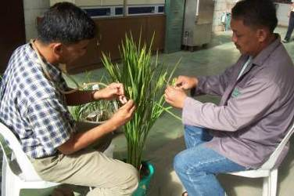


Make the backcrosses
X
Swarna
Popular variety
IR49830
Sub1 donor
F1 X
Swarna
BC1F1

Slide 46
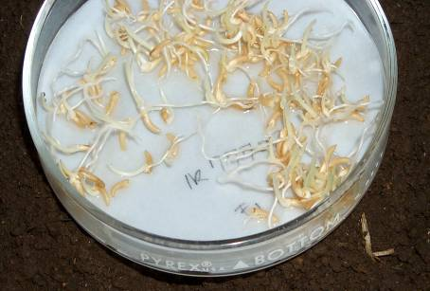
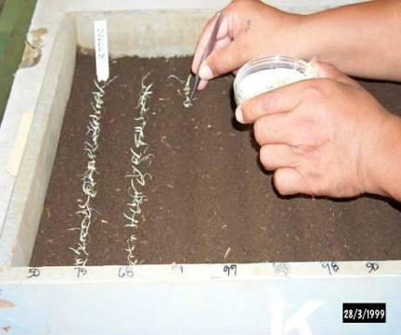
Seeding BC1F1s
Pre-germinate the F1 seeds and seed
them in the seedboxes

Slide 47
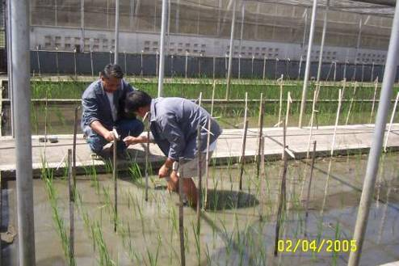
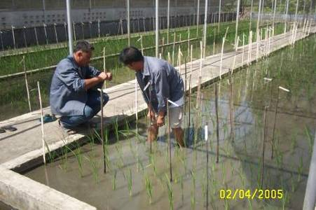
Collect the leaf samples - 10 days after transplanting for marker analysis

Slide 48
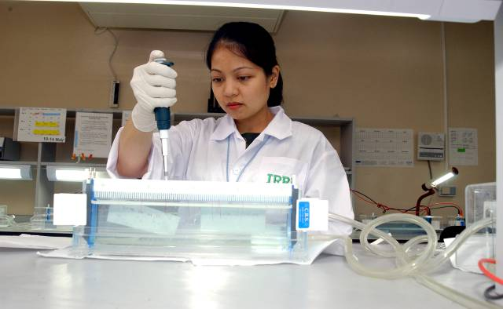
Genotyping to select the BC1F1 plants with a desired character for crosses

Slide 49
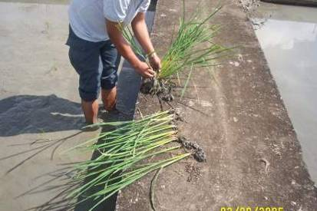
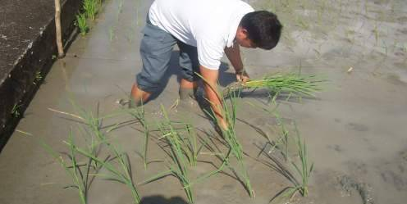
Seed increase of tolerant BC2F2 plant

Slide 50
Selection for Swarna+Sub1
Swarna/
IR49830 F1
X
Swarna
376 had Sub1
21 recombinant
Select plant with fewest donor alleles
BC1F1
697 plants
Plant #242
Swarna
X
BC2F2
937 plants
BC2F1
320 plants
Plants #246 and #81
158 had Sub1
5 recombinant
Swarna
Plant #227
X
Plant 237
BC2F2
1 plant Sub1 with
2 donor segments
BC3F1
18 plants

Slide 51
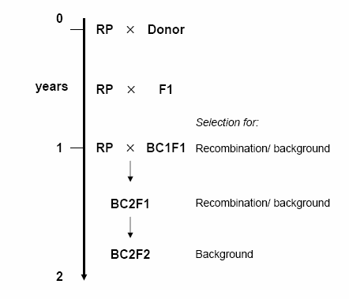
Time frame for “enhancing” mega-varieties
Name of process: “variety enhancement” (by D. Mackill)
Process also called “line conversion” (Ribaut et al. 2002)
May need to continue until BC3F2
Mackill et al 2006. QTLs in rice breeding: examples for abiotic stresses. Paper presented at the Fifth International Rice Genetics Symposium.
Ribaut et al. 2002. Ribaut, J.-M., C. Jiang & D. Hoisington, 2002. Simulation experiments on efficiencies of gene introgression by backcrossing. Crop Sci 42: 557–565.

Slide 52
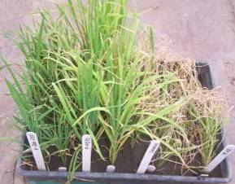
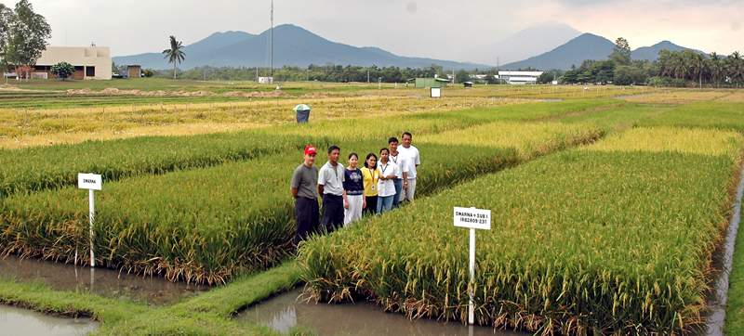
Swarna with Sub1

Slide 53
Graphical genotype of Swarna-Sub1
BC3F2 line
Approximately 2.9 MB of donor DNA

Slide 54


Swarna | 246-237
Percent chalky grains
Chalk(0-10%)=84.9 Chalk(10-25%)=9.1 Chalk(25-50%)=3.5 Chalk(>75%)=2.1 | Chalk(0-10%)=93.3 Chalk(10-25%)=2.3 Chalk(25-50%)=3.7 Chalk(>75%)=0.8
Average length=0.2mm | Average length=0.2mm
Average width=2.3mm | Average width=2.2mm
Amylose content (%)=25 Gel temperature=HI/I Gel consistency=98 | Amylose content (%)=25 Gel temperature=I Gel consistency=92

Slide 55
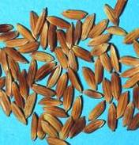
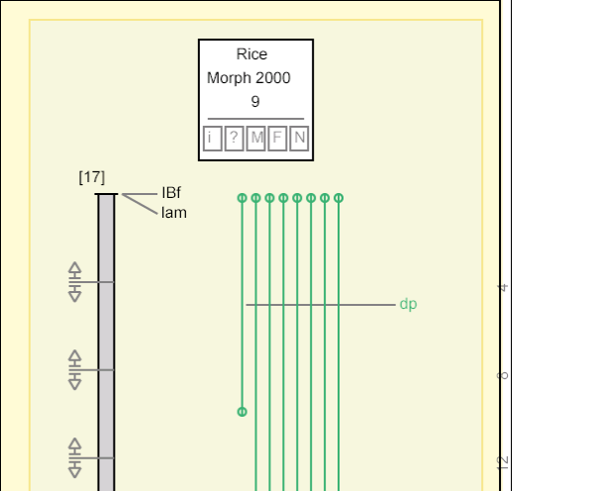
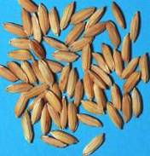
IBf locus on tip of chrom 9: inhibitor of brown furrows

Slide 56
Some considerations for MAB
IRRI’s goal: several “enhanced Mega varieties”
Main considerations:
  Cost
  Labour
  Resources
  Efficiency
  Timeframe
Strategies for optimization of MAB process important
  Number of BC generations
  Reducing marker data points (MDP)
  Strategies for 2 or more genes/QTLs

Slide 57
SECTION 4
CURRENT STATUS OF MAS: OBSTACLES AND CHALLENGES

Slide 58

Current status of molecular breeding
A literature review indicates thousands of QTL mapping studies but not many actual reports of the application of MAS in breeding
Why is this the case?

Slide 59
Some possible reasons to explain the low impact of MAS in crop improvement
Resources (equipment) not available
Markers may not be cost-effective
Accuracy of QTL mapping studies
QTL effects may depend on genetic background or be influenced by environmental conditions
Lack of marker polymorphism in breeding material
Poor integration of molecular genetics and conventional breeding

Slide 60



Cost - a major obstacle
Cost-efficiency has rarely been calculated but MAS is more expensive for most traits
  Exceptions include quality traits
Determined by:
  Trait and method for phenotypic screening
  Cost of glasshouse/field trials
  Labour costs
  Type of markers used

Slide 61
How much does MAS cost?
*cost includes labour
Institute | Country | Crop | Cost estimate per sample* (US$) | Reference
Uni. Guelph | Canada | Bean | 2.74 | Yu et al. (2000)
CIMMYT | Mexico | Maize | 1.24–2.26 | Dreher et al. (2003)
Uni. Adelaide | Australia | Wheat | 1.46 | Kuchel et al. (2005)
Uni. Kentucky, Uni. Minnesota, Uni. Oregon, Michigan State Uni., USDA-ARS | United States | Wheat and barley | 0.50–5.00 | Van Sanford et al. (2001)
Yu et al. 2000 Plant Breed. 119, 411-415; Dreher et al. 2003 Mol. Breed. 11, 221-234; Kuchel et al. 2005 Mol. Breed. 16, 67-78; and Van Sanford et al. 2001 Crop Sci. 41, 638-644.

Slide 62
How much does MAS cost at IRRI?
Consumables:
Genome mapping lab (GML) ESTIMATE
  USD $0.26 per sample (minimum costs)
  Breakdown of costs: DNA extraction: 19.1%; PCR: 61.6%; Gel electrophoresis: 19.2%
  Estimate excludes delivery fees, gloves, paper tissue, electricity, water, waste disposal and no re-runs
GAMMA Lab estimate = USD $0.86 per sample
Labour:
  USD $0.06 per sample (Research Technician)
  USD $0.65 per sample (Postdoctoral Research Fellow)
TOTAL: USD $0.32/sample (RT); USD $0.91/sample (PDF)

Slide 63
Cost of MAS in context: Example 1: Early generation MAS
P₁
x
P₂
F₁
F₂
2000 plants
USD $640 to screen 2000 plants with a single marker for one population

Slide 64
Cost of MAS in context: Example 2 - Swarna+Sub1
Swarna/
IR49830 F1
X
Swarna
376 had Sub1
21 recombinant
Background selection – 57 markers
BC1F1
697 plants
Plant #242
Swarna
X
Plant #246
158 had Sub1
5 recombinant
23 background markers
BC2F1
320 plants
Estimated minimum costs for CONSUMABLES ONLY.
Foreground, recombinant and background BC1- BC3F2 selection = USD $2201
X
Swarna
11 plant with Sub1
10 background markers
BC3F1
18 plants
Swarna+Sub1

Slide 65

Cost of MAS in context
Example 1: Pedigree selection (2000 F2 plants) = USD $640
  Philippines (Peso) = 35,200
  India (Rupee) = 28,800
  Bangladesh (Taka) = 44,800
  Iran (Tuman) = 576,000
Example 2: Swarna+Sub1 development = USD $2201 (*consumables only)
  Philippines (Peso) = 121,055
  India (Rupee) = 99,045
  Bangladesh (Taka) = 154,070
  Iran (Tuman) = 1,980,900
Costs quickly add up!

Slide 66
A closer look at the examples of MAS indicates one common factor:
Most DNA markers have been developed for….
MAJOR GENES!
In other words, not QTLs!! QTLs are much harder to characterize!
  An exception is Sub1

Slide 67
Reliability of QTL mapping is critical to the success of MAS
Reliable phenotypic data critical!
  Multiple replications and environments
Confirmation of QTL results in independent populations
“Marker validation” must be performed
  Testing reliability for markers to predict phenotype
  Testing level of polymorphism of markers
Effects of genetic background need to be determined
Recommended references:
Young (1999). A cautiously optimistic vision for marker-assisted breeding. Mol Breeding 5: 505-510.
**Holland, J. B. 2004 Implementation of molecular markers for quantitative traits in breeding programs - challenges and opportunities. Proceedings of the 4th International Crop Sci. Congress., Brisbane, Australia.

Slide 68
Breeders’ QTL mapping ‘checklist’
LOD & R² values will give us a good initial idea but probably more important factors include:
What is the population size used for QTL mapping?
How reliable is the phenotypic data?
  Heritability estimates will be useful
  Level of replication
Any confirmation of QTL results?
Have effects of genetic background been tested?
Are markers polymorphic in breeders’ material?
How useful are the markers for predicting phenotype? Has this been evaluated?

Slide 69
Integration of molecular biology and plant breeding is often lacking
Large ‘gaps’ remain between marker development and plant breeding
  QTL mapping/marker development have been separated from breeding
  Effective transfer of data or information between research institute and breeding station may not occur
Essential concepts in may not be understood by molecular biologists and breeders (and other disciplines)

Slide 70
Advanced backcross QTL analysis
Combine QTL mapping and breeding together
‘Advanced backcross QTL analysis’ by Tanksley & Nelson (1996).
  Use backcross mapping populations
  QTL analysis in BC2 or BC3 stage
  Further develop promising lines based on QTL analysis for breeding
P₁
x
P₂
P₁ x F₁
P₁ x BC1
BC2
QTL MAPPING
Breeding program
References:
Tanksley & Nelson (1996). Advanced backcross QTL analysis: a method for the simultaneous discovery and transfer of valuable QTLs from unadapted germplasm into elite breeding lines. Theor. Appl. Genet. 92: 191-203.
Toojinda et al. (1998) Introgression of quantitative trait loci (QTLs) determining stripe rust resistance in barley: an example of marker-assisted line development. Theor. Appl. Genet. 96: 123-131.

Slide 71

Future challenges
Improved cost-efficiency
  Optimization, simplification of methods and future innovation
Design of efficient and effective MAS strategies
Greater integration between molecular genetics and plant breeding
Data management

Slide 72
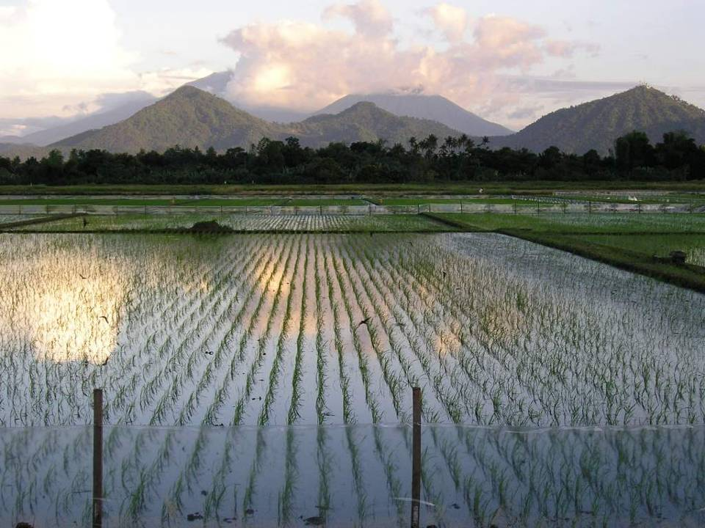
Future of MAS in rice?
Most important staple for many developing countries
Model crop species
  Enormous amount of research in molecular genetics and genomics which has provided enormous potential for marker development and MAS
Costs of MAS are prohibitive so available funding will largely determine the extent to which markers are used in breeding

Slide 73


Food for thought
Do we need to use DNA markers for plant breeding?
Which traits are the highest priority for marker development?
When does molecular breeding give an important advantage over conventional breeding, and how can we exploit this?
How can we further minimize costs and increase efficiency?

Slide 74


Thank you!

