Slide 1
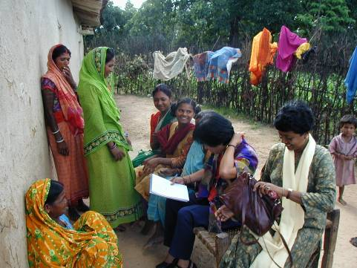
Planning rice breeding programs for impact
Participatory approaches

Slide 2

Learning objectives
Describe the need of participatory methods
Describe when farmer participation is most effective
Describe effective designs for participatory varietal selection (PVS)
Understand what questions should be on surveys
Demonstrate organization & analysis of PVS data
Demonstrate how to “scale up” PVS
Describe the research issues

Slide 3
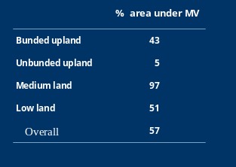
MV Adoption in Kalahandi,
Orissa
S Pandey Feb 03

Slide 4
How do conventional variety testing programs usually work?
Varieties entering the program are chosen by researchers
Most steps in the testing process are done on the research station
Researchers decide which traits are important
Very few varieties are tested on farms

Slide 5

Problems of many conventional variety testing programs
Varieties selected by researchers may not be adopted by farmers!
Researchers may not know which characteristics are most important to farmers
Conditions on research station may be different than on-farm
Farmers evaluate only a few varieties
Emphasis is on measurement of grain yield
WHY?
Notes:
Ask class for possible reasons why sometimes farmers do not adopt new variaties

Slide 6
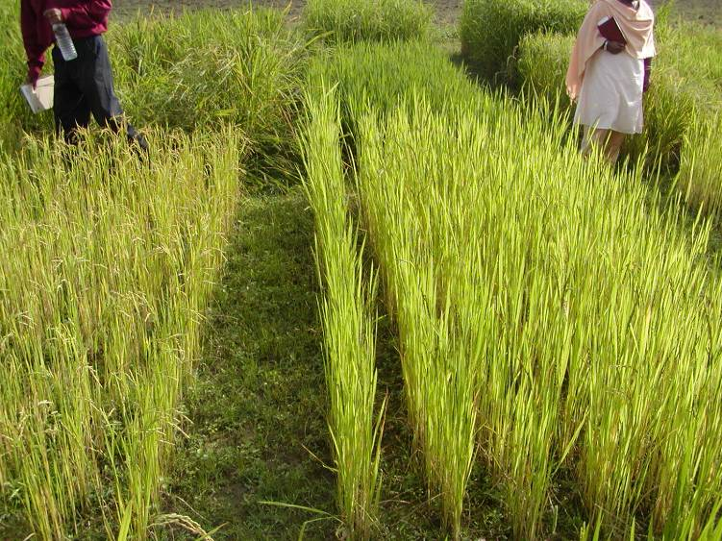
Varietal performance under 0 N:
BAU, Ranchi

Slide 7
Step | No. of lines | Farmer Participation?
Pedigree | 1000 | No
OYT | 100 | No
AYT | 30 | No
Official | 20 | No
Minikit | 5 | Yes

Slide 8

Features of participatory variety selection programs
Many varieties are evaluated on farm, by farmers!
Farmers’ opinions and knowledge systematically collected and used in selection decisions
More attention to grain quality and other traits important to farmers

Slide 9
When should PVS be used in addition to research station trials?
When conditions on station and on farm are very different
When farmers’ needs and preferences are not well understood by researchers
When more replication is needed because on-farm conditions are very variable

Slide 10
How does PVS differ from on-farm testing ?
Only farmer management is used (no package!)
Farmer opinions about varieties under test are systematically collected
Environmental replication is extensive
BUT:
→Rainfed rice breeding programs encounter many problems in working on-farm

Slide 11

Access to farm sites may be inconvenient resulting in:
High transport costs
Untimely planting and harvest
Inadequate monitoring
Under-replication

Slide 12
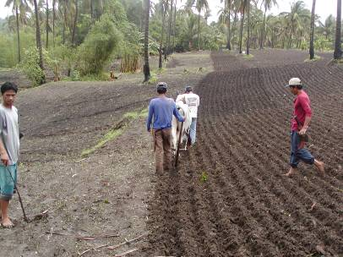
Features of a useful PVS system:
Minimum researcher involvement per trial
Trials requiring no layout
Farmer ratings replace agronomic measurements

Slide 13
Purpose of participatory methods in terms of response model
Reduce lack of correlation between SE and TPE
Increase H by increasing replication over farms
Increase selection intensity by permitting more varieties to be evaluated on-farm

Slide 14
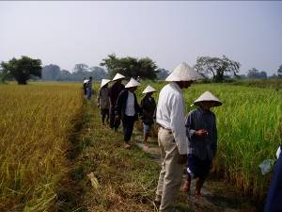
Purpose of participatory methods in terms of farmer opinion
Institutionalizes collection of farmer preference data
Ensures that farmer preference data are quantified

Slide 15
How should farmer-managed trials be designed?
minimum researcher involvement
keep farmers motivated and interested in the trial
permit evaluation on many farms
permit quantitative data to be obtained about both farmer preference and agronomic performance

Slide 16

The Mother-Baby model
“Mother-Baby” system now widely used for farmer-managed trials
Trials are replicated over several villages and over several farms in each village
”Mother trial” is researcher managed, with a large number of varieties
“Baby” trial is farmer-managed, with a subset

Slide 17
Original mother-
baby design
Village 2
15
5
5
Village 1
5
15
5
Village 3
5
15
5
5
5
5

Slide 18
Mother trial
Mother trial contains all varieties in test
One Mother trial per village
May be replicated or unreplicated
Laid out, planted, and harvested under supervision of researchers
Yield and other agronomic traits measured

Slide 19
IRRI and WARDA recommend:
→Test many (>10) varieties in researcher-managed trial in year 1
→Test the best varieties from year 1 (10 or less) in farmer-managed trials in year 2

Slide 20
Purpose of researcher-managed trials
Lets farmers view and evaluate all varieties at 1 site
Rainfall, soil fertility, and other environmental data can be collected
High and low levels of fertilizer can be compared
Researchers can measure yield
Quickly eliminates unacceptable varieties

Slide 21
Farmer-managed
(Baby) trials
Baby trials are planted, managed, and harvested by farmers
Each baby trial has only 2-4 varieties, but many farmers participate (>20)
Yield may be measured if resources permit
Farmer evaluations are most important information from baby trials
Little researcher involvement per farm
Farmer ratings replace most agronomic measurements

Slide 22
Purpose of farmer-managed trials
Needs and conditions of farmers = highly variable
Varieties must be evaluated for agronomic performance and quality by many farmers
Many replications = easier to detect variety differences
Goal is estimation of cultivar acceptability rather than yield

Slide 23

What are practical problems with Baby trials?
Many trials needed for reliable results
Measuring yield on-farm is difficult
Each farmer can evaluate only 1-3 varieties
Many Baby trials are lost, especially if farmers receive more than 1 test variety
At least 0.5 kg of seed per farmer is needed

Slide 24
How to analyze “Mother” trials
For agronomic data, replicated on-farm trials are analysed like any other MET
For farmer preference data, Preference Analysis can be used
Preference Analysis is a rapid approach to collecting preference information from a group of farmers who visit a “Mother” trial

Slide 25
Does anyone want to share experiences or opinions about mother-baby trials?

Slide 26
Data collection for Preference Analysis
Conducted in a variety trial with a “large” number of entries
A group of representative farmers is brought to the trial to “vote” for the best and worst variety
Allows farmer opinions about varieties at a particular crop stage to be collected.

Slide 27
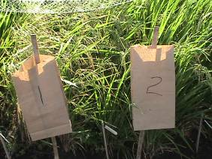

Protocol for Preference Analysis
A bag or box is placed in front of each variety to collect ballots
A group of farmers is each given 2 “ballots” for good varieties and 2 ballots for bad varieties. Ballots are of different colors

Slide 28
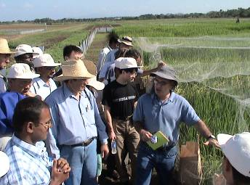
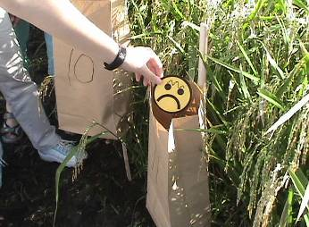
Protocol for Preference Analysis
Farmers are walked through the trial and “introduced” to the layout
4. Farmers are allowed to go through the trial freely to “vote” for best and worst varieties

Slide 29
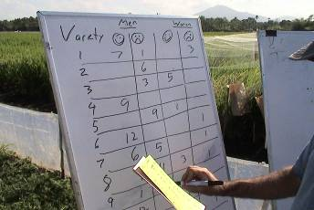
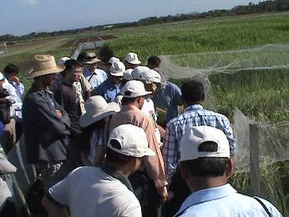
Protocol for Preference Analysis
Researchers collect ballots and count votes for best & worst
Whole group then visits 1 or 2 of the varieties receiving most votes. Farmers are asked why they prefer these varieties
1 or 2 disliked varieties are visited, and comments collected

Slide 30
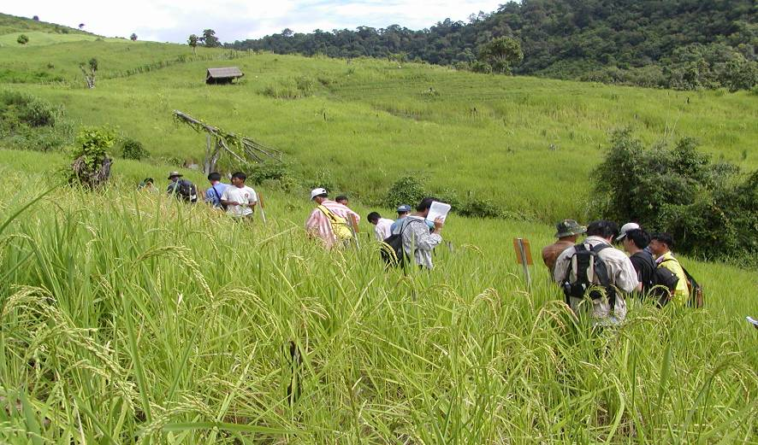
Preference analysis in Laos

Slide 31
Data analysis for Preference Analysis
1. At each site, a preference index can be calculated for each variety:
Preference index = (No. of positive votes – No. of negative votes)/total votes cast
ANOVA on preference index can be done over sites, with each site considered a replicate
If only a single site is available, a chi-square test of homogeneity can be performed for positive and negative votes separately

Slide 32
Preference analysis over 17 sites:
Laos 2002
Cultivar
Grain yield (t/ha)
Grain yield
(stan.)
Preference score¹
Dam
1.93
0.16
0.127
Do hom
1.76
-0.17
0.063
Mak hin soung
2.21
0.58
0.175
Mak thoua
1.55
-0.47
0.137
Nok
1.94
0.16
0.238
Taa roon
1.75
-0.21
0.079
Local check
1.88
0.15
0.150
LSD_{.05}
0.36
0.59
0.135

Slide 33
Research issues
How much replication is needed?
Are ratings closely related to researcher measurements? Which are better?
Do farmer preference ratings predict adoption?

Slide 34
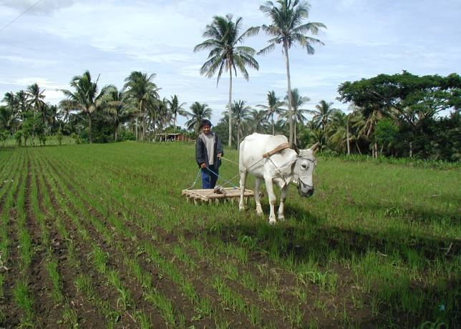
Case :
Batangas, WS 2002
3 mother trials
66 baby trials
15 varieties
3 lines/baby trial

Slide 35
Varieties
1. Improved upland varieties:
  CT6510-24-1-2
  Apo (IR55423-01)
2. Traditional Philippine upland tropical japonicas
  Dinorado
  Azucena
  Palawan
3. Advanced IRRI breeding lines (10)

Slide 36
Protocol
Mother trials
  3 barangays
  2 reps/site
  Laid out by researchers, managed by farmers
  Community preference analyses conducted before harvest
  Yield measured

Slide 37
Protocol
Baby trials
  In each barangay, ca. 20 farmers received 2 kg of each of 3 varieties
  Seeded without researcher assistance
  Farmers rated yield, overall preference on a 1-5 scale
  Community assistants collected crop-cut sample from each plot

Slide 38
Predicted LSD_{.05} (t ha⁻¹) for crop-cut grain yield measured in Philippine Mother-Baby trials
Number of farms (reps) per variety | Mother trial | Baby trial
5 | 0.30 | 0.96
10 | 0.22 | 0.68
20 | 0.15 | 0.34

Slide 39
Correlations among visual yield ratings, overall preference ratings, planting intentions, and crop-cut yield Batangas, 2002*
 | BT overall rating | BT yield rating | BT crop cut
MT yield | 0.80 | 0.87 | 0.76
BT overall rating |  | 0.95 | 0.86
BT yield rating |  |  | 0.79
* Means of 15 cultivars evaluated over 66 Baby trials

Slide 40
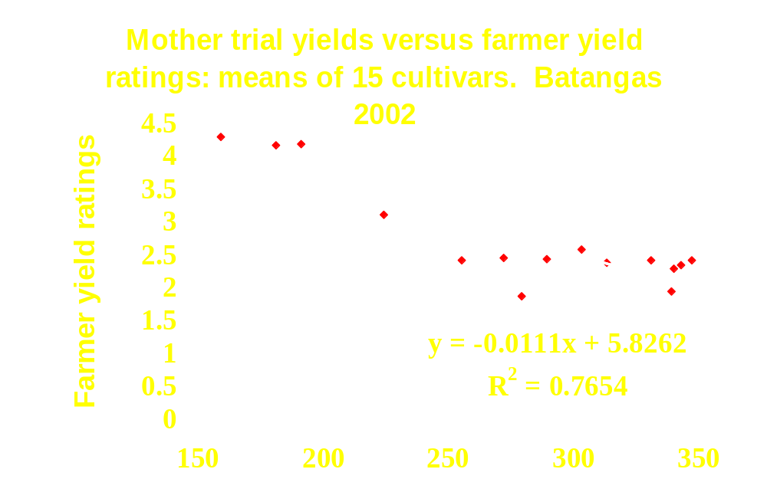
Mother trial yields (g m⁻²)

Slide 41
How well did performance in 2002 PVS trials predict adoption in 2004?
Predictor | R²
Baby trial yield | 0.36
Baby trial farmer yield rating | 0.47
Mother trial yield | 0.38

Slide 42
Survey questions for baby trials
Farm characterization questions
  Land type, management
Agronomic questions
  Ask about important growth and agronomic characteristics
  Administer survey in field at appropriate stage

Slide 43
Survey questions for baby trial
End use quality questions
  Harvesting, straw quality, threshing
  Cooking, eating, leftover rice, storage
Overall preference
  Overall, what does the farmer think of the variety?
Planting intentions for next year
  Does the farmer plan to grow the variety next year from saved seed?
  Was seed given to anybody?

Slide 44
Farmer rates each trait of interest as:
1 =Much better than own variety
2 =A little better than own variety
3 =The same as own variety
4 =A little worse own my variety
5 =Much worse own my variety

Slide 45
Example of a model for analysis of PVS data
P = M + V + L + VL +F(VL) + G + GV + GL + GVL + E
  M = overall mean
  V = Village
  L = Land type
  F = Farm
  G = Genotype
  E = residual

Slide 46
File organization for Baby trial analysis
Village | Farm | Line | N fert | Rotation | Yield | Preference | Planting next year
1 | 1 | 1 | No | Cont | 1.3 | 1 | 1
1 | 1 | 2 | Yes | Maize | 2.1 | 4 | 0
1 | 1 | 3 | No | Cont | 1.6 | 4 | 0

Slide 47
Approaches to scaling up
Research center networks
Reduce researcher involvement per trial
- ratings rather than crop cuts
Collaborate with agricultural development organizations with village network

Slide 48
Can anyone briefly explain the importance of farmer participation?

Slide 49
Synthesis of results on PVS research 1
PVS is important for:
  Testing under farmer agronomic management
  Institutionalizing the collection of farmer opinions
Small-scale on-farm trials (“Mother trials) should replace most on-station AYT testing
Only high-quality material should be yield-tested

Slide 50
Synthesis of results on PVS research 2
4. Farmer agronomic ratings are closely related to agronomic measurements
Farmer-preferred varieties are occasionally not the highest-yielding
Performance in farmer-managed trials, as assessed by farmers themselves, is a good predictor of adoption.

