Slide 1
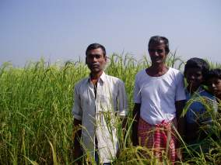
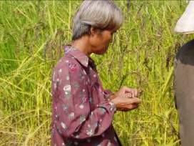
Planning rice breeding programs for impact
Factors affecting the adoption of
improved varieties

Slide 2

Learning objectives
Identification of the factors affecting farmer adoption of rainfed rice cultivars.
Case studies on the spread of widely-adopted rainfed rice varieties.
The role of farmer-to-farmer dissemination
How do these factors affect the breeding process and objectives?
“Brainstorming” ideas for increasing adoption of new varieties

Slide 3
MV adoption in Kalahandi, Orissa
Environment | % MV
Unbunded upland | 5
Shallow lowland | 43
Medium land | 97
Lower fields | 51
Overall | 57
S. Pandey, 2003
Notes:
MV= Modern Variety

Slide 4

Question to the group:
Why is the rate of adoption of new rainfed rice varieties so low?
  New varieties may not be superior under farmer management, even though they are superior on-station
  They may be inferior in characteristics that breeders are not aware of, but that farmers value
  Farmers may not have access to seed of or information about new varieties
Notes:
Participants can give their opinions

Slide 5
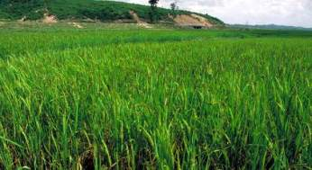
Case study: Mahsuri
Developed by an FAO-sponsored indica x japonica crossing program at Cuttack, India in 1950’s
Selected for performance under improved management
Tall, yellowish leaves, lodging- and sprouting-prone
Breeders disliked
the plant type
Susceptible to diseases
(blast)

Slide 6
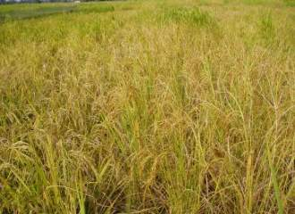
Case study: Mahsuri
BUT:
  High grain quality
  Tolerates stagnant water to 70 cm
  Productive under low inputs
  Spread farmer-to-farmer
  in India, Nepal, Bangladesh, and Myanmar

Slide 7
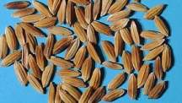
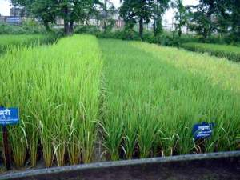
Swarna: another example of a rainfed rice variety spreading from farmer to farmer
Mahsuri-type quality
Input-responsive, with high yield potential
Susceptible to BPH, sheath blight, submergence, late-season drought

Slide 8
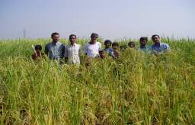
The role of farmer-to-farmer spread in varietal dissemination
Most important mechanism by which rainfed varieties spread
Some farmers are very active in varietal introduction and seed exchange (sometimes called nodal farmers)
Variety dissemination programs that target
farmers with a strong interest in evaluating new
material: more success
Informal seed programs
providing nodal farmers
with small amounts of seed
can be highly cost-effective

Slide 9

Brainstorming exercise
List: 1 popular, widely-used irrigated variety and 1 popular, widely-grown rainfed variety in your country
  Where did the variety come from (e.g. from a research station, foreign introduction, farmer variety)?
  Was it officially tested and released?
  How did it spread (e.g. public sector seed program, private sector sales, farmer-to-farmer distribution)?
  What are the characteristics of the variety that farmers value?

Slide 10
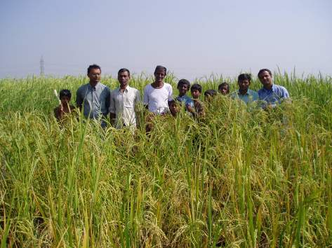
Results of 2005 PRBPFI discussion on varietal spread

Slide 11
Bangladesh
Irrigated - BRRIdhan28/BRRIdhan29
Rainfed - BR11
- from research station i.e. BRRI developed/bred
-officially tested and released
- seed spread thru public sector (6%), private sector (6%), farmer to farmer (88%)
BRRIdhan28
- early (escaping from flash flood and hailstorm), high yield, good grain and eating quality
- Field early released for the next (Aus) crop

Slide 12
Bangladesh
BRRIdhan29
- high yielding, good eating and grain quality, suitable for flood free areas
BR11
- high yield, medium bold grain, good eating quality, good agronomic characters

Slide 13
Cambodia
San Prdao (early duration)
PhKa (medium duration)
Released by CARDI community
Spread by: extension, NGOs, private sector (seed company), on-farm trials & farmer to farmer
Those varieties have: good eating quality, high yielding, short duration, aroma and slender

Slide 14
China
Hexi No. 41
- yield test in some countries
- farmers like it because of its excellent appearances
- organized technicians to extension
- In village: farmer to farmer
- Farmer trends: yield quality, appearance (e.g. big panicle), disease resistance

Slide 15
GAMBIA
Irrigated-ITA212
- variety came from IITA
- official tested but not formally released
- spread thru public sector seed programme, private sector seed sales but mainly farmer-to-farmer dist.
- high yielding, high responsive to N, good grain quality

Slide 16
GAMBIA
Rainfed-Prasana
- foreign introduc/research station
- officially tested but not formally released
- public sector seed program, private sector sales but mainly farmer-to-farmer
- early maturing, slender grains, high amylose content, tall stature
NERICAs (1-7)
- Research Station (WARDA)
- Officially tested and released
- Public sector program, farmer-to-farmer
- early maturing, grain quality, drought tolerance, weed-competitiveness, medium stature

Slide 17
Laos
PNG1 (Irrigated)
TDK4 (RL) - both glutinous
- both varieties come from IRRI which selected at Lao condition
- tested on station and onfarm
PNG1 1995 and TDK41995
- controlled by Lao government and PAFOR and DAFO with the participation of farmers
- HYV, good eating quality, low input

Slide 18
India
Irrigated : HMT - Selection by farmer
- not officially released/tested
- farmer to farmer
- small grains with good cooking quality
Irrigated: Indrasaran - selection by farmers
- not officially released/tested
- farmer to farmer
- long slender, high yielding

Slide 19
India
Rainfed: Mahsuri; Swarma; Sharbati
- high yield
- basmati type grain, no aroma
- farmer to farmer
- not officially released

Slide 20
Korea
Nampyeongbyeo (Japonica)
- Honan Agricultureal Research Institute (1990s)
- officially tested in 15 plots across the country
- disease, insect reaction test
- environmental stress (cold, yield)
- distributed by public sector seed multiplication program
- farmers' choice for good yield (above 5ton/ha), cultural stability and high eating quality

Slide 21
Philippines
Popular irrigated variety (2002)
- PSB Rc 82 (2000): 110d; farmer to farmer, millers
- PSB Rc 18 (1994): 123d; IR64-like; farmer to farmer; millers
- IR64 (1985): 113d (standard)
- PSB Rc 72H (1997): 125d; IR64-like aromatic; government, millers
Popular rainfed variety (2002)
- PSB Rc14 (1992) UPLB Variety: 110d; IR64-like; farmer to farmer, millers

Slide 22
Questions to the group
Does the breeder’s responsibility end with official release of a new variety?
Is it the breeder’s job to ensure that the variety he or she produces is adopted?
How can breeding programs help with the spread and adoption of their varieties?
Notes:
Group discussion

Slide 23
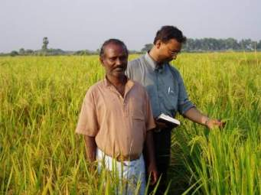

Dr. S.K. Mallik
Rainfed lowland breeder,
Chinsurah, W. Bengal, India
Works in flood-prone lowlands subject to stagnation at depths of >50 cm.

Slide 24
He actively & systematically promotes improved varieties for flood-prone areas
Arranges a village meeting in a flood-prone area, with the help of extension workers
Talks to farmers about their problems in cropping flood-prone areas, and visits the field
A few farmers with a strong interest in varieties are identified as collaborators
Each collaborating farmer is provided with approximately 5 kg of several improved varieties to plant in flood-prone fields. No formal trial design is used.
Dr. Mallik meets with cooperators during and after the season to find out which varieties are most useful to them.
Preferred varieties are disseminated by farmers to their neighbors

Slide 25
Any questions or comments?

Slide 26
Summary
Many released varieties are not adopted by farmers
Non-adoption may be because the variety does not meet farmers’ needs, or because farmers lack access to seed or information on new varieties.
Often, varieties that spread rapidly from farmer to farmer are those with highly preferred quality traits.
Breeders can increase rates of adoption by integrating farmers into the selection process, and providing leadership on varietal dissemination activities.

