Slide 1
Planning rice breeding programs for impact
Experimental design

Slide 2

Learning objectives
Review the features of modern experimental designs that allow separation of the effects of genotype and environment
Understand the application of randomized complete-block designs (RCBDs), alpha-lattices, and augmented designs

Slide 3

Linear model for plot measurements
→For a completely randomized design (CRD):
Where:
Yij = a plot measurement
μ = the mean of all plots
Gi = the effect of the ith genotype
ej = the “residual” effect of the jth plot
  G’s and e’s sum to 0
Yij = μ + Gi + ej
[4.1]

Slide 4
The function of experimental design
Modern experimental designs reduce the effect of field heterogeneity (e’s) on estimates of genotypic value

Slide 5

Field variation can be continuous or discontinuous
Old bund
Fertility or depth gradient

Slide 6
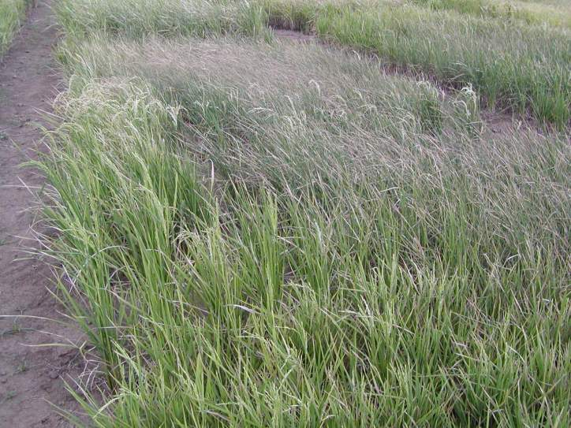
Field variation introduced by sprinkler irrigation
Notes:
Example of UNDER lapping sprinkler irrigation

Slide 7
Blocking versus replication
Tools for managing field heterogeneity are replication, randomization, and blocking:
  Replication with randomization make are the most effective tools. They are effective against any kind of field heterogeneity
  Blocking (grouping of experimental lines in small, contiguous sets of plots) is most effective when heterogeneity is due to a smooth gradient

Slide 8
Randomized complete-block designs
RCBDs group all varieties in a replicate into a single block
Block effect is removed from residual
  CRD Model: Y_{ijk} = μ + G_{i} + e_{J}
  RCBD Model: Y_{ijk} = μ + G_{i} + R_{j} + e_{k(j)}
→Effective when variety number is small
→Most effective when field gradient is gradual
Notes:
CRD: Complete Randomized Design; RCBD: Randomized Complete Block Design

Slide 9
Blocking = effective against a smooth gradient in fertility or water depth
Deep water
Shallow water

Slide 10
Deep water
Shallow water
Old bund

Slide 11
Incomplete-block designs
Break up large “complete” blocks into smaller blocks with a fraction of the treatments
Useful when heterogeneity is great within blocks
Often used when number of test varieties large
Work well when field gradient is smooth

Slide 12

Can anyone briefly summarize when to use blocking and when to use replication?
Notes:
Question to the group

Slide 13
Alpha-lattices
Flexible incomplete block designs that accommodate any even number of entries, any number of replicates
  →For example, a 42-entry trial could be divided into 6 blocks of 7 lines per rep.
Randomization equalizes frequency of pair wise comparisons within incomplete-blocks
Analysis removes incomplete-block effects
Usually provides a small increase in precision

Slide 15
Augmented designs
Flexible incomplete block designs that accommodate
  any even number of entries in a single replicate
Experimental lines replicated once
Checks occur in each block
Checks used to estimate block effects
Checks provide error term
Effective, BUT much of the field is taken up with checks

Slide 16
Effectiveness of incomplete block designs in controlling error
Lattices can also be analysed as RCBDs
Effect of alpha lattice analysis on precision can be evaluated by comparing SEM values from lattice and RCBD analysis

Slide 17
Tests of effectiveness of alpha-lattice designs in increasing precision
Trial set | SEM for RCBD (kg/ha) | SEM for alpha-lattice (kg/ha)
NE Thailand RL (WS 2001) | 406 | 398
IRRI upland (DS 2002) | 197 | 187
IRRI upland –single rows (DS 2004) | 20.3 | 11.7

Slide 18
Gridding to control heterogeneity in unreplicated nurseries
Useful for traits like seedling vigor, PA, GY
Nursery is divided into blocks
Selection is done within blocks only
No repeated checks needed

Slide 20
When should you use:
alpha-lattices?
augmented designs?
gridding?
Notes:
Question to group

Slide 21
Conclusion
Replication reduces influence of e’s
Blocking removes part of e’s due to gradient
Alpha-lattices reduce effect of “smooth” within-replicate variation →Benefits positive but small
Augmented designs reduce effect of “smooth” within-field variation, but need many repeated checks
Gridding reduces effect of “smooth” within-field variation, without repeated checks

