Slide 1
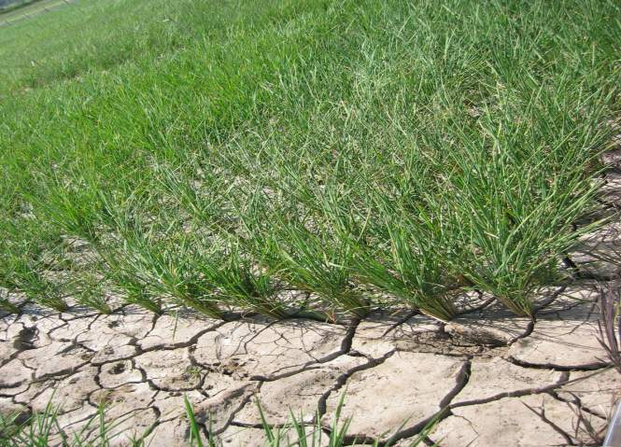
Screening and trait-based selection for drought resistance in rice
R. Serraj & J. Cairns

Slide 2
Outline
Introduction: the drought challenges
Types of drought & functional definition of drought ‘resistance/tolerance’ (DR)
Considerations in designing a drought screening program
Design & management of field drought experiments
Direct selection for yield under stress
Trait-based selection for drought resistance
Examples and case studies
Conclusions

Slide 3
Challenges in manipulating drought resistance (DR) genes
Most physiological and metabolic processes are + affected: cell growth, stomata, photosynthesis, translocation,..
Very large number of genes regulated by drought
Large genetic populations required
Even component traits are difficult to screen
Logistical challenges for dealing with a large number of genes even when identified
Notes:
Challenges in

Slide 4
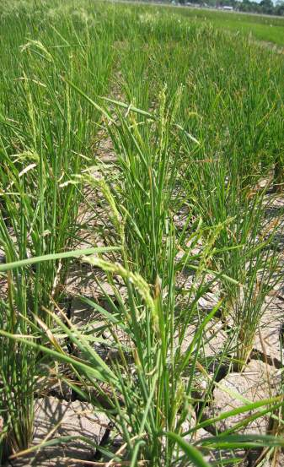
Drought stress and rice response
Rice tends to be more sensitive to drought stress than other crops?
Lowland/aquatic adaptation
Shallow, compact root system
Deep roots not efficient at water extraction
Higher tissue sensitivity to water deficit?
High sensitivity of grain set to stress
Very sensitive to timing of stress
Other mechanisms?

Slide 5
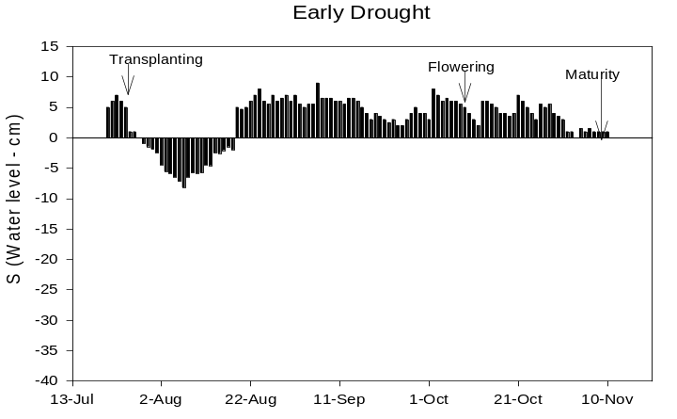
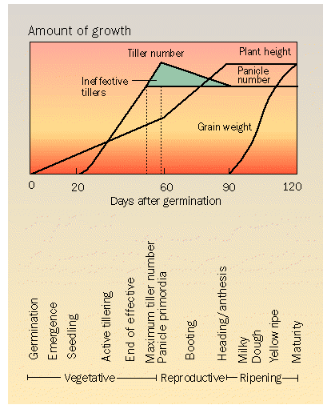
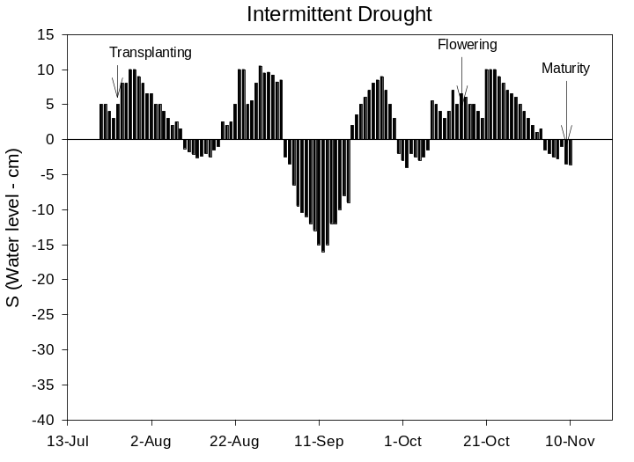
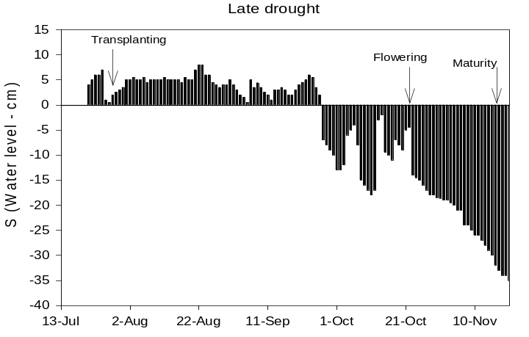
Timing, duration & intensity of stress occurrence
Early drought
Intermittent drought
Terminal drought

Slide 6
1st message:
Know your target environment : what type of stress is more frequent?

Slide 7
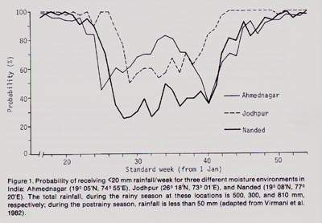
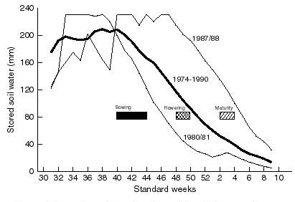
Characterization of target environment
Use historical climate series, crop simulation & water balance models
Rainfall probability
Available soil moisture (post-rainy season)
Breeding Target? Germination, crop establishment, vegetative growth & tillering, flowering, grain filling

Slide 8
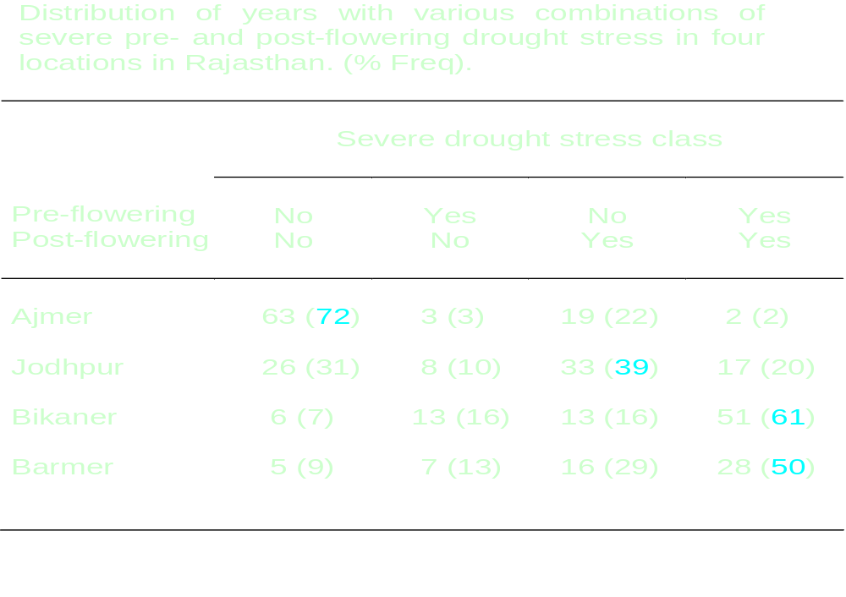
Example: variability of pearl millet TPEs in N.W. India

Slide 9
Functional definition of ‘drought resistance’
How to define "drought tolerance" that can be realistically pursued in a breeding program ?
Stable grain yield under stress
Adaptive responses to stress
Underlying biological mechanisms
Alleles coding for the mechanisms
“Resistance" has to be researchable, breakable into simpler levels (e.g. floret sterility and ASI in maize, rooting effects vs. rooting pattern..), should focus on heritable genetic variation, linked to yield, feasible

Slide 10
2nd message:
Know your target environment : What type of stress is more frequent?
Yield stability under drought should be the target

Slide 11
Drought screening environments
1. Artificially create stress in the "normal" growing season
+ avoids genotype x season problems
- excluding water is costly/difficult (reproducibility)
- no control of stress occurrence (timing, severity & duration)
2. Manage water-deficits in a non-growing season
+ application of uniform, repeatable & controlled stress environment
+ maximize genetic component of the observed variation
- extrapolation of results to TPEs?
Combination of options?

Slide 12
Objectives of a screening system
Focus on TPE & adaptation to major stress constraints
Minimize problems in detecting heritable differences in DR
Yield under stress as function of: yield potential, escape, DR
Use drought sensitivity index (DSI) to distinguish DR from escape & yield potential
DR as the ability to maintain yield components in stress compared to non-stress:
  maintenance of grain number, grain size, biomass, yield, harvest index

Slide 13
Screening facility/system
Differentiate among genotypes
degree of yield reduction (+ 50%), manage ‘escape’ effects, use period of max evapotranspiration (ET) demand, time initiation of stress carefully, adjust for differences in escape
Apply uniform stress (drought nursery approach)
“uniform” soil water profile, uniform pre-stress crop growth, water application & water use
Repeatable stress
standard planting time & management procedures, initiate stress by phenological stage, stable water use environment, dedicated field facility, well-established management practices

Slide 14
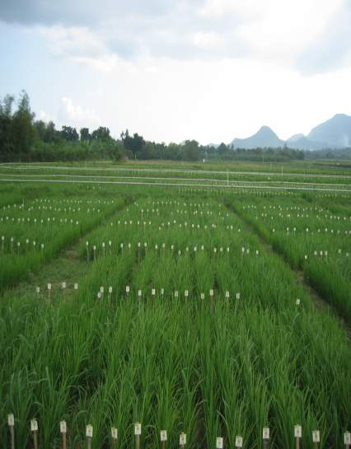
Considerations for screening
Phenology, morphology
Growth stage at which stress occurs
Severity and duration of stress
Management levels and options
Plot size, design
Interacting factors
  Biotic stresses
Crop quality, economics

Slide 15
3rd message:
Know your target environment : What type of stress is more frequent?
Yield stability under drought should be the target
Screening system should be uniform, repeatable and differentiate genotypes

Slide 16
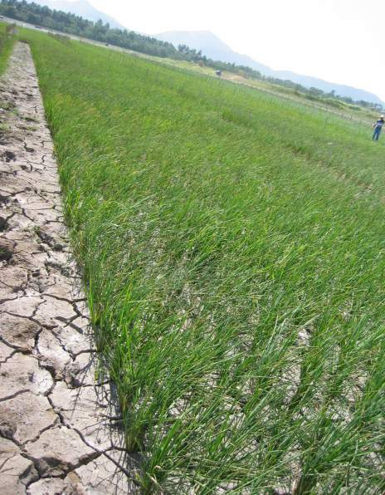
Field management for drought screening
land plane field regularly
minimize pre-stress differences
band fertilizer with precision
weed management over all year
pest & disease control
uniform stand (over-sow and thin?)

Slide 17
Control of field irrigation
Method | Freq | Advantages | Disadvantages
Surface / Furrow | Δ / 3 x wk | Robust components Efficient water use Easy to measure | Inefficient water use Requires land leveling Hard to measure amount of water Requires raised beds Row spacing too wide for rice
Sprinkler | 3 x wk | Robust components Efficient water use Easy to measure | Uneven distribution pattern same timing of stress for all entries Large border areas needed Leaks, blockages and wind
Drip | daily | Differential irrigation/ plot Efficient water use Uniform application | Expense of components (filters etc) Limits weed control options Labor cost: check quality of irrigation
Combinations: e.g. sprinkler irrigation in early stages, drip or surface irrigation at later stage, precise final irrigation

Slide 18
Design & data management
Statistical design
  fit design to field constraints (alpha designs)
  adjust for primary & secondary gradients
  replicates & soil gradients – local spatial variation
  final irrigation differences
  sprinkler application gradients
Data organizing/checking:
  missing/duplicate data, expected range, detect and correct outliers
Data analysis procedures:
  spatial analysis/adjustment, error variance and heritability, best linear unbiased estimates

Slide 19
4th message:
Know your target environment : What type of stress is more frequent?
Yield stability under drought should be the target
Screening system should be uniform, repeatable and differentiate genotypes
Field and irrigation management are critical for drought screening (you have the data you pay for…)

Slide 20
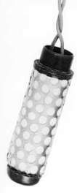
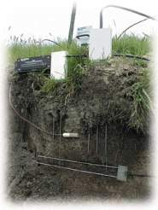
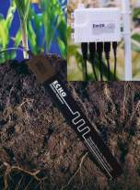

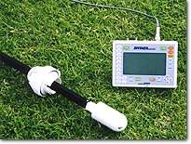
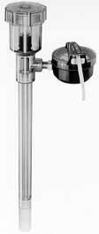
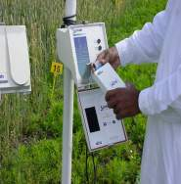
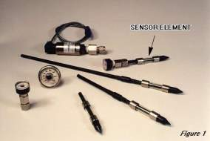


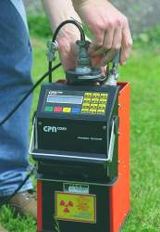
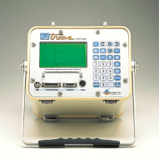
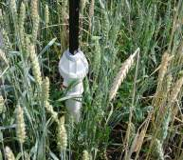
Soil moisture monitoring techniques: What’s best?
IAEA 3-year study comparing various devices & different cropping systems
Notes:
Various soil moisture monitoring equipments are available in the market, choosing the right device can be a daunting task.
The SMNP has been the method for irrigation scheduling for many years, however, licensing, training of users and safety regulations pertaining to the radioactive source make their use preventive and expensive in some situations.
The Joint FAO/IAEA Div. Nuclear Applications in Food and Agriculture decided that it was time to do a thorough comparison, comparing the SMNP with other major sensors such as the TDR, capacitance sensors and soil water potential devices.

Slide 21
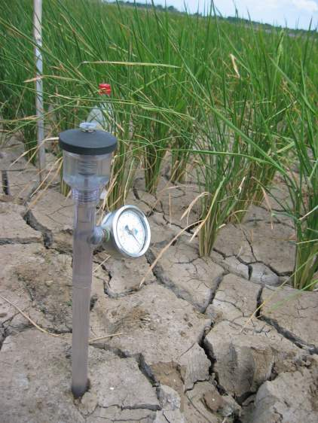
Comparison of soil water measuring techniques
Soil Moisture Neutron Probe is the preferred soil water measurement technology:
  measures larger volume of soil than others - adv variability of soil water on the small scale near to the access tube;
  less sensitive to salinity or temperature - large errors in capacitance or TDR systems used in access tubes.
Alternatives (depending on needs and $):
  Gravimetry
  Tensiometers
  Thetaprobe
  Diviner-2000
Notes:
Advantages:
simple, repeatability, dependable and reliable
fast, economical, non-destructive
temporal soil moisture changes can be monitored
relatively easy to install
large volume of soil is measured, providing more reliable measurements of soil moisture than most methods in large scale studies
moisture changes with depth can be determined The conclusion of this comparative study was that most of the devices examined, worked well some of the time but all of them performed quite badly in some circumstances. The group was aware that the choice of a water measurement technology is often made for economic, convenience, and other reasons and there was a need to be able to get the best results from any device. The choice of a technology is sometimes not made by the ultimate user, or even if it is, the main constraint may be financial rather than technical.

Slide 22
Screening Tools and Methodologies
Line Source Irrigation
Rain-out shelters
Drained paddy (lowland)
Continuous intermittent stress (upland)

Slide 23
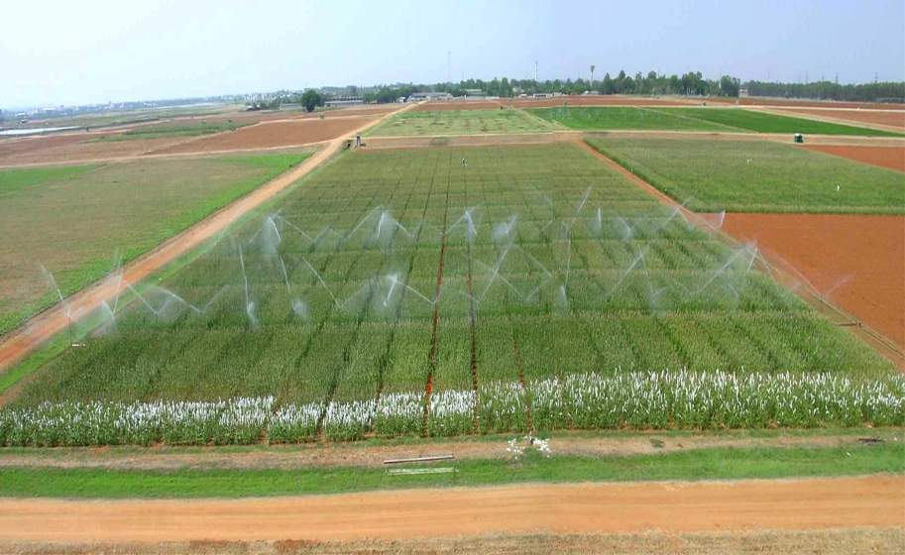
Line source moisture gradient evaluation

Slide 24
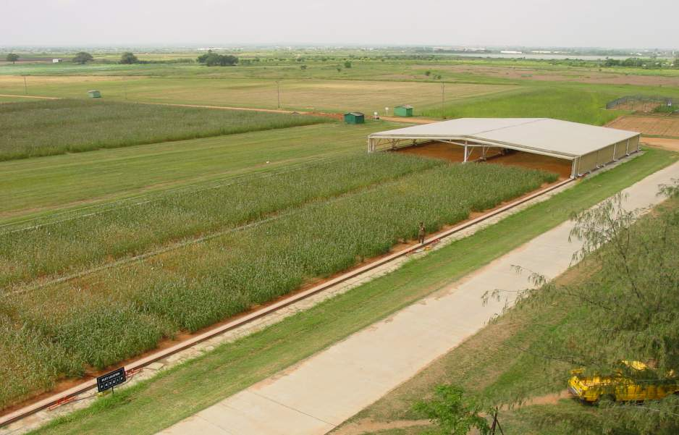
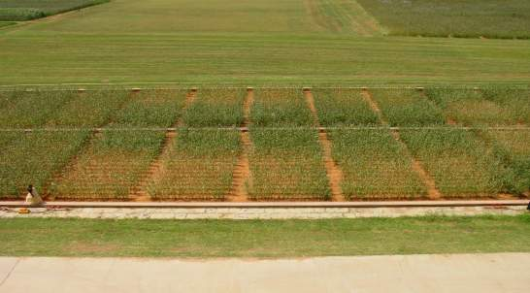
Drought evaluation under rain-out shelter

Slide 25
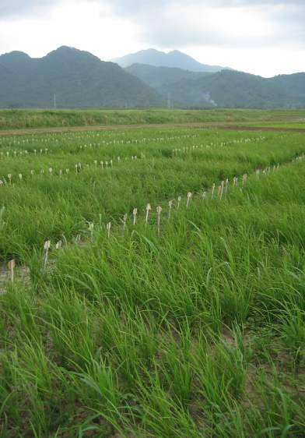
Dry-season managed environments
1. vegetative screening
Are they useful?
can be useful as a comparative method IF stands are good, water can be applied evenly AND this is the type of stress that occurs in the target environment
e.g. subsets of diverse IRRI germplasm collection
Strategy:
Select for lines that continue growth with early water shortage (deep effective roots, continued tillering) – avoid survival stage!
Select lines that tolerate delayed transplanting – early vigor
(e.g. Batangas area: delayed rainfall)
URV2-DS-2006:900 entries x 3 reps

Slide 26
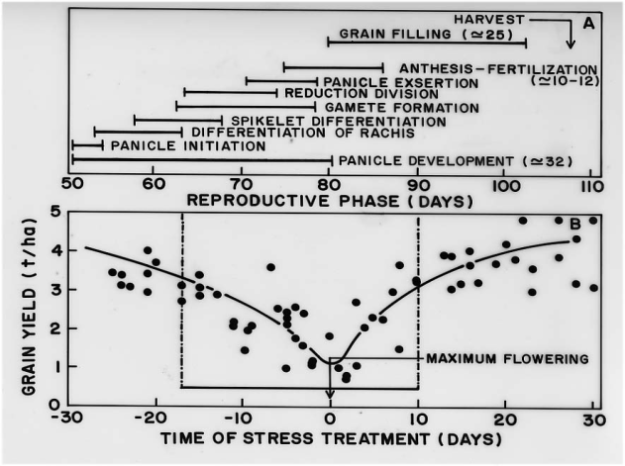
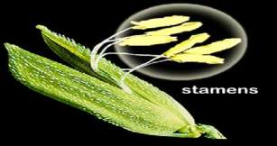
Dry-season managed environments
2. reproductive-stage screening
Management is complex: interaction of phenology x stress phase
Stress management options should be adjusted for cultivar phenology:
staggered planting,
individual plot irrigation

Slide 27
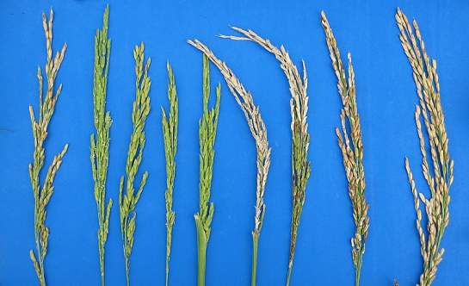
Applying stress at flowering
14-20 days of water exclusion around flowering reduces yield by 50-80 %
when flag leaf auricle reaches auricle of the penultimate leaf on the first tiller, ~7 days before 50% anthesis in control plots
Effects:
Spikelet fertility
Pollen formation
Panicle exertion
Pollen germination
Fertilization
Embryo development/abortion
Azucena panicles 03DS
Last irrigation d57 d64 d69 d73 d78 d85 d90 d95 control

Slide 28
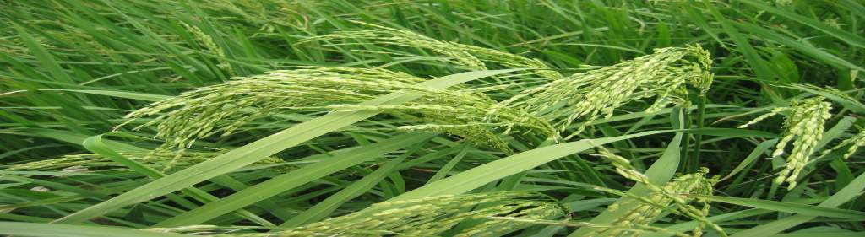
Direct selection for yield components
Heritability of yield under stress is not very different from yield in NS in case of well-managed experiments
Need to consider yield in good years as well as in drought years – must have yield potential experiments
Need to reduce yield by >50% in stress treatment to get valuable variation
Variation in maturity and yield potential can interfere with drought responses!

Slide 29
5th message:
Know your target environment : What type of stress is more frequent?
Yield stability under drought should be the target
Screening system should be uniform, repeatable and differentiate genotypes
Field and irrigation management are critical for drought screening (You have the data you pay for…)
Screening procedure = f (targets, needs & means)
(No single size fits all…)

Slide 30
Trait-based crop yield improvement under drought
Unsuccessful for 3 major reasons :
Lack of effective integrative multidisciplinary approach associating physiology, breeding, genetics, modeling..
Criteria more related to survival mechanisms than to productivity
Too long & unranked “shopping list” of physiological traits to be improved
Priority as a function of the target environment

Slide 31
Putative physiological traits applied in breeding for drought tolerance
Emergence characteristics/vigor
Nutrient acquisition/uptake efficiency
Leaf development & photosynthesis
Water use efficiency (WUE) component traits
Deep root development
Canopy temperature/stomata regulation
Osmotic Adjustment/relative water content
Hormonal control: ABA, GA , Ethylene
Stay green/senescence
Grain number maintenance
Grain fill duration and rate
Harvest index under drought
Yield & its components under drought etc…

Slide 32
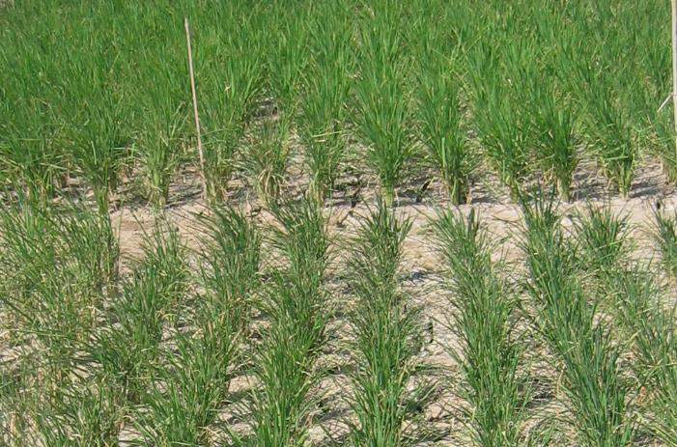
Simple scoring methods such as leaf drying and rolling, scored around flowering stage can be a useful secondary traits for detecting differences in plant water status

Slide 33
Breeding for drought-affected environments
Options
direct selection for yield & components, trait-based selection, MAS, transgenics
Strategy
direct selection for yield has promise (slow?)
close attention to experimental design and management
donor parental lines with useful traits
secondary traits can be helpful, but with careful and integrated approach

Slide 34
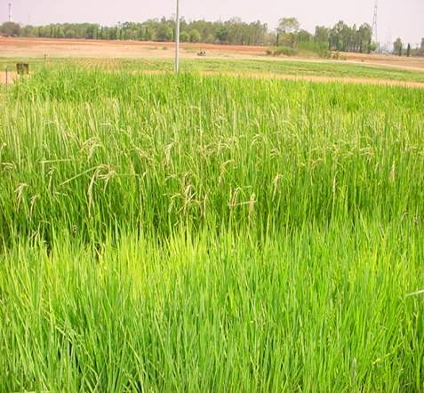
Marker Assisted Breeding:
Genomic tools for applied plant breeding
  Choice of parental lines for crosses
    Diversity assessment
  Choice of breeding scheme
    Required degree of recombination
  Selection criteria
    Improve heritability
    Reduce time required
  Components of more complexly inherited traits
    Pyramiding oligo-genes
    Minimizing undesirable correlations
  LD & Associative mapping
  Phenotyping is most critical

Slide 35
6th message:
Know your target environment : What type of stress is more frequent?
Yield stability under drought should be the target
Screening system should be uniform, repeatable and differentiate genotypes
Field and irrigation management are critical for drought screening (You have the data you pay for…)
Screening procedure = f (targets, needs & means) (No single size fits all…)
Trait-based improvement needs careful choice and requires integration of breeding & other disciplines

Slide 36
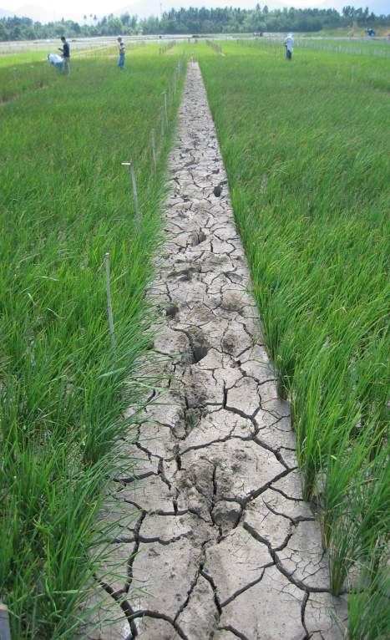
Conclusions
No quick fix to drought stress: “the pathway exists!”
Small and steady steps + integration and synergy
Improvements: site & TPE characterization (historical weather data), more drought-prone sites(?), Systems analysis, DSI, soil hydrology, database, trials replication, careful and yield-based trait dissection..

