Slide 1

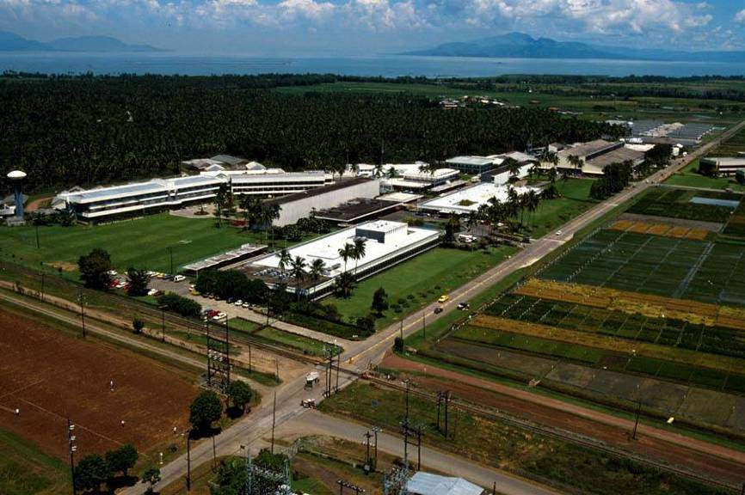
Breeding for Salt Tolerance in Rice
R.K. Singh
PBGB, IRRI

Slide 2
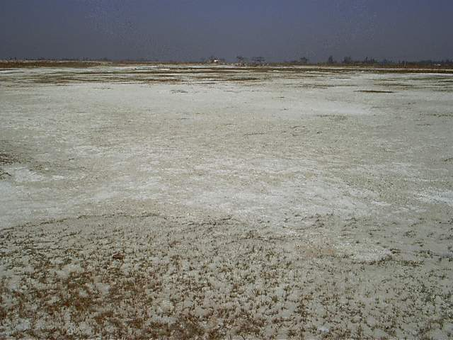
Outlines of the Lecture
Extent of the problem and management options
Reason of Limited Success
Plant adaptation – salt tolerant mechanisms
Morphological symptoms
Basic concepts (genotype vs. phenotype and heritability)
Genetic Studies
Screening techniques
Breeding strategy
Physiological mechanisms
Molecular mapping
Varietal development
NRM approaches

Slide 3
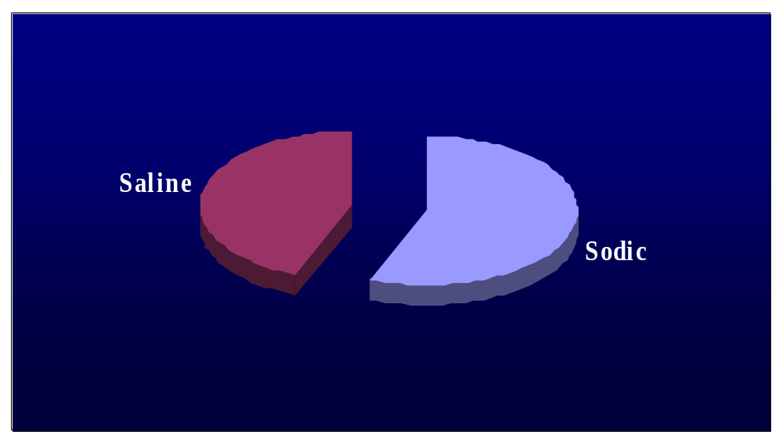
EXTENT OF SALT-AFFECTED SOILS
World’s Total area
12.78 b ha
340 x 10⁶ ha (Ponamperuma, 1984)
954 x 10⁶ ha ( Massoud, 1974)
10% area ~ 1.2 b ha (Tanji, 1991)
FAO Database
397 x 10⁶ ha (3.1%) – Saline soils
434 x 10⁶ ha (3.4 %)– Sodic Soils
Asia, Pacific and Australia (M ha)
195
249
Total : 444 M ha
Source : FAO database

Slide 4
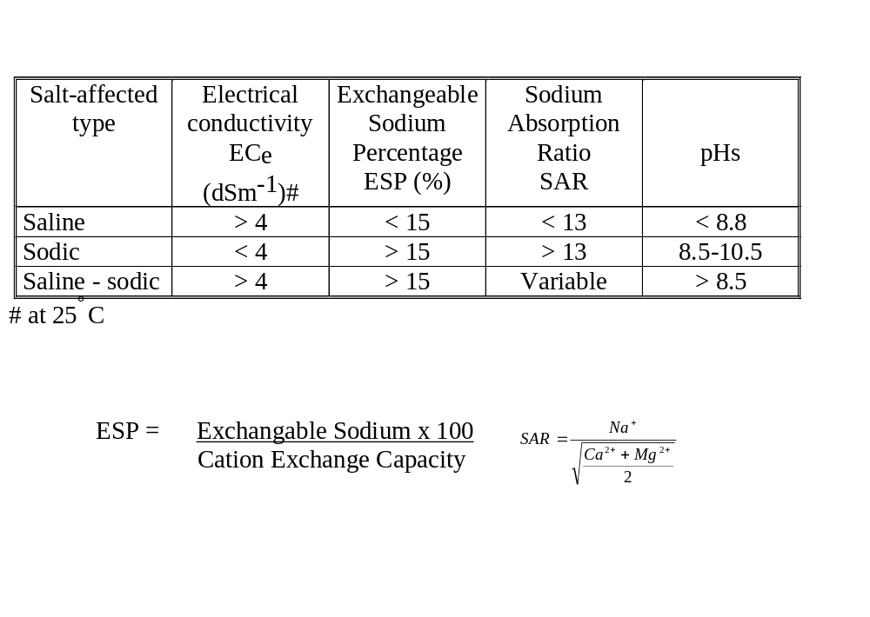
What are the salt-affected soils ?

Slide 5
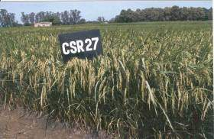
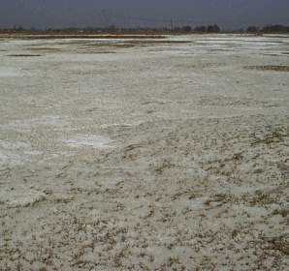
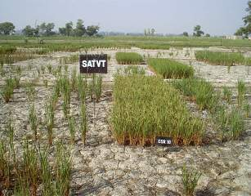
How to Manage the Salt-affected Areas ?
Do we need ST cultivars ?
1. Environment modifying approach : Change the environment for the normal growth of plants
2. Crop based approach : Select or develop crop variety which can withstand the salt stress
Rice has enormous variability

Slide 6
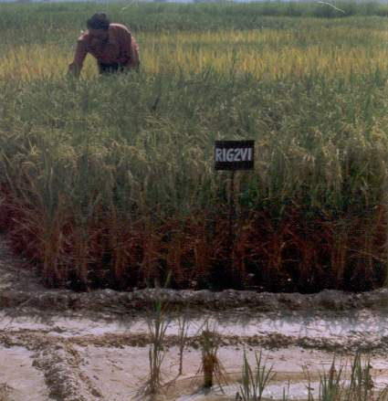
Management of the Salt-affected Soils
3. Hybrid Approach It is the combination of environment modifying and plant based approach. Advantages: More viable Highly productive Low resource cost
Salt tolerant rice variety, CSR13, with 25% Gypsum
Local variety without gypsum

Slide 7
Reasons of Limited Success
Salt stress seldom happen in isolation
Harsh, highly variable environment, large G/E
Lack of efficient / precise screening procedure
Lack of mechanistic understanding
Low priority and less number of researchers involved

Slide 8
Salt Stresses and Associated Complexities
S
A
L
T
S
T
R
E
S
S
E
S
S
A
L
I
N
E
Acid
(P, Zn)
Fe, Al
tox
R
A
I
N
F
E
D
Sub-
merged
Deep-
water
Drought
G
r
a
I
n
Q
u
a
l
i
t
y
SO₄
(P, Zn)
Fe, H₂S
tox
Peat
(P, Zn)
Al, Organic
Acids tox
ALKALINE
(P, Zn)
(Fe)
Irrigated
INLAND
SALINE
(P & Zn)
(Source: Glenn B. Gregorio)

Slide 9
Breeding
for
Salt tolerance + High productivity
Single trait
Na⁺ Exclusion
Tissue tolerance
K⁺ uptake
Partitioning etc.
All are quantitative trait
Quantitative trait

Slide 10
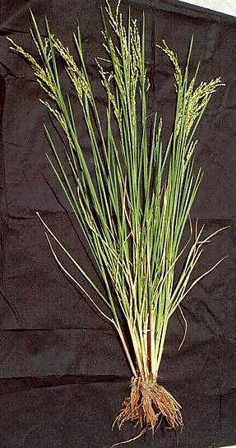
Predominant salt-tolerance mechanisms operating in plant
4. Sequestration of the toxic ions to vacuole or cell wall – cell level compartmentation
3. Excretion of salt through salt glands, salt-hairs or bladders – in most halophytes
2. Transporting the toxic ions to stem, leaf sheath or older leaves – plant level compartmentation
1. Restricting the entry of toxic ions at root level - Exclusion
Na⁺ Cl⁻

Slide 11
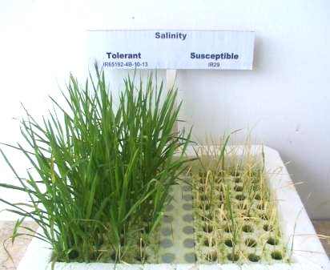
Physiology: traits associated with salinity tolerance
Regulation of uptake
Earliness
Responsive
stomata
Compartmentation
In old tissue
Protective metabolites
Polyamines, dehydrins, glyoxalates
Upregualtion of
antioxidants
Vigorous growth
AOSS
Osmoprotectants
K⁺
[Na⁺]
Compartmentation within tissue
(tissue tolerance)
AVP1
AtNHX1
H⁺
Na⁺
H⁺
SOS1
PP_{i}ase
Vacuolar Na⁺/H⁺
Na⁺
H⁺
Source : A.M. Ismail
Plasma Na⁺/H⁺

Slide 12
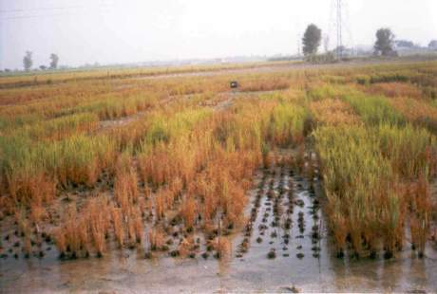
Manifestation of Salt Stress
Morphological Symptoms
❖ White leaf tip followed by tip burning (salinity)
❖ Leaf browning & death (sodicity)
❖ Stunted plant growth
❖ Low tillering
❖ Spikelet sterility
❖ Low harvest index
❖ Less florets per panicle
❖ Less 1000 grain weight
❖ Low grain yield
❖ Change in flowering duration
❖ Leaf rolling
❖ White leaf blotches
❖ Poor root growth
❖ Patchy growth in field

Slide 13
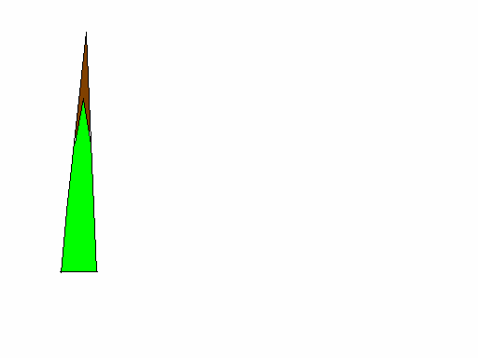
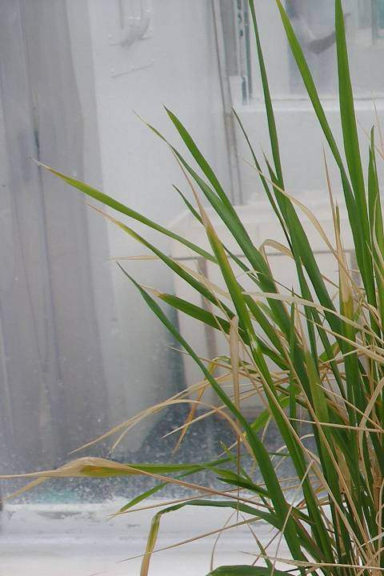





First symptom
“Leaf tip burning”
“Leaf tip burning extends toward base through Lamina”
“Ultimate death of leaf – always from oldest to youngest”
Salinity symptoms at the vegetative stage

Slide 14
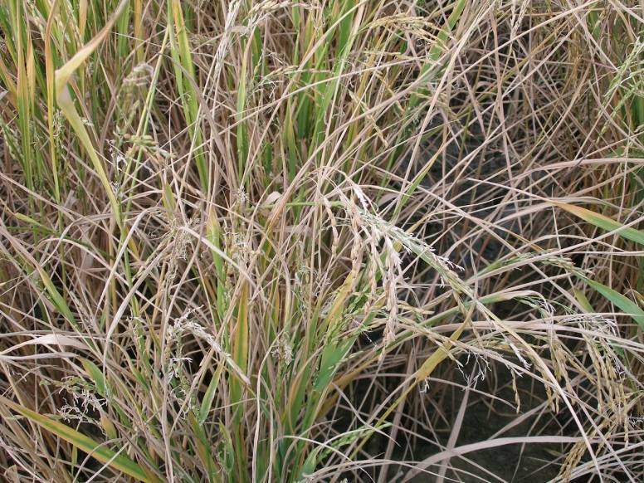
Effect of salinity at Reproductive stage – Spikelet Sterility

Slide 15
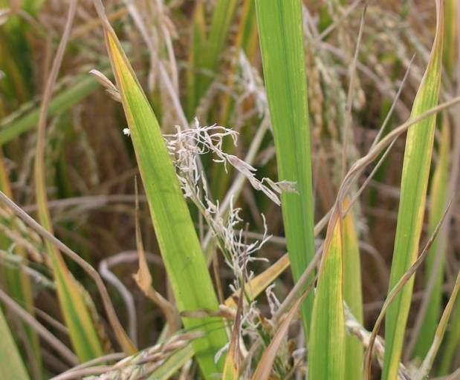
Effect of salinity at reproductive stage – papery sterile spikelets

Slide 16
Manifestation of Salt Stress
Physiological & Biochemical
❖ High Na⁺ transport to shoot
❖ Preferential accumulation of Na in older leaves
❖ High Cl⁻ uptake
❖ Lower K⁺ uptake
❖ Lower fresh and dry weight of shoot and roots
❖ Low P and Zn uptake
❖ Increase of non-toxic organic compatible solutes
❖ Increase in Polyamine levels
Screening parameters ?

Slide 17
Vegetative vs. Reproductive stage salt tolerance
Which is the most reliable stage for screening ?
Association between | Correlation Coeff.
 | Glasshouse studies | Field studies
Veg. stage tolerance vs. Grain yield Rep. stage tolerance vs. Grain yield Veg. stage vs. Rep. stage tolerance | - 0.58^{ns} - 0.97** 0.59^{ns} | - 0.022^{ns} - 0.82** 0.34^{ns}

Slide 18
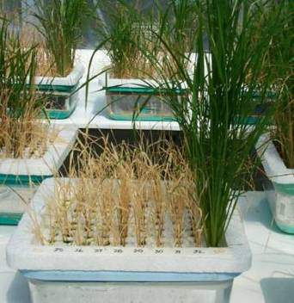
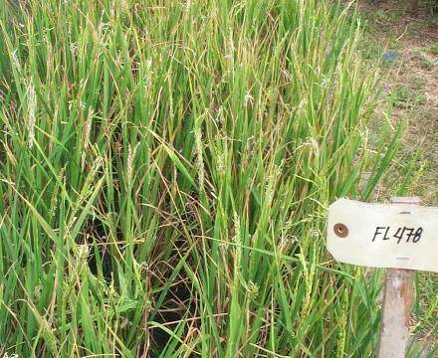
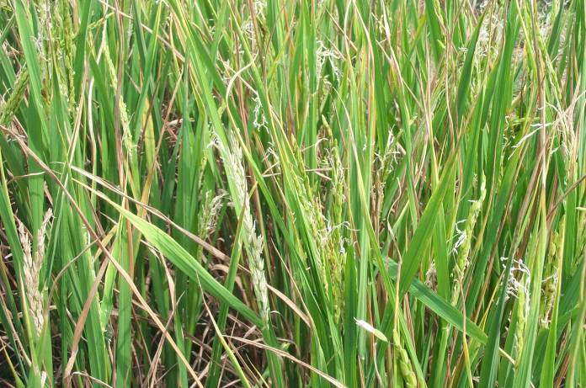
IR66946-3R-178-1-1
Papery florets
Chaffy panicles

Slide 19
Basic Concepts – Genotype vs. phenotype
Plant breeding is based upon most basic yet most important genotype and phenotype relationship (William Johannsen, 1903)
Genes cannot push a trait to develop unless appropriate environment is provided
No amount of manipulation can cause a phenotype to develop unless necessary genes(s) are present

Slide 20
Probability of getting the desirable genotype
Why Recurrent selection – mating of the selected individuals ?
 | Number of gene(s) responsible for a trait (n) / Genotypic classes
 | 1 | 2 | 5 | 10
F2 F3 F4 F5 F6 | 1:2:1 3:2:3 7:2:7 15:2:15 31:2:31 | 1:2:1:2:4:2:1:2:1 3:2:3:6:4:6:3:2:3 7:2:7:14:4:14:7:2:7 15:2:15:30:4:30:15:2:15 31:2:31:62:4:62:31:2:31 | 243 classes | 59,049 classes
P* | 1/4 | 1/16 | 1/ 1,024 | 1/ 1,084,576
*: P is the probability of getting the desired homozygote at all the loci in smallest perfect population in F₂ (1/4^{n})
Trait A = 5 loci -- Desired recombinant – 1/1,024
Trait B = 10 loci -- 1/1,084,576
Prob. of getting both desired one in one background = 1/1,024 x 1/1,084,576
= 1/ 1,110,605,824 (> 1b)

Slide 21
Heritability concept
Heritability : Ratio of Genotypic or Additive vs. Phenotypic variances
Estimates always based on “target population in both space and time and of-course environment where it is estimated”
Heritability estimates: Usually biased upward
Genetical factors – difficult to separate out the epistatic factors (Add x Add) from the allelic interaction (Add)
Environmental : Plant breeders try to minimize it by replicating (r) the materials, growing at different locations (l) over years (y).

Slide 22
Heritability concept
Broad sense – σ²_{G} / σ²_{P} = H
Narrow sense - σ²_{A} / σ²_{P} = h² (not the heritability square)
h² : derived from Sewall Wright’s terminology (Systems of Mating. 1921), where h is the path coefficient / standard partial regression coeff.
Defines:
Identity between relatives – Empirical resemblance
Transmitting from parents to offspring
Prediction of the genetic gain from the selection

Slide 23
Heritability concept
Linear Model:
P = µ + G + GxE + E
P = µ + G + [GxL + GxY + GxLxY] + [r +L+Y+LY+e]
σ²_{p} = σ²_{g} + ryσ²_{gl} + rlσ²_{gy} + rσ²_{gly} + rlyσ²_{e}
ry rl r rly
σ²_{g}
H = ------------------------------------------------
σ²_{g} + ryσ²_{gl} + rlσ²_{gy} + rσ²_{gly} + rlyσ²_{e}
ry rl r rly

Slide 24
Precision vs. Resources
Precision
Resources
r
low
No. of
l
more
y
Very High
Since the salinity is highly variable in soil due to the dynamic state of soluble salts hence one should go for more blocks at different locations over the years (judiciously compromising the resources) for the precise estimates

Slide 25
Heritability controls genetic advance under selection
Genetic Advance under Selection (G_{s})
Depends upon:
Heritability
Phenotypic variance
Standardized selection differential (k)
G_{s} = k . σ²_{p} . H
G_{s} = k. σ²_{p} . σ²_{g}/ σ²_{p}
G_{s} = k. σ²_{g}
Population %
q
2σ
σ
0
σ
2σ
k = selected plants / total populations
= q / n
If 1% plants selected; k = 2.64
Similarly
5% = 2.06
10% = 1.76

Slide 26
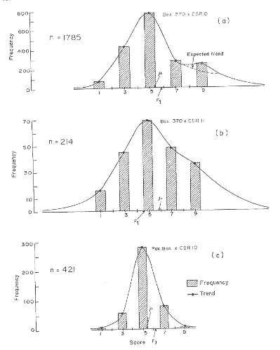
Genetics of Salt Tolerance
Inheritance Pattern
SALINITY
Based on reproductive stage tolerance
Bas. 370 / CSR10
Bas. 370 / CSR11 Pak. Bas. / CSR10
Controlled by numerous minor genes as revealed by the normal distribution curve with few major genes (skewness)
Substituted

Slide 27
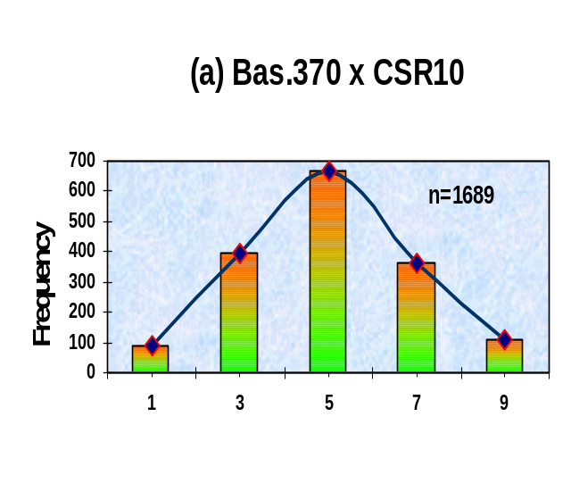
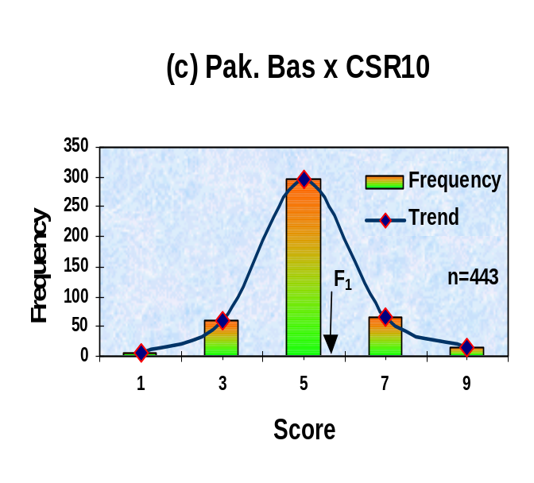
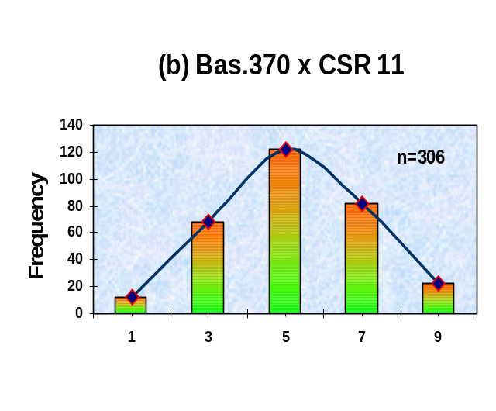
Genetics of Salt Tolerance
Inheritance for sodicity tolerance
Similar results (based on the same crosses
P2
F₁
X
P1
X
P1
F₁
X

Slide 28
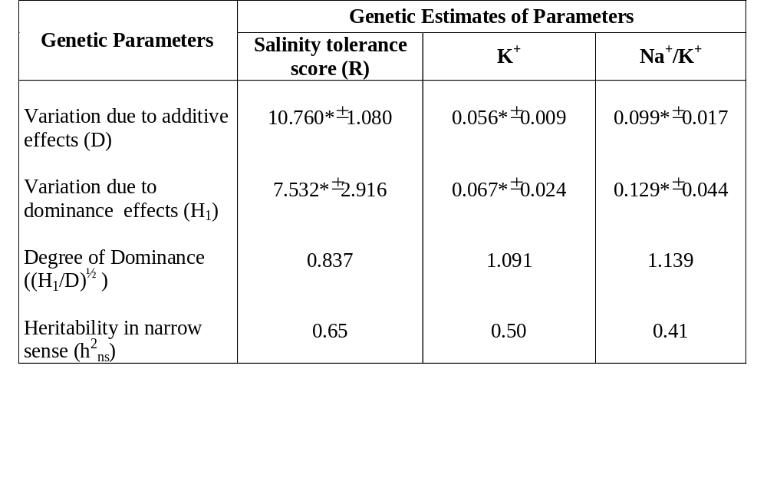
Genetics of Salt tolerance
Gene Action (based on 6x6 diallel)
SV | df | Mean Square
GCA SCA Error | 5 15 40 | 15.36* 3.71* 0.22 | 0.238* 0.066* 0.012 | 0.100* 0.033* 0.006

Slide 29
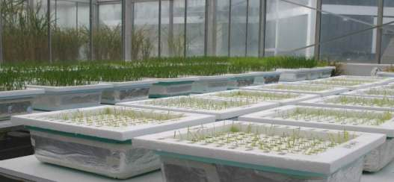
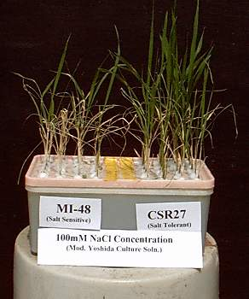
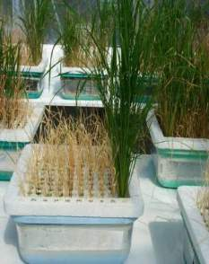
Screening Techniques Standardised
Seedling stage tolerance:In 20 days can classify the tolerance level

Slide 30
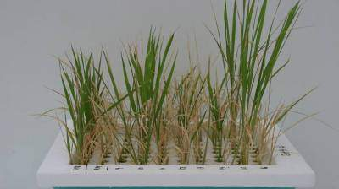
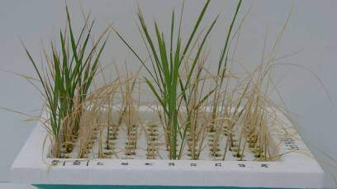
Screening technique standardised
Cheriviruppu
Tolerant check
IR 66946-3R-178-1-1
IR 29 (sensitive check)
Muskan41
KR 1-24
IR 66946-3R-178-1-1
IR 29
NB: Instead of Pokkali, now IR 66946-3R-178-1-1 is being used as tolerant check
which is derived from IR29 / Pokkali cross. It is semi-tall, photoinsensitive and highly
salt tolerant

Slide 31
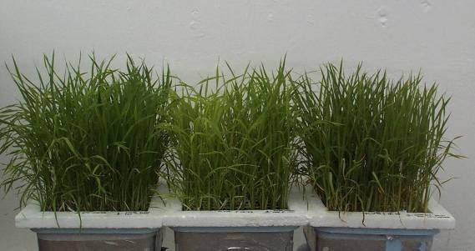
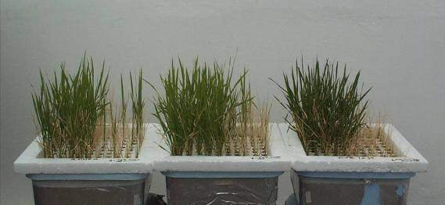
Normal
1 2 3
FL478 / IR29 FL478 / IR29 FL478 / IR29
Saline
1 2 3
(Source: Dante Adorada)
FL478 / IR29 FL478 / IR29 FL478 / IR29
Performance of 1 mo-old FL478 (tolerant line) and IR29 (susceptible variety) rice seedlings under normal and saline (14d EC12 then 14d EC18) conditions using SNAP and nutrient solutions: (1) 100% SNAP solution in tap water, (2) 75% SNAP solution in tap water, and (3) nutrient solution in distilled water.

Slide 32
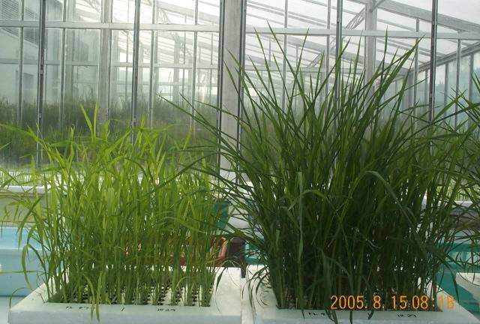
Comparison between 28-day old rice seedling grown for 21 days in SNAP solution (Simple Nutrient Addition Program) with (a) 100% nitrate and (b) 90% nitrate & 10% ammonium in their composition.
(Source: Dante Adorada)

Slide 33
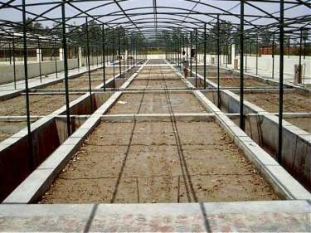
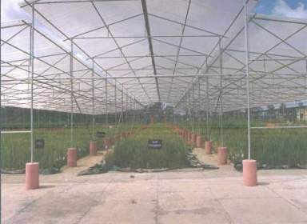
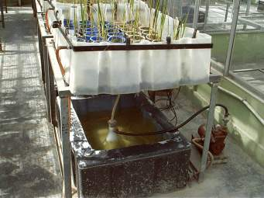
Phenotyping for the Adult Plant Salinity Tolerance
Microplots with controlled salinity and sodicity
Saline Soil Environment
(Rain shelter)
Sodic Soil Environment
Automatic Circulatory Solution Culture System

Slide 34
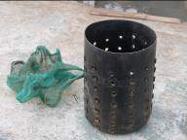
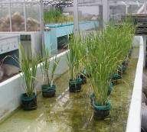
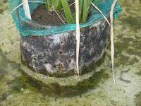
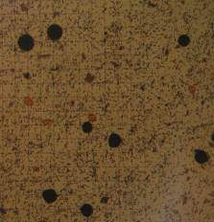
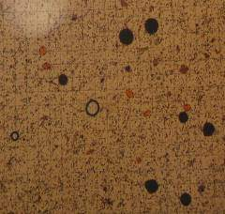
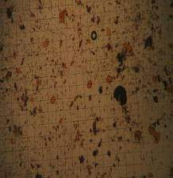
Screening Techniques Standardized
Adult Plant
Soil surface
collar
15 cm
Perforated
part with filter
Fertile Pollen
Sterile Pollen
20 cm
Hollow plastic cylinder with
close bottom
0mM
60mM
100mM
Pollen Sterility at different Salt Stress Levels

Slide 35
Salinity Tolerance in Rice
Na is the most notorious element causing salt related problems in plants
Its higher uptake hinders the metabolic activities in plants
Plants try to resist this element using various physiological mechanisms
  Na⁺ exclusion,
  Tissue Tolerance
  Higher K⁺ uptake to counter Na
  Compartmention (Preferential accumulation of Na⁺ in stem, leaf sheath, older leaves etc.)
  Early vigour
  …… Many more

Slide 36
Breeding Strategy
Identification of the genotypes based on the inherent physiological mechanism (Na exclusion, K uptake, Tissue tolerance and high initial vigor etc.) responsible for salinity tolerance
Inter-mating of the genotypes with high degree of expression of the contrasting salinity tolerance mechanism
Identifying / screening of the recombinants for pooling/ pyramiding of the mechanisms

Slide 37
Breeding Strategy
Identify the donors for predominant physiological mechanisms responsible for salt tolerance
Na⁺ exclusion,
Tissue Tolerance
K⁺ uptake,
Preferential accumulation of Na⁺ in stem, leaf sheath, older leaves etc.
Early vigour
However, none of the rice variety posses all the possible positive mechanism conferring salinity tolerance.

Slide 38
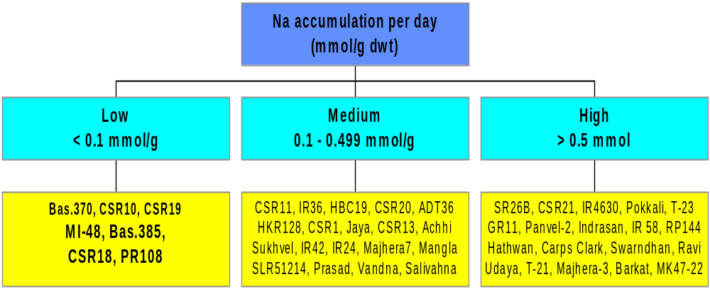
Grouping of the rice varieties on the basis of
Na accumulation per day

Slide 39
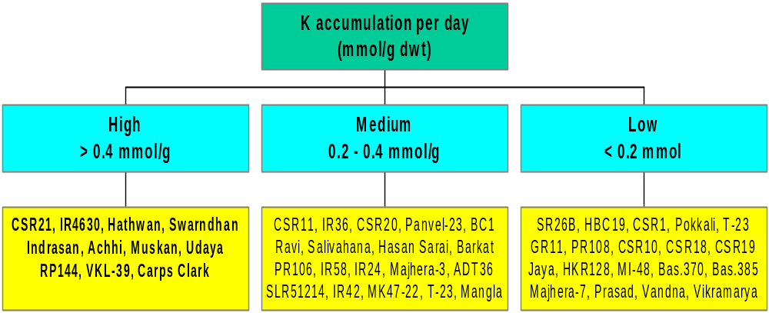
Grouping of the rice varieties on the basis of
K accumulation per day

Slide 40
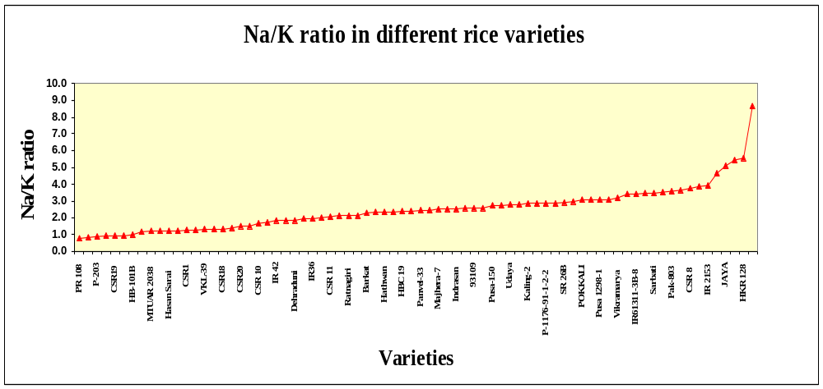

Slide 41
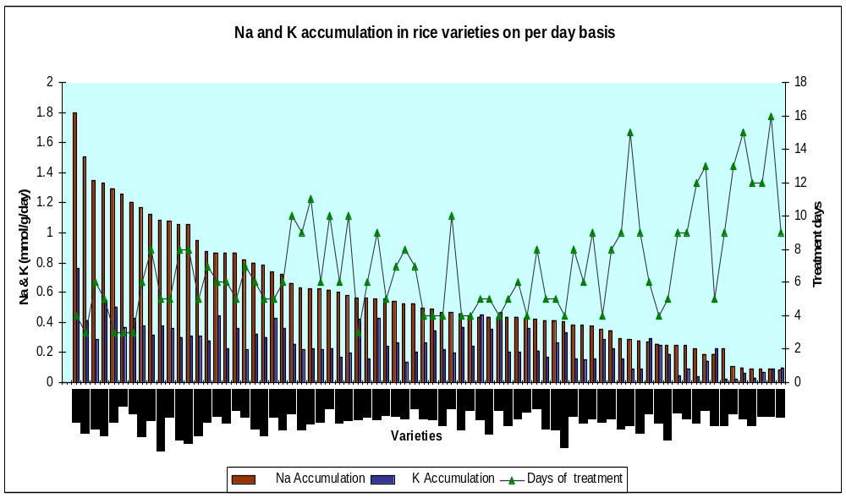

Slide 42
Rice variety C
Good excluder
+
High tissue tolerance
Rice variety A
Good excluder
+
poor tissue tolerance
Rice variety B
Poor control at root level
+
High tissue tolerance
Garbage
Na⁺
K⁺
Dustbin

Slide 43
DSMS involving MAS
Series – P1
Basic parents
Season 1
Series – P2 F₁ diallels
F1 Plants
Season 2
F2 Seed
Backcross Series BC₁F₁
MAS
Marker based screening
Series – P3
1st selective mating
F2 Plants*
Modified bulk / pedigree selection
F1 Plants
Season 3
F3 Seed
F2 seed
Backcross Series BC₂F₁
MAS
Series – P4
2nd selective mating
F3 Plants (MAS
F2 Plants*
Modified bulk / pedigree selection
F1 Plants
Season 4
F4 Seed
F3 seed
F2 seed
MAS
F4 Plants
Backcross Series BC₃F₁
F3 Plants
F2 Plants*
Modified bulk / pedigree selection
F1 Plants
Season 5
F5 seed
F4 seed
F3 seed
F2 seed
MAS
F5 Plants
F4 Plants
F3 Plants
F2 Plants*
Modified bulk / pedigree selection
Season 6
F6 seed
F5 seed
F4 seed
F3 seed
BC₃F₂ Plants
F6 Plants
F5 Plants
F4 Plants
F3 Plants
Season 7
F7 seed
BC₃F₃ seed
F6 seed
F5 seed
F4 seed
Stabilised lines & RILs
Adaptive varieties +trait, NILs
Stabilised recombinant lines
Improved lines with multiple abiotic stress
Improved lines with multiple abiotic stress
Output

Slide 44
An Ideal High Yielding Salinity Tolerant Variety
Highly tissue tolerant
Good Excluder- Minimum per day uptake of Na⁺
High uptake of K⁺ per day
Low Cl⁻ uptake
Low Na⁺/ K⁺ ratio
Good initial vigour
Agronomically superior with high yield potential (plant type + grain quality)

Slide 45
Breeding Strategy
Grouping of the genotypes based on the inherent physiological mechanism responsible for salinity tolerance
Inter-mating of the genotypes with high degree of expression of the contrasting salinity tolerance mechanism
Identifying / screening of the recombinants for pooling/ pyramiding of the mechanisms - MAS

Slide 46
Progress of Saltot locus
Short arm of chromosome 1
Saturated map of the Chromosome 1 (Saltol segment) is developed
Closely linked
markers linked to
the saltol locus
identified
MAS is being
validated in 3
breeding populations
RM283
RM283
0.0
RM283
0.0
0.0
R844
R844
27.4
R844
AP3206
27.4
27.4
0.0
S2139
CP03970
S2139
28.4
S2139
28.4
28.4
RM23
1.0
RM3412
RM23
40.0
RM23
40.0
40.0
1.3
60.6
RM8094
RM140
1.2
RM140
64.9
RM140
RM493
C52903S
66.2
C52903S
1.8
CP6224
C1733S
1.9
71.2
C1733S
RM113
RM140
RM113
75.3
RM113
75.3
75.3
S1715
S1715
77.2
S1715
77.2
77.2
S13994
S13994
91.9
S13994
91.9
91.9
98.2
98.2
98.2
RM9
RM9
RM9
99.1
99.1
99.1
R2374B
R2374B
103.1
103.1
103.1
RM5
RM5
RM5
119.5
119.5
119.5
C1456
C1456
123.5
C1456
123.5
123.5
RM237
RM237
RM237
RM246
RM246
129.9
RM246
129.9
129.9
(Source: Glenn B. Gregorio)
A

Slide 47
Chromosome location of associated QTL of Salinity tolerance trait
AP3206
CP010136
RM3412
LOD threshold
CP03970
a
RM8094
RM493
b
CP6224
RM140
2.5
0.0

Slide 48
Rice Chromosome 1
Saltol region ( Major QTL K⁺/Na+ratio )
cM
60.6
60.9
62.5
64.9
65.4
65.8
66.2
67.6
67.9
CP12 domain, putative
Stress-inducible membrane pore protein
Zinc finger, C3HC4 type (RING finger), putative
Universal stress protein family
Cation-chloride co-transporter
Receptor like protein kinase
Myb-like DNA-binding domain, putative
Peroxidase, putative
Cell wall protein type (Extensin,Hydorxyproline rich, glycine rich)
Cation transporter
Phospholipase D. Active site motif, putative
Protein kinase domain, putative
Dual specificity phosphatase, catalytic domain, putative
Pectinemethyesterase/invertase inhibitor
Pectinesterase
preprotein translocase, SecA subunit
Sec23/Sec24 trunk domain, putative
Ser Thr Kc
Protein kinase domain
S-adenosylmethionine synthetase
chloroplast membrane protein
Cold shock protein
secretory peroxidase
CBL-interacting protein kinase 19
Peroxidase, putative
Cell wall protein type (Extensin, Hydorxyproline rich, glycine rich)
phospholipid/glycerol acyltransferase –like
Mitochondrial carrier protein, putative
GDSL-like Lipase/Acylhydrolase, putative
organic cation transporter
major facilitator superfamily protein
Cell wall protein type (Extensin,Hydorxyproline rich, glycine rich)
(Source: Ellen Tumimbang)

Slide 49
preprotein translocase, SecA subunit
chloroplast membrane protein
CBL-interacting protein kinase 19
Sec23/Sec24 trunk
SAM synthetase
Ser Thr Kc
S_Tkc;
WD40
WD40
Receptor like kinase
cold shock protein
secretory peroxidase
Peroxidase, putative
SALtol Region ( Major QTL K⁺/Na+)
12.0Mb
0.27 Mb
(~40 genes)
12.27 Mb
12.11Mb
12.27Mb
11.9 Mb
12.13 Mb
12.25Mb
12.40Mb
11.10Mb
B1153f04
OSJNBa0011P19
12.7Mb
P0426D06
B1135C02
cM
60.6
60.9
62.5
64.9
65.4
65.8
66.2
67.6
67.9
Chromosome 1 of Rice
(Source: Ellen Tumimbang)

Slide 50
List of genes that are located in the region of QTL and up-regulated by high salinity in rice
Gene name | Insertion lines | Clone ID full length cDNA | Rice 60k chip data under high salinity (fold-induction) |  |  | References
 |  |  | 0.5 h | 2 h | 6 h
Pectinesterase | 1B-23740, 1B-23741 CG408589 | Ak105998 | 1.1 | 3.3 | 4.9
Ser/thr kinase |  | AK065231 |  | 2.3 | 2.7 | Guo et al., 2001
Phospholipase D | 1515 | AK120868 |  | 3.5 | 2.6 | Kacperska, 2004 Zhu, 2002
SecA/protein transport factor | CL520490 CL520492 | AK070488 | 3.1 | 1.5
Peroxidase |  | AK099187 |  | 2.6 | 3.05 | Pastori and Foyer, 2002 Sottosanto et al., 2004
Alkaline Invertase |  | AK120720 | 4.0 | 2.2 | 4.2
Unknown cDNA |  | AK099887 | 0.37 | 1.6 | 2.4
(Source: Ellen Tumimbang)

Slide 51
The position of the candidate genes in chromosome 1
Saltol region ( Major QTL K⁺-Na+ratio )
cM
60.6
60.9
62.5
64.9
65.4
65.8
66.2
67.6
67.9
Pectinesterase
Phospholipase D. Active site motif -- putative
  Putative SecA-type chloroplast protein transport factor
  Serine/threonine kinase
  Peroxidase
Plant neutral/alkaline invertase
(Source: Ellen Tumimbang)

Slide 52
Mapping Salinity Tolerance Genes at Reproductive Stage
QTLs for salinity tolerance genes at seedling
stage are different from reproductive stage
Seedling stage tolerance in chrom 1.
Reproductive stage tolerance in chrom 3, 4, 7, and 9
Dr. Mirza M. Islam
Ph.D.

Slide 53
Salt tolerant rice varieties developed by IRRI and released in Philippines
IRRI 112 - PSBRc48 (Hagonoy)
IRRI 113 - PSBRc50 (Bicol)
IRRI 124 - PSBRc84 (Sipocot)
IRRI 125 - PSBRc86 (Matnog)
IRRI 126 - PSBRc88 (Naga)
IRRI 128 - NSICRc106
Other salt-tolerant rice varieties
CSR10, CSR13, CSR23, CSR27, CSR30, CSR36 and Lunishree, Vytilla 1, Vytilla 2, Vytilla 3, Vytilla 4, Panvel 1, Panvel 2, Sumati, Usar dhan 1, 2 & 3 (India); BRRI dhan 40, BRRI dhan 41 (Bangladesh); OM2717, OM2517, OM3242 (Vietnam)

Slide 54
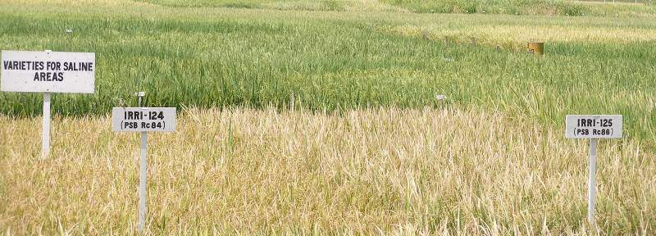
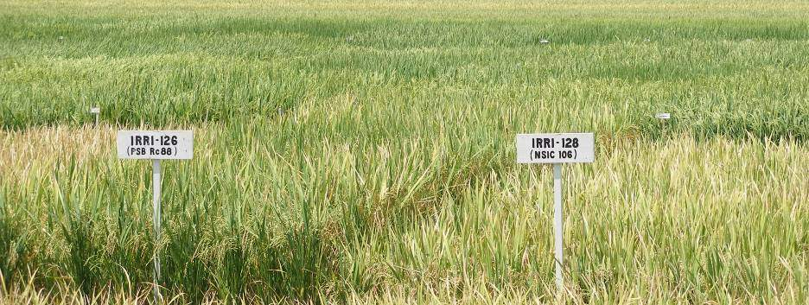

Slide 55
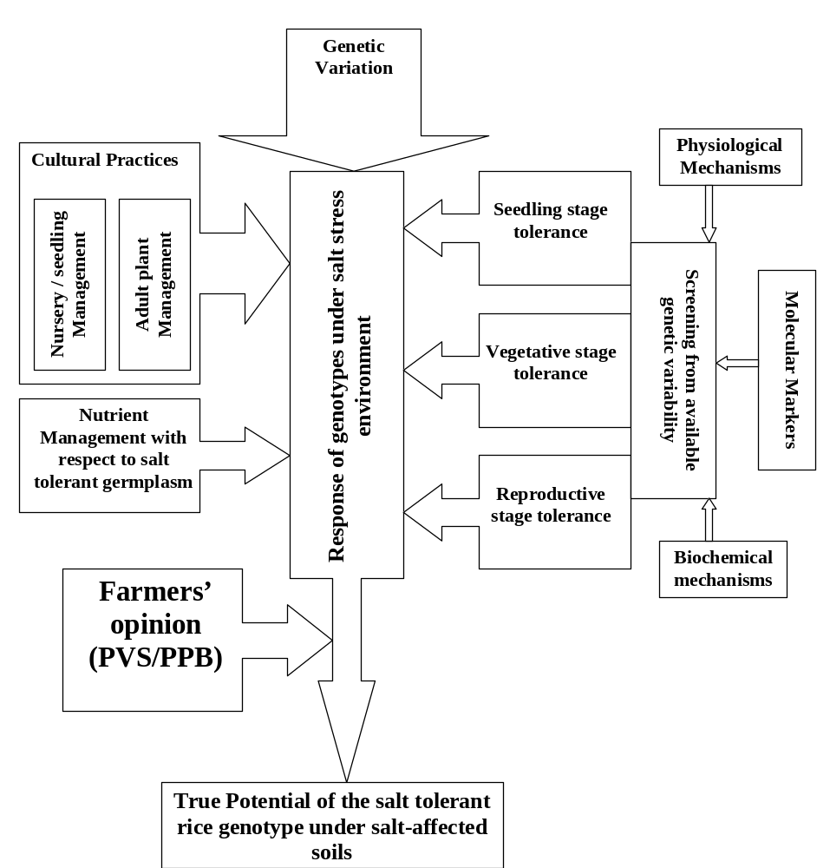
Realization of the Genetic Potential
Promote the Interdisciplinary IRRI-NARS collaborative research, based on CNRM technology and its validation in the farmers participatory mode

Slide 56
Progress in salinity research
 | Saline | Sodic | Zn-def | Acid
Donor | ✓ | ✓ | ✓ | ✓
Screening technique | ✓ | ✓ | ⬧ | ⬧
 | ✓ | ✓ | ✓ | ✓
Mechanism | ✓ | ✓ | ⬧ | ⬧
Genetics | ✓ | ? | ⬧ | ⬧
MAS development |  | ⬧ | ⬧ | ⬧
Elite lines | ✓ | ✓ | ✓ | ?
Lab.
Field
✓ = completed, = fast track, = not available
/available /on-going

Slide 57
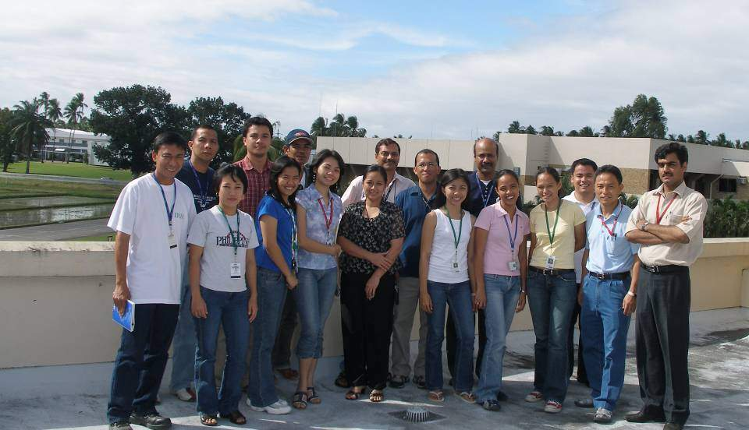
Glenn B. Gregorio Rafiqul Islam Mirza M. Islam Jong C. Ko
R K Singh Andy Sajise Ghasem M. Nejad Glenn Alejar
Adorada Dante Venus Elec Swe Thein Midie
Rhulyx Mendoza Jean Melgar Lorelie Ramos Venessa
Ellen Tumimbang Jaarmi Orly Kelvin
Rollin De Ocampo Angelito Francisco
Thanks for Your Kind Attention

Slide 58
Please feel free to contact any time
r.k.singh@cgiar.org

