Slide 1
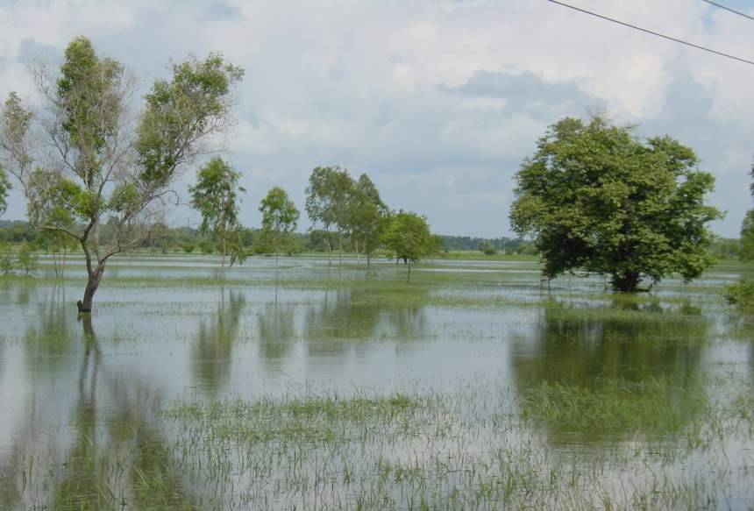
Physiology of Submergence Tolerance and Prospects for Breeding
Abdelbagi M. Ismail
Crop, Soils and Water Sciences Division

Slide 2
The problem
Flashfloods regularly affect around 30 million ha of rice areas (largest areas: India, Bangladesh, Thailand; others: Cambodia, Laos, Indonesia)
Estimated Economic Loss > US$ 400 M
Submergence tolerance is physiologically complex but genetically simple and has been transferred to high-yielding background
The submergence tolerance trait is not widely available to farmers who need it most

Slide 3
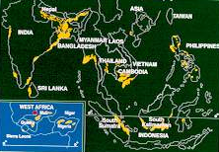
Flood-prone areas in Asia

Slide 4
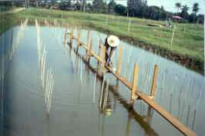
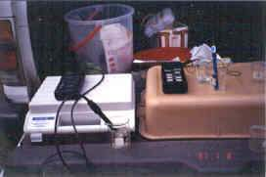
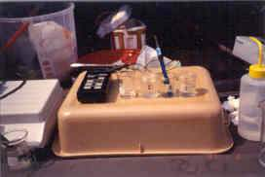
Environmental characterization

Slide 5
Characterization of the environment
Regional flooding and recession patterns, duration and depth
Flood water conditions
  Information on water temperature, turbidity, CO₂, O₂, light & pH, etc.
  Substantial variability observed in different locations, suggests the need for site specific evaluation

Slide 6
Flood-prone environments
Flood type | Tolerance mechanisms
Early- at crop establishment | Flooding during germination & early seedling growth Delayed transplanting
Flash-flooding (short duration) | Submergence tolerance (Sub1 type)
Flash-flooding (longer duration) | Submergence tolerance Regeneration ability
Deep water (Stagnant, slow rise) | Facultative elongation Water stagnation
Deep water (fast ) | Fast elongation ability

Slide 7
Tolerance to flooding during germination and seedling establishment

Slide 8
The problem
All crops are sensitive to flooding during germination
Rice is an exception but tolerance is limited to coleoptile growth
In areas where direct seeding is practiced, early flooding can result in crop failure
Replanting is costly, many farmers may not afford it
Important under irrigation where dry seeding under water could help in weed control
Notes:
About 8000 accessions were screened and few tolerant lines were identified. These will be used for further studies and for breeding

Slide 9
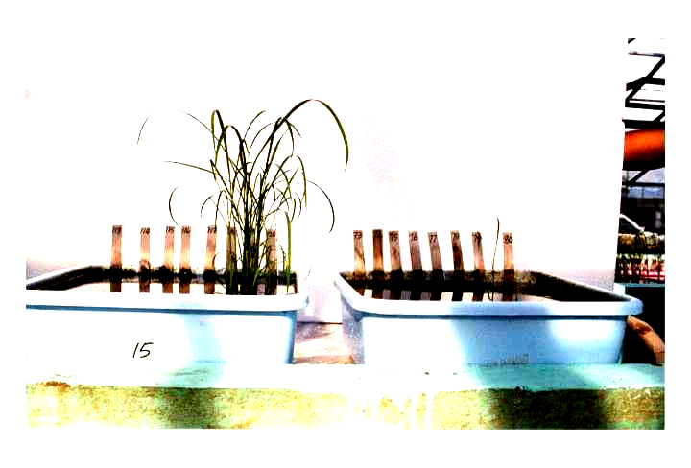
Screening for seed germination and establishment under anaerobic conditions
Seeds of each line planted in rows and submerged under 10 cm of water head

Slide 10
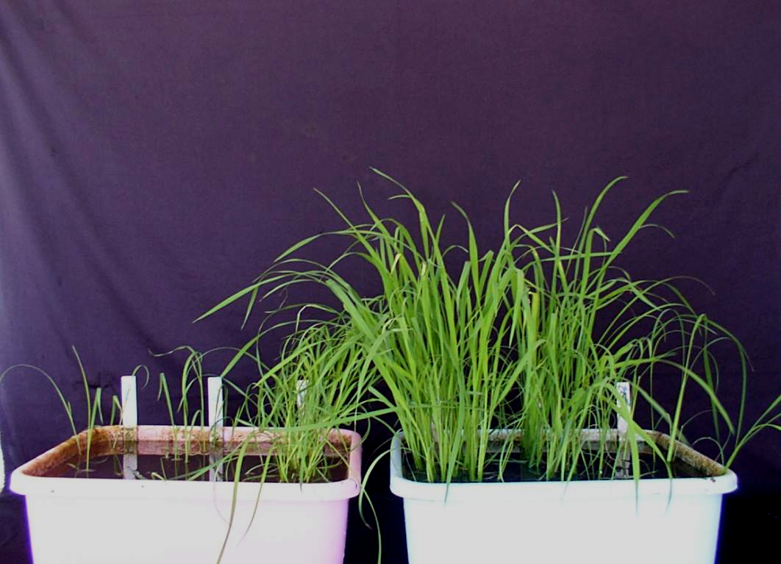
KHAIYAN
IR64
FR13A
KHAO HLAN ON

Slide 11
Some characters of tolerant and intolerant cultivars
Cultivar | Origin | Days to flower | 100 seed wt | Days to emergence |  | % survival
 |  |  |  | soil | water
Dholamon | Bangladesh | 72 | 1.15 | 4 | 9 | 81
Liu-Tiao-Nuo | China | 61 | 2.70 | 4 | 9 | 72
Khaian | ? | 66 | 0.81 | 5 | 11 | 74
Khao Hlan On | Myanmar | 53 | 0.83 | 4 | 9 | 73
IR64 | Philippines | 65 | 2.00 | 7 | 13 | 7
FR13A | India | 70 | 0.97 | 7 | 13 | 10
IR42 | Philippines | 73 | 0.84 | 7 | 13 | 9
Correlation with survival |  | -0.47 | -0.002 | -0.97 | -0.95
Notes:
Percentage survival is negatively correlated with days to emergence from soil and water but not with seed weight, days to flowering and plant height at maturity

Slide 12
Tolerance to anaerobiosis is associated with:
Faster germination and shoot growth
germination: 4.5 d vs 7d
Emergence from water: 9 vs 13 d
Faster stem elongation and leaf area development
Faster coleoptile growth under anoxia
High activity of enzymes associated with starch breakdown
Not associated with:
Root growth rate
Average grain wait (between cultivars)
Cycle length
Plant height at maturity

Slide 13
Other physiological traits associated with tolerance
Higher sugar contents in seeds
Higher ethylene production
High activity of amylases during the first few days of hypoxia
Slower rate of carbohydrate depletion under flooding
Tolerant cultivars have more NSC but is utilized at slower rate under flooding to support the growing seedling for longer duration
Notes:
After 7 d activities of all enzymes involved in carbohydrate metabolism were higher in the susceptible cultivar IR42 like α- and β amylases, debranching enzyme, α-glucosidase, acid and alkaline phosphatases

Slide 14
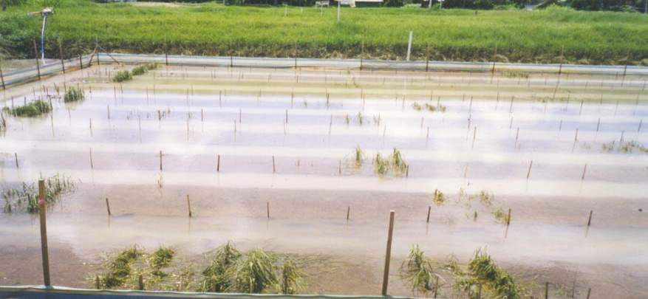

2. Flash flooding: for 1 to 2 weeks
Existing varieties are susceptible
Few tolerant landraces were identified
Good progress achieved in understanding the physiology and genetics of tolerance

Slide 15
Examples of known donors
FR 13A (IR49830-7)
FR13B
Goda Heenati
Kurkaruppan
BKNFR76106-16-0-1-0
Thalavu

Slide 16
Other sources of tolerance
  Khoda
  Khadara
  Kalaputia
Potentially higher level of tolerance than FR13A
  Atiranga
  Matiaburush

Slide 17
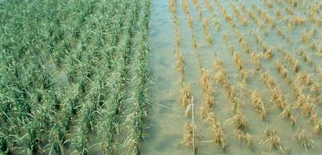
The phenotype
Submerged for12 d

Slide 18
Traits Associated with tolerance to flash flooding (complete submergence)
A. Shoot carbohydrates (CHO)
High correlation observed between survival and stem CHO
Manipulating stem CHO before submergence greatly affect survival as shading, time of day, CO₂ supply in flood water, water turbidity etc.

Slide 19
CHO remaining after submergence is more important than that before submergence
Before submergence
After submergence
20
20
15
15
10
10
Total NSC (%)
5
5
R² = 0.27
R² = 0.74
0
0
0
50
100
0
50
100
Survival (%)
Survival (%)

Slide 20
B. Anaerobic respiration (AF)
Essential for survival under anaerobiosis
Linked to increased activity of enzymes involved in alcohol fermentation
Recent studies showed that AF decreased progressively with time in tolerant lines
Evidence also suggested that down regulation of AF may be adaptive to conserve energy

Slide 21
C. Stem elongation
Limited stem elongation conserve CHO and improve survival
Strong negative correlation between elongation ability and survival
Inhibition of GA biosynthesis improved survival

Slide 22
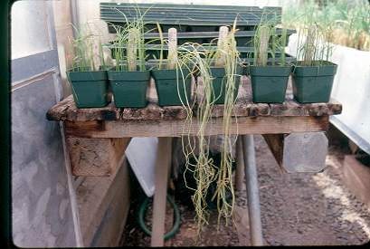
Submergence tolerance and shoot elongation

Slide 23
Strong negative correlation between elongation ability and survival
60
R² = 0.56**
40
Elongation (cm)
20
y = -0.34x + 51.5
0
20
40
60
80
100
Survival (%)

Slide 24
Limited stem elongation conserve CHO and improve survival
60
R² = 0.50**
40
Elongation (cm)
20
y = 3.74x + 12.3
0
3
6
9
12
NSC consumed during submergence

Slide 25
Inhibition of GA biosynthesis improved survival
Treatment | FR13A | Sabita | Hatipanjari | IR42
Submerged | 83b | 19c | 31c | 8c
S+ GA₃ | 56d | 2d | 22d | 4c
S+ PB | 94a | 74a | 75a | 53a
Mean | 77 | 37 | 46 | 26
Plant Sci. 168:131-136 (2005)

Slide 26
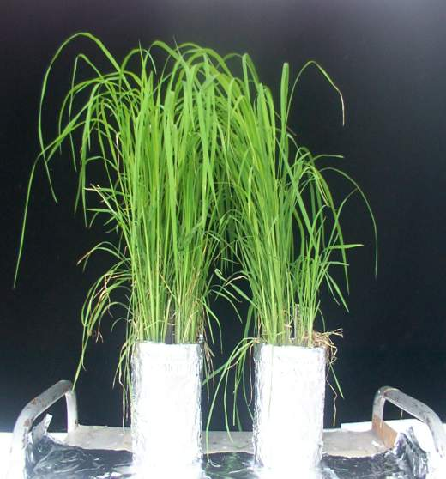
D. Ethylene generated during submergence
Blocking ethylene decreased chlorophyll degradation, increased sugar and starch content and improved survival
T
S
T
S
+MCP
-MCP

Slide 27
Chlorophyll Content
% Dry Weight
2.00
IR42
1.75
1.50
Normal
1.25
submerged +MCP
1.00
submerged
0.75
0.50
0
2
4
6
1
3
5
7
Submergence
Recovery
Time (d)

Slide 28
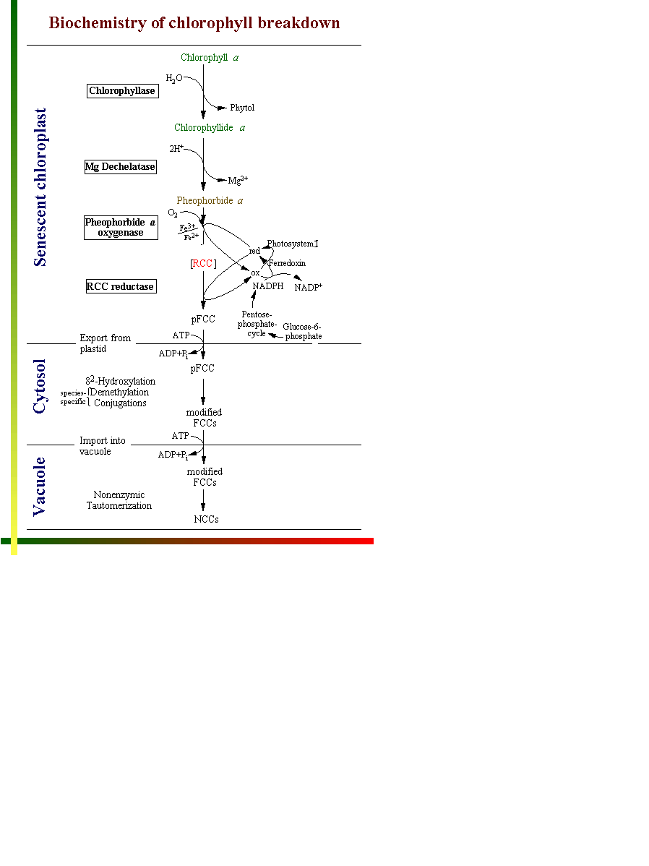

Slide 29
Chlorophyllase activity (Units mg protein⁻¹)
0.7
No 1-MCP and submerged
0.6
With 1-MCP and submerged
0.5
IR42
0.4
0.3
0.2
0.1
0.0
0
2
4
6
1
3
5
7
Submergence
Recovery
Time (d)
Chlorophyllase activity is higher in leaves of susceptible lines both during and after submergence but decline with MCP treatment

Slide 30
Relative chlorophyllase gene expression (%)
400
IR42
300
200
FR13A
100
0
1S 2S 3S 4S 5S 6S 1D 2D 3D
Expression increased by 3.5-fold during submergence and by 4-fold during recovery in the intolerant cultivar
Func. Plant Biol. 30:813 (2003)

Slide 31
Relative expression of chlorophyllase gene during and after submergence in IR42
6
5
4
No 1-MCP treatment
Relative Chlase gene expression
3
2
1-MCP treatment
1
0
0
1S 2S 3S 4S 5S 6S 1R 2R 3R
9

Slide 32

Blocking ethylene perception:
Decreased chlorophyll degradation,
Maintained sugar and starch content
Improved survival

Slide 33
E. Post submergence events
Symptoms develop progressively after submergence as yellowing of leaves
Caused by generation of active oxygen species (AOS) and toxic oxidative products

Slide 34
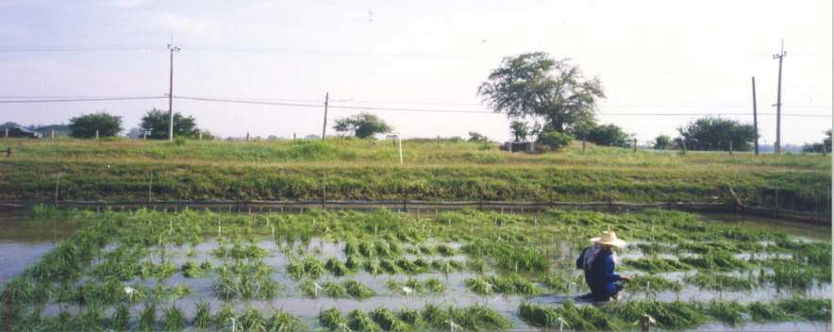
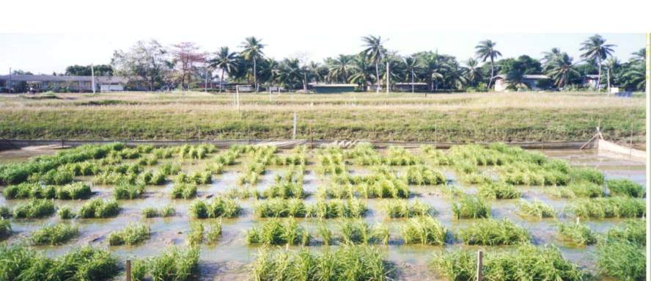
Day 0
Day 1

Slide 35
Efficient active oxygen-scavenging system
Light
CO₂
Chlorophyll
Photosynthesis
Glucose
Glycolysis
Respiration
O₂^{.-}
SOD
Lipid peroxidation
(MDA)
H₂O₂
AsA
GSSG
NADPH
NADP
DHAsAR
CAT
APX
MDAsAR
GR
H₂O + O₂
NADPH
GSH
NADP
MDAsA
DHAsA
Ascorbic acid- glutathione cycle
G-3-P
Glycolysis

Slide 36
H₂O₂ ( μmol g⁻¹ leaf FW)
25
20
IR42, Submerged
15
10
FR13A, Submerged
5
FR13A, Control
0
IR42, Control
0 1 2 3 4 5 6 1 2 3 4 5 6 7
0
1
2
3
4
5
6
7
8
9
10
11
12
Submergence
Recovery
Days
Generation of hydrogen peroxide (H₂O₂) during submergence and recovery

Slide 37
Lipid membrane breakdown is higher in susceptible lines
MDA content (% of control)
300
IR42
200
FR13A
100
0
High
Low
High
Low
Light intensity
MDA content during recovery under artificial light.

Slide 38
Reduced ascorbic acid decreased in susceptible lines
AsA as % of total ascorbate
100
FR13A
IR42
75
50
25
0
Low
High
Low
High
Light intensity
Activity of enzymes involved in removing AOS increased in tolerant lines

Slide 39
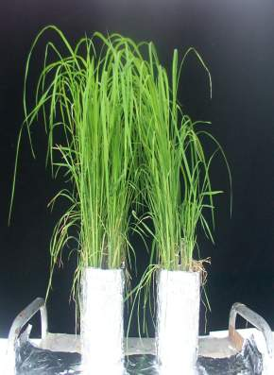
The traits associated with tolerance are:
Energy
maintenance
Protection
Minimum elongation
Carbohydrate level in stem
Optimum fermentation
Underwater photosynthesis
Efficient AOS scavenging
Low ethylene synthesis or sensitivity
T
S

Slide 40
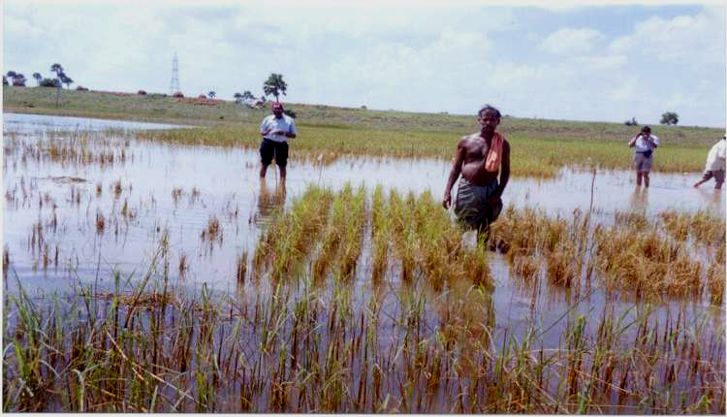
3. Regeneration Ability
Ability to generate new growth after prolonged flooding of more than 2 weeks

Slide 41
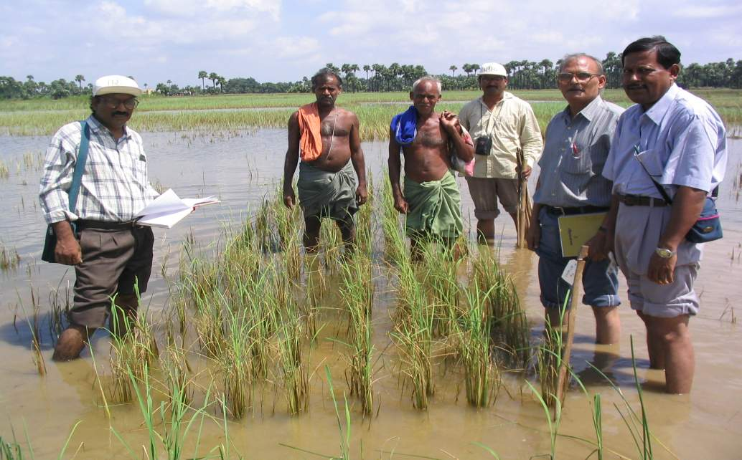
Submerged for 19 d under > 2 m of water
Fast regrowth 2 d after desubmergence

Slide 42
4. Tolerance to delayed transplanting
    Donors identified
    Physiology and genetics?
    Breeding?
5. Tolerance to water stagnation
    Reduce tillers and panicle size
    Suitable Donors?
    Biology? Genetics?

Slide 43
6. Elongation ability of DW rice
Received relatively little attention
Triggered by oxygen deficiency
Mediated by at least 3 plant hormones: ethylene, ABA, GA
Associated with low potential productivity due to high energy demand
Facultative elongation is useful if water rise is slow and taller seedlings are not needed for TP
Fast elongation, higher tillering and kneeing ability
Notes:
Ethylene increase sensitivity to GA which enhance internodes elongation. ABA inhibit the growth promoting effect of GA. Ethylene increase under submergence due to increased synthesis and entrapment. Both ethylene and submergence reduced the indigenous levels of ABA

Slide 44

Some management options can enhance performance of tolerant genotypes
  Enriching nursery with N, P, Zn & FYM
    can result in more robust and taller seedlings
    It can increased CHO content of seedling
    Improve seedling establishment and plant survival
    Yield increased substantially
  Older seedlings widely spaced in the nursery (75 g m⁻² instead of >150 g m⁻²)
  Nutrient supply after water recedes enhances rate of recovery and yield

Slide 45
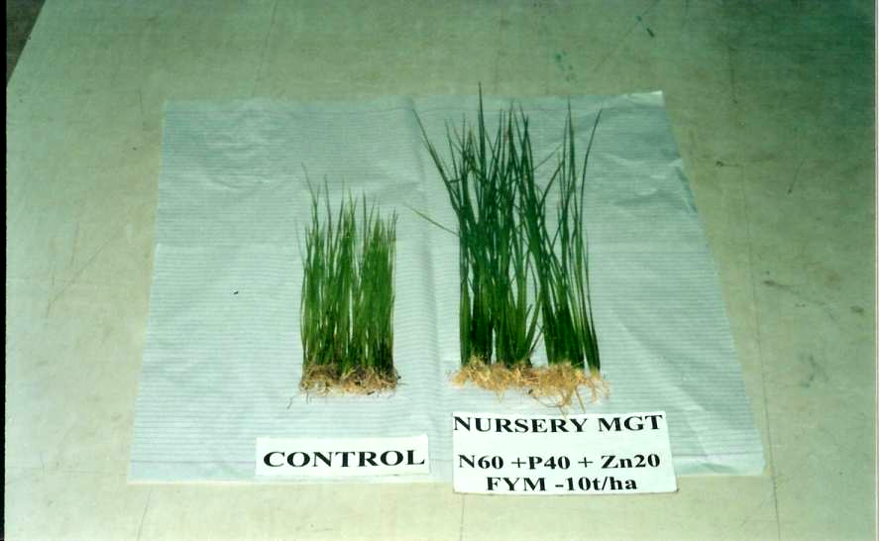
Proper nutrient management in the nursery resulted in more robust seedlings

Slide 46
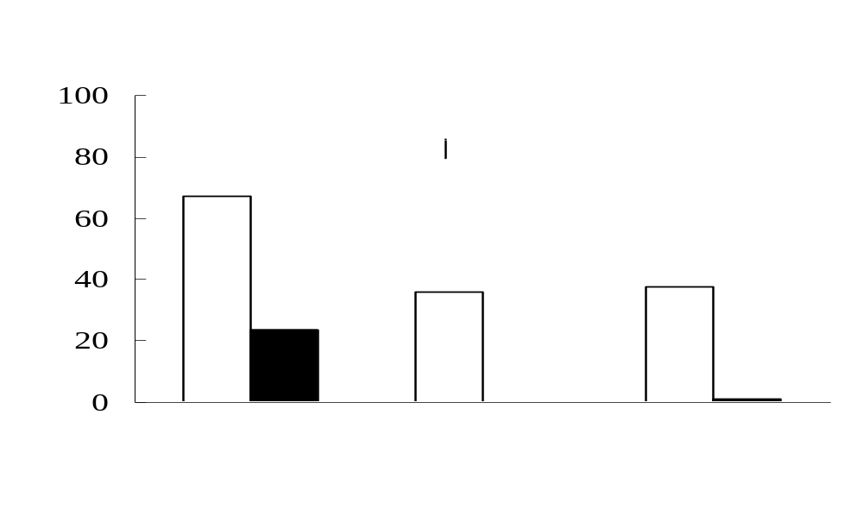
Too much N in the nursery will reduced survival

Slide 47
Photosynthesis at day 3 of recovery (µmol CO₂ m⁻² sec⁻¹)
60
R = - 0.78**
40
20
0
3.10
3.35
3.60
3.85
4.10
Leaf N before submergence (% DW)
Leaf N before submergence correlated negatively with photosynthesis after submergence

Slide 48
Screening for submergence
tolerance
The period of submergence varies and often not under full experimental control
Field ponds and concrete tanks are more ideal and easy to manage

Slide 49
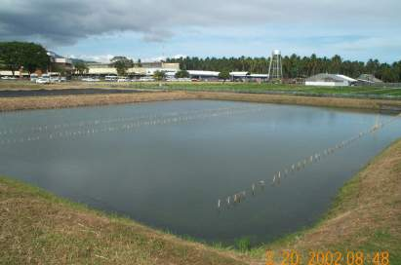
Submerged uncovered

Slide 50
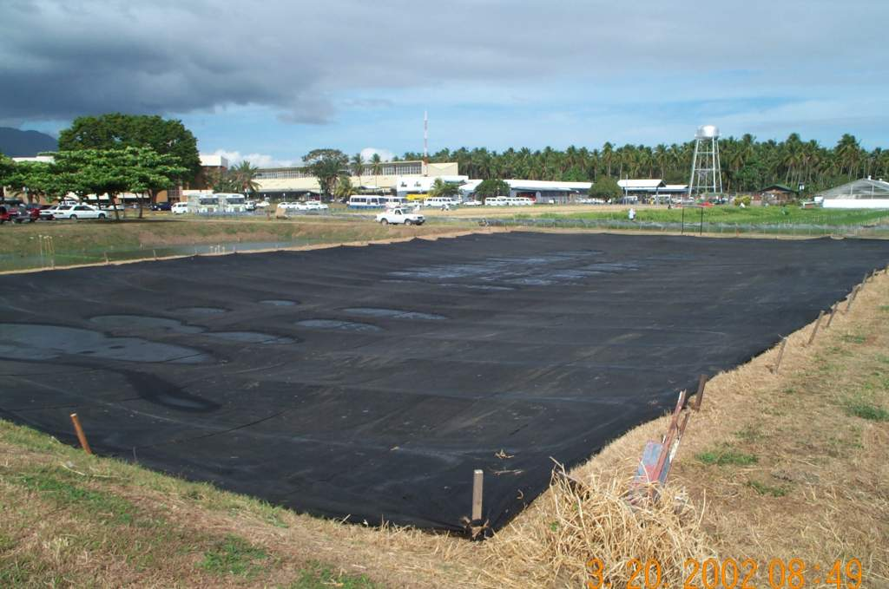
C25 submerged & covered

Slide 51
Can we simulate screening for turbid conditions by artificial shading?
Five contrasting cultivars compared under shaded, clear and turbid water conditions
  Elongation was higher under clear water
  Rate of NSC depletion was higher under turbid water but lowest in shaded followed by clear water
  Percentage survival was higher under shaded conditions and least under turbid water
  Water temperature was 2-3 ⁰C higher in clear water than in turbid or shaded water
  Oxygen level was lower under turbid water
Screening under shaded conditions may not be effective in breeding for conditions where water turbidity is high

Slide 52
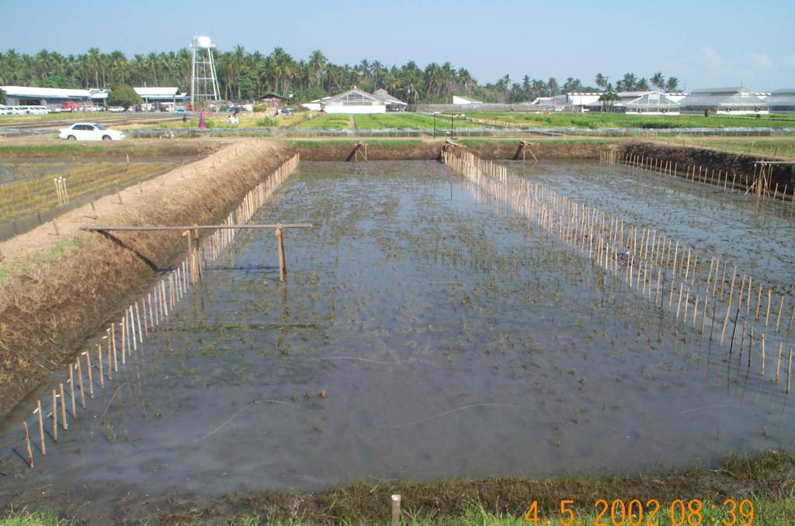
C25 right after desubmergence

Slide 53
Sowing
14-30 d old (?)
Submerge
6-14 d (age)
Desubmerge
10 to 20 d
Score

Slide 54
Scale for scoring submergence tolerance of rice in the field.
Index Dscription Scale (%)
1 Minor visible symptom of injury 100%
3 Some visible symptom of injury 95-99
5 Moderate injury 75-94
7 Severe injury 50-75
9 Partial to complete death 0-49
Adopted from SES

Slide 55
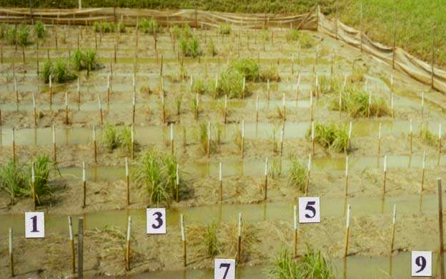
Scoring for submergence tolerance

