Slide 1
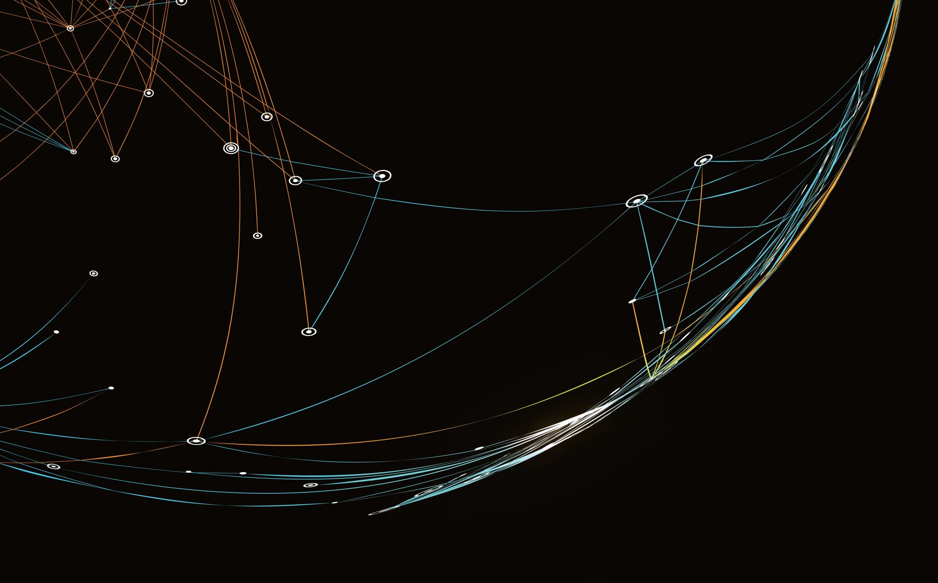
Space-Time Coding
21014096 Tufan Yasin Bölükbaş
18014125 Alirıza Bilir
19014070 Mert Ceylan

Slide 2
INTRODUCTION
Efficient modulation and coding schemes have been developed to ensure reliable high-data-rate wireless communication in the face of challenges like multi-path fading, interference, and noise. Diversity in time, frequency, area, polarization, and angle is employed to prevent channel fading, enhancing link reliability, albeit at the cost of some bandwidth efficiency. Spatial diversity, achieved through multiple antennas at the transmitter and/or receiver, is increasingly popular as it minimizes fading without sacrificing valuable bandwidth. Transmit diversity methods, using multiple antennas at the base station for downlink broadcasts, address challenges in establishing receive diversity in portable/mobile terminals due to size and power constraints. This system, known as Multiple Input Multiple Output (MIMO), offers higher channel capacity compared to single antenna systems. Channel statistics, often following a Rayleigh distribution, pose difficulties for reliable signal determination, necessitating diversity through temporal, frequency, polarization, and spatial resources.

Slide 3
What ıs space tıme codıng?
The signals sent are suffers attenuation in many cases due to external interference. This makes it difficult for the receiver to receive the signal.. By sending additional information in temporal, frequency, polarization and spatial forms, information is given about the distortion in the signal and this technique is called ‘diversity’.

Slide 4
Time Variety
The signal is sent many times, allowing the receiver to make a more accurate decision about the signal.
Frequency Diversity
Signals are sent with different frequencies, thus providing a better estimate of channel parameters at the receiver.
Space Diversity
Signals are sent from the same antenna with different polarization or with different antennas

Slide 5
space tıme Trellıs codes
Space–time trellis coding, a recent development, combines receiver signal processing with coding techniques suitable for multiple transmit antennas, offering substantial gains. Specifically designed codes for two to four transmit antennas exhibit excellent performance in slow fading environments, approaching the outage capacity computed by Telatar, Foschini, and Gans with a 2–3 dB difference. These codes achieve three to four times the bandwidth efficiency of current systems, providing an optimal tradeoff between constellation size, data rate, diversity advantage, and trellis complexity. However, when the number of transmit antennas is fixed, the decoding complexity of space–time trellis coding increases exponentially with both diversity level and transmission rate. Similar to trellis coded modulation (TCM) for single antenna systems, space–time trellis coding (STTC) employs an encoding trellis, with the coding gain determined by structure and state count. A soft Viterbi decoder retrieves transmitted symbols at the receiver, where a block of data symbols is input into the STTC encoder, and the output symbols are transmitted through various antennas. At the end of a burst, the encoder returns to the zero state by appending a tail of zeros to the input stream. The provided trellis illustrates this process using quadrature phase shift keying (QPSK)

Slide 6
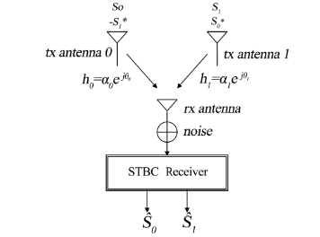
Space–time block coding
Space-time block coding, discovered by Alamouti, generalizes to an arbitrary number of transmitting antennas and can achieve the full diversity promised by transmitting and receiving antennas. When employing Space-Time Block Coding (STBC), a code matrix is formed by buffering a block of data symbols from multiple indicated antennas, and at the receiver, appropriate methods identify these symbols. The challenge in STBC lies in designing the code matrix to optimize diversity gain, coding gain, and channel capacity, with the additional requirement of implementing simple receiver detection methods for transmitter code design.
Alamouti addressed decoding complexity by proposing a scheme for two transmit antennas, which was later generalized into Space–Time Block Coding for an arbitrary number of transmit antennas. This scheme, illustrated in figure, achieves full diversity promised by both transmit and receive antennas. These codes maintain a notable property of a simple maximum likelihood decoding algorithm based solely on linear processing at the receiver

Slide 7

TRANSMISSION MODEL
In a wireless communication system with many antennas at the base station, signals are transmitted simultaneously in each time slot. We can express the signals received from antennas as follows:
The noise samples denoted $n_{t}^{j}$ are independent samples of a zero-mean complex Gaussian random variable with variance $n/(2SNR)$ per complex dimension.

Slide 8


TRANSMISSION MODEL
Assuming perfect channel state information is available, the The receiver computes the decision metric:
And decides in favor of the code word that minimizes the sum

Slide 9

Encoding algorıthm of Space–time block coding
A space–time block code is defined by a pxn transmission matrix G . The entries of the matrix G are linear combinations of the variables x1,x2...xk and their conjugates. The number of transmission antennas is n , and we usually use it to separate different codes from each other. For example,represents a code which utilizes two transmit antennas and is defined by:

Slide 10

Decodıng algorıthm of Space–time block coding
Maximum likelihood decoding of any space–time block code can be achieved using only linear processing at the receiver. Let's examine an example using the G2 matrix below:

Slide 11

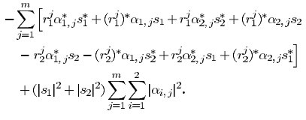


Suppose that there are $2^{b}$signals in the constellation. At the first time slot 2b bits arrive at the encoder and select two complex symbols $s_{1}$and $s_{2}$. These symbols are transmitted simultaneously from antennas one and two, respectively. At the second time slot, signals ${−s}_{2}^{∗}$and $s_{1}^{∗}$ are transmitted simultaneously from antennas one and two, respectively. Then maximum likelihood detection amounts to minimizing the decision metric:
The minimizing values are the receiver estimates of $s_{1}$and $s_{2}$ , respectively. We expand the above metric and delete the terms that are independent of the codewords and observe that the above minimization is equivalent to minimizing:

Slide 12
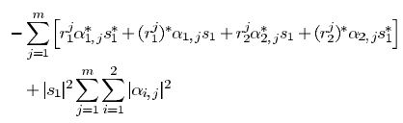
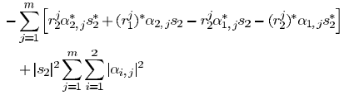
If we divide the metric into two parts, one of which is a function of only s1 and the other is a function of only s2, we obtain the following two equations

Slide 13
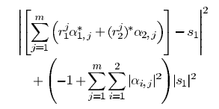
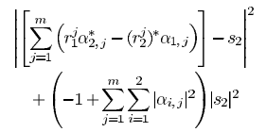
If we minimize both metrics, we get the following values

Slide 14
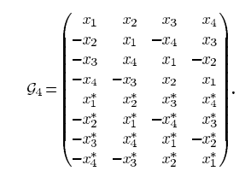
PERFORMANCE ANALYSIS
Let's analyze G4 given below if the energies of different symbols are equal to each other:

Slide 15
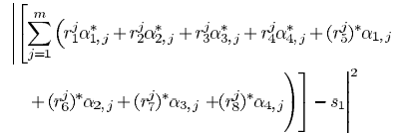

The decoder minimizes the decision metric:
for decoding $s_{1}$which can be rewritten as ${|{\breve{s}}_{1}−s_{1}|}^{2}$ where

Slide 16

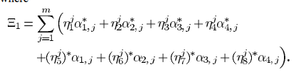
By replacing $r_{t}^{j}$from in the above equation and simple manipulations, we arrive at
By the last equation, the random variable is a zero-mean complex Gaussian random variable.

Slide 17
SIMILUATION STEPS
Simulation of Bit Error Rate (BER) Calculation using Alamouti Coding This simulation is designed to calculate the bit error rate (BER) using Alamouti coding in wireless communication.
1)Data Generation: The data to be transmitted is generated as a sequence of random complex numbers, each element having a value of +1 or -1. This data is considered the signal used for transmission. 2)Alamouti Coding (Encode): The generated data is transformed into an Alamouti matrix. This matrix illustrates how the data is encoded among different antennas during transmission. 3)Creating a Channel Model: Using the Rayleigh channel, the simulation models the transmitted signal to reflect real-world conditions. This model represents signal propagation, reflection, and various interactions. 4)Transmission and Receiver Phase: Addition of Noise: A noise model representing random noise encountered in actual communication environments is added to the transmitted signal. Signal Processing at the Receiver: Incoming signals at the receiver are processed using the Alamouti algorithm to separate and process the received data. 5)Error Calculation and Tracking Total Error Count: The decoded data at the receiver is compared to the original data, errors are calculated, and the total error count is tracked. 6)Calculation of Bit Error Rate: The total error count is divided by the total number of transmitted bits to compute the bit error rate (BER).

Slide 18
Graphical Analysis
The obtained BER values from the simulation are plotted against different Signal-to-Noise Ratio (SNR) levels on a graph. This graph is used to assess communication system performance and visualize the relationship between SNR and BER. Higher SNR values generally correspond to lower BER, while lower SNR values are associated with higher BER. This graph helps understand how communication systems perform under different conditions. Particularly, higher BER at lower SNR indicates that communication systems have a higher error rate under lower quality conditions.

Slide 19
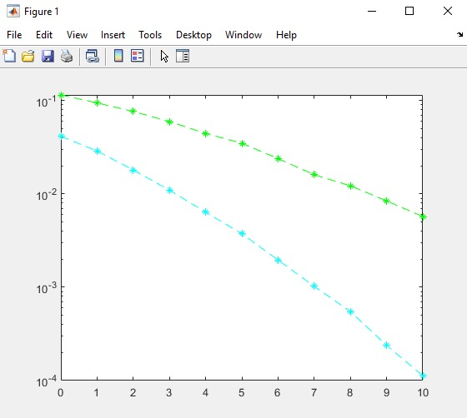
SIMULATION RESULTS
Simulation results regarding the performance of the codes for 2 receivers and 1 transmitter and 2 receivers and 2 transmitters:
2 receivers and 1 transmitter
2 receivers and 2 transmitter

Slide 20

PERFORMANCE ANALYSIS
When comparing the bit error rate (BER) performances between the 2T2R and 2T1R antenna configurations, a notable contrast is observed despite both configurations sharing the same number of transmitters. The variation arises due to the discrepancy in receiver antennas.
In the case of 2T2R, with two transmitters and two receivers, the BER graph displays a more favorable performance starting from an SNR level of approximately ${10}^{−1.5}$, gradually decreasing over roughly 10 units to reach a BER of ${10}^{−4}$,. This signifies the 2T2R setup's ability to achieve substantially lower error rates, showcasing its robustness and reliability in signal reception and decoding even in challenging SNR conditions.
Contrarily, the 2T1R configuration, featuring two transmitters and a single receiver, demonstrates a different BER trend. Beginning at an SNR level around 10^-1, the BER only descends to approximately ${10}^{−2}$ after progressing roughly 10 units in SNR. This reveals a comparatively higher error rate within this setup due to reduced diversity in signal reception, resulting in a less robust performance in adverse SNR conditions compared to the 2T2R configuration.
Understanding the impact of antenna configurations on communication systems is crucial. Despite having the same number of transmitters, the differing receiver setups significantly influence the system's performance, highlighting the importance of receiver diversity for achieving better error rates, especially in challenging signal-to-noise ratio environments.

