Slide 1
Recursive Functions
Dr. H. İrem Türkmen

Slide 2
Recursive Functions
A recursive function can be defined as a routine that calls itself directly
Recursion can reduce time complexity.
Recursion adds clarity and reduces the time needed to write and debug code.
Requires more memory due to function call overhead.

Slide 3
Factorial: n!=n*(n-1)! F(n)=n*F(n-1)
#include <stdio.h>
int factRecurseInf(int n)
{
printf("processing..");
return n*factRecurseInf(n-1);
}
int factRecurse(int n)
{
if (n==1) return 1;
else
return n*factRecurse(n-1);
}
int main( )
{
printf ( "%d\n", factRecurse(4) );
// printf ( "%d\n", factRecurseInf(4) );
return 0;
}

Slide 4
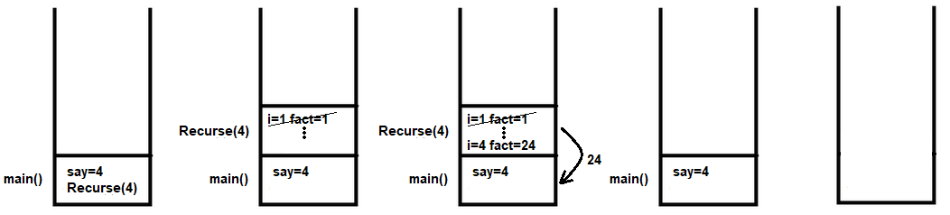
#include <stdio.h>
int Recurse(int n)
{
int i,fact=1;
for (i=1;i<=n;i++)
fact=fact*i;
return fact;
}
int main( )
{
int say=4;
printf("%d",Recurse(say));
return 0;
}

Slide 5
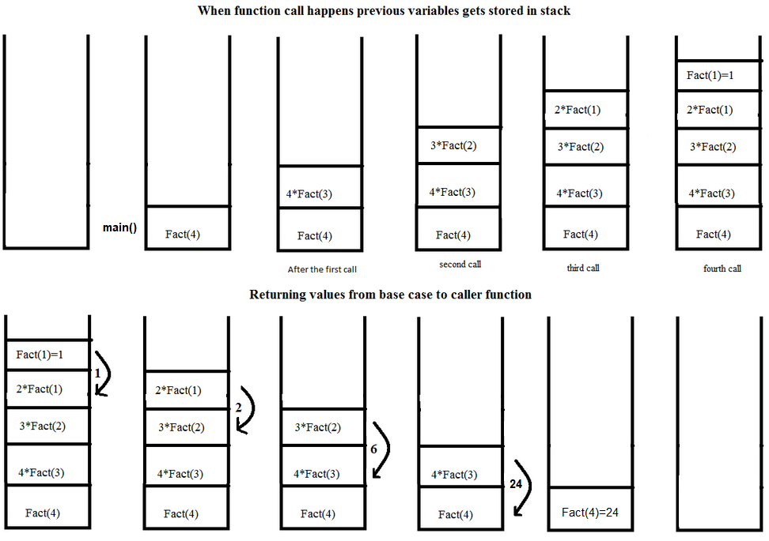
int factRecurse(int n)
{
if (n==1)
return 1;
else
return n*factRecurse(n-1);
}
int main( )
{
printf ( "%d\n", factRecurse(4));
return 0;
}

Slide 6
Exponentiation
Avoid stack overflow !!
What if factRecurse(-3) ??
Exponentiation: x^{n}=x * x^{n-1}
int UsRecurse(int x, int n)
{
if (n==1) return x;
else
return x*UsRecurse(x,n-1);
}
M=UsRecurseV3(-4,2) ?
M=UsRecurseV3(4,-2) ?

Slide 7
#include <stdio.h>
float UsRecurse(int x, int n)
{
if (n==1) return x;
else
return x*UsRecurse(x,n-1);
}
float UsRecurseV2(int x, int n)
{
if (n==0) return 1;
else
return 1.0/x*UsRecurseV2(x,n+1);
}
float UsRecurseV3(int x, int n)
{
if (n==0) return 1;
else
if (n<0) return 1.0/x*UsRecurseV3(x,n+1);
return x*UsRecurse(x,n-1);
}
int main( )
{
printf ( "%f\n", UsRecurseV3(4,-2) );
return 0;
}

Slide 8
Calculate the sum of two numbers
What is the purpose? What if a and b are negative?
int TopRecurse(int a, int b)
{
if (b==0)
return a;
else
TopRecurse(a+1,b-1);
}
int main( )
{
printf ( "%d\n", TopRecurse(4,2) );
return 0;
}
TopRecurse(5+1,1-1)
TopRecurse(4+1,2-1)
TopRecurse(4,2)
6
6

Slide 9
Calculate the sum of array elements
int DiziTopRecurse(int* dizi, int b)
{
if (b==0) return dizi[b];
else
return dizi[b]+DiziTopRecurse(dizi,b-1);
}
int main( )
{
int dizi[5]={3,2,1,5,1};
printf ( "%d\n", DiziTopRecurse(dizi,4) );
return 0;
}
dizi(0)=3
dizi[1]+DiziTopRec(dizi,0)
dizi[2]+DiziTopRec(dizi,1)
dizi[3]+DiziTopRec(dizi,2)
dizi[4]+DiziTopRec(dizi,3)
DiziTopRec(dizi,4)
3
3+2
3+2+1
3+2+1+5
3+2+1+5+1

Slide 10
Search an array element
int ElemanAraRecurse(int* dizi, int b, int x)
{
if (b<0) return -1;
else
if (dizi[b]==x)
return b;
else
return ElemanAraRecurse(dizi,b-1,x);
}
int main( )
{
int dizi[5]={3,2,1,5,1};
printf ( "%d\n", ElemanAraRecurse(dizi,4,7) );
return 0;
}

Slide 11
An effective recursive function
Recursive exponentiation with O(n)
int powRv1(int x,int y)
{
if (y==0)
return 1;
else
return x*powRv1(x,y-1);
}

Slide 12
An effective recursive function
x^{p} = x^{p/2} * x^{p/2} if p mod 2 == 0
x^{p} = x^{p/2} * x^{p/2} * x if p mod 2 == 1
int powRv2(int x, unsigned int y)
{
int temp;
if( y == 0)
return 1;
temp = powRv2(x, y/2);
if (y%2 == 0)
return temp*temp;
else
return x*temp*temp;
}
O(log₂n)

