Slide 1
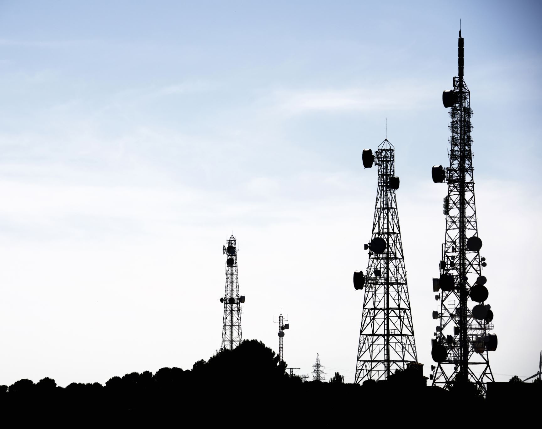
Base Station Location Optimization for Wireless Sensor Networks
EHM4260 Project
Alirıza Bilir
18014125

Slide 2
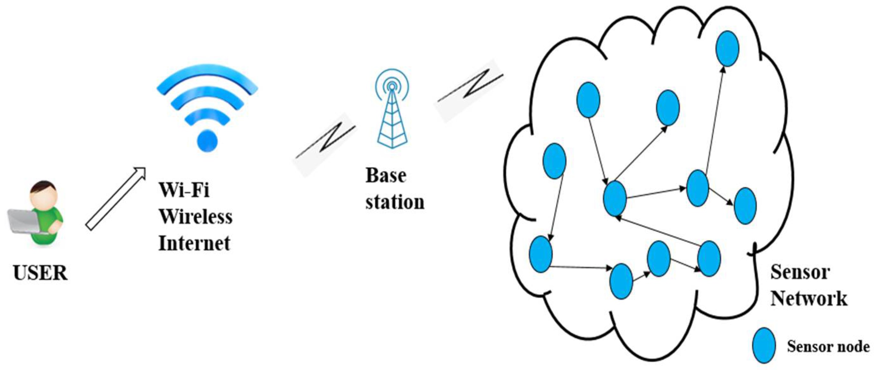
WSN (Wireless Sensor Network)
A Wireless Sensor Network (WSN) comprises network nodes functioning as sensors that gather local data and transmit it to a central base station wirelessly. This technology is ideal for deployment in hazardous or inaccessible areas to provide crucial information.

Slide 3
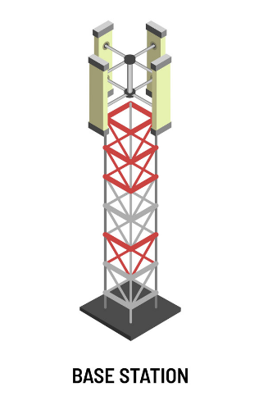
Base Station
A base station is hardware or a device central to wireless communication networks, responsible for facilitating and controlling data communication. It typically serves as the central point of a network, communicating with surrounding devices to exchange data.

Slide 4
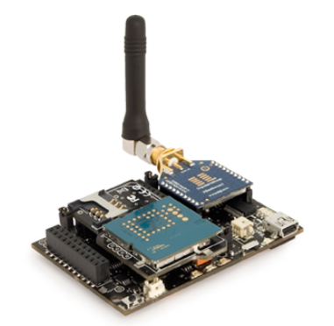
Sensor Nodes
These nodes have the ability to collect, process, and transmit information in their surroundings. They typically have limited processing power, storage capacity, and energy resources. Sensor nodes in WSNs can monitor environmental conditions, detect physical events, and wirelessly transmit this information to a central station.

Slide 5
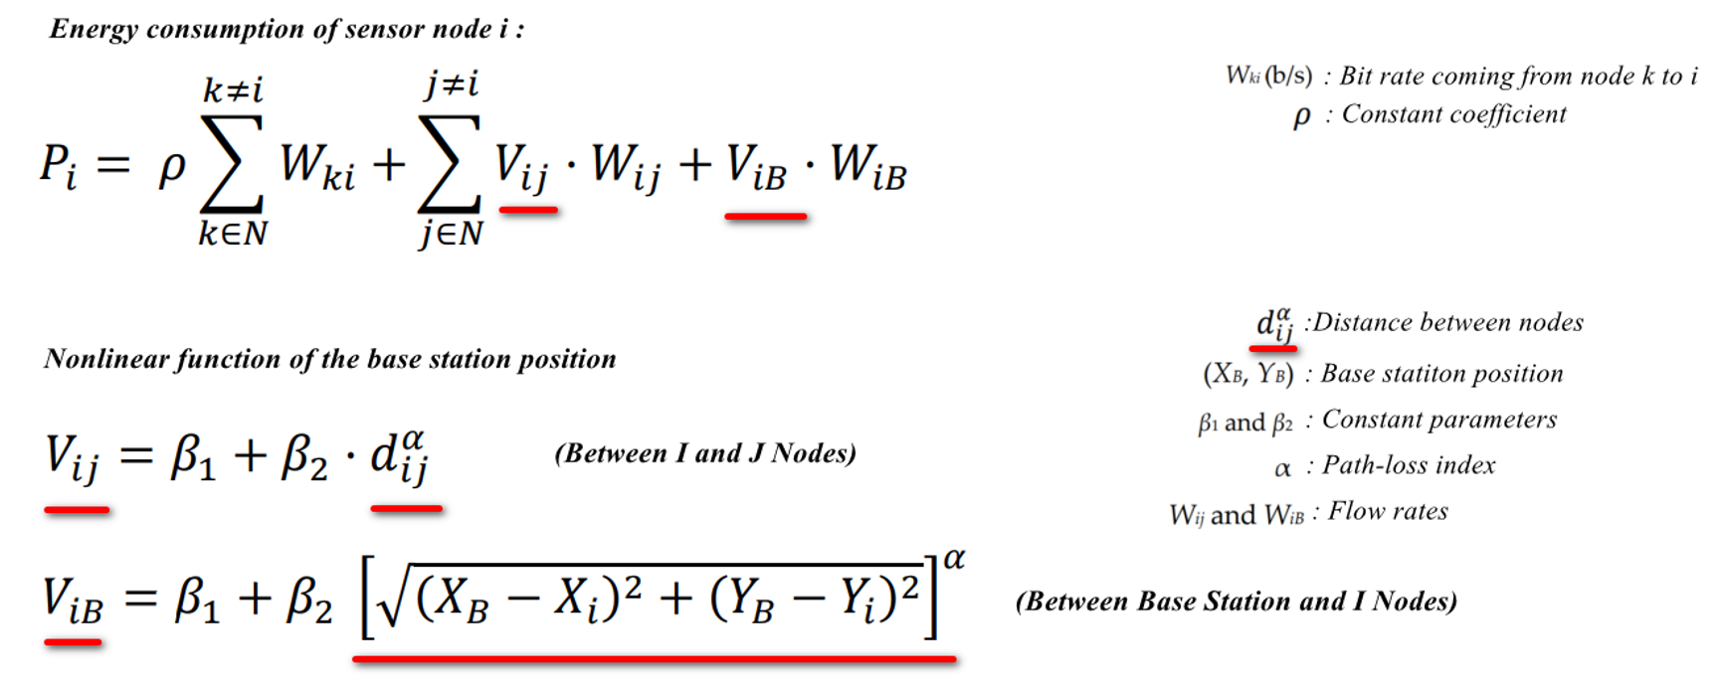
Node Energy Consumption

Slide 6
Lifetime of WSN
The drawback of WSNs lies in the limited energy capacity of sensor nodes, typically batteries, which gradually deplete over time. As nodes lose power, they cease to function, disrupting data exchange and affecting the network's effectiveness. The period from activation until the first node's energy depletion determines the network lifetime, a crucial metric for evaluating WSN efficiency. Enhancing this lifetime is pivotal for improving WSN performance. This paper focuses on optimizing energy consumption to extend the network's lifetime, a pivotal consideration in WSN management.

Slide 7
Popular Optimization Methods
Centroid Method
• Smallest Total Distances Method
• Smallest Total Squared Distances Method
• Greedy Method

Slide 8

Centroid Method
Defined as the center of all sensor nodes, this method determines the center of the network by averaging the coordinates of all sensor nodes. The resulting point is considered the center of the network.

Slide 9
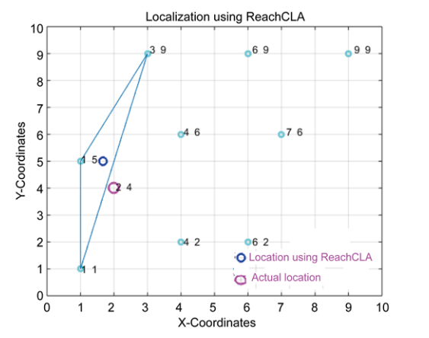
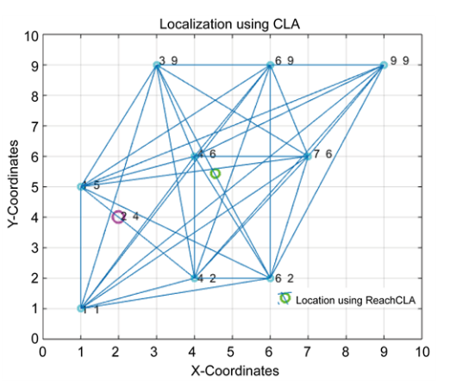
Centroid Location Examples
Multi Base Station Single Base Station

Slide 10
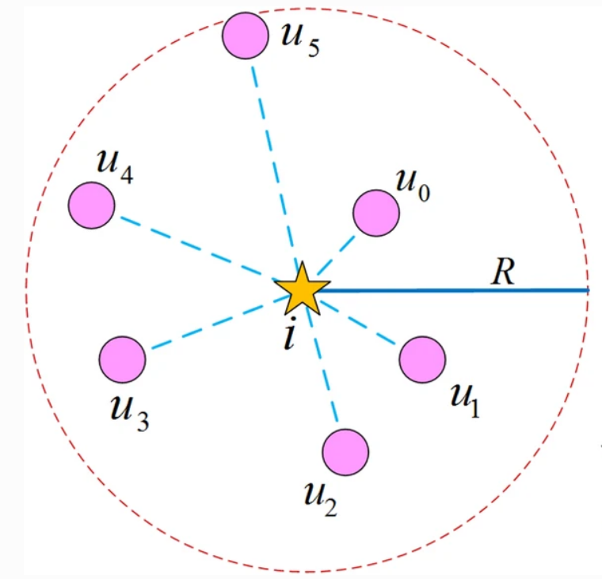
Smallest Total Distances Method
This method identifies the point with the smallest total distance to all sensor nodes. It selects the point where the cumulative distance to sensor nodes is the minimum, hence becoming the location for the base station.

Slide 11
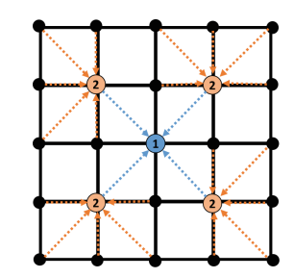
Smallest Total Squared Distances Method
This approach finds the point with the smallest total squared distance to sensor nodes. It calculates the total squared distance from sensor nodes to a specific point, choosing the location where this total squared distance is minimized as the base station location.

Slide 12
Greedy Method
Utilizing representatives of sensor nodes, this method aims to find the center of the network. It constructs representatives from sensor nodes and combines these representatives to calculate the network's center. This approach adopts the concept of representatives of sensor nodes converging to determine the network's center.

Slide 13
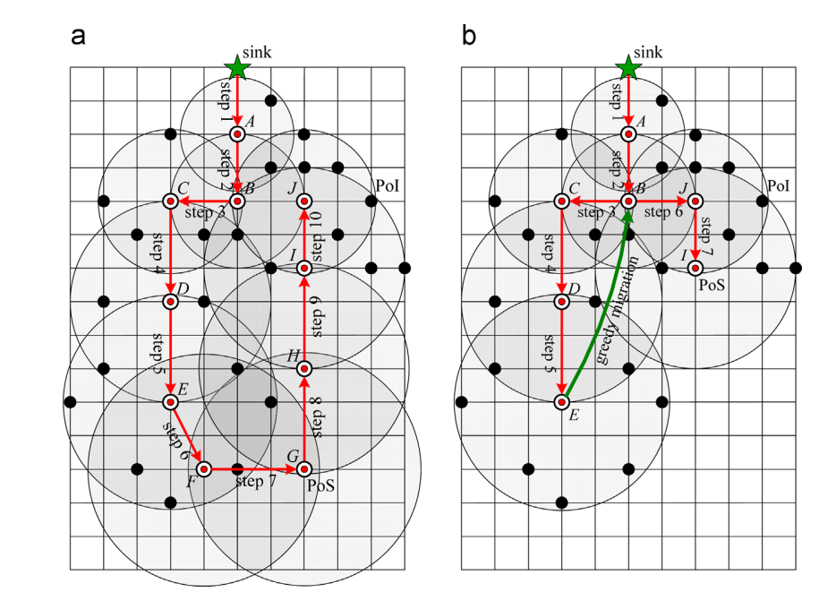
Greedy Method Example
a – ACO Based Location (Ant Colony Optimization) use 10 Base Station
b – ACO-Greedy Location use 7 Base Statiton

