Slide 1

Orthogonal Time Frequency Space (OTFS) Modulation
MERT CEYLAN ALİRIZA BİLİR YİĞİTHAN ÖZAY Mustafa güler ömer albayrak

Slide 2
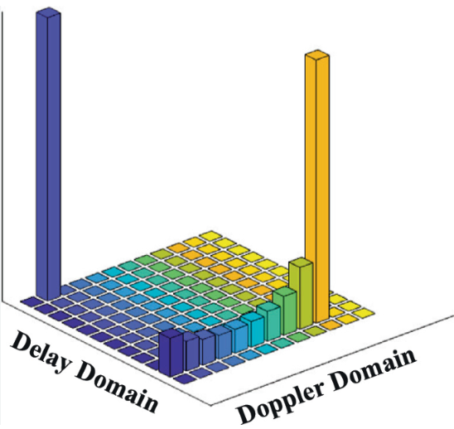
What ıs otfs?
OTFS is an innovative two-dimensional modulation technique used in wireless communication. Unlike traditional modulation techniques, OTFS operates signals in the delay-Doppler domain instead of the time and frequency domains.

Slide 3
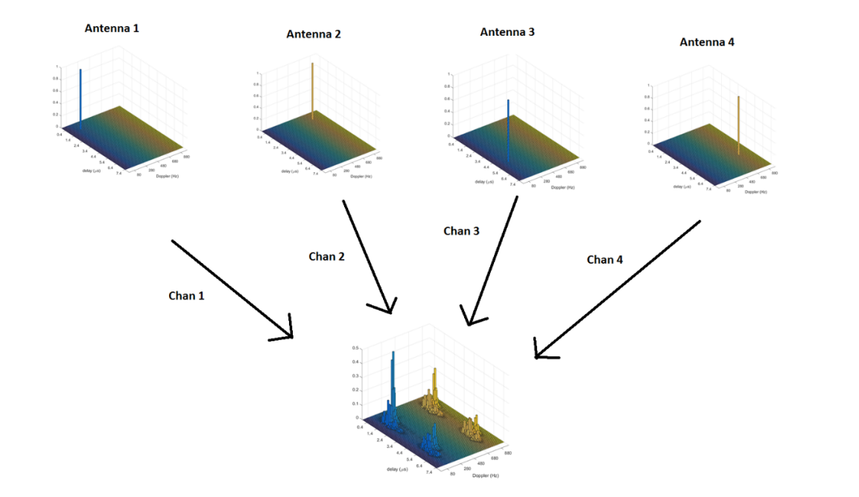
What IS OTFS?
OTFS, or Orthogonal Time Frequency Space, is a modulation technique designed for wireless communication systems, particularly those operating in highly dynamic environments, such as high-speed vehicular and high-mobility scenarios. It is an advanced modulation scheme that aims to overcome the limitations of traditional modulation techniques like Orthogonal Frequency Division Multiplexing (OFDM) in such challenging conditions.
Antenna Ports Multiplexed in the Delay-Doppler Domain

Slide 4
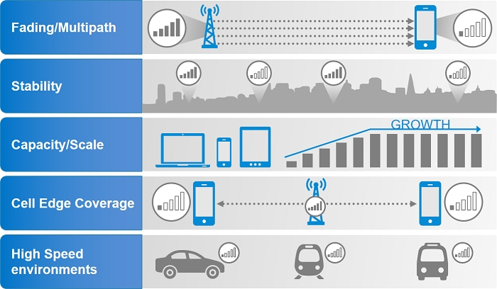
The Fundamental Features of OTFS Modulation
OTFS operates signals in the delay-Doppler domain. This provides much more resilient communication against channel variations. Additionally, OTFS enhances the reliability of the signal by utilizing both time and frequency diversity. For example, if a signal experiences fading at a certain time or frequency, OTFS can recover the signal from other regions of the delay-Doppler domain that are less affected.

Slide 5
Advantages of OTFS
1 - Performance Improvements
2 - Resilience to High Doppler Effects
3 - Superior Performance in Short Packets
4 - Compatibility with Large Antenna Arrays(MIMO)

Slide 6
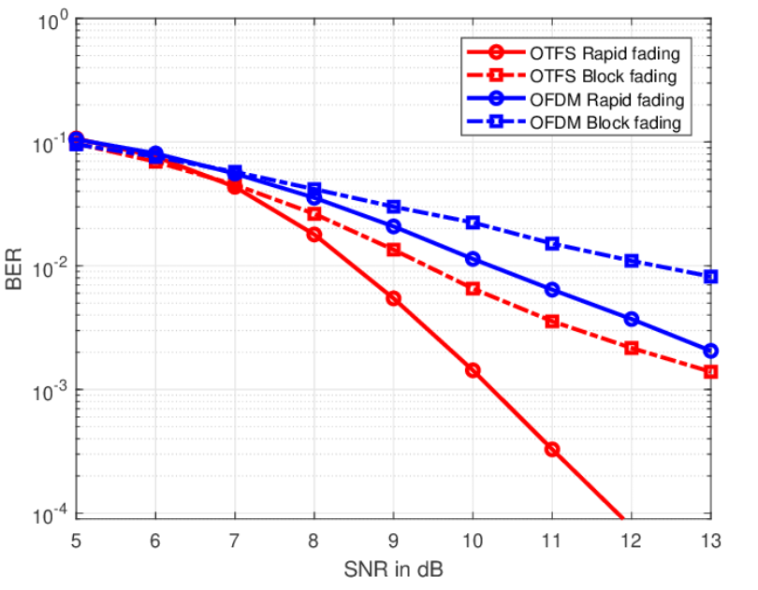
Comparison of OTFS and OFDM
Channel Diversity
Channel Independence
Block Error Rate Performance

Slide 7
Contributions of OTFS to System Operation
Simplification of the System
Elimination of Transmitter Adaptation
Ease of Implementation

Slide 8

Applıcatıons of OTFS
High-Speed Vehicles
Short-Range Communication
5G and Beyond

Slide 9
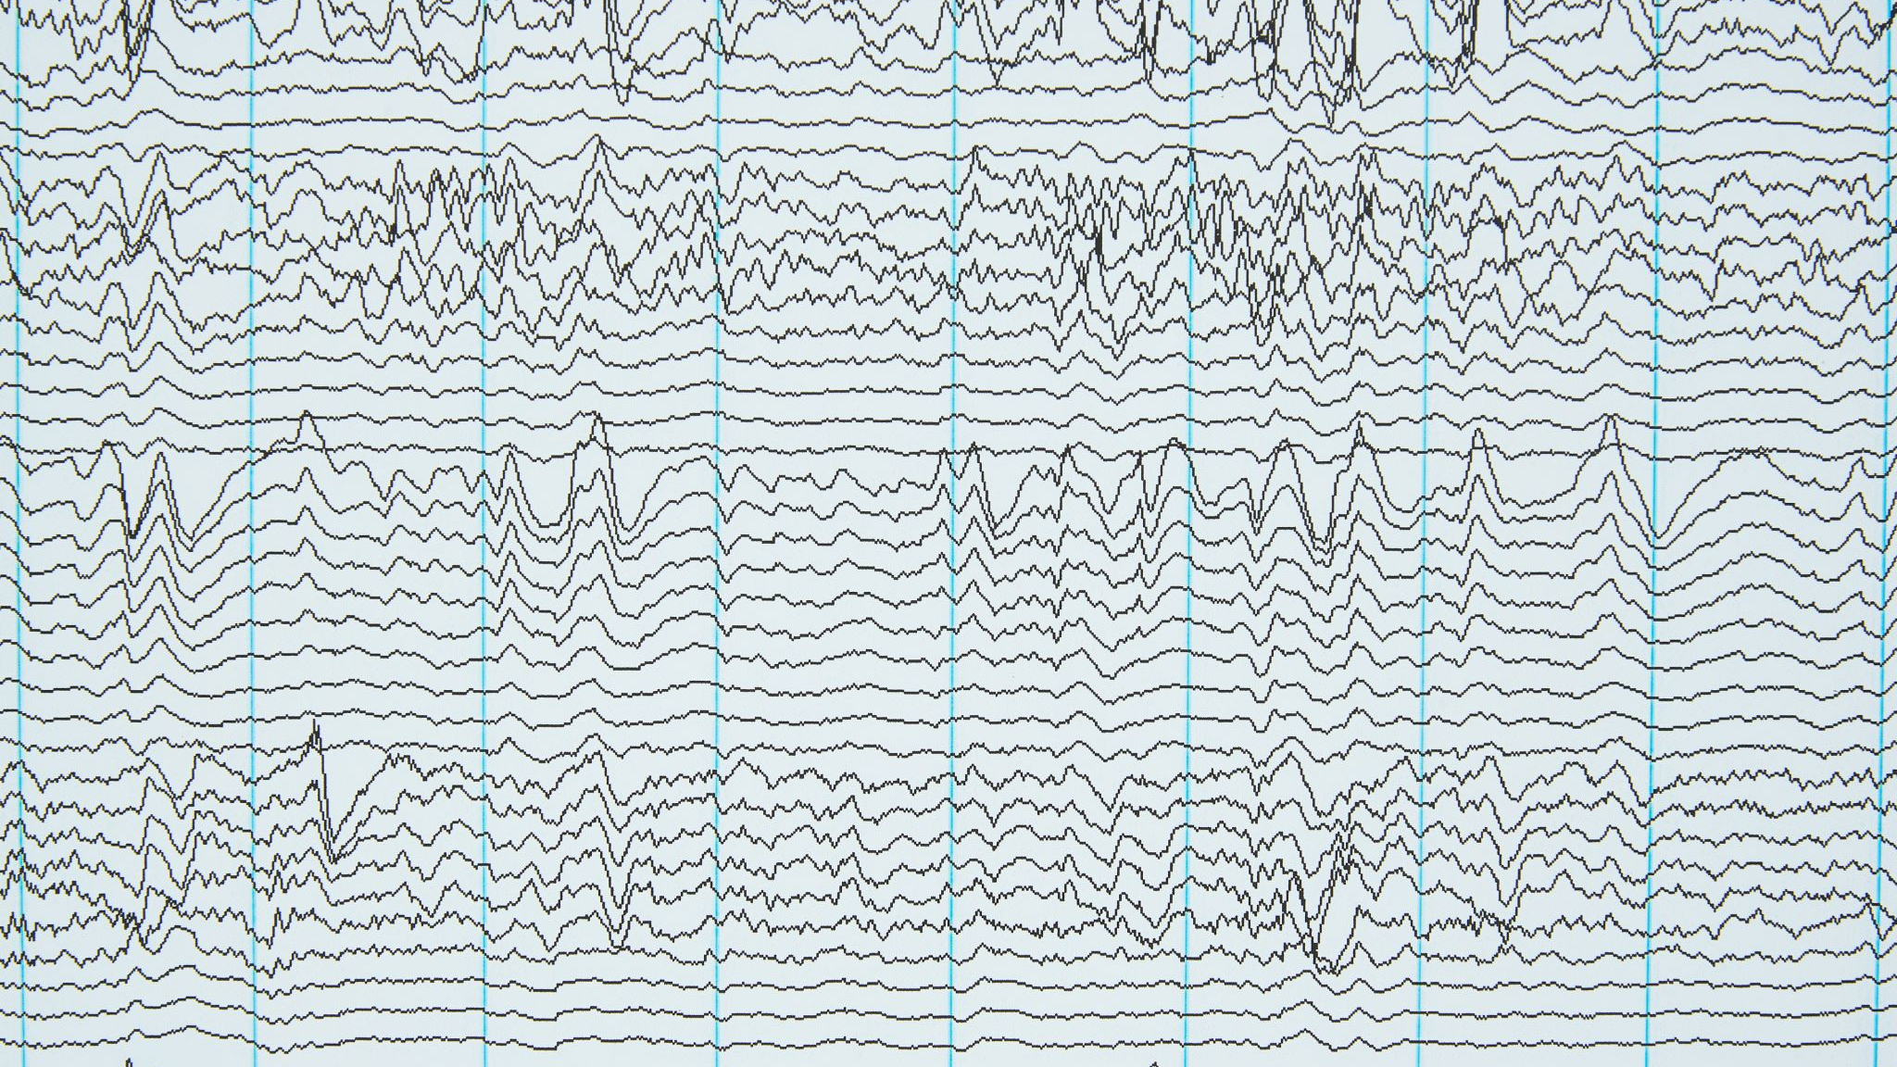
Otfs modulatıon
Modulation in the Delay-Doppler Domain: The data to be transmitted is modulated in the delay and Doppler frequency dimensions. This allows the data to be represented in the delay and Doppler frequency dimensions instead of time and frequency. In the delay-Doppler domain, each symbol is carried on a DD domain pulse.

Slide 10
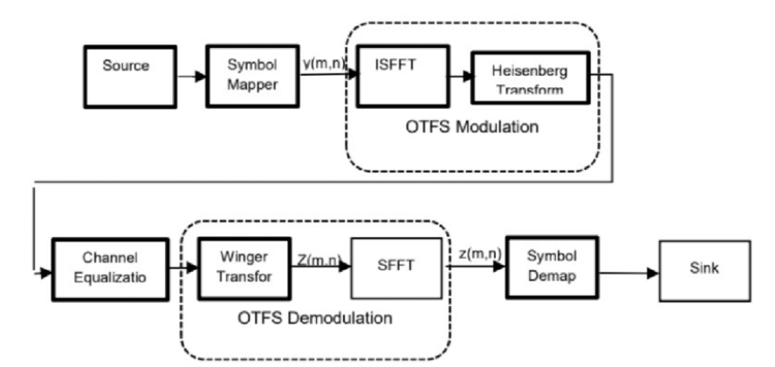

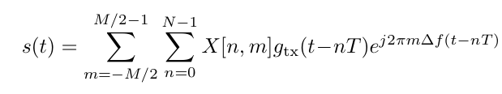
Otfs modulatıon
ISFFT:
HEISENBERG TRANSFORM=

Slide 11
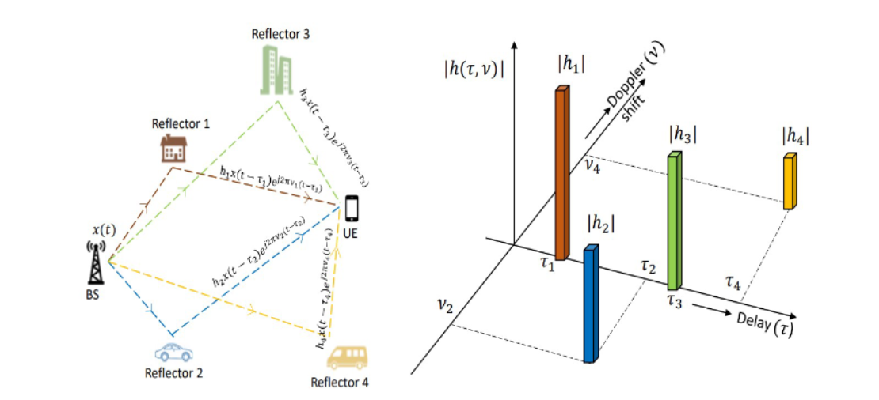
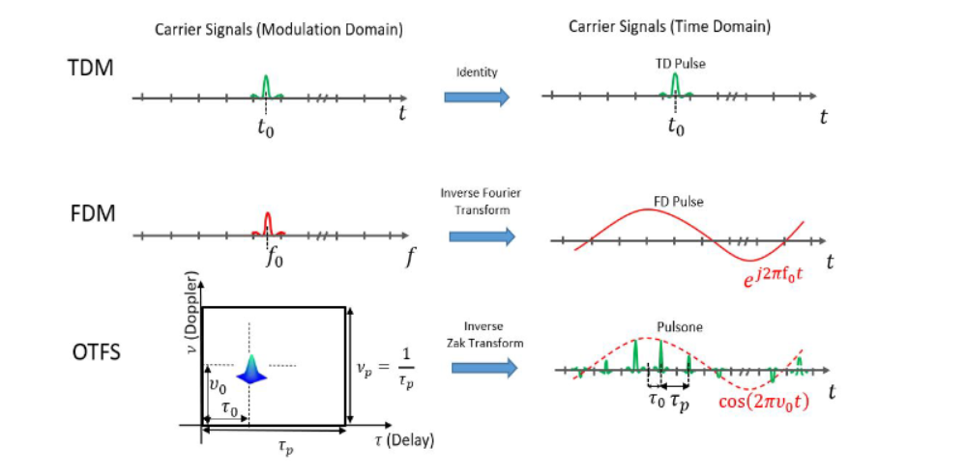
Otfs modulatıon
The first and third reflectors do not introduce Doppler shifts since they are stationary. Also, the Doppler shift induced by the second and the fourth reflector have opposite polarity as these mobile reflectors are travelling in opposite directions

Slide 12
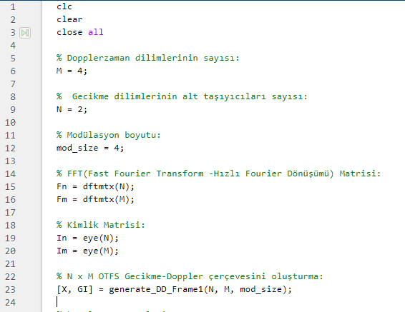

Slide 13
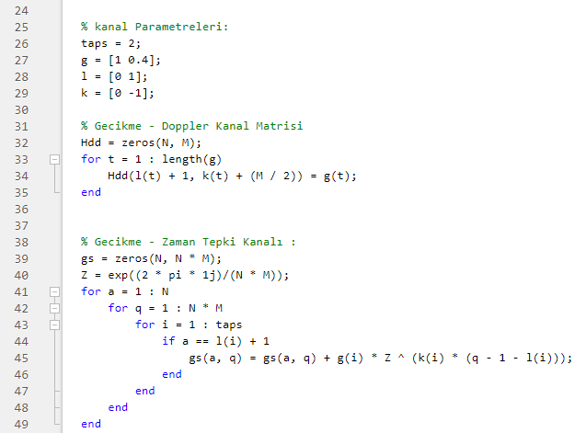

Slide 14
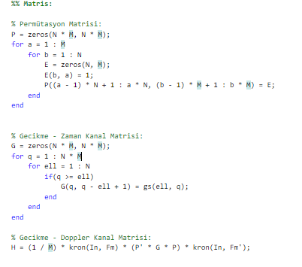

Slide 15
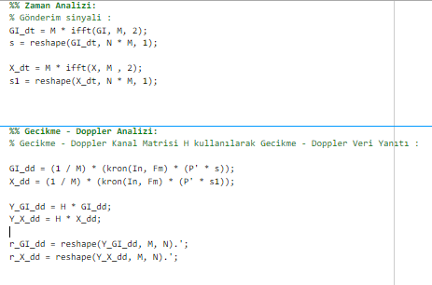

Slide 16
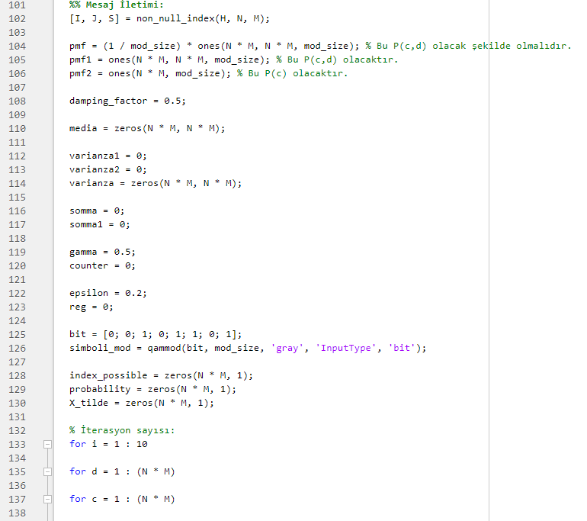

Slide 17
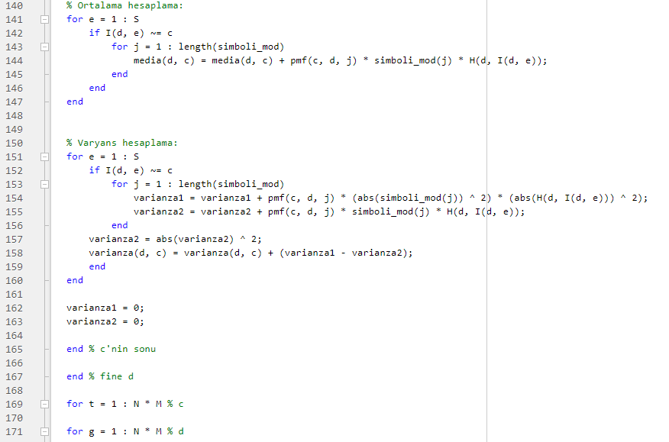

Slide 18
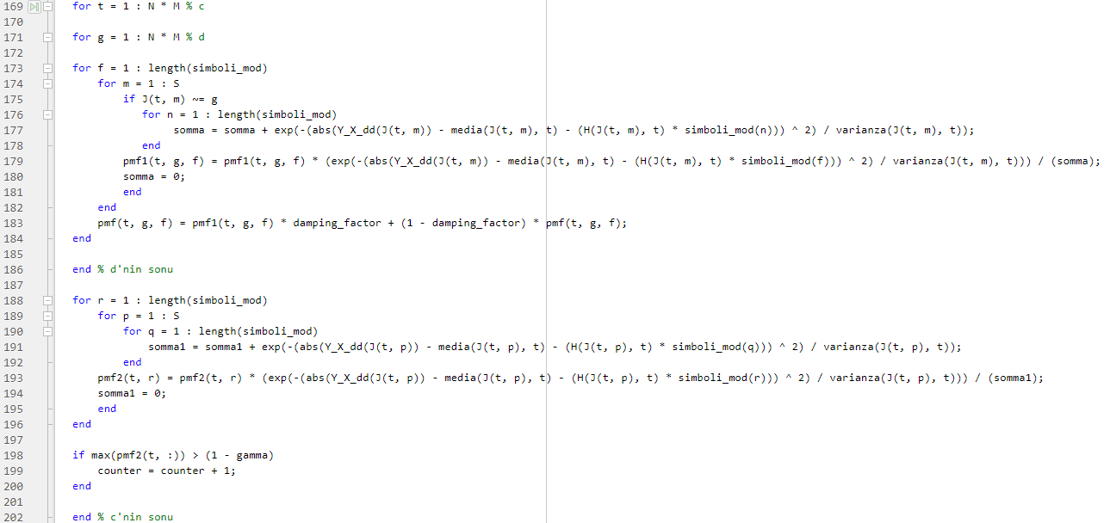

Slide 19
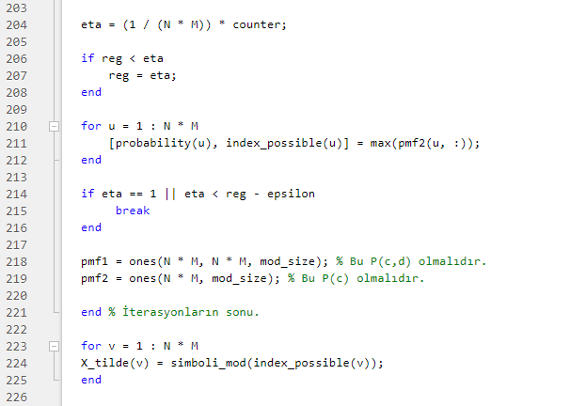

Slide 20
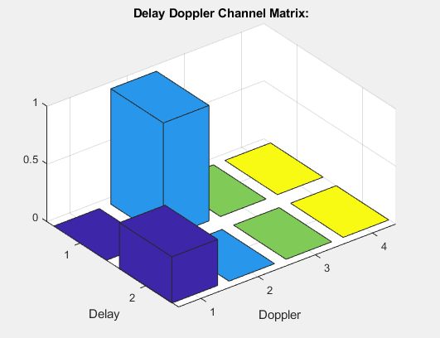

Slide 21
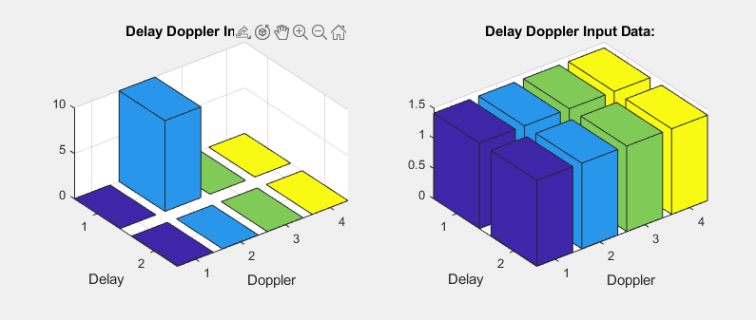

Slide 22
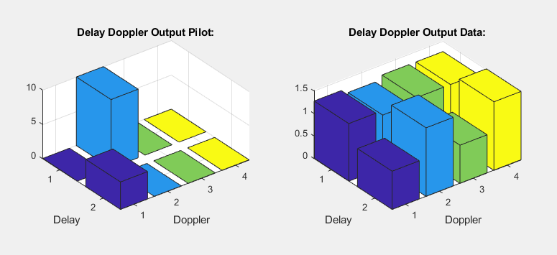

Slide 23
Summary of Fındıngs and Performance Gaıns
The research conducted has demonstrated the effectiveness of OTFS in communication systems. Particularly, the superior performance of OTFS in communication with high-speed moving objects has been identified. The results obtained indicate that OTFS can play a significant role in real-world applications.
Especially in environments with high Doppler effects and in short packet transmissions, the performance of OTFS is much better than its competitors. These findings indicate that OTFS can be a preferred option in practical applications.

Slide 24
Future Research Areas
Future studies should aim to expand the application range of OTFS and further enhance its performance. In particular, in-depth investigations should be conducted on the performance of OTFS in multi-user environments, and research on the integration of OTFS in new-generation wireless communication standards should be explored. Additionally, the effects of OTFS on other important performance metrics such as security, energy efficiency, and spectral efficiency should also be examined.

Slide 25

Teşekkürler
MERT CEYLAN
ALİRIZA BİLİR
YİĞİTHAN ÖZAY
Mustafa güler
ömer albayrak

