Slide 1
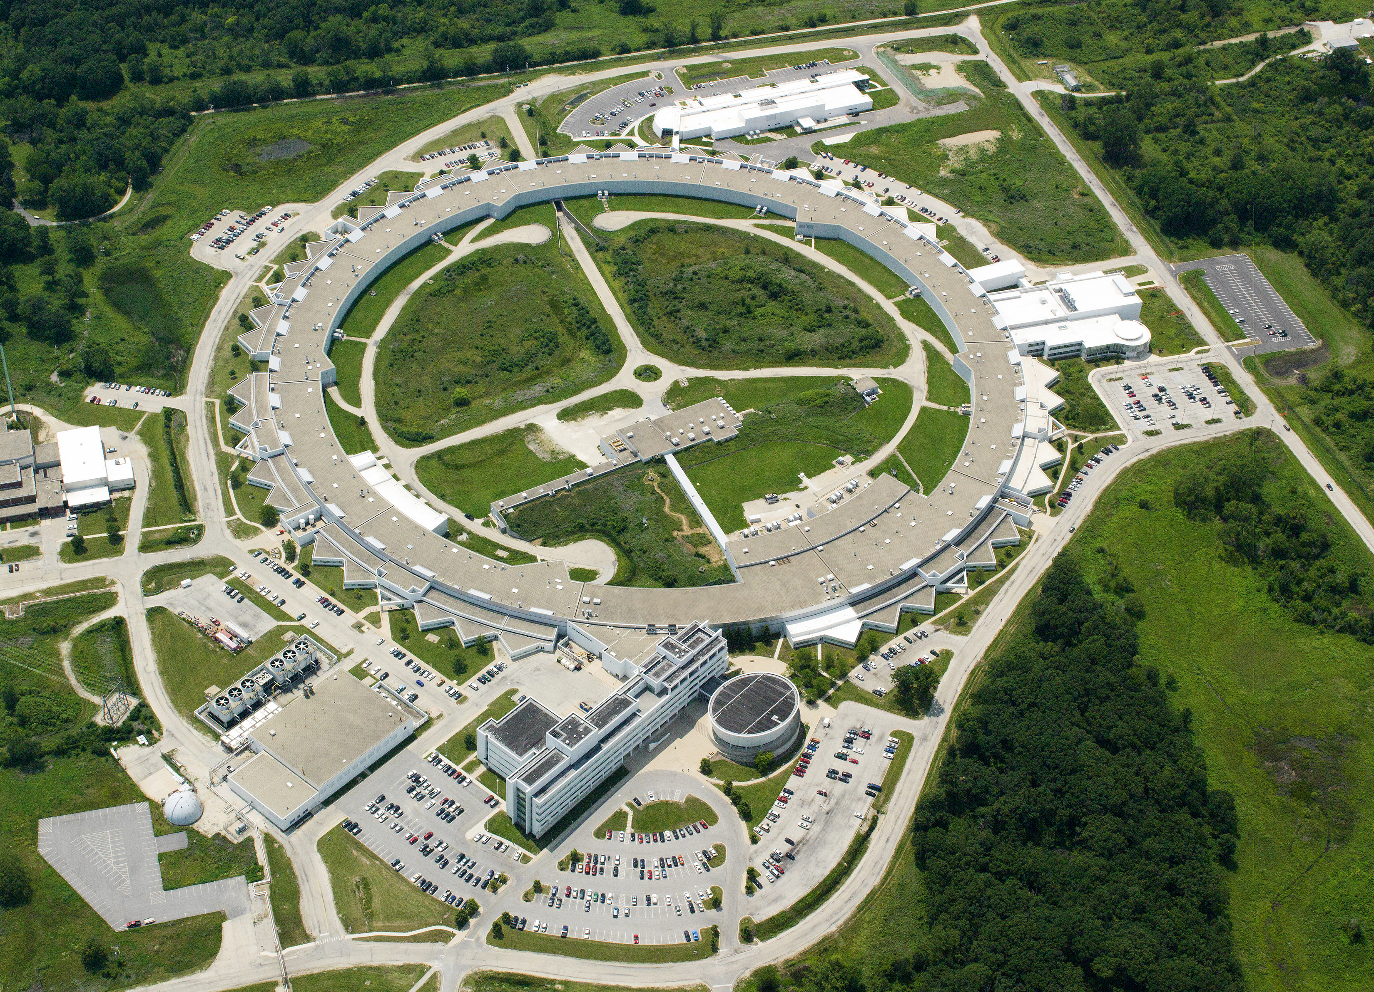
LS-CAT Board Meeting
Stephen Streiffer
Director, APS
Associate Laboratory Director, Photon Sciences
October 15, 2018
Notes:
Univ of Chicago Review, Aug. 30, 2010
1

Slide 2
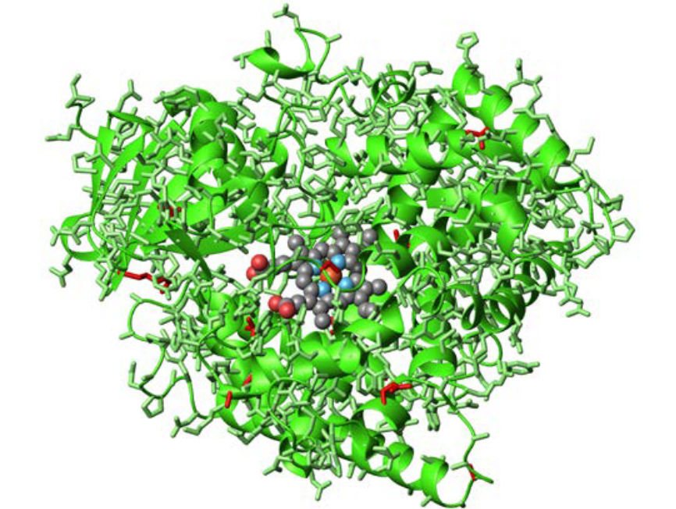
APS Research Contributes to
2018 Nobel Prize in Chemistry
Dr. Frances Arnold of the California Institute of Technology was one of three awardees of the 2018 Nobel Prize in Chemistry for her work showing how “directed evolution” can be utilized to develop proteins or enzymes that efficiently produce chemicals, biofuels and pharmaceuticals
As part of this research, the atomic structures of the enzymes were studied at the Advanced Photon Source, a U.S. Department of Energy Office of Science user facility at Argonne National Laboratory
Structure of an evolved biocatalyst
for cyclopropanation, determined at the
General Medical Sciences and Cancer Institutes facility at the Advanced Photon Source

Slide 3
APS Users by Discipline

Slide 4
APS-U Status
FY19 Appropriation of $130M (vs. President’s Budget Request of $60M)
CD-2 (Project cost and schedule baseline) approved on December 9, 2018
Working on final designs, $89.5M in long-lead procurements underway
Includes ~160 storage ring magnets, certain hutches, selected monos and mirrors
Headed towards CD-3 (Final designs ~80% complete, full budget authority): Review targeted for spring
Successful completion enables continued commercial procurements on schedule beyond the $89.5M LLP authorization already received
FY20 funding is critical to maintain momentum
Proposed $150M meets project needs; PBR due in ~March
Advancing funding from later years addresses potential contingency issue; reduces risk of schedule delay
Reduction of funding from proposed level directly reduces number of industrial contracts that can be let in FY20; will cause project delays by pushing these to later years
On track for shut-down and storage ring installation start in June 2022 (technically limited)
Notes:
For 2020 delays…we have 160M of estimated procurements…or ~13.3M per month. So…a 80M reduction in funding equals a 6 month delay basically; a 40M reduction equals a 3 month delay; etc.
I suggest asking for 40M bump up in FY20 (get feedback from HK?) by moving the money forward from FY22 for instance (TPC stays constant…be sure to say that). The full procurement of the long beamline building is 17M in TY, escalated, etc (we are guessing it will be lower but….). Beyond that it buys us flexibility (the other stuff we specifically moved out 0.9M of orbit feedback controllers; 1.6M of unipolar controllers; and 1.7M of hutches (33-ID)

Slide 5
APS-U Project Schedule
CD-1
Approve Alternative Selection & Cost Storage
CD-3B
Approve
Long Lead Procurements
CD-2
Approve Performance Baseline
CD-3
Approve
Start of Fabrication
CD-4
Approve Start of Operations Project Completion
Research & Development
Conceptual Design
Preliminary Design
Final Design
Procurement & Assembly
Installation & Commissioning
Schedule
Contingency
FY14/
prior year
FY15
FY16
FY17
FY18
FY19
FY20
FY21
FY22
FY23
FY24
FY25
FY26
Notes:
Bob suggest you use this slide instead of the one you have. I tweaked the schedule contingency arrow a little.

