Slide 1
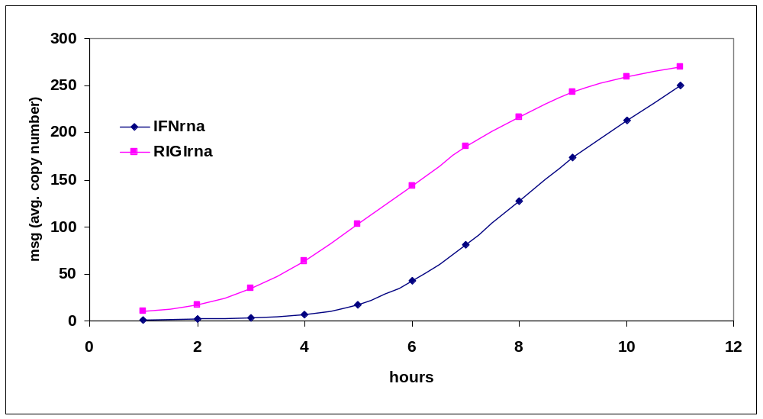

Slide 2
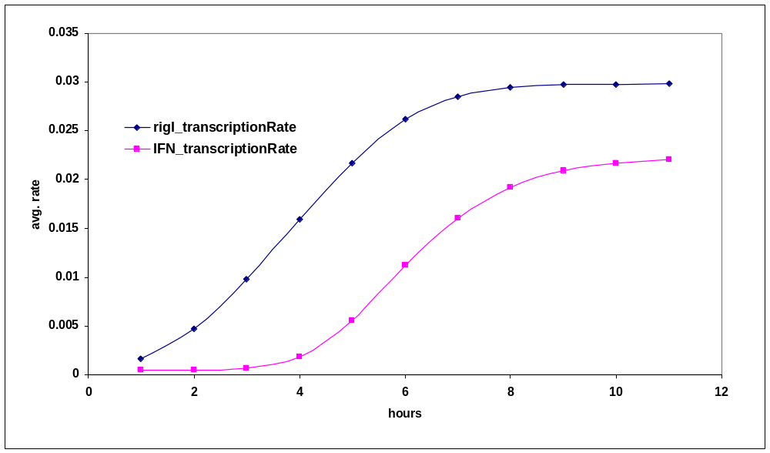

Slide 3
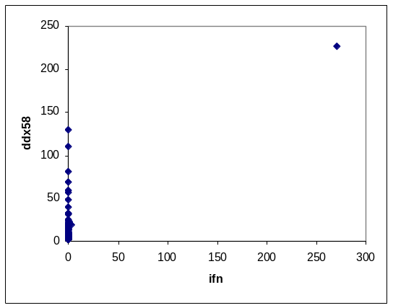
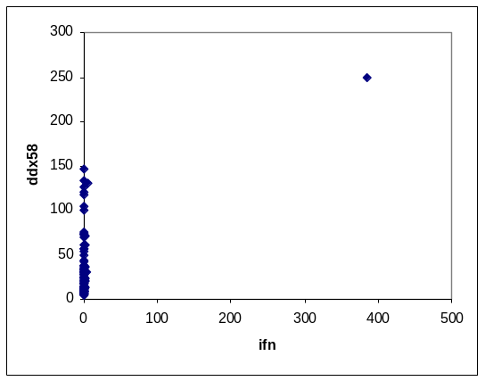
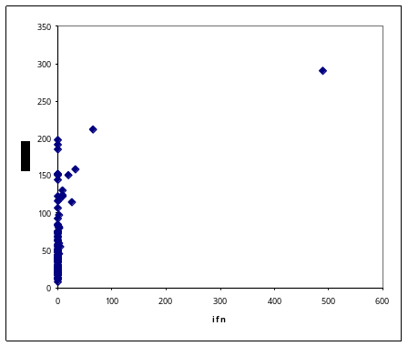
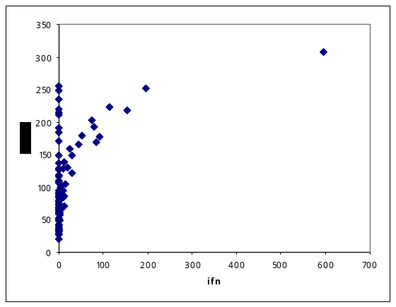
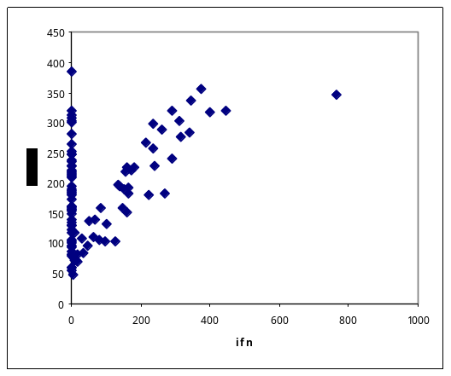
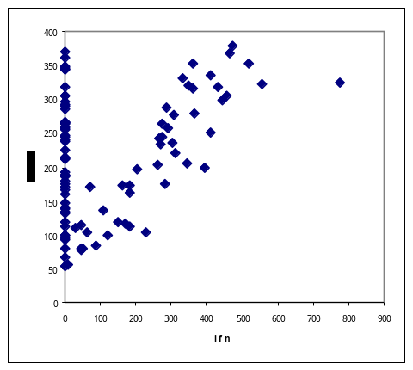
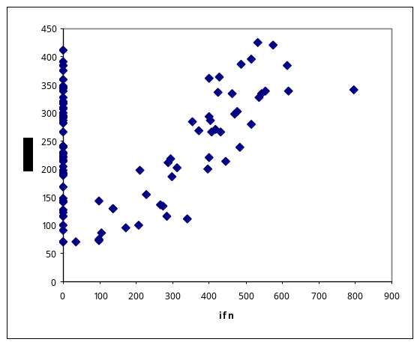
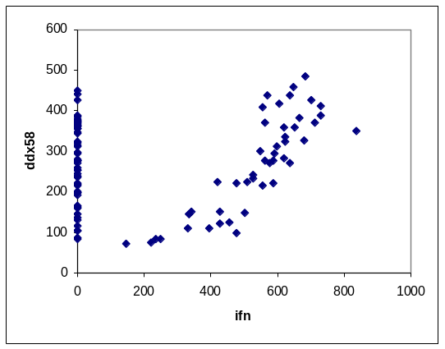
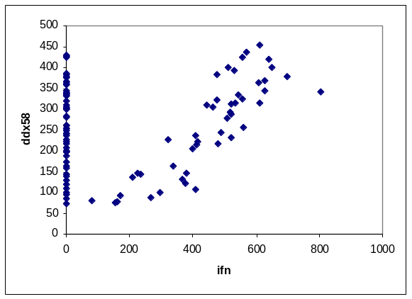

Slide 4
ifn D: 1
TIME_STEP_LENGHT: 25
cell number: 100
max transcription RateConstant: 0.05
max translation RateConstant: 0.002
typical_prot degradation Rate Constant: 0.0001
typical_rna degradation Rate Constant: 0.0001
IFN_rna_activation_hill Coef: 4
DDX58_rna_activation_hill Coef: 1
infectivityThreshould: 0.5
Ppob TypeIR bind IFNb: 3.125e-005

Slide 5
