Slide 1

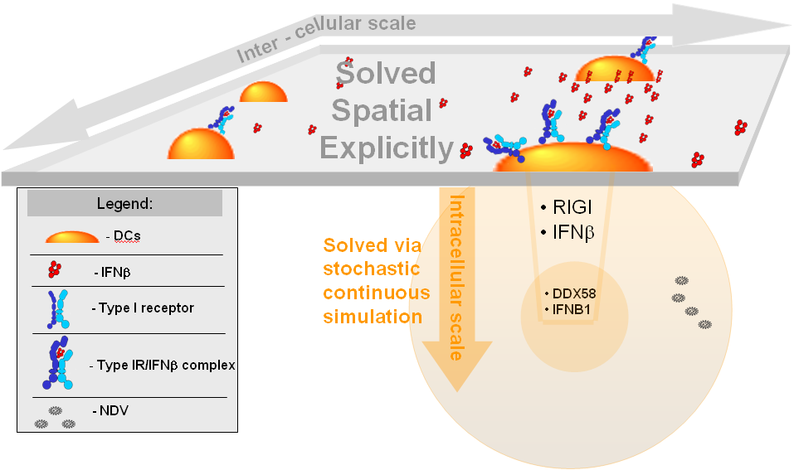
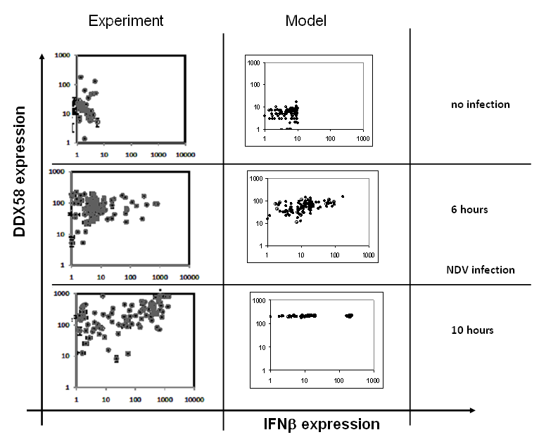
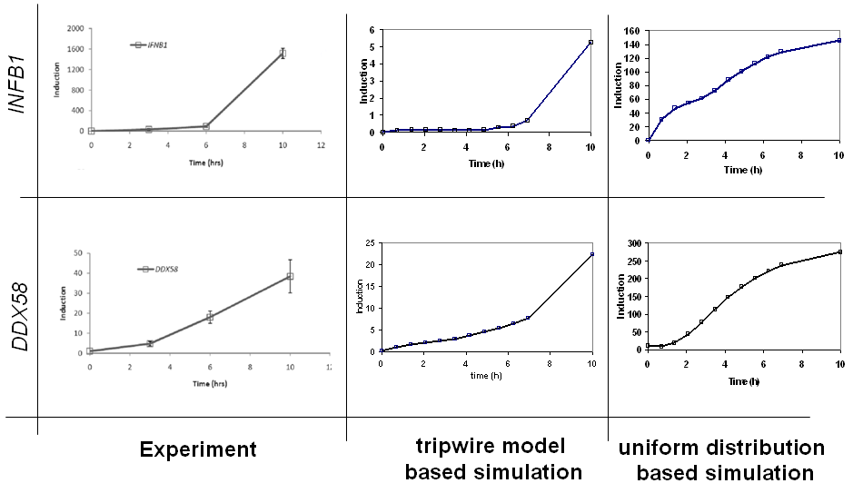
Coregulation Mapping Based on Individual Phenotypic Variation in Response to Virus Infection
German Nudelman^{1†}, Jianzhong Hu^{2†}, Yishai Shimoni^{1†}, Stuart C. Sealfon¹, James G. Wetmur²
¹Center for Translational Systems Biology and Department of Neurology, ²Department of Microbiology, Mount Sinai School of Medicine, New York, NY 10029, USA
ABSTRACT
THE MODEL
Viral infection leads to the production of type I interferons, which act through the interferon receptor to activate transcription of many antiviral genes, including DDX58, which encodes Rig-I. However, examination of the kinetics of transcription of DDX58 and interferon beta (IFNB1) following viral infection shows that induction of DDX58 occurs earlier than the induction of IFNB1. One possible explanation for this paradox would be that the average responses measured do not reflect the variations in individual cell responses. A few "tripwire" cells could induce IFNB1 early and secrete biochemically undetectable levels of IFN that are still able to induce DDX58 in other cells. This hypothesis was tested via an agent based model (ABM).
The ABM simulation we have developed is a multiscale realization of the Human Dendritic Cells (DCs) viral infection process implemented using a Monte Carlo algorithm. It contains DCs expressing TypeI IFN receptors on the cell surface, surrounded by IFN molecules diffusing within a medium. On the intracellular scale, each cell is modeled through running a stochastic simulation of IFNB1 and DDX58 transcript and protein dynamics. The simulation emulates the inter-cellular dynamics of the DC population in a spatially explicit manner, using biophysically measured parameters for modeling IFNB1 diffusion in the medium and TypeI IFNB1 receptors diffusion on the cell surface. The composition of the system is numerically analyzed and presented graphically. The simulation Graphic User Interface visualizes the simulation in real time by generating an animation through depicting the state of the cell surface at each iteration.
The simulation is consistent with the hypothesis that IFNB1 transcription in early responding cells can be sufficient for the significant DDX58 induction in the population. Experimental single cell measurements have confirmed for the IFNB1-DDX58 interplay by following infection of populations of and single human DCs by Newcastle Disease Virus (NDV).
RESULTS
DDX58/IFNB1 gene expression scatter plots (simulation vs. experiment)
DDX58 is induced earlier that IFNB1 only in simulation based on tripwire scenario
Conclusions
We have developed a multiscale simulation of the RIGI mediated INFβ response during viral infection process of the Human Dendritic Cells.
Tripwire model is the only plausible scenario, explaining the experimental result, showing induction of INFβ gene earlier than the INFβ gene itself.
ACKNOWLEDGEMENTS
This work was supported by NIH NIAID Contract No. HHSN2662000500021C and Grant U19 AI62623.

