Slide 1
Do Safety Dollars
Save Lives?
Senior Capstone
Data Science
Levi Sayles
Xavier University · 2025–2026
Evaluating ODOT's Road Construction Investments
328,000 road segments · 910,000 crashes · 13,550 safety projects · 5 years of data

Slide 2
BACKGROUND
Where This Started
The Data
“
ODOT's public crash records, road inventory, pavement condition scores, and construction project
We look for projects based on current needs — but we never go back to evaluate them.
Meeting 1 — Initial Analysis
Presented early findings to a group of ODOT engineers and planners. Walked through crash patterns, project locations, and preliminary DiD results.
— ODOT Engineer
Meeting 2 — Results Confirmed
This project is an attempt to change that.
Presented final findings. ODOT confirmed the results reflect patterns they recognize — including the investment gap on local and collector roads.
Xavier University | Data Science Capstone | 2025–2026

Slide 3
THE QUESTION
The Question
1,390
$140M+
13,550
Ohio Traffic Fatalities
2023
Safety Construction
Spending 2023
Safety-Funded
Projects (2020–24)
When Ohio spends money on road safety construction,
does it actually make roads safer?
Xavier University | Data Science Capstone | 2025–2026

Slide 4
THE DATA
Four Datasets. One Pipeline.
Crash Records
Road Inventory
Pavement Condition
Construction Projects
~910,000 events · 2020–2024
GPS location, severity, year
328,709 segments · Statewide
ADT, road class, speed limit, length
Local + State PCR data
PCR score, IRI, distress indicators
13,550 safety-funded projects
Route, mileposts, type, cost, date
Master Analysis Dataset
328,709 segments · 5 years · Panel structure · Crash rate per million vehicle miles traveled
Xavier University | Data Science Capstone | 2025–2026

Slide 5
TECHNICAL WORK
Building the Pipeline
1. Spatial Join — Crashes to Roads
Crash records are GPS points. Road segments are lines. No shared ID exists between them. Used st_nearest_feature() to match each of 910,000 crashes to its closest road segment geometry.
2. CTL Range Overlap — Projects to Segments
Projects are defined by route + milepost range. A simple ID match pulls in entire routes — miles of unrelated road. Wrote a range overlap filter: segment must physically intersect the project's milepost boundaries.
3. Panel Data Structure
Final dataset: 328,000 segments × 5 years. Required aggregating crashes by segment and year, computing exposure-adjusted crash rates using vehicle miles traveled, and dropping 2022 as a transition year.
Xavier University | Data Science Capstone | 2025–2026
Notes:
Explain 2 better. Needs to be pretty brief for the most part

Slide 6
METHODOLOGY
How Do We Measure Impact?
Difference-in-Differences (DiD)
The Core Idea
1
Compare crash rates on treated roads before vs after construction
BEFORE
AFTER
Project
completes
2
Compare crash rates on similar untreated roads over the same period
Treated road
The difference between those two differences = the project effect
DiD
effect
3
Control road
Why DiD for this project?
Model: Segment + year fixed effects · SE clustered at segment level · ADT-matched controls
Roads receiving safety funding are not random — they are already known problem roads. DiD controls for this by comparing change over time rather than raw levels, removing baseline differences between treated and untreated roads.
Xavier University | Data Science Capstone | 2025–2026

Slide 7
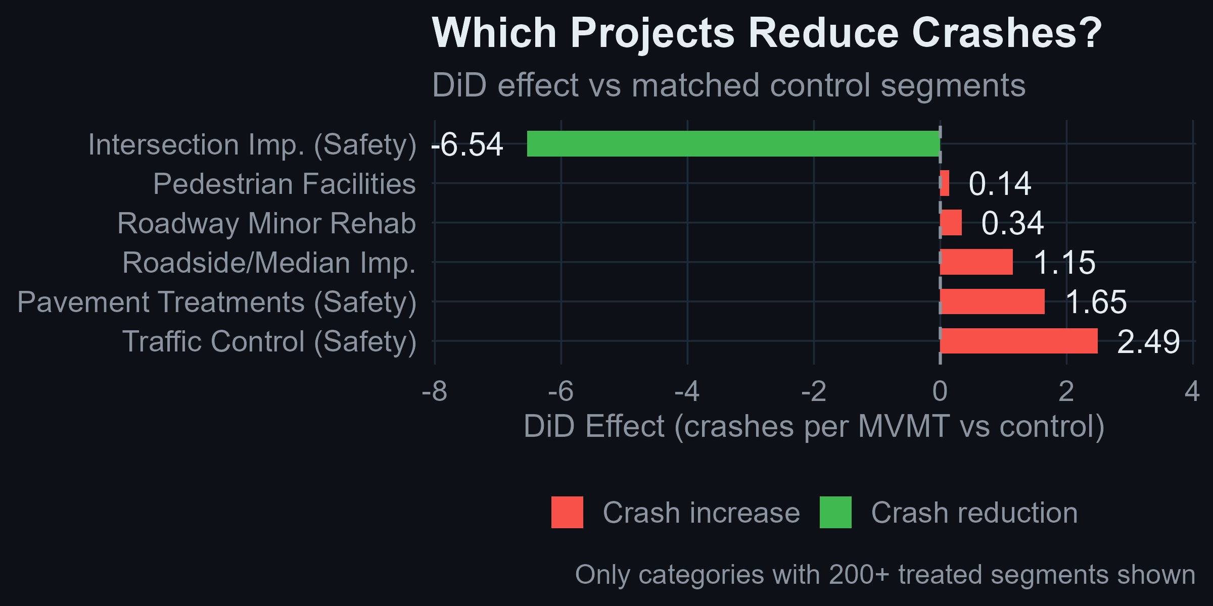
MAIN FINDING
The Main Finding
OVERALL EFFECT
INTERSECTION IMPROVEMENTS
p = 0.185
−6.5
Not statistically significant
crashes/MVMT — only category with a clear signal
Results by Project Type
Intersection Improvement
−6.54
Pedestrian Facilities
+0.14
Roadway Minor Rehab
+0.34
Roadside / Median
+1.15
Traffic Control
+2.49
Change per MVMT vs comparable untreated roads
Xavier University | Data Science Capstone | 2025–2026

Slide 8
UNPACKING THE RESULT
So What's Actually Happening?
A null overall result doesn't mean nothing is happening — it means very different outcomes are being averaged together.
Plainfield Rd Roundabouts
Eastern Corridor VAR TSG
SR 32 / SR 125 Overlay
Intersection Improvement
Traffic Control
Roadway Minor Rehab
Before
After
Before
After
Before
After
75.3
30.1
19.9
34.8
0.82
0.82
▼ 45.2
▲ 14.9
— 0.0
Structural redesign of how vehicles interact. Eliminates the most dangerous crash types.
Signal timing changes redirected traffic patterns in ways that increased conflict points.
AC overlay makes the road smoother. Doesn't change geometry, speed, or conflict points.
Xavier University | Data Science Capstone | 2025–2026
Notes:
Insert visuals from case study

Slide 9
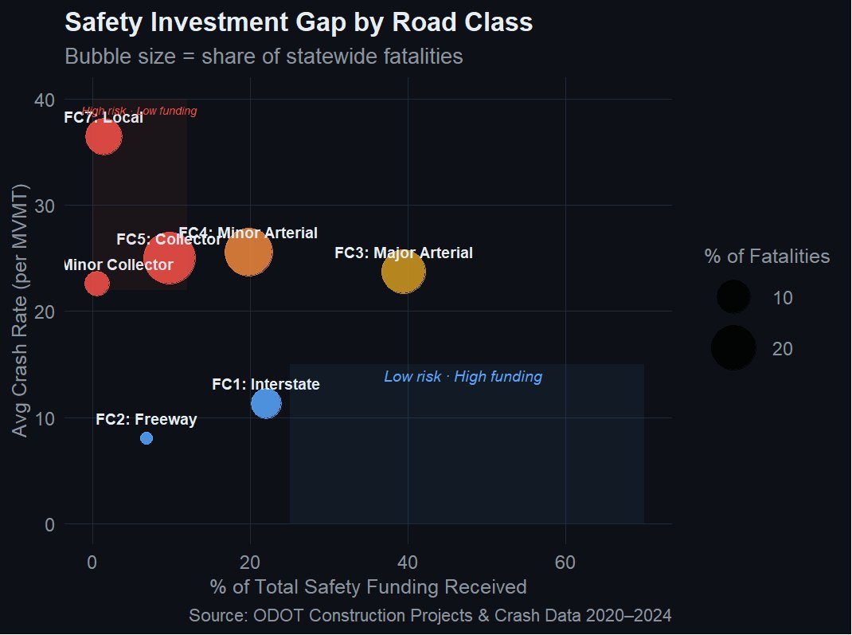
INVESTMENT GAP
Where Is The Money Going?
The Problem
52.5%
of Ohio fatalities on
FC4 + FC5 roads
1.4%
of safety funding
to local roads (FC7)
39.5%
of safety funding
to major arterials (FC3)
Xavier University | Data Science Capstone | 2025–2026

Slide 10
THE TOOL
This Question Needs to Be Asked Every Year
ODOT spends safety dollars every year. New projects complete every year. New crash data arrives every year. A one-time analysis doesn't solve that — it just answers the question once.
❌ Analysis takes months to run manually
→
✓ Pre-computed data loads instantly for any county
❌ Results buried in R scripts no one else can run
→
✓ Interactive app — no coding required, any analyst can use it
❌ Findings specific to 2020–2024 only
→
✓ Upload new crash and project data annually to refresh everything
Xavier University | Data Science Capstone | 2025–2026

Slide 11
THE TOOL
ODOT Safety Investment Analyzer
An interactive Shiny application that makes this entire analysis reusable — any county, any district, any year, no coding required.
County Dashboard
Project Evaluator
Risk Explorer
Safety profile for any Ohio county — crash rates, fatality share, funding distribution
Before/after crash trends for any project. Individual or aggregate by project type.
Highest-risk untreated segments in any county. Click to see location on map.
Funding Gap
Cost Effectiveness
Investment vs risk by road class. Statewide or county-level. Two metric options.
Project cost vs crash rate change. Every project as a point. Who delivers value?
Xavier University | Data Science Capstone | 2025–2026

Slide 12
HAMILTON COUNTY DEEP DIVE
A Story from District 8
LIVE APP DEMO — ODOT Safety Investment Analyzer
1
County Dashboard → HAM
Local roads: 41 crashes/MVMT. Interstates: 19. Interstates get 33% of funding.
2
Funding Gap → By County → HAM
Interstates capture 63% of safety dollars — the safest roads in the county.
3
Project Evaluator → Plainfield
Crash rate: 75.3 → 30.1 after roundabout completion. A 60% reduction.
4
Project Type Trend → Statewide
Intersection improvements show consistent downward trend statewide.
5
Cost Effectiveness
Plainfield roundabout: expensive, but clearly effective. Cost ≠ outcome.
Xavier University | Data Science Capstone | 2025–2026

Slide 13
CHALLENGES
What Made This Hard
Selection Bias
Regression to the Mean
Safety funds go to roads already flagged as problems — not random roads. Addressed with segment fixed effects and ADT matching, but cannot be fully eliminated in observational data.
Roads get funded during crash spikes. Crash rates naturally fluctuate — a bad year tends to be followed by a better one regardless of intervention. A classic statistical pattern.
Measuring Causation vs Correlation
Partial Safety Funding Labels
When crash rates drop after a project, how do we know the project caused it and not just random variation? We cannot run a controlled experiment. DiD gets closer to causation, but cannot fully eliminate unobserved confounders.
ODOT flagged that some projects are labeled safety-funded but only partially draw from safety dollars. Our cost effectiveness estimates use total project cost — a conservative interpretation.
Xavier University | Data Science Capstone | 2025–2026
Notes:
Make sure you understand selection bias fix words

Slide 14
TAKEAWAYS
What This Means
01
Intersection Improvements Work
The one project type with a clear, consistent, replicable safety return. Expensive but effective — and underrepresented in Ohio's safety portfolio relative to demonstrated impact.
02
The Safety Label Is Applied Too Broadly
Pavement overlays show no crash reduction effect — but their value is preventative, not corrective. Good pavement prevents blowouts and improves braking. That benefit doesn't show up in before-after crash rate comparisons.
03
High-Risk Roads Are Underserved
FC4 and FC5 roads account for over 52% of Ohio fatalities but receive less than 30% of safety funding. Local roads have the highest crash rate per trip in the network and receive 1.4% of safety dollars.
Xavier University | Data Science Capstone | 2025–2026
Notes:
Don’t like 2

Slide 15
Do safety dollars
save lives?
Thank You
Questions?
It depends entirely on
how you spend them.
Levi Sayles
Xavier University
Data Science Capstone
2025 – 2026
The data to make better decisions already exists.
This project is an attempt to make it easier to use.
328K segments · 910K crashes · 13,550 projects · 5 years · 88 counties · p = 0.185

