Slide 1




Primeiros Passos na API
do Zabbix com Python

Slide 2
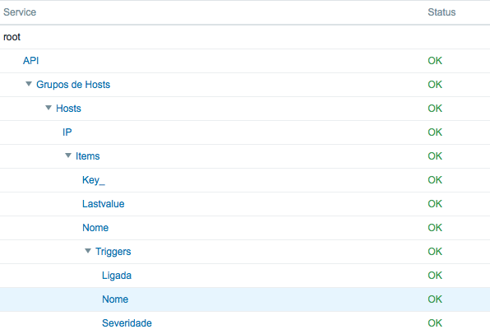

Slide 3


Slide 4
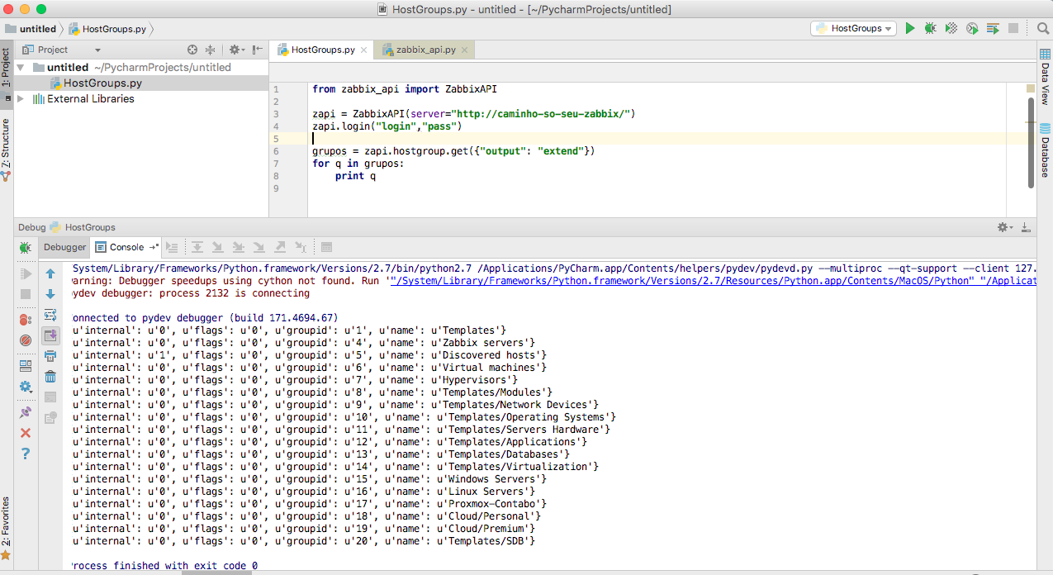
Grupos:

Slide 5
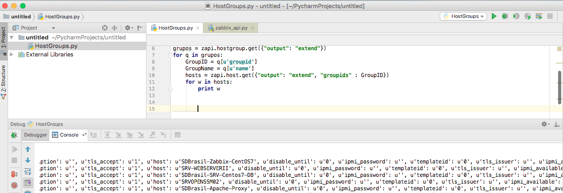
Hosts:

Slide 6
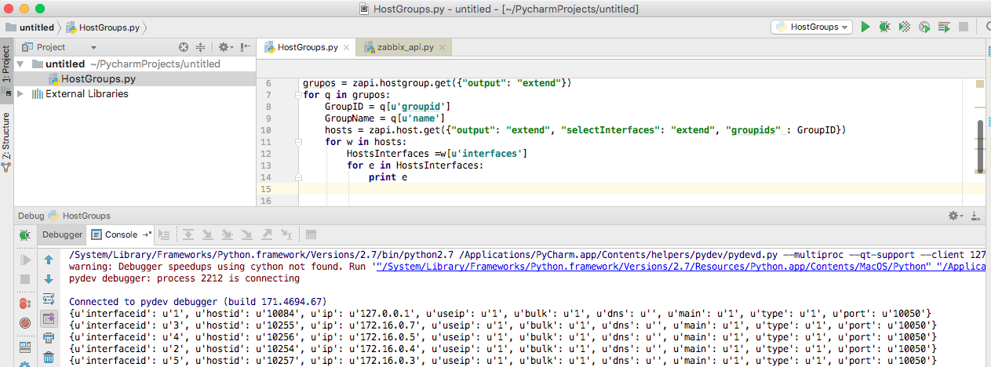
Hosts -> IP

Slide 7
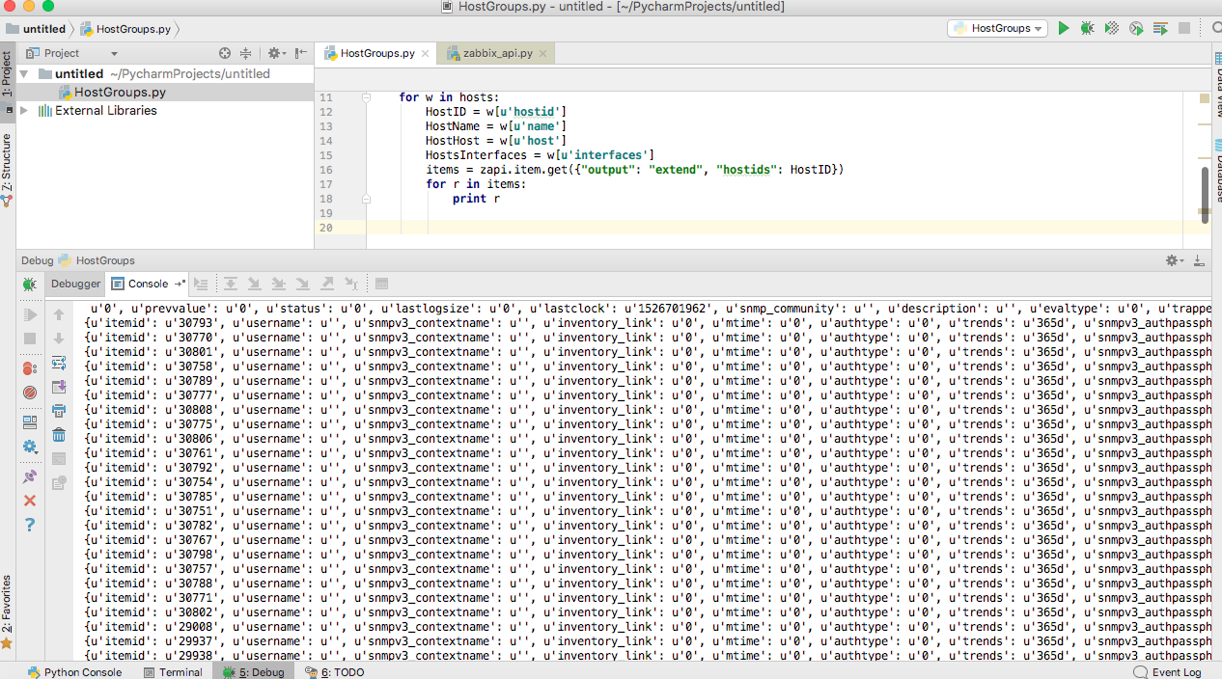
Items:

Slide 8
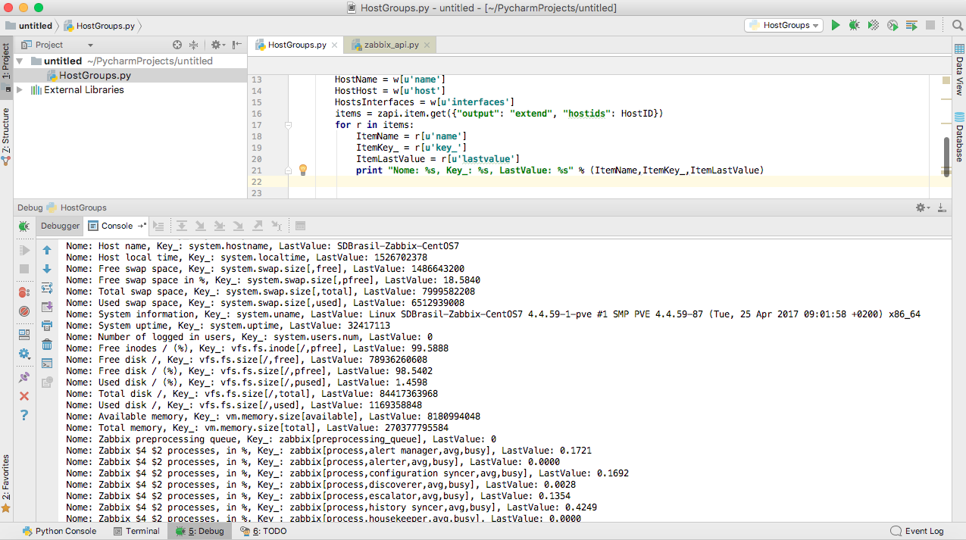
Items -> Name, Key_, LastValue

Slide 9
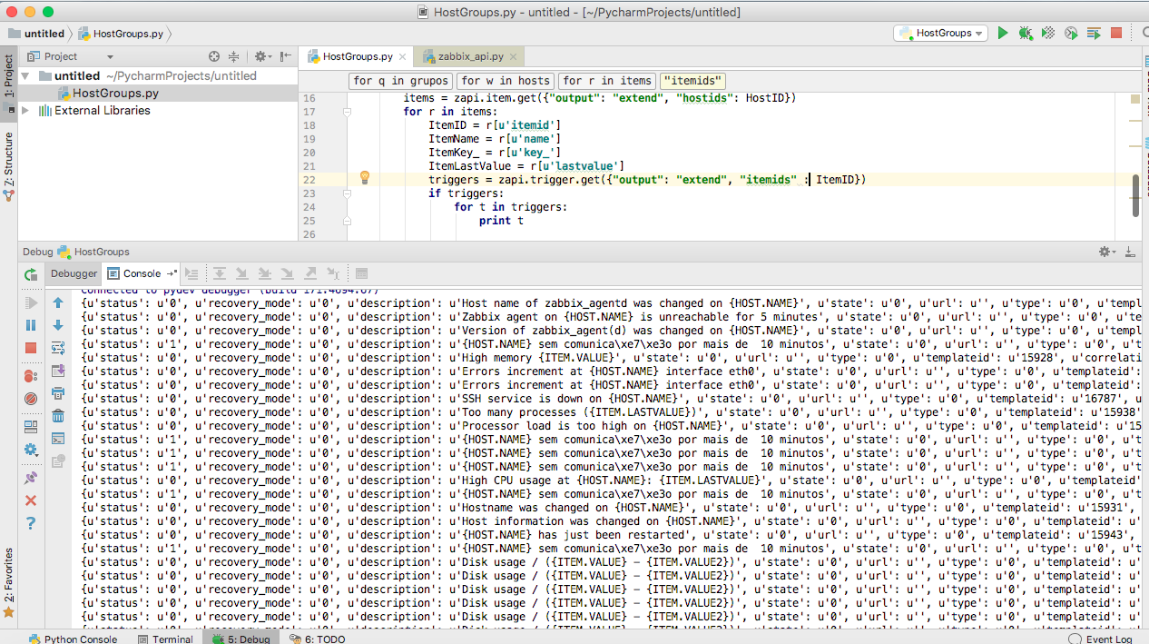
Triggers:

Slide 10
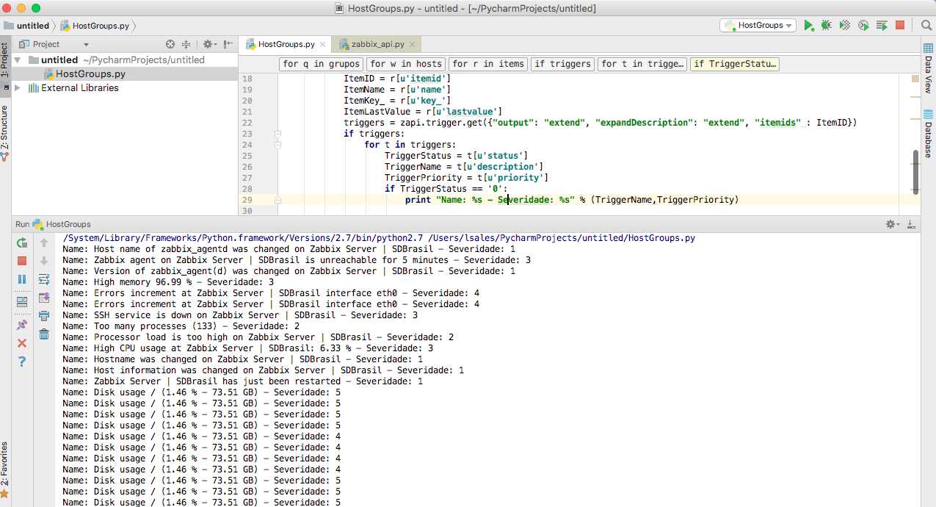
Triggers -> Nome,Severidade, Status

Slide 11
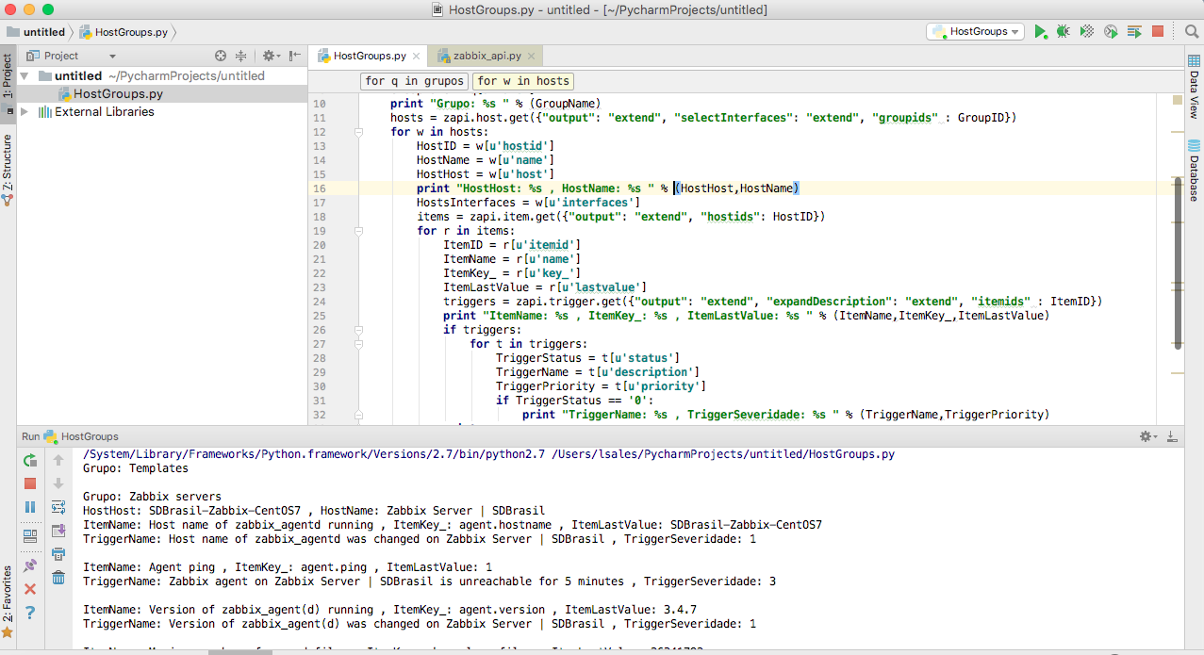
Report Geral:

Slide 12
Metodos Usados
Metodos
https://www.zabbix.com/documentation/3.4/manual/api/reference/hostgroup
https://www.zabbix.com/documentation/3.4/manual/api/reference/host
https://www.zabbix.com/documentation/3.4/manual/api/reference/item
https://www.zabbix.com/documentation/3.4/manual/api/reference/trigger

Slide 13


Slide 14

Luiz Sales
Managing Partner at ServiceMonit
Specialist and Professional Zabbix
luiz.sales@servicemonit.com.br
https://github.com/lsa1es/
https://www.linkedin.com/in/lsa1es/

