Slide 1
Defender_black_vs_Controller_white
counterfactual_base Winner: N.A.

Slide 2
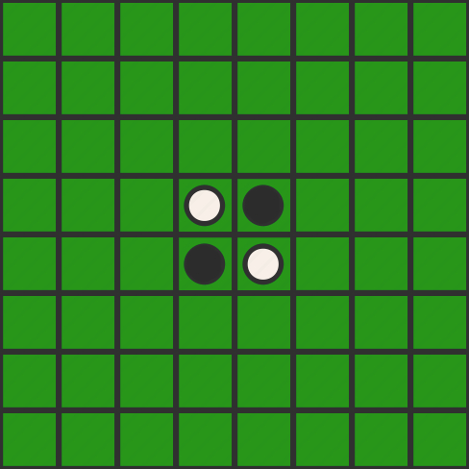
turn: 0 player: None move: None

Slide 3
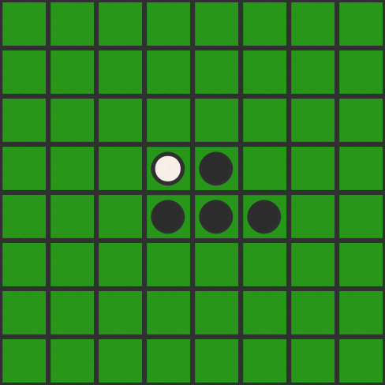
turn: 1 player: Black move: 56

Slide 4
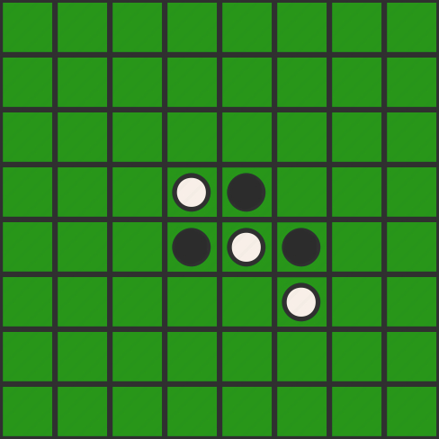
turn: 2 player: White move: 66

Slide 5
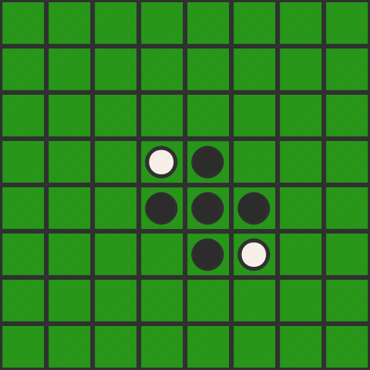
turn: 3 player: Black move: 65

Slide 6
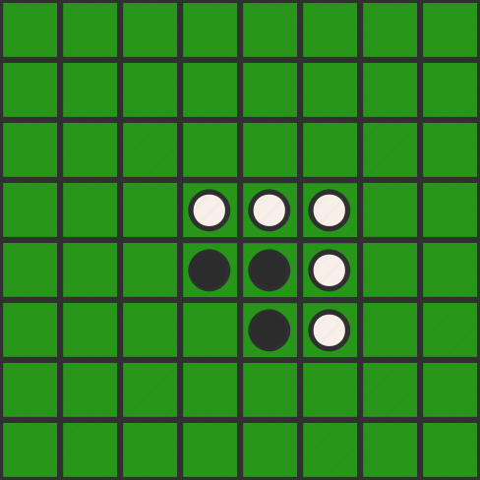
turn: 4 player: White move: 46

Slide 7
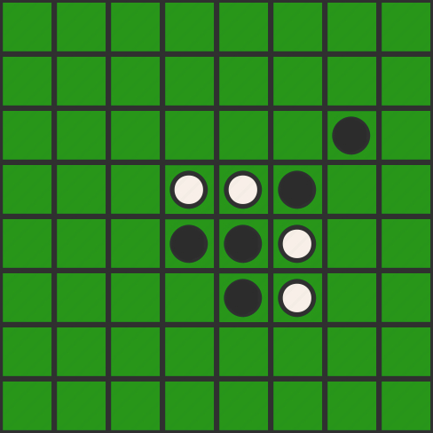
turn: 5 player: Black move: 37

Slide 8
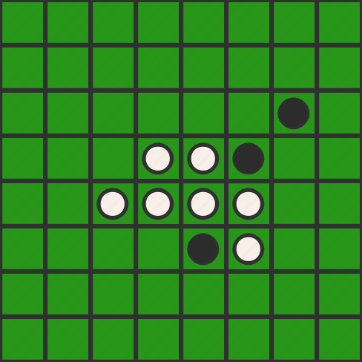
turn: 6 player: White move: 53

Slide 9
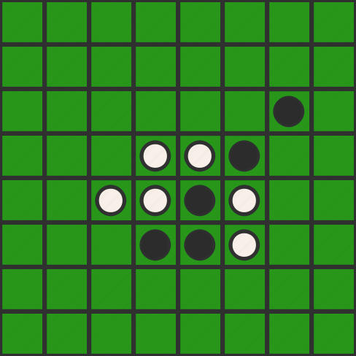
turn: 7 player: Black move: 64

Slide 10
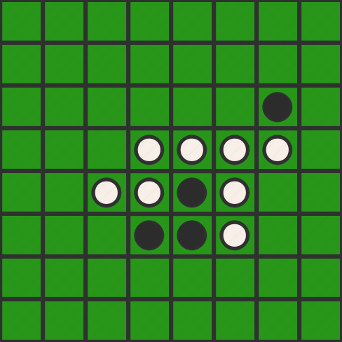
turn: 8 player: White move: 47

Slide 11
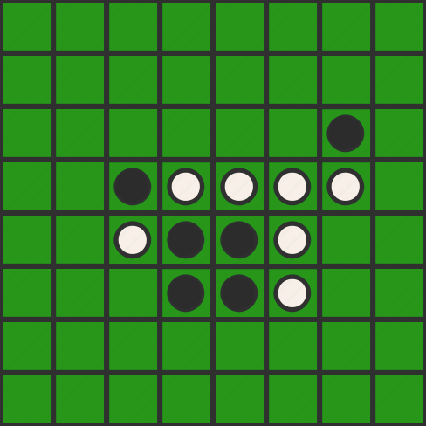
turn: 9 player: Black move: 43

Slide 12
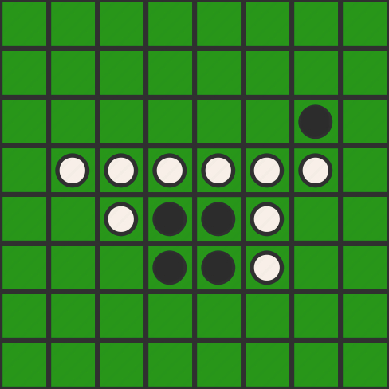
turn: 10 player: White move: 42

Slide 13
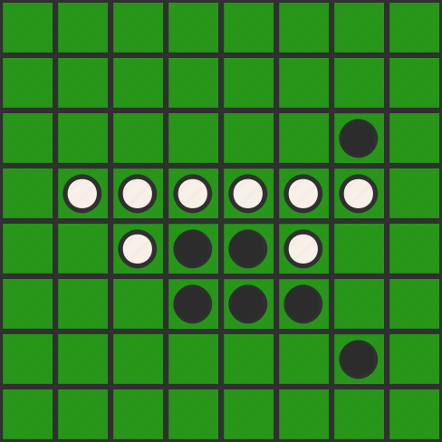
turn: 11 player: Black move: 77

Slide 14
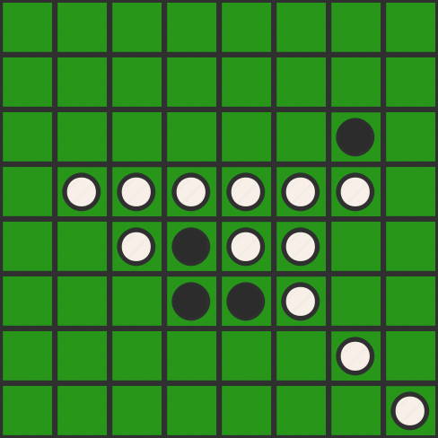
turn: 12 player: White move: 88

Slide 15
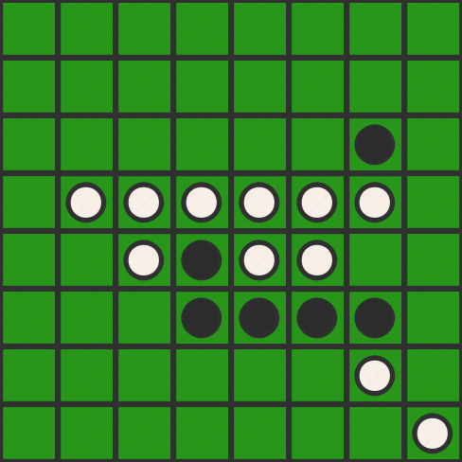
turn: 13 player: Black move: 67

Slide 16
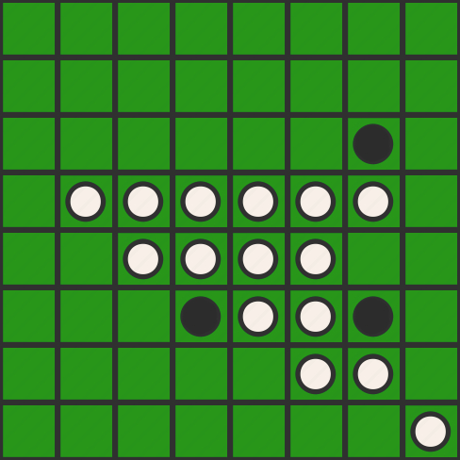
turn: 14 player: White move: 76

Slide 17
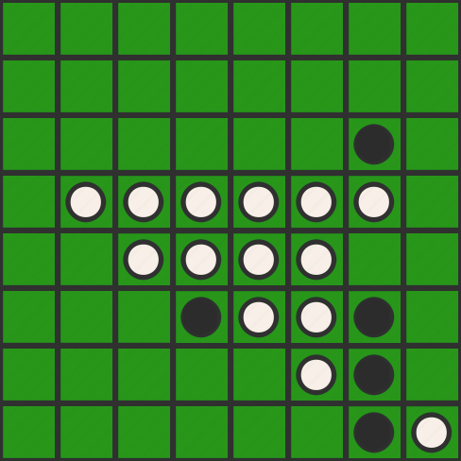
turn: 15 player: Black move: 87

Slide 18
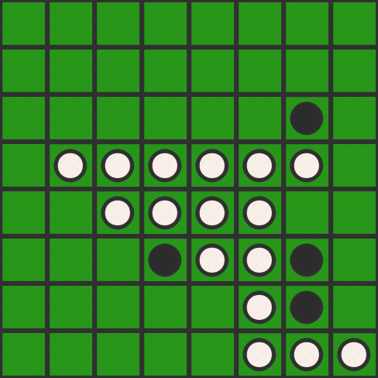
turn: 16 player: White move: 86

Slide 19
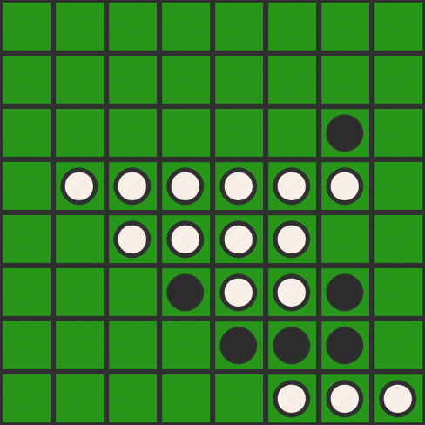
turn: 17 player: Black move: 75

Slide 20
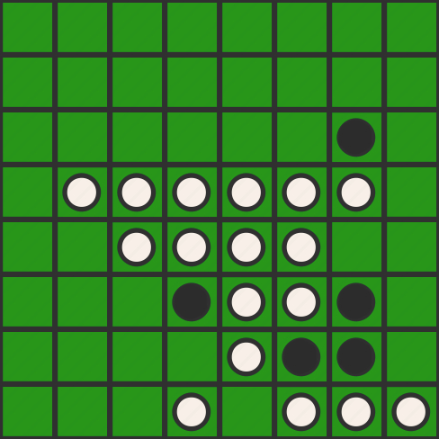
turn: 18 player: White move: 84

Slide 21
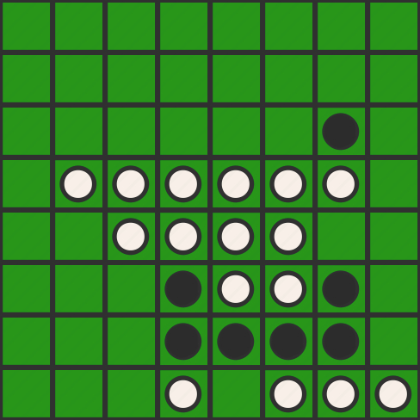
turn: 19 player: Black move: 74

Slide 22
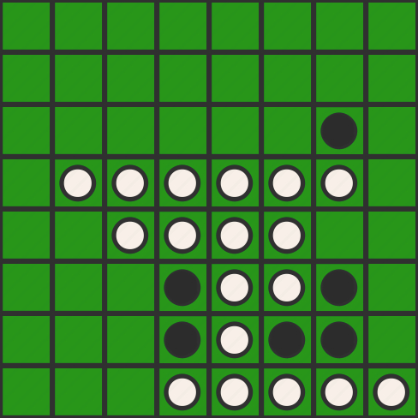
turn: 20 player: White move: 85

