Slide 1
othello_results/base_game__Corner_Bot_black_vs_Cleric_white
cf_base Winner: N.A.

Slide 2
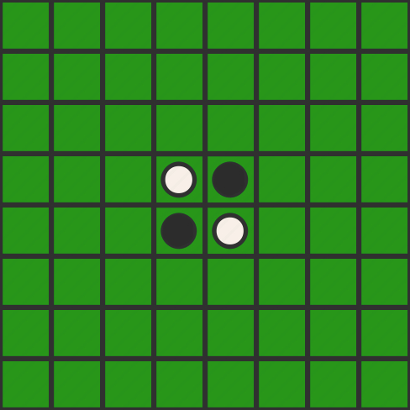
turn: 0 player: None move: None

Slide 3
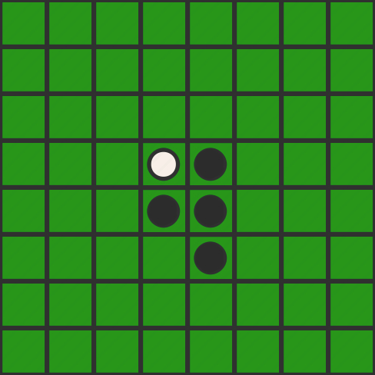
turn: 1 player: Black move: 65

Slide 4
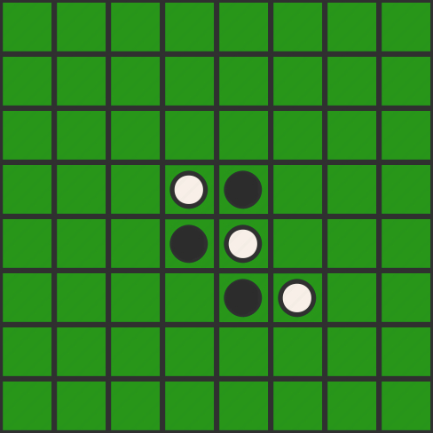
turn: 2 player: White move: 66

Slide 5
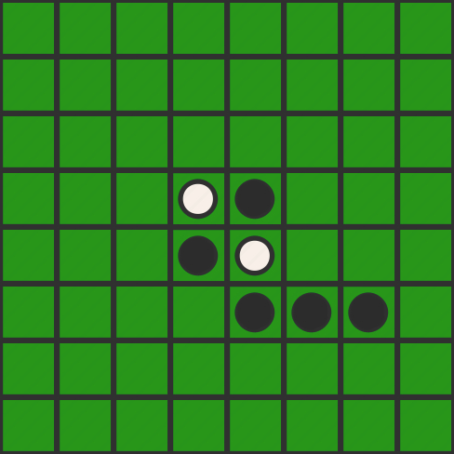
turn: 3 player: Black move: 67

Slide 6
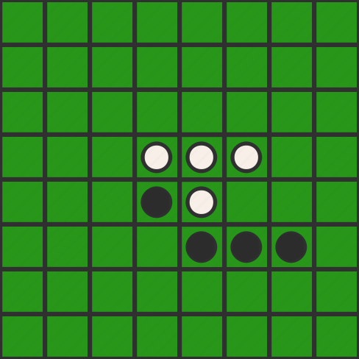
turn: 4 player: White move: 46

Slide 7
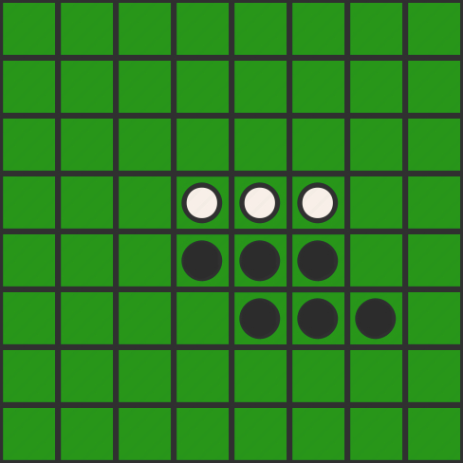
turn: 5 player: Black move: 56

Slide 8
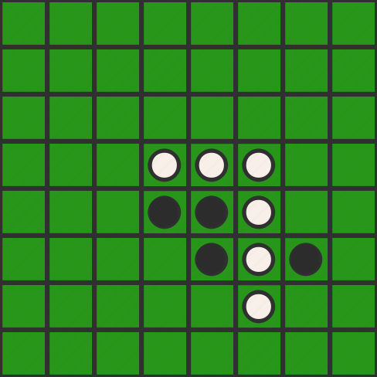
turn: 6 player: White move: 76

Slide 9
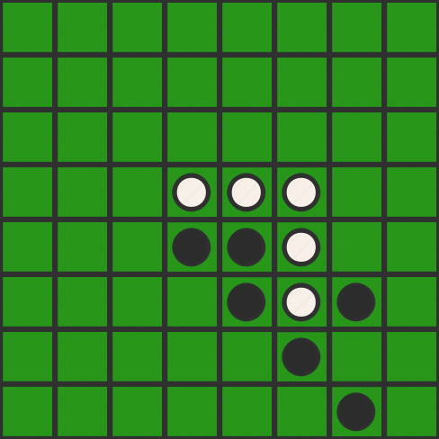
turn: 7 player: Black move: 87

Slide 10
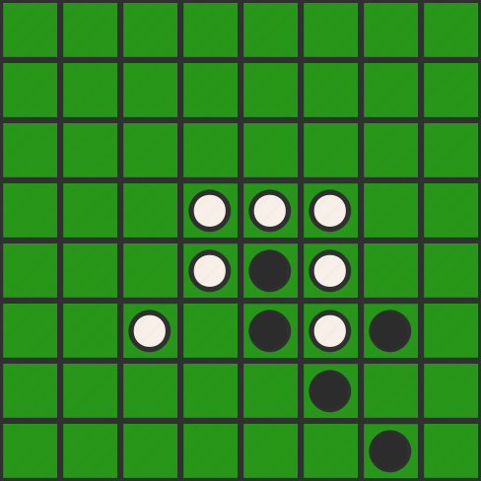
turn: 8 player: White move: 63

Slide 11
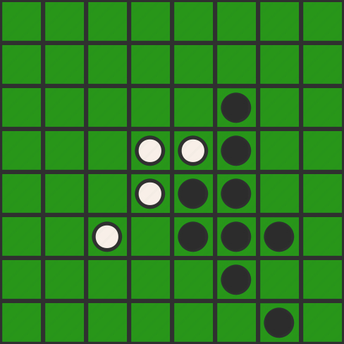
turn: 9 player: Black move: 36

Slide 12
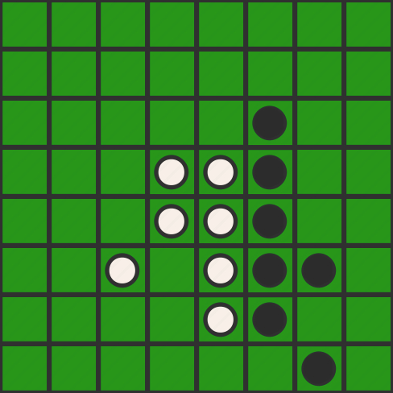
turn: 10 player: White move: 75

Slide 13
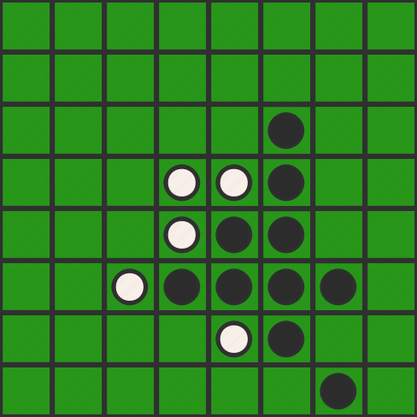
turn: 11 player: Black move: 64

Slide 14
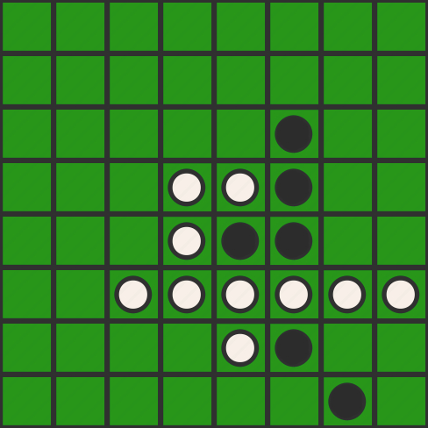
turn: 12 player: White move: 68

Slide 15
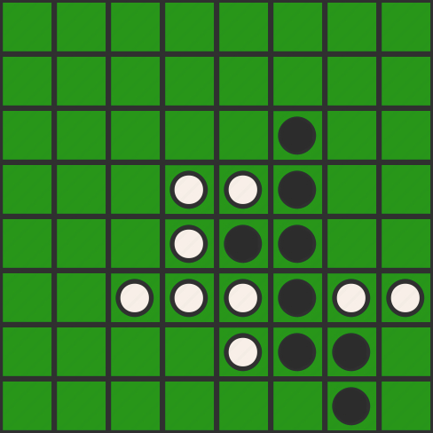
turn: 13 player: Black move: 77

Slide 16
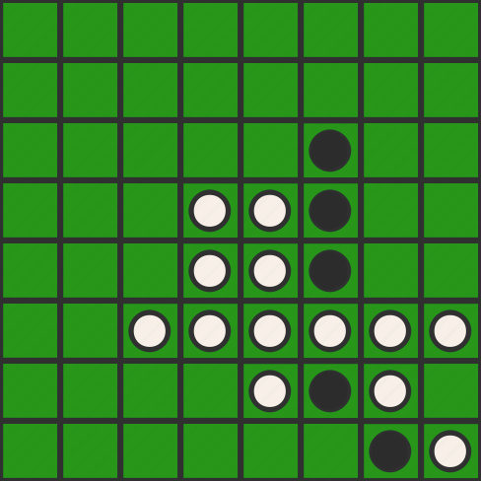
turn: 14 player: White move: 88

Slide 17
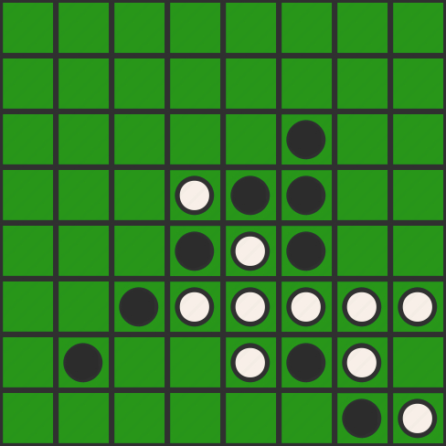
turn: 15 player: Black move: 72

Slide 18
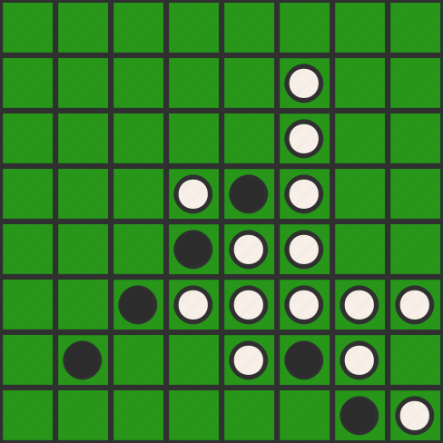
turn: 16 player: White move: 26

Slide 19
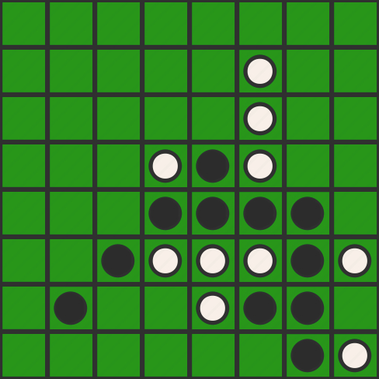
turn: 17 player: Black move: 57

Slide 20
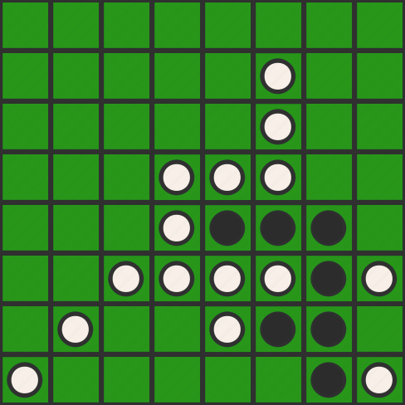
turn: 18 player: White move: 81

Slide 21
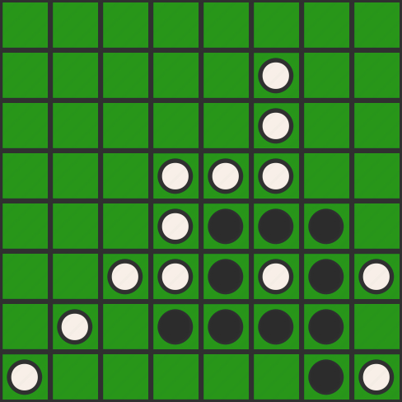
turn: 19 player: Black move: 74

Slide 22
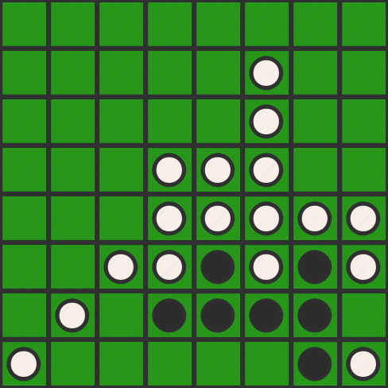
turn: 20 player: White move: 58

Slide 23
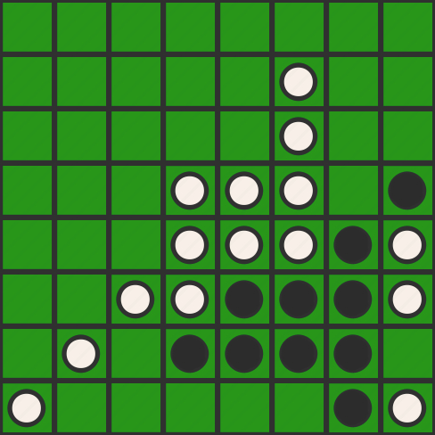
turn: 21 player: Black move: 48

Slide 24
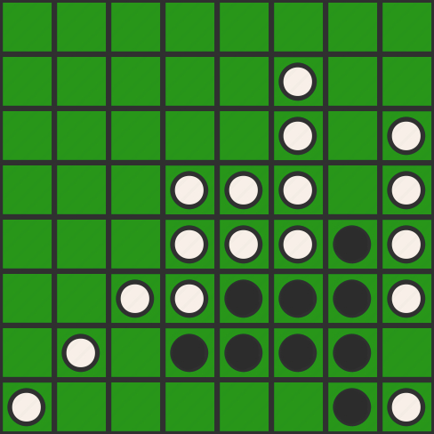
turn: 22 player: White move: 38

Slide 25
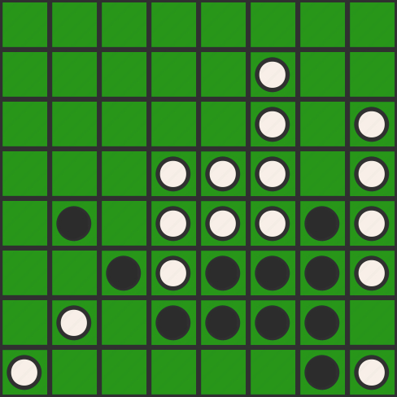
turn: 23 player: Black move: 52

Slide 26
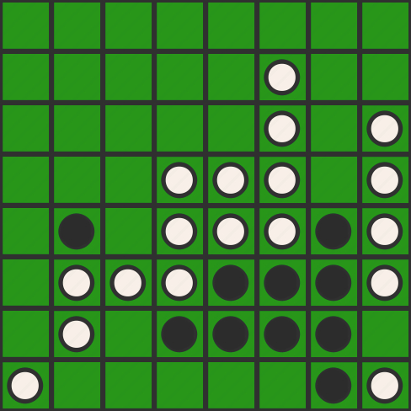
turn: 24 player: White move: 62

Slide 27
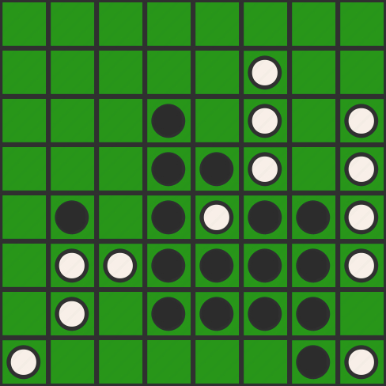
turn: 25 player: Black move: 34

Slide 28
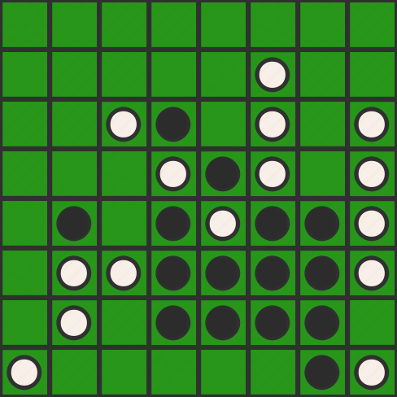
turn: 26 player: White move: 33

Slide 29
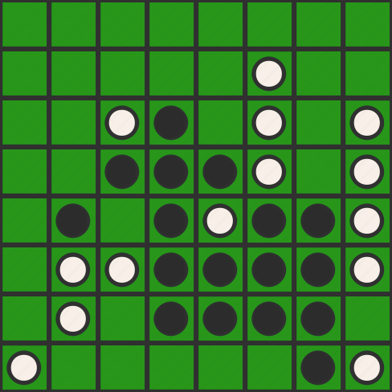
turn: 27 player: Black move: 43

Slide 30
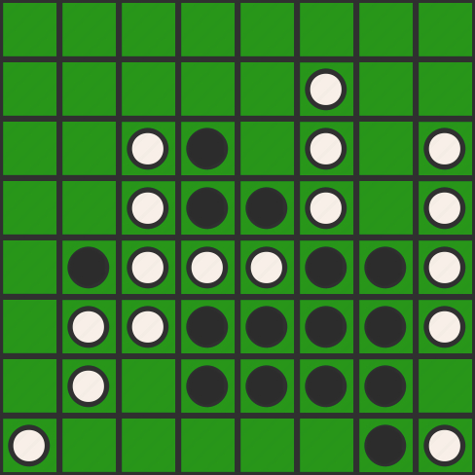
turn: 28 player: White move: 53

Slide 31
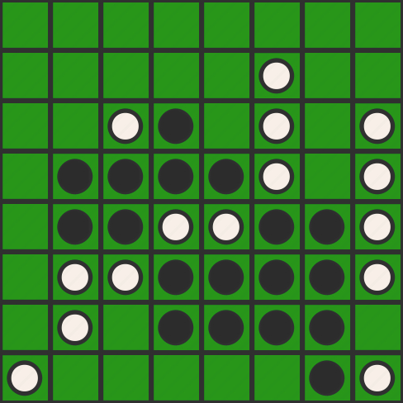
turn: 29 player: Black move: 42

Slide 32
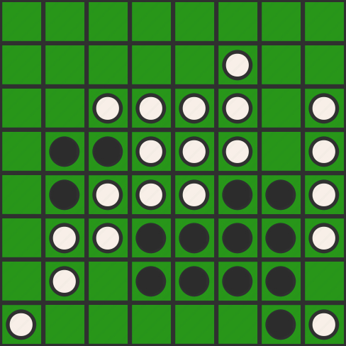
turn: 30 player: White move: 35

