Slide 1
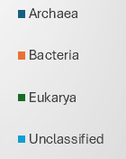
Benthic Community PIE CHARTS

Slide 2
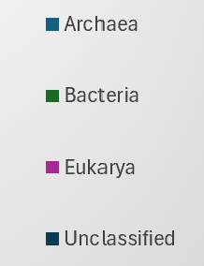
Soil Community
PT. 1

Slide 3
Soil Community
PT. 2

Slide 4
Water Community
PT. 1

Slide 5
