Slide 1
Git
By Luis Salvatierra

Slide 2
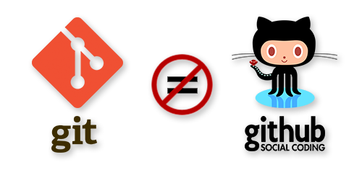

What is Git ?
Git is a distributed source code management(SCM) system

Slide 3
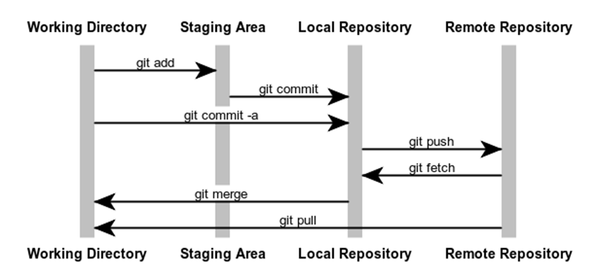
Distribution concepts

Slide 4
GIT Global Configuration
Identity
$ git config --global user.name “Papa John”
$ git config --global user.email papajohn@mailinator.com
Check configuration
$ git config --list

Slide 5
GIT INITIALIZATION
Clone repository
$ git clone <url>
$ touch Readme.md
$ git add Readme.md
$ git commit –m “add readme”
$ git push origin master
Init local repository
$git init
$git remote add origin <url>
$git add …..

Slide 6
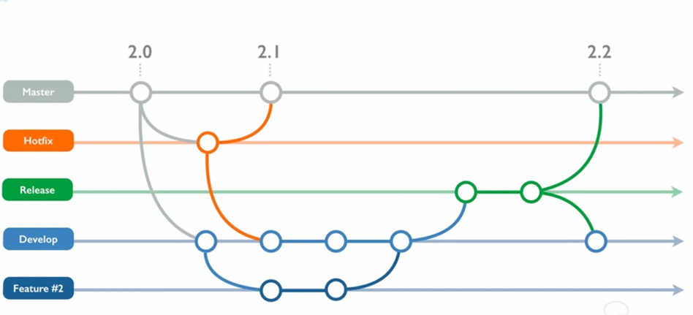
Git branch Modeling

Slide 7
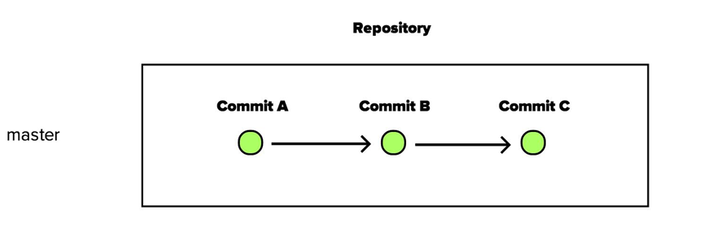
GIT BRANCH
Branch is a alternate time line in the history of our repository
All repositories have a master branch

Slide 8
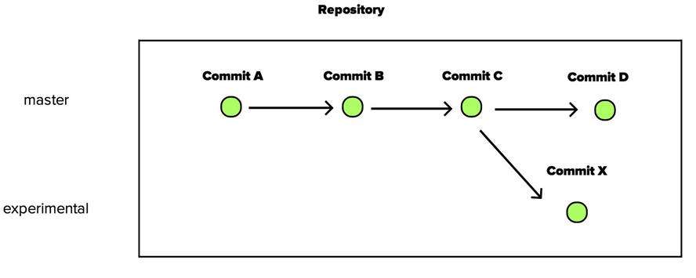
GIT New BRANCH
$ git checkout –b <branch_name>

Slide 9
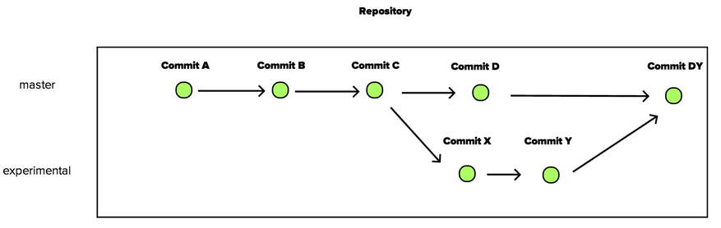
GIT MERGING BRANCH
$ git merge

Slide 10

WEB-BASED GIT Repositories

