Slide 1

Advanced Multifunctional Court Cases Management System (CCMS) for Supreme Court Lawyers by Using Latest Laravel PHP Web Framework
CIS6002 – Software Engineering Dissertation PROJECT PROPOSAL PRESENTATION D M L S DASSANAYAKE (ST20197917)

Slide 2
Project Purpose
This project’s main purpose is to develop well functional advanced court case management system and using this system supreme court lawyers will able to manage their court cases/ clients and many more legal relational information.
With this application lawyers can keep the records at their fingertips.
Another main focus of this project is to update and fix international/local existing systems issues by adding new advanced features and functions.
This is a fully automation management system and this system will be able to fix all manual data management issues.
Moreover, lawyers will able to manage their client’s works by storing their legal data and information in database enabling access to their files at any time at any place when they are in need very simply and easily.

Slide 3
Problem Statement
Government supreme court lawyers use all their efforts to win the justice from their part there is no digitalized proper way of managing their work stuff, legal data and information for lawyers to work effortlessly.
It is that they must waste a lot of their time and effort to file a case by filling all the accurate documents into separate files.
Whenever any client intervened with a case, the respective lawyer has to open a file for that case and have to collect and then file all the legal information; documents; shreds of evidence; proceedings all these things manually.
Moreover, if any change occurred in those documents the lawyer must find the files one by one through the file rack, to take the correct file out of from the rack, and to do each update manually.
Furthermore, if a lawyer is handling many cases of a single client then the lawyer must maintain several files. So, this management of multiple files for a single client makes the lawyer’s work complex and more tiresome.

Slide 4
Literature Review
Though the Sri Lankan lawyers have not yet stepped into the means of using applications or any other software to manage their paperwork more efficiently using a case data management system, in the technical renaissance, some foreign lawyers have touched the step of digitalization.
There are many systems in the application in foreign law firms. Namely, those systems are “Cilo”, “MyCase”, “Filevine”, “E-File Cabinet”, “CaseFox”, “App4Legal”, “Best Case”, “Pro Law”, etc.
But these software applications are not much applicable for the Sri Lankan context lawyers.
Mainly because their functional requirements have targeted on billing and invoicing, expense tracking and time tracking.
But with the proposed system the major functionality is targeted on document and case data and information management as in a Sri Lankan law firm the burning problem is the inefficiency and the ineffectiveness with the bulks of files loaded in narrow office rooms.

Slide 5
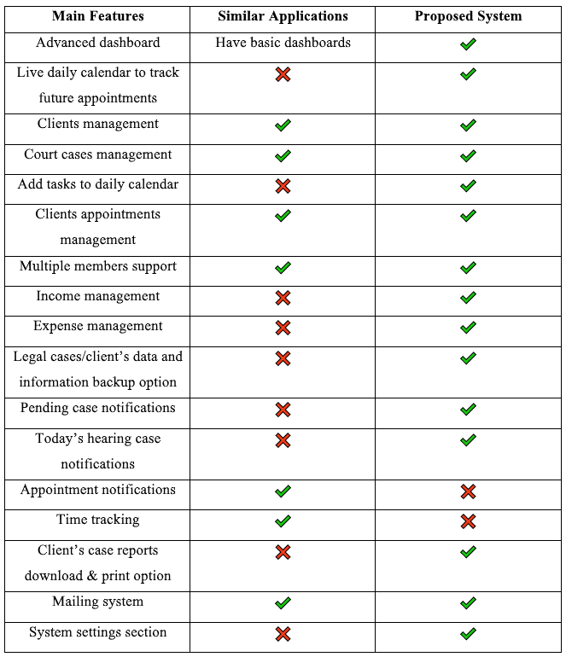
Systems Comparison

Slide 6
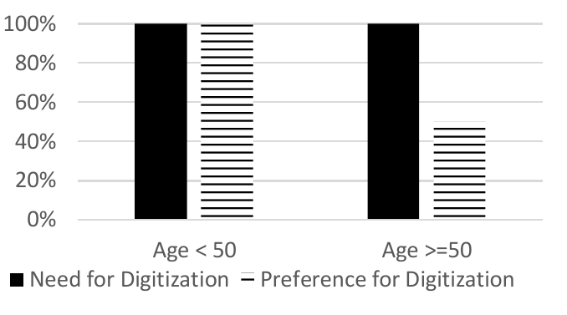
Result from the interviews and survey
The is the final overview according to the age groups of the Sri Lankan Lawyers’ analysis results.

Slide 7
Proposed System
Password recovery option – system will send recovery link to lawyer’s email address.
Advanced system dashboard – display summary of data and some more important information. Such as upcoming appointments tracking calendar.
Court case notifications – today’s hearing cases notifications and pending cases notifications.
Clients management – manage client’s details and information.
Court cases management – manage client’s court cases reports and other legal details.
Lawyer tasks management – manage lawyer’s future tasks.
Clients appointments management – manage client’s appointments.
Add team members – team members and roles. (personal case assistant, main assistant, Clark, etc.)
Lawyer income management – service and invoice.
Add vendors – add vendors to the system. (Office building provider, stationary provider, printing machines repair team etc.)
Expenses management – expenses and expense types (Phone bills, stationary expenses, electricity bill, etc.)
System settings section - case types, court types, courts, case status, judge, tax, general settings, database backup etc.

Slide 8
Software Requirements
Operating system: Windows 10
Web browser: Firefox Developer Edition
Web server: XAMPP
Code editor and IDE: Visual Studio Code
Version control software: GitHub Desktop
Graphics editor: Adobe XD/ Adobe Photoshop
Wireframe tool: Balsamiq Wireframes
Front-end: HTML/ SCSS/ SASS/ JavaScript
Back-end: PHP(Blade) Laravel/ Core PHP/ SQL
Other (PHP Extensions): BCMath PHP Extension, Ctype PHP Extension, JSON PHP Extension, Mbstring PHP Extension, OpenSSL PHP Extension, PDO PHP Extension, Tokenizer PHP Extension, XML PHP Extension

Slide 9
Hardware Requirements
Electronics – laptop or desktop pc, keyboard and mouse
RAM – minimum 2GB or 4GB
Screen Resolution – minimum 1920x1080
CPU – minimum Core i3 or i5
Hard Disk Space – minimum 500MB
Internet connection

Slide 10
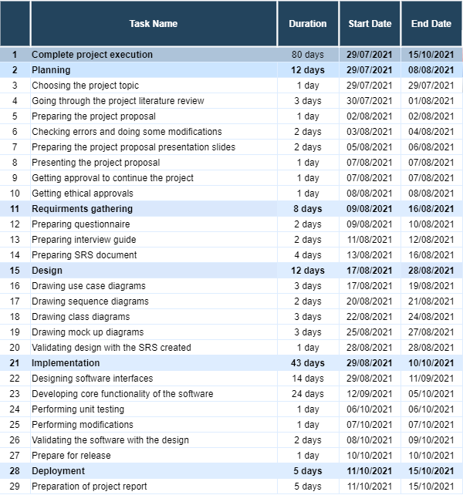
Project Schedule

Slide 11
References
Aarthi, S., Siddharth, S., Athreya, V., & Balaji, P. (2018). LEGAL FILES MANAGEMENT SYSTEM USING BIG DATA. 2018 3rd International Conference on Communication and Electronics Systems (ICCES), (Icces), 979–983.
App4Legal vs Best Case vs CaseFox vs ProLaw - 2020 Feature and Pricing Comparison. (n.d.). Retrieved April 5, 2020, Available at: https://www.capterra.com/legal-case-management software/compare/146976-180363-121682-35611/App4Legal-vs-Best-Case-Bankruptcy-vs-CaseFox-vs-ProLaw. [Accessed 17 August 2021].
Aschner, K. (1986). Files management in the pre-paperless office. Journal of Information Systems Management, 3(4), 78–81. Available at: https://doi.org/10.1080/07399018608965279. [Accessed 17 August 2021].
Best Legal Case Management Software | 2020 Reviews of the Most Popular Tools & Systems. (n.d.). Retrieved April 5, 2020, Available at: https://www.capterra.com/Legal -case-management-software/. [Accessed 17 August 2021].
Classification, P. (2002). (12) Patent Application Publication (10) Pub. No.: US 2002/0019741 A1.
Clio - ABA Legal Technology Buyers Guide. (n.d.) Retrieved October 11, 2019, Available at: http://buyersguide.americanbar.org/sites/clio/3092/Document+Management. [Accessed 17 August 2021].
Clio vs eFileCabinet Comparison | GetApp®.(n.d.). Retrieved April 6, 2020, Available at: https://www.getapp.com/finance-accounting-software/a/ cilo/compare/efilecabinet/.
Du Plessis, T., & Du Toit, A. S. A. (2005). Survey of information and knowledge management in South African law firms. SA Journal of Information Management, 7(1). Available at: https://doi.org/10.4102/sajim.v7i1.252E [Accessed 17 August 2021].
vans, N., & Price, J. (2017). Managing information in law firms : changes and challenges. Filevine - ABA Legal Technology Buyers Guide. (n.d.). Retrieved October 11, 2019, Available at: https://buyersguide.americanbar.org/sites/filevine/8930/Document+Management [Accessed 17 August 2021]. Etc.

Slide 12
THANK YOU!

