Slide 1





SPRING MEDIA

Slide 2

About me
My name is Luis Augusto, I’m a computer science student from FACyT in Venezuela.
I’m in love with programming and how computers work

Slide 3
What does my project do?
I made a webapp based on the week 4’s problem set called filter.
It’s a image filter as in the used in the problem set but made with java as the backend and angular as frontend; and with some aditional filter as brightness, saturation, negative, etc.

Slide 4
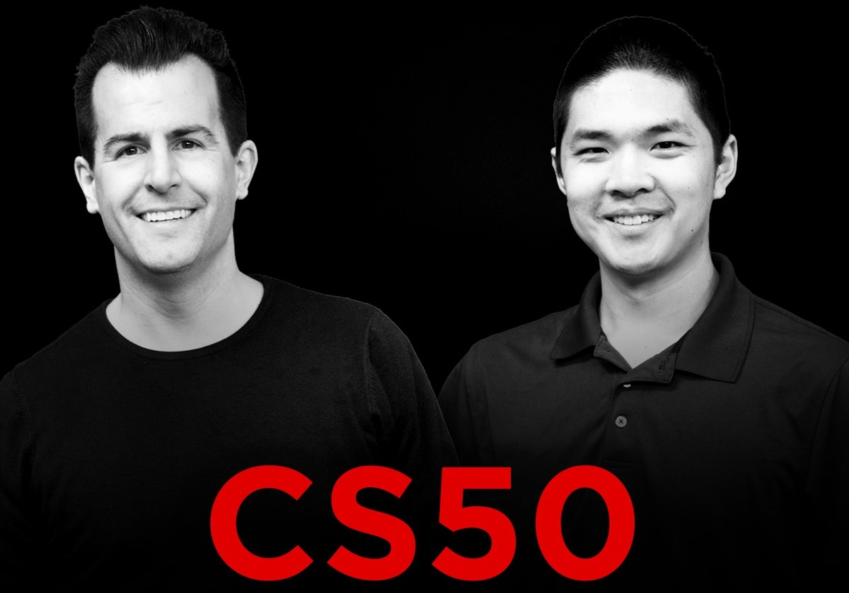
Thanks to all the CS50x team!
You have made one of the most awesome computer science course out there.
Special thanks to David and Brian, you’re such amazing teachers, I really loved your way to explain complicated thing and made them simple.

