Slide 1





Little Helper
Pitch Shifter / Auto Tuner

Slide 2
Agenda
Motivation
Plan
Requirements
Single sine
Method 1 – Changing output fs
Method 2 – Generate new sine
Test
Single tone
Notes:
Mads

Slide 3


Motivation
Unknow area
Challenge
Notes:
Lasse
Funktionen auto tune er ukendt
Bruges af mange nye kunstnere
At flytte en hel tone lyder udfordrende

Slide 4

Plan
Simple sine
Changing frequency – chirp
Pure tone
Voice
Notes:
Lasse
Stepwise for at opnå større forståelse, evt. forstå flaskehalse.

Slide 5
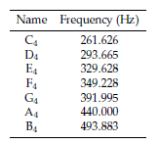
Requirements
Accuracy- ±2.5 Hz
Memory – 16 kB
Speed – 50 ms
Max cycles pr sample 11875
Notes:
Mads

Slide 6


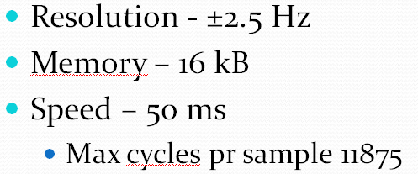
Single sine – method 1
Method 1 handling of the requirements
Nr. of samples
Calculation and storage
Hurdles
Speed
Changeable fs
Notes:
Mads
Mindre her

Slide 7
Single sine – method 2
Method 2 handling of the requirements
Frequency finding – Instantaneous Frequency
Sine generator
Limitations
More sines
Notes:
Mads

Slide 8
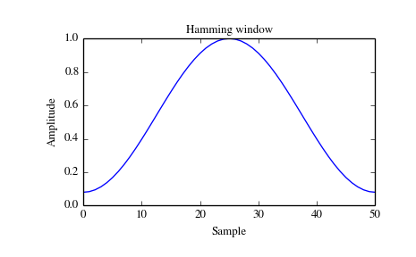
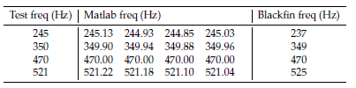
Test
Resolution
Improvements
Cycle usage
Notes:
Mads

Slide 9


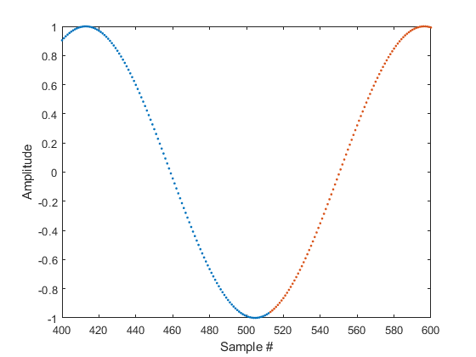
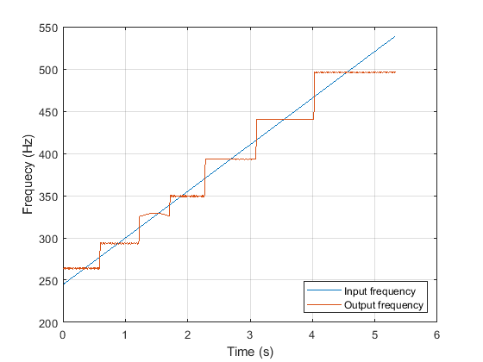
Test
Matlab demonstration
Chirp input
Input chirp
Output C-major
Notes:
Lasse
Så hvad kan det færdige MATLAB script?

Slide 10
Single tone
Ideas
Look up table
Sine Generation
Resampling
Tone/Harmonic | C4 (261Hz) | D4 (293Hz) | E4 (329Hz)
1. harmonic | 522 Hz | 586 Hz | 685 Hz
2. harmonic | 783 Hz | 897 Hz | 987 Hz
3. harmonic | 1044 Hz | 1172 Hz | 1316 Hz
Notes:
Lasse
Hvordan finder vi den spillede tone?
Hvordan spiller vi den rigtige tone?
Evt. hvordan virker Guitar Pitch Shifter

