Slide 1
IT-AMS
GPS Tracker

Slide 2
Problemstilling
Motivation
Formål
Forudsete problemer

Slide 3
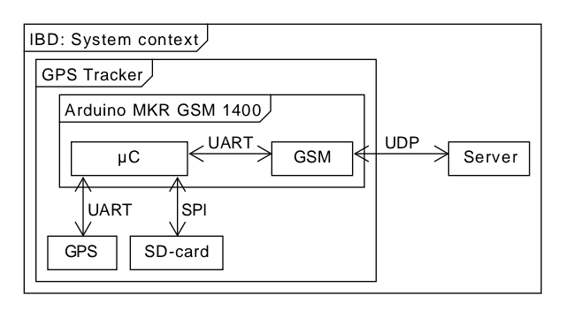
Design & Demo

