Slide 1
Android UI: Lab Exercise
Android ui
Notes:
Hello and welcome to this lab exercise for the lessons in the Android UI section.

Slide 2
Android UI Lab Exercise
Part 1: Nested Layouts
Part 2: Click Me Button Listeners
Part 3: Margin, Padding, And Gravity
Notes:
This lab exercise will consist of three parts which will cover
How to use nested layout in part 1
Creating listeners and attaching them to buttons in part 2
And finally using margin padding and gravity in part 3

Slide 3
Before Beginning
Add any additional Java code needed for completing the exercise parts
All UI components should be of minimum width and height in order to contain their content if not otherwise stated
All strings should be stored in strings.xml and all dimensions in dimens.xml
Create a new Project with a MainActivity and layout_part_1.xml
Follow the instructions for Part 1: Nested Layouts. You can Run the demo application to verify the desired UI
Create a new layout xml file and name it layout_part_2.xml and follow the instructions for Part 2: Click Me Button Listeners
In order to run replace the line setContentView(R.layout.layout_part_1); with setContentView(R.layout.layout_part_2);
Create a new layout xml file and name it layout_part_3.xml and follow the instructions for Part 3: Margin, Padding, and Gravity. In order to run replace the line setContentView(R.layout.layout_part_2); with setContentView(R.layout.layout_part_3);
Notes:
Before beginning this lab exercise please note that some additional Java code may be required in order to complete some sections. This code should be added to MainActivity.java. All UI components should be of minimum width and height in order to contain their content, unless otherwise stated. All strings should be stored in strings.xml and all dimensions in dimens.xml.
You will need to create a new project. You can name the project whatever you want but insure that it is created with a blank activity named MainActivity and call its layout layout_part_1.xml. Then use this newly created layout to follow the instructions and complete part 1 of this lab exercise. Once part 1 is completed you can run the demo application to verify results.
Once the results are verified create a new xml by right clicking on the layout folder and selecting new->layout resource file. Name this file layout_part_2.xml and follow the instructions for part 2: click me button listeners. For this exercise you will need to add code to MainActivity.java, also insure that you replace the setContentView(R.layout.layout_part_1) with setContentView(R.layout.layout_part_2). Then run the application for part 2 and verify it works as intended
Once part 2 is verified create a new layout xml and name it layout_part_3.xml and follow the instructions for part 3:Margin, Padding, and Gravity. Insure to replace the setContentView line in the MainActivity with setContentView(R.layout.layout_part_3).

Slide 4
Part 1: Nested Layouts (layout_part_1.xml)
Create a view with vertical linear layout as its base view
The Linear layout should contain the following items in vertical order
Relative layout with id ‘rlTopContainer’ that should contain
TextView with the text ‘top left’ in the top left corner with id ‘tvTopLeft’ with
Textview below tvTopLeft with the text ‘below’ and id ‘tvBelow’ aligned left and aligned right with tvTopLeft
Button in the top right corner of the layout with the text ‘top right’ and id ‘btnTopRight’
TextView with the text ‘text below relative layout’ and id ‘tvBelowRL’
Bonus: color backgrounds of each item for easy identification
Notes:
For part 1 of this lab exercise we will create an xml layout with nested layouts. Nested layouts are when a layout is a child of another layout. Please not that using nested instances of LinearLayout can lead to performance issues especially when using layout_weights.
The base element of this view should be a vertical linear layout. This linear layout should contain as its first child a relative layout with id rlTopContainer. This relative layout should have 3 children of its own. The first child should be a text view with the text top left and id ‘tvTopLeft’ it should be anchored to the top left of the relative layout (see align parent attributes of children of relative layout for more information). The next child should be a textview below tvTopLeft with the text below and the id tvBelow. It should also be aligned left and aligned right with tvTopLeft. The last child should be a button in the top right corner of the layout with the text top right and the id btnTopRight
Below the relative layout as a child of the linearlayout and not the relative layout should be another textview with the text ‘text below relative layout’ and with the id ‘tvBelowRL’. For a bonus for this lab exercise you can set a different background color to each element so that they will be more easily identifiable from other elements.

Slide 5
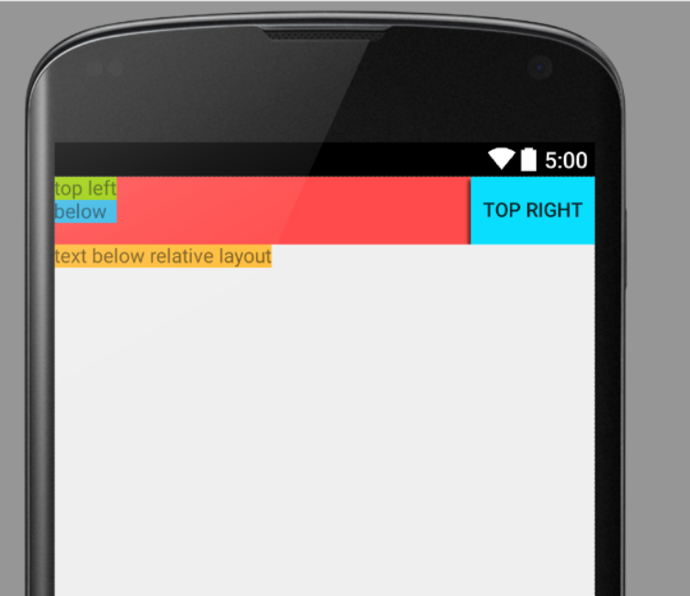
Part 1: Nested Layouts
Notes:
When you are done with part 1 you should have a layout that looks like something like this. Please note that the colored backgrounds are part of the bonus element and without background colors only the black text should be visible.

Slide 6
Part 2: Click Me Button Listeners (layout_part_2.xml)
Create a layout with two buttons one on the far left and one on the far right.
The button on the left should have id ‘btnLeft’ with default text ‘Click me’
The button on the right should have id ‘btnRight’ and no default text
In the onCreate of the activity each button should have an onClick listener attached (or in the xml of the layout) so that when a button is pressed it clears its text and the other button sets its text to ‘Click Me’
Notes:
For the second part of this lab exercise we are going to set click listeners to two buttons. First create a layout with two buttons one on the far left and one on the far right. The button on the left should have id btnLeft and should have the text attribute set to click me. The button on the right should have id btnRight and no default text. In the onCreate of our activity each button should set an on click listener or this can also be done in the xml using the onclick attribute. These on click listeners should operate that when a button is pressed its text is cleared and the second button sets the text Click Me.

Slide 7
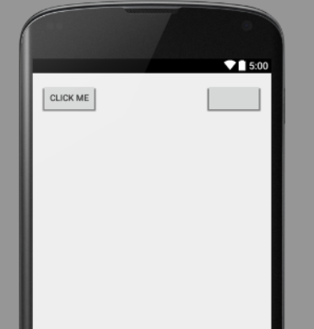
Part 2: Click Me Button Game
Notes:
The layout for this exercise should start as pictured here. Once the left button is pressed the right button should read click me and the left button should have empty text. Then when the right button is pressed the text should return to the state as pictured here.

Slide 8
Part 3: Margin, Padding, And Gravity (layout_part_3.xml)
Create the following constants in dimens.xml
small_padding = 8dp, medium_padding = 16dp, large_padding = 32dp
small_margin = 16dp, large_margin = 32dp
In the layout for this part layout_part_3.xml make the base layout view a LinearLayout with id llPaddingMarginGravity and orientation vertical
The llPaddingMarginGravity linear layout should have width and height to match parent.
Add a textview as the first child with
Id = tvFirst, text = ‘first’
Layout gravity = right
Left padding = small_padding
Top padding = large_padding
Margin bottom = large margin
Add a textview as second child with
Id = tvSecond , text = ‘second’
Layout gravity = center_horizontal
Left margin = small_margin
Top padding = small_padding
Margin top = large margin
Notes:
For part 3 of this exercise you will need to add 5 values to the dimens.xml file for this application which are small_padding = 8dp, medium_padding = 16dp, large_padding = 32dp, small_margin = 16dp, large_margin = 32dp. In the layout for this part, layout_part_3.xml make the base layout view a linearlayout with id llPaddingMarginGravity and with orientation vertical.
Add as the first child of this linear layout a textview with id ‘ttfirst’ and text ‘first’. Insure that the layout gravity is set to right, the left padding is set to small padding, the top padding is set to large padding, and the bottom margin is set to large margin.
The second child of this linear layout is another textview with id ttSecond and text ‘second’. It should have its layout gravity set to center horizontal, its left margin set to small margin, its top padding set to small padding and its top margin et to large margin.
Again for a bonus in this exercise you can add background colors to each element to more easily identify them.
Also please note that the parent layout for this view llPaddingMarginGravity should have a width and height to match parent.

Slide 9
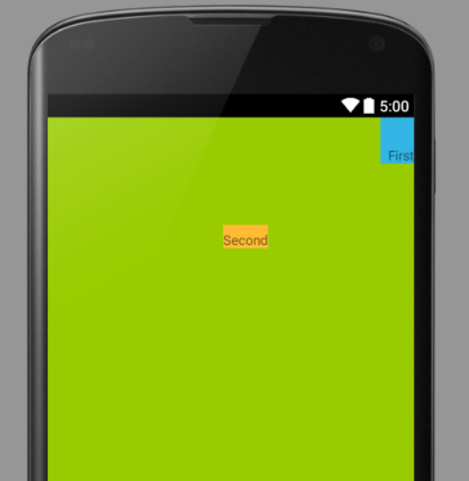
Part 3: Margin, Padding, And Gravity
Notes:
When you complete this Exercise you should have a view that looks like the one presented here. Please note that a green background color was added to the linear layout, a blue background color was added to the first child, and an orange background color was added to the second child.
A solution for this exercise is also included with an accompanying video to explain how it was constructed.

