Slide 1
Lab Exercise 1
Introduction to Android
Notes:
Hello and welcome to the first lab exercise in this video series. In this lab exercise we will practice some of the material that we covered in the videos for this section.

Slide 2
Hello World Run and Debug
Code snippets are represented by bold and italicized text
Download and install Android Studio on your development machine
Open Android Studio and create a new project as demonstrated in the previous video
Make sure to add android:id="@+id/myTextView" textivew in your main_activity.xml
Run the application on a device or an AVD (Android Virtual Device)
For running on a real device follow the instructions at http://developer.android.com/training/basics/firstapp/running-app.html
Add the line TextView helloText = (TextView) findViewById(R.id.myTextView); to the end of you onCreate method and then place a breakpoint on that line and debug your application
When the application stops on the breakpoint evaluate the expression for our TextView ((TextView)findViewById(R.id. myTextView)).getText();
Notes:
In this lab exercise you will create your first Android project and run it on a device or an Android emulator. Please note that code snippets from this slide that need to be used or copied into your project are represented in bold and italicized text.
First make sure you download and install all of the prerequisites for Android Studio and then install Android Studio on your development machine. Once Android Studio is installed open it to make sure everything works as desired. If you have problems with installing or running Android studio try searching for resolutions online. The Android development community is large and very helpful so you can usually find solutions to your configuration problems.
Once Android Studio is installed and working as expected, in the quick start section of the welcome to Android Studio screen click the New Project option and create a project with the same parameters that we used in the previous video. Once your project is created and Android Studio has finished initializing needed assets and files for the project run the application on an Android device or on an Android Virtual Device. Please not that if you are running the application on a real device you will need to enable usb debugging on the device. In order to enable usb debugging please follow the instructions at developer.android.com/training/basics/firstapp/running-app.html
Once you have successfully run the application on a device or on an Android virtual device, go back into our main activity and add the line ‘TextView helloText = (TextView) findViewById(R.id.myTextView);’ to the end of your onCreate method. Place a breakpoint on the newly added line of code using a left mouse click on the gray bar on the left side of the code editor to the left of the code.
Once the breakpoint is placed debug your application on a real device or an Android virtual device and once it stops on the breakpoint we previously placed press the key combination of alt and f8 to open the expression evaluator. In the evaluation screen enter the code snippet in step five to evaluate the string value of the textview of our hello world application.

Slide 3
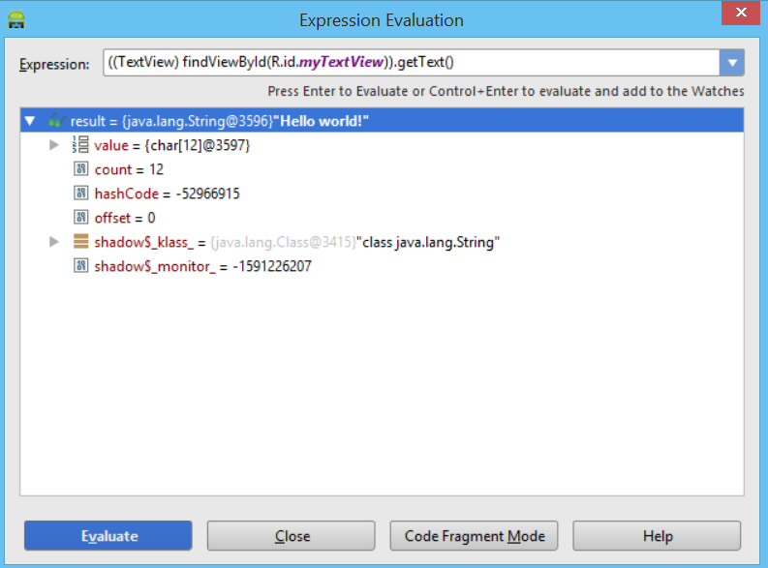
Hello World Evaluate Result
Result = “Hello world!”
Notes:
Once the expression evaluator has time to compute the result you should receive the result of the string hello world exclamation point. If you did not receive that result, please check that the expression you are evaluating matches to the expression from step 5. You should receive a result similar to the image below.
Thank you for joining us in this lab exercise and in the next lesson we will take a look at java essentials for Android.

