Slide 1

SKILL ENHANCEMENT PROJECT PRESENTATION
DriveIndia - Car Rental System
By
L Sathya Sai
43110846

Slide 2
AGENDA
Introduction
Abstract
Objective
System Architecture / Ideation Map
Module Implementation
Results and Discussions
Conclusion
References

Slide 3
Abstract
DriveIndia - Car Rental System is an online platform that enables users to rent cars easily. It allows customers to view featured vehicles, book cars through a secure portal, and check the availability of services in various locations. The system integrates MongoDB Compass for backend data management, ensuring efficient storage and retrieval of booking data.

Slide 4
Existing System
Currently, most car rental processes are handled manually or through disconnected systems. This leads to booking errors, lack of transparency in vehicle availability, and inefficient record management.

Slide 5
Proposed System
DriveIndia proposes a digital car rental platform that automates the booking process. Users can log in, view vehicles, and make bookings online. The data is securely stored in MongoDB Compass, allowing real-time tracking of bookings and vehicle status.

Slide 6
Advantages
• Easy online access for booking and management
• Real-time vehicle availability
• Secure data handling using MongoDB Compass
• User-friendly interface
• Saves time and reduces manual effort

Slide 7
Disadvantages
• Requires internet connectivity
• Initial setup and hosting cost
• Technical maintenance required

Slide 8
Hardware Requirements
• Processor: Intel i3 or above
• RAM: Minimum 4 GB
• Storage: 250 GB or more
• Internet connection
• System with browser support

Slide 9
Software Requirements
• Frontend: HTML, CSS, JavaScript
• Backend: Node.js
• Database: MongoDB Compass
• IDE: VS Code
• Operating System: Windows / Linux / macOS

Slide 10
Modules
1. Home Page
2. Featured Vehicles
3. Booking Portal (Login and Database Integration)
4. Location of Services
5. Create Your Own (Future Enhancement)

Slide 11
Module Description
• Home Page: Displays an overview and navigation options.
• Featured Vehicles: Highlights available vehicles with details.
• Booking Portal: Handles login and booking forms linked to MongoDB Compass.
• Location of Services: Shows rental availability in different regions.
• Create Your Own: Placeholder for user-defined customization module.

Slide 12
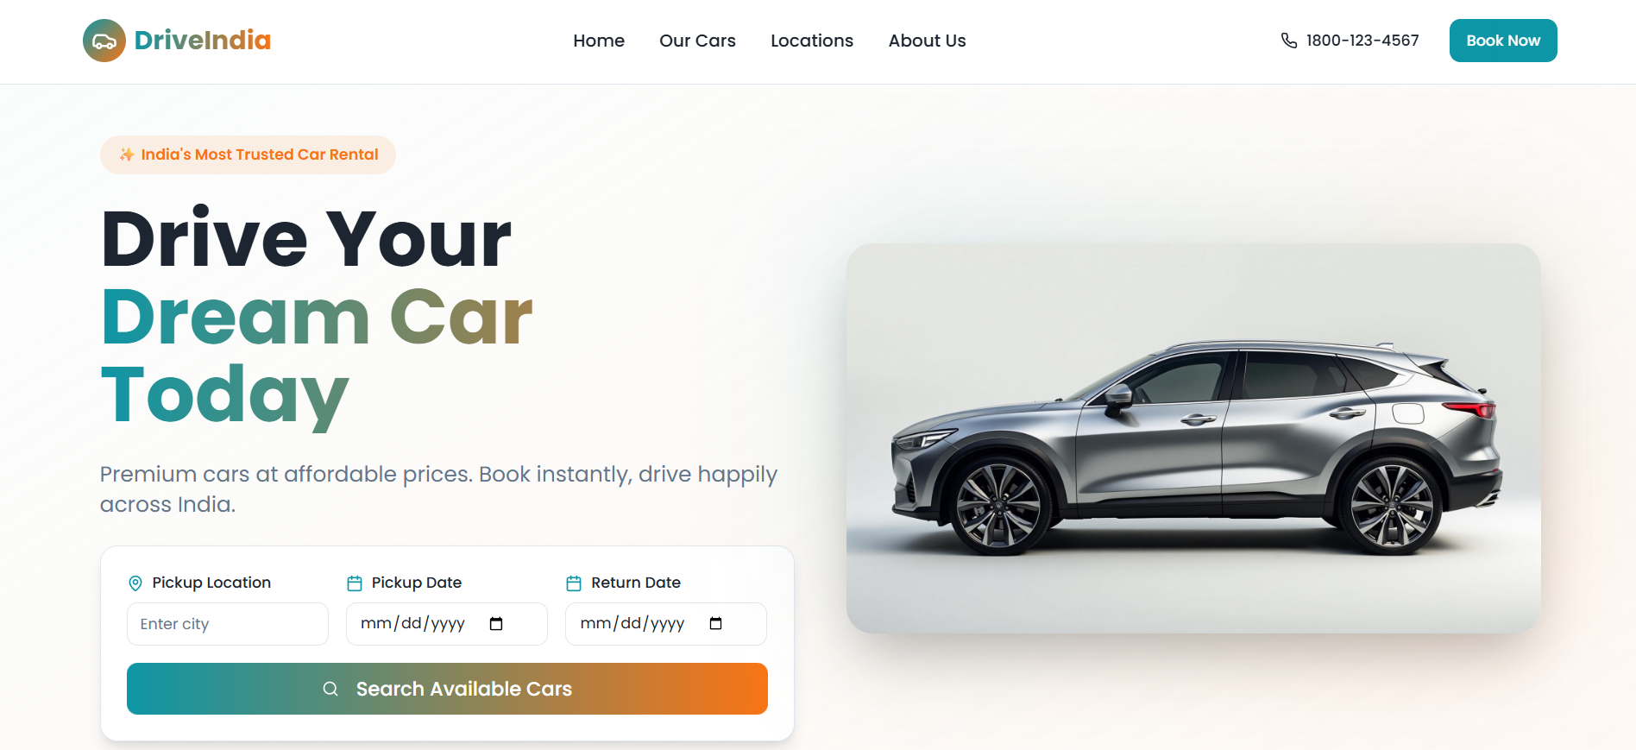
Sample Output (Screenshots)

Slide 13
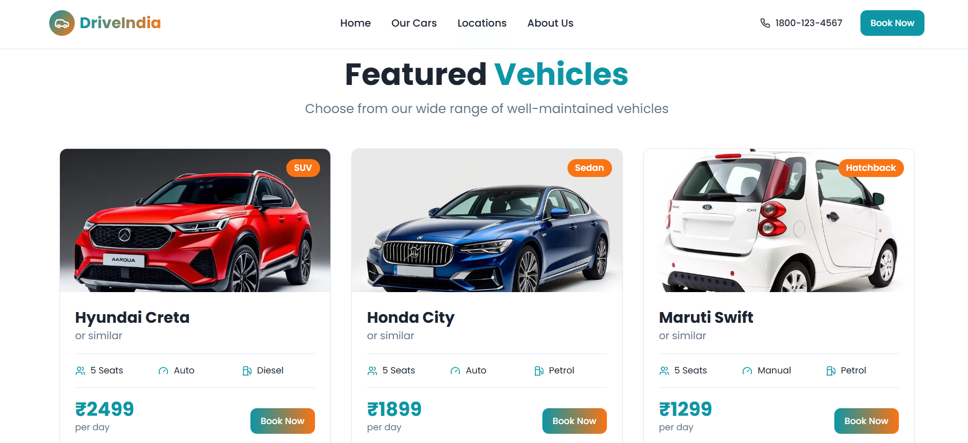
Sample Output (Screenshots)

Slide 14
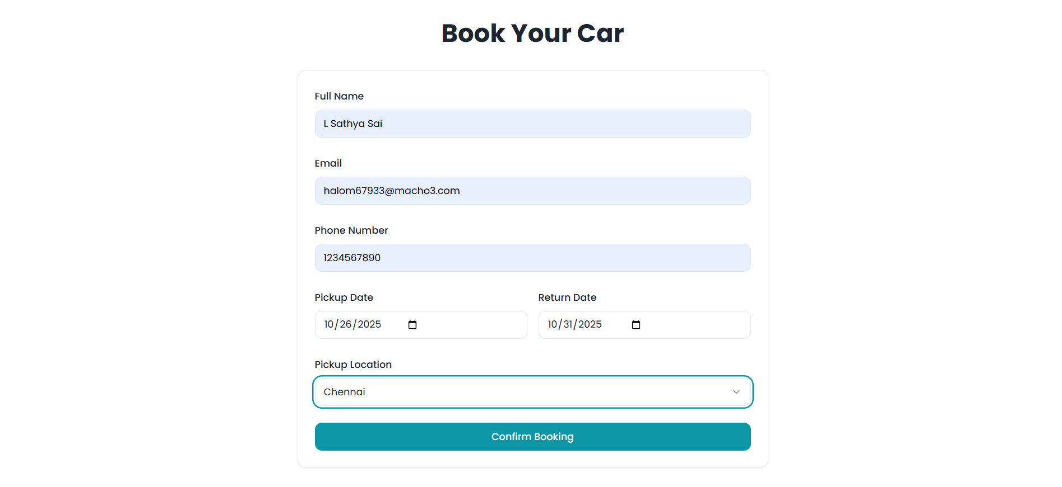
Sample Output (Screenshots)

