Slide 1
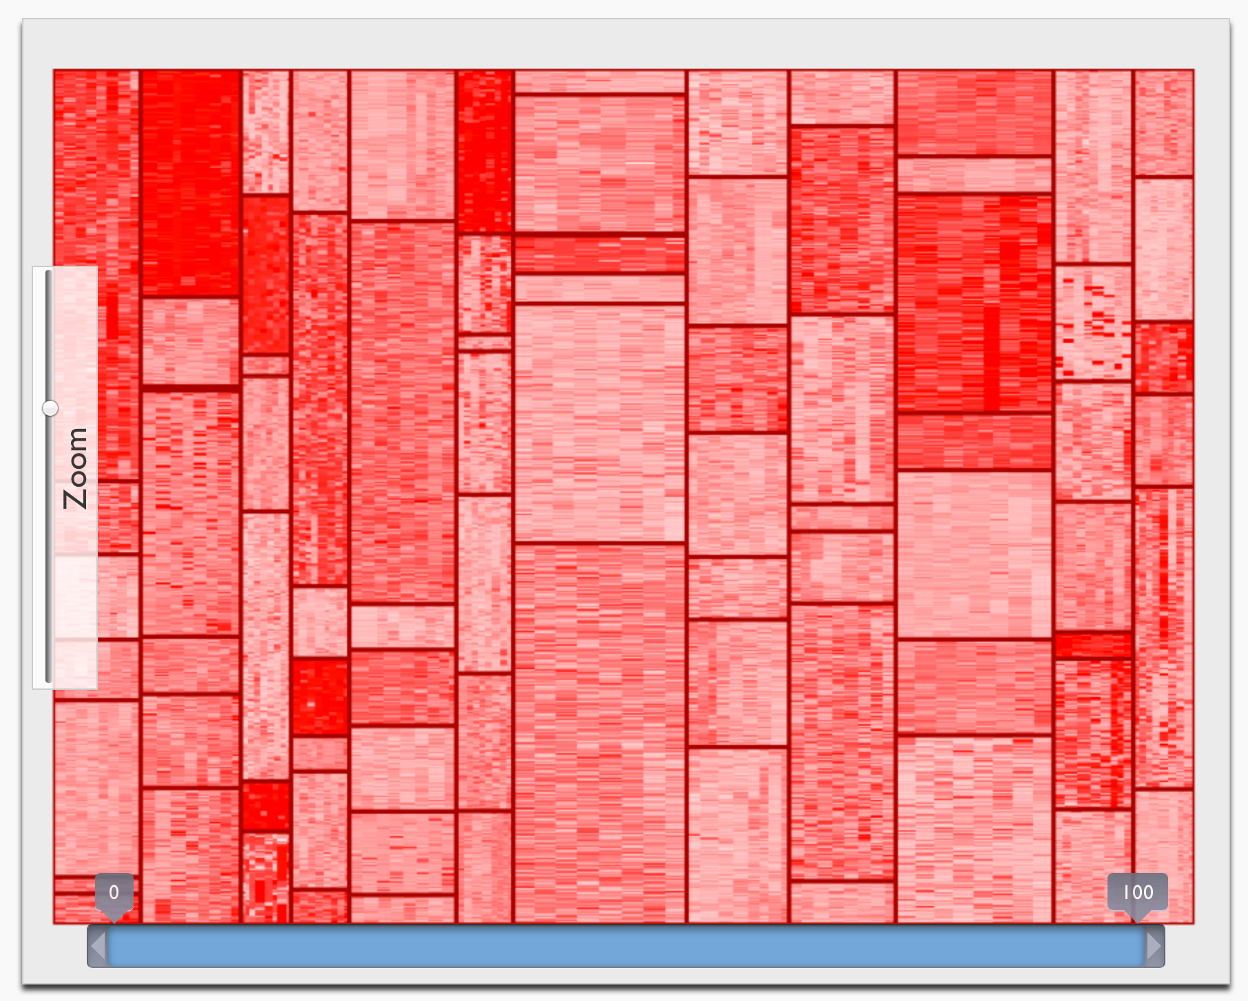
Offline
Online
language spec
attrib. grammar
layout
tree of constraints
Reducer
Code Generator
Layout Engine
runtime scheduler, …
ordered attrib. grammar
scene graph
tree of vertex buffers
Synthesizer
Renderer
schedule of parallel
tree traversals
visualization

Slide 2
language spec
attrib. grammar
Reducer
ordered attrib. grammar
Synthesizer
schedule
parallel tree traversals
Code Generator
Offline
Online
layout
tree of constraints
Layout Engine
runtime scheduler, …
scene graph
tree of vertex buffers
Renderer
visualization

