Slide 1
Using time-structured data to estimate the evolutionary rate of Frog Virus 3 – a simulation study
By: Logan Billet

Slide 2
INSTRUCTIONS
At the end of the course, each student will record a video (about 10 minutes long) about the project to share with the class, and in the last days of class each student will lead a discussion of their project for 5-10 minutes

Slide 3
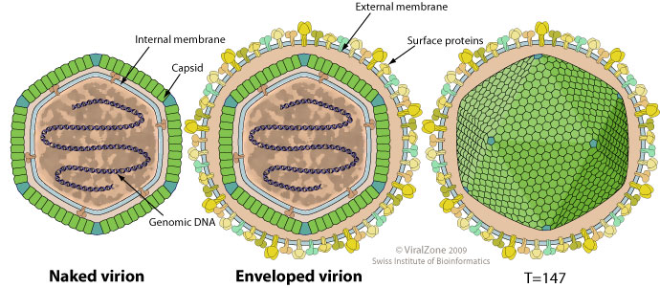
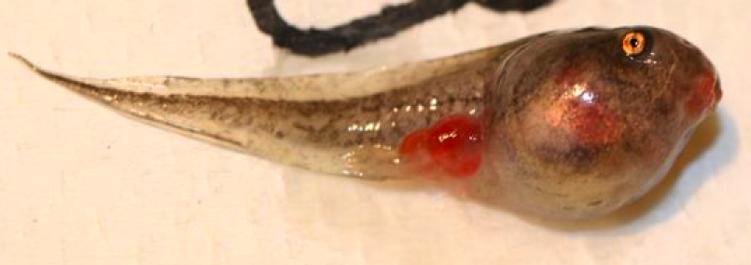
What is Frog Virus 3?
Double-stranded DNA virus (Family = Iridoviridae; Genus = Ranavirus)
~105,000 base pairs contained within an icosahedral capsid
Linked to amphibian die-offs in North America, South America, Europe, Asia, and Australia
https://viralzone.expasy.org/585?outline=all_by_species
Notes:
Ranaviruses broadly infect fish, reptiles, and amphibians
The capsid displays an icosahedral symmetry (20 sides) with an internal lipid membrane. Virions are either externally enveloped or not depending whether they budded from the cell membrane

Slide 4
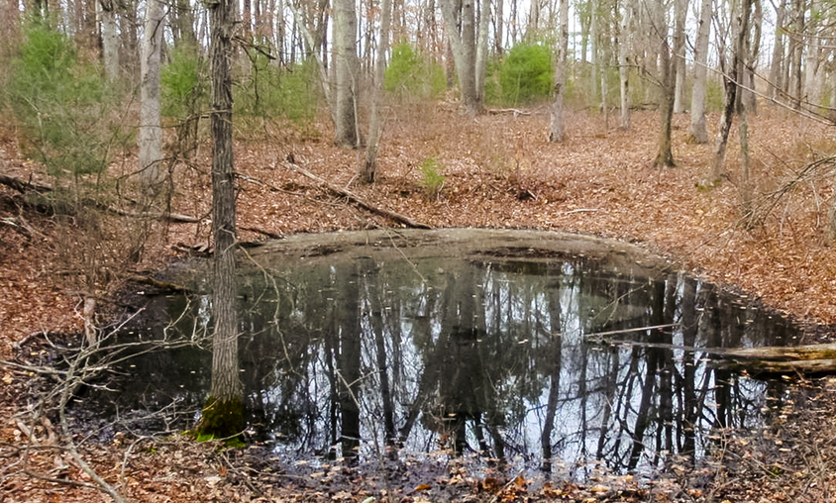
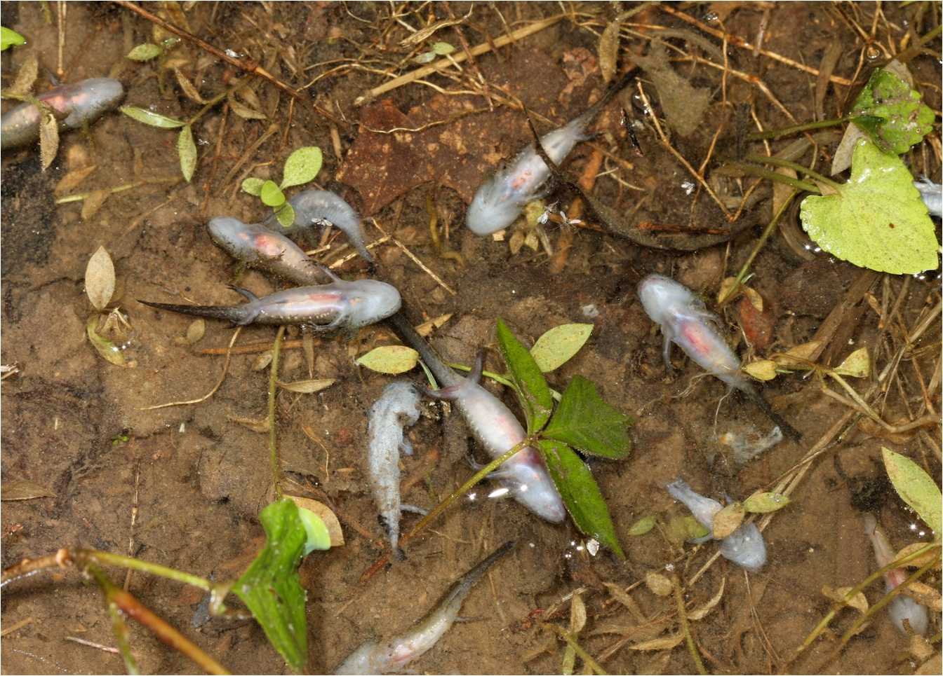
FV3 in Connecticut vernal ponds
High prevalence
Detected in ≥ 50% of ponds
First detected in 2002
Most likely present before this
Implicated in mass mortality events
https://friendsofthebluehills.org/protect-vernal-pools/
Notes:
Ranaviruses are responsible for 40-60% of amphibian die-off events observed in North America

Slide 5
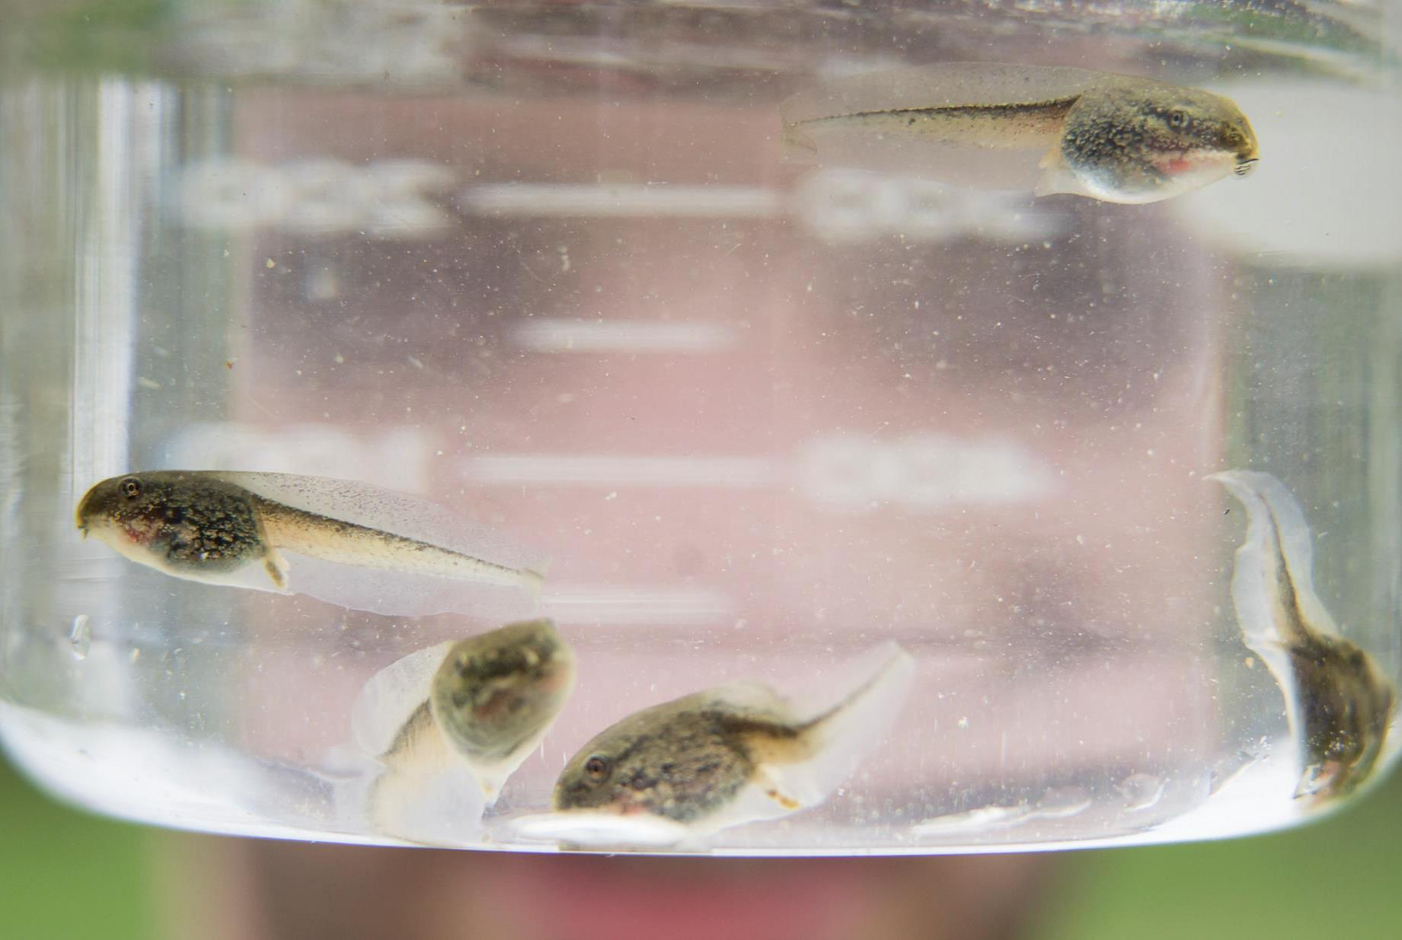
Archived samples - an opportunity?
20 years of sampling at YMF ponds
Preserved and archived in Yale Peabody Museum Collection
Useful for determining changes in infection prevalence across time and space
Could detected viral DNA also be useful for estimating FV3 nucleotide substitution rate?

Slide 6
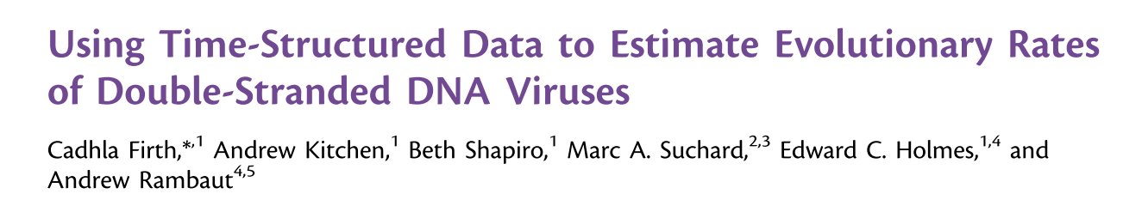
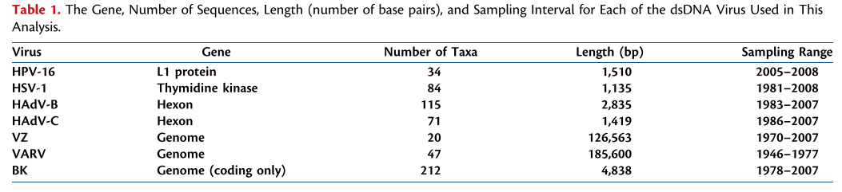
Inspiration
Used time-structured data to estimate evolutionary rates of seven human dsDNA viruses
Bayesian framework (BEAST)
E.g., herpes simplex virus-1 (HSV-1), varicella-zoster (VZ) virus
evolutionary rate estimates ranged from 10⁻⁶ to 10⁻³ subs/site/year
Firth et al. 2010, Mol. Biol. Evol. 27(9):2038–2051.

Slide 7
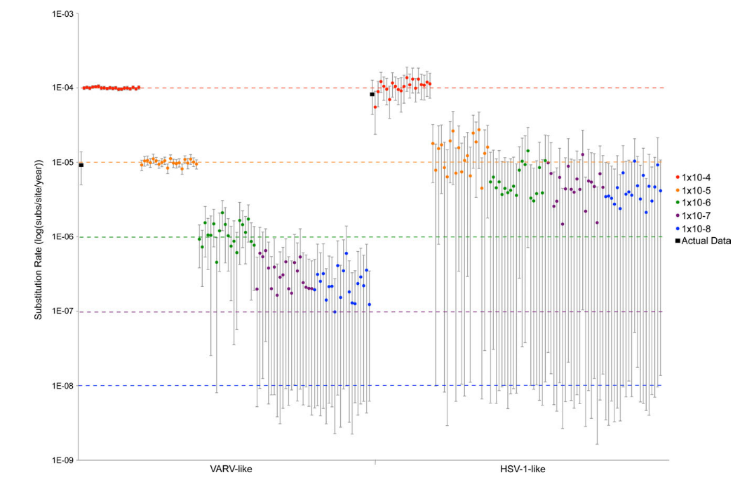
Inspiration
185,000 BP, 47 sequences, 31 yr span
1,100 BP, 84 sequences, 27 yr span
Used simulation data to validate their estimates
Assessed their ability to recover the nucleotide substitution rates of sequences with a known evolutionary history
Finding: temporal signal in data began to break down at low substitution rates
BUT lower than those estimated from the data
Firth et al. 2010, Mol. Biol. Evol. 27(9):2038–2051.

Slide 8
Project objective
Use simulation framework from Firth et al. (2010) to explore the viability and limits of using archived samples to estimate FV3 nucleotide substitution rate
Could inform a museum specimen sampling regime in the future

Slide 9
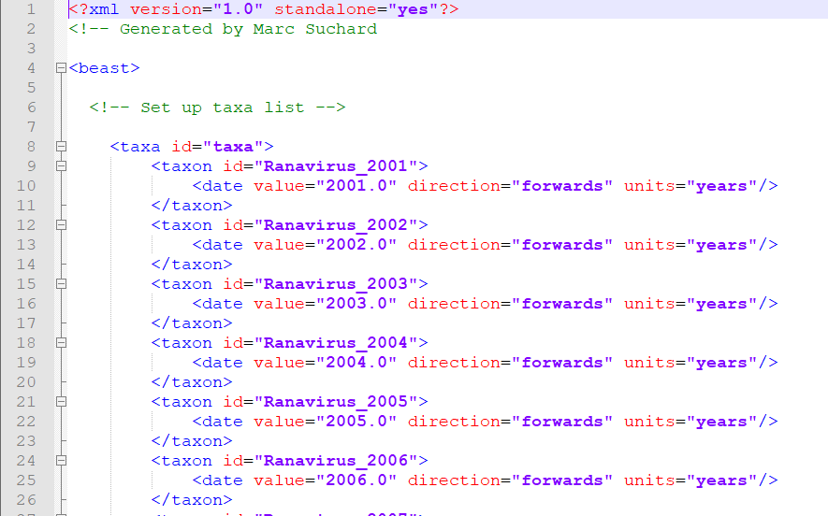
Workflow
Used supplemental XML (Extensible Markup Language) file from Firth et al. (2010) at template
BEAST uses XML files and has its own custom tags to work with
Notes:
Basically just plain text files that use custom tags to describe the structure and other features of the document →

Slide 10
Workflow
Set up XML files to explore a range of scenarios based on sampling time range: 2001 – 2020 (20 yrs)
Two taxa set sizes: 20 and 100 taxa
Clamped taxa to specific years (1 or 5 samples per year)
Used MCMC to generate a random starting tree
Two separate heights: 100 ybp or 1000 ybp

Slide 11
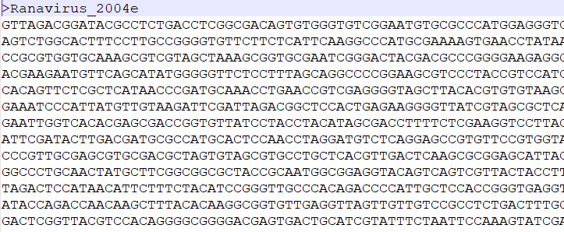
Workflow
Simulated nucleotide sequence sets of two different sizes…
1,200 bp (single-gene alignment)
100,000 bp (full-genome alignment)
Using one of three nucleotide substitution rates…
1.0E-4 subs/site/year
1.0E-6 subs/site/year
1.0E-8 subs/site/year
Under the HKY model of sequence evolution
base frequencies and transition/transversion ratios based on empirical data
Notes:
data set-specific base frequencies
These rates represent what might be considered a fast, intermediate, and slow substitution rate, respectively, for a dsDNA virus (Duffy et al. 2008).

Slide 12
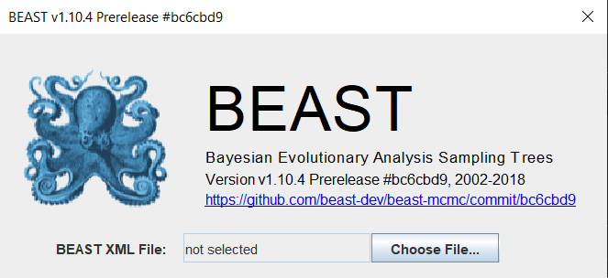
Workflow
24 total simulation combinations
2 taxa sets × 2 nucleotide sequence size sets × 2 root heights × 3 substitution rates
Replicated each combination 5 times
Total of 120 MCMC simulations
Performed posterior inference assuming a strict clock, HKY model, and constant population size
Simulations were run for 10 million generations, with subsampling every 1,000 generations

Slide 13
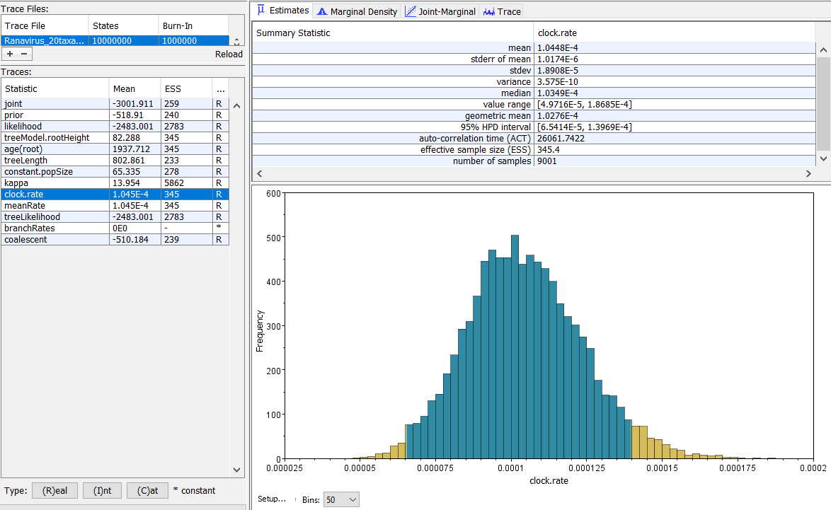
Workflow
Used Tracer to extract estimated clock rates ± 95% HPD and evaluate mixing and convergence
10% burn in

Slide 14
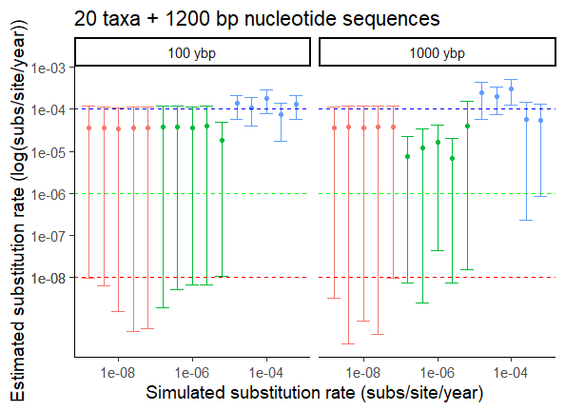
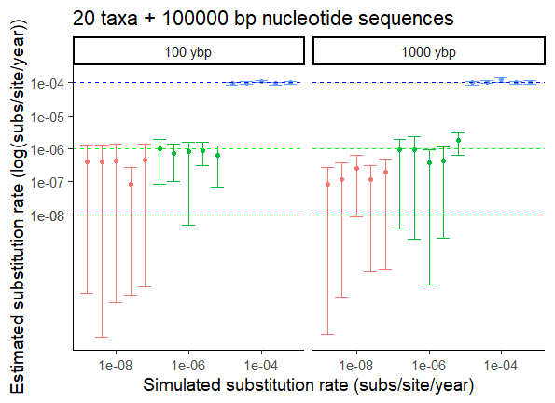
Results – 20 taxa

Slide 15
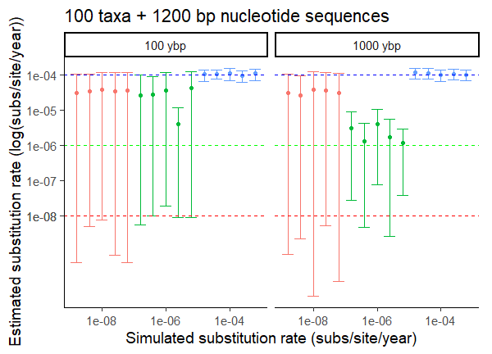
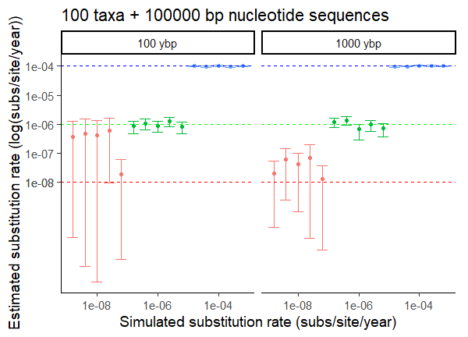
Results – 100 taxa

Slide 16
Main takeaways
Increasing the number of taxa (20 vs 100) and nucleotide sites (1200 vs 100,000) enhances ability to accurately estimate substitution rates
Lower range of dsDNA substitution rates reported in Firth et al. (2010) for human dsDNA viruses (1.0E-6) may be accurately estimated from ~20 time-structured taxa with whole-genome sequences
Tree root height (100 ybp vs 1000 ybp) doesn’t significantly impact estimate accuracy
May be more difficult to accurately estimate substitution rates when sampling interval (20 yrs) is small relative to time frame of sequence evolution (Firth et al. 2010)
Even in best simulation situation (100 taxa, 100,000 bp, 100 ybp), temporal signal breaks down at 1.0E-8 subs/site/yr
sampling interval is probably too small relative to the simulated rate of virus evolution

Slide 17
Future considerations
Strict clock may be a poor reflection true molecular clock → variable rates
Only used HKY model for simplicity → actual data may be better fit by different model
Estimates may be improved by increasing the number of MCMC simulations

