Slide 1

Hierarchical Bayesian Models
Steve Elston
Copyright, 2023 2024, Stephen F Elston. All rights reserved.

Slide 2
Introduction
Many real-world datasets have discrete categories or strata
Example, a chemist might measure a reaction rate at several discrete levels of pH and temperature
Example, demographic categories and different regions
Apply an hierarchical Bayes model for these situations

Slide 3
Introduction
Key points in this lesson:
Pooled vs. unpooled models
Defining hierarchical models through hyperpriors and priors
Evaluation and comparison of Bayesian models

Slide 4
Pooled vs. Unpooled Models
Pooled model computes model coefficients that give the best fit to the overall dataset
Pooled model has a flat structure
Model coefficients are at the same level
Pooling maximizes statistical power using all available data to fit a model
Pooling limits flexibility if strata have different behavior

Slide 5
Pooled vs. Unpooled Models
Unpooled models are the opposite of pooled models
For each category a separate and independent model is fit
Approach maximizes flexibility
Variance of each of the many models is large
Unpooled models have a flat structure

Slide 6
Overview of Hierarchical Models
Hierarchical models find the best of both worlds
Hierarchical approach is between the extremes of pooled and unpooled models
Hierarchical models constructed as a hierarchy of hyperpriors
The Hyperpriors represent the prior information on the pooled data
Hyperpriors act as priors for each specific case

Slide 7
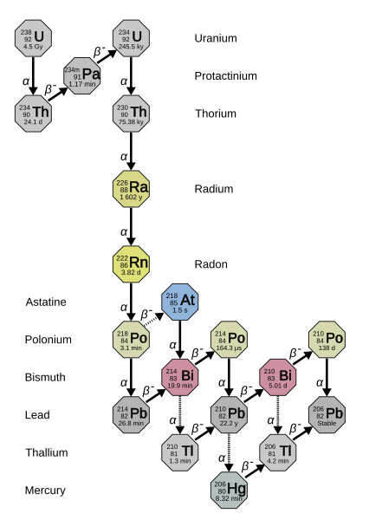
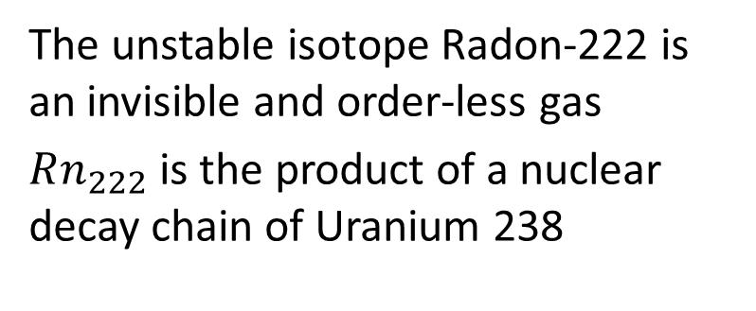
Example: Dangers of Radon in Homes
The unstable isotope Radon-222 is an invisible and order-less gas
$Rn_{222}$ is the product of a nuclear decay chain of Uranium 238
Decay chain of Uranium-238 to Radon-222
Credit: Wilipedia Radon-222 article

Slide 8
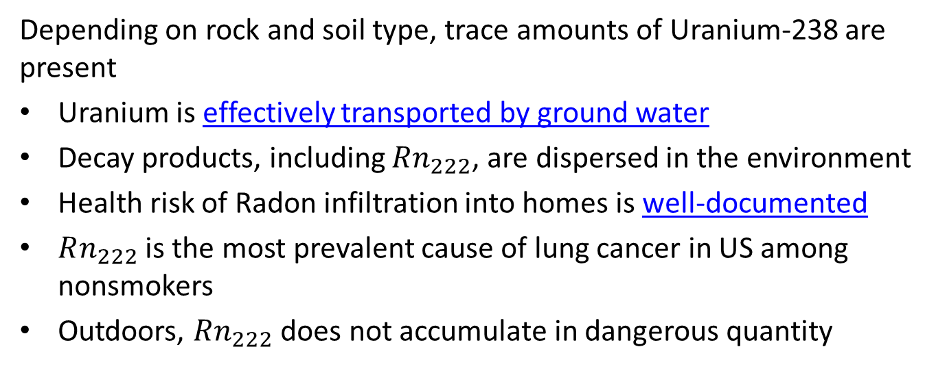
Example: Dangers of Radon in Homes
Depending on rock and soil type, trace amounts of Uranium-238 are present
Uranium is effectively transported by ground water
Decay products, including $Rn_{222}$, are dispersed in the environment
Health risk of Radon infiltration into homes is well-documented
$Rn_{222}$ is the most prevalent cause of lung cancer in US among nonsmokers
Outdoors, $Rn_{222}$ does not accumulate in dangerous quantity

Slide 9
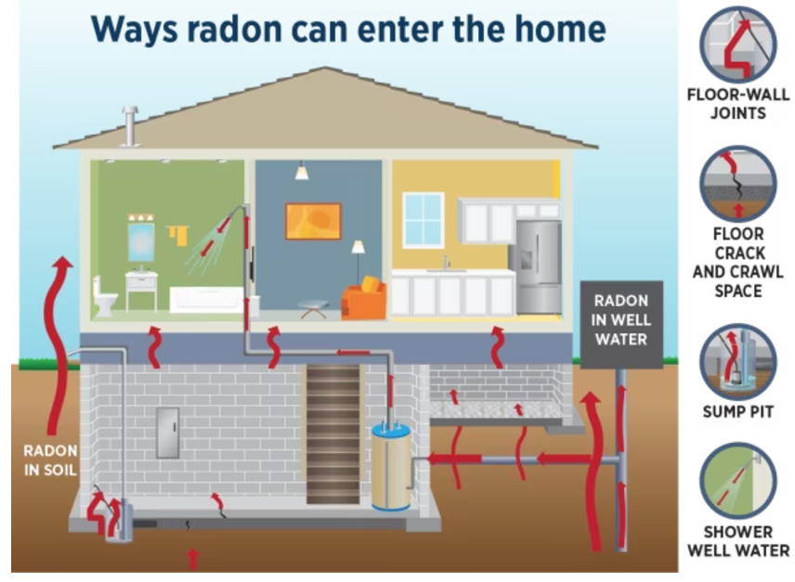
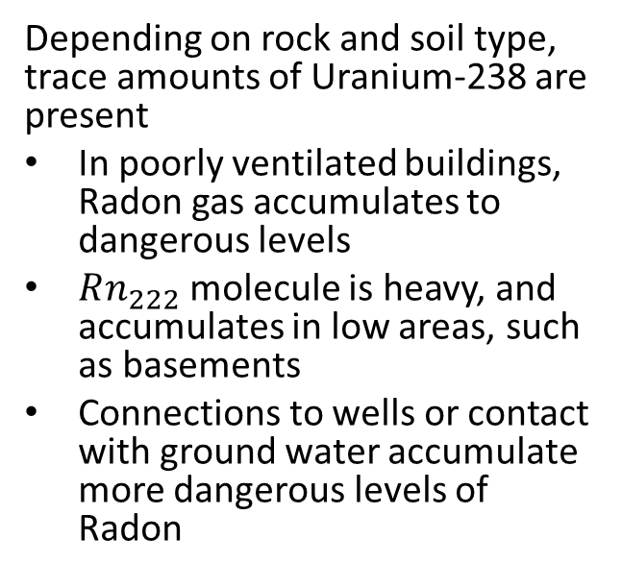
Example: Dangers of Radon in Homes
Depending on rock and soil type, trace amounts of Uranium-238 are present
In poorly ventilated buildings, Radon gas accumulates to dangerous levels
$Rn_{222}$ molecule is heavy, and accumulates in low areas, such as basements
Connections to wells or contact with ground water accumulate more dangerous levels of Radon
Common ways Radon-222 enters homes
Credit: Massachusetts Department of Public Health

Slide 10
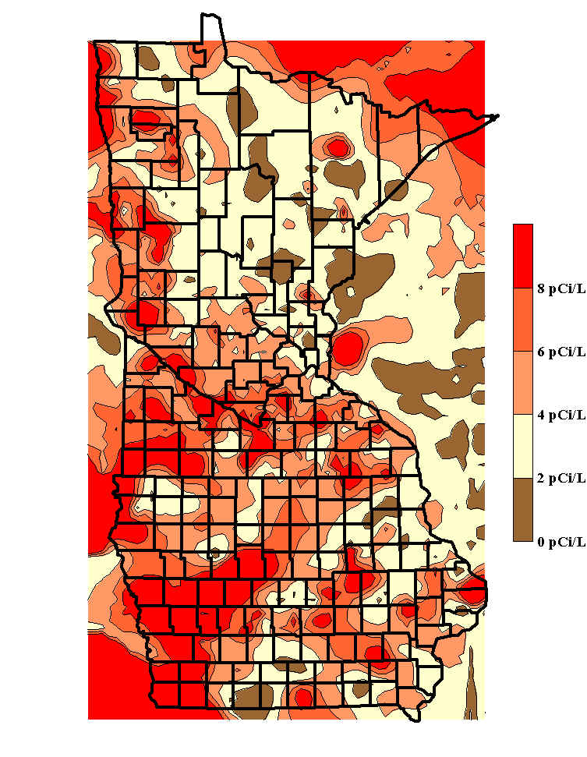
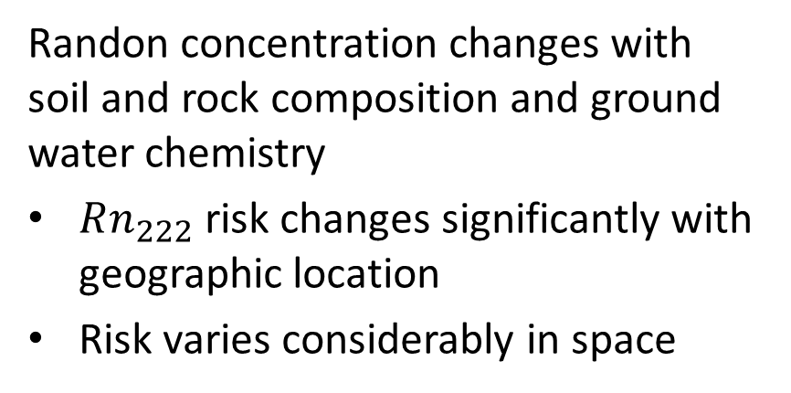
Example: Dangers of Radon in Homes
Randon concentration changes with soil and rock composition and ground water chemistry
$Rn_{222}$ risk changes significantly with geographic location
Risk varies considerably in space
Map of Radon in homes for counties in IA and MN
Credit: Minnesota Radon Project

Slide 11
Bayesian Modeling of Radon Concentration
For this example we construct and compare three models:
A pooled model with a single intercept and slope for all counties
An unpooled model with separate intercepts and slopes for each county
An hierarchical model with hyperpriors for all counties
Next level are slopes and intercepts for each county computed using the hyperpriors.

Slide 12
Radon Dataset
print(radon_data.head())
## Unnamed: 0 idnum state state2 ... fips Uppm county_code log_radon ## 0 0 5081.0 MN MN ... 27001.0 0.502054 0 0.832909 ## 1 1 5082.0 MN MN ... 27001.0 0.502054 0 0.832909 ## 2 2 5083.0 MN MN ... 27001.0 0.502054 0 1.098612 ## 3 3 5084.0 MN MN ... 27001.0 0.502054 0 0.095310 ## 4 4 5085.0 MN MN ... 27003.0 0.428565 1 1.163151 ## ## [5 rows x 30 columns]

Slide 13
Pooled Model
First try a pooled model
Pooled model is a linear regression model of the log of Radon concentration
Single slope and intercept coefficients
Coefficient values computed from the data pooled over all of the counties
This model is flat, with respect to county
We assume the observations within each county are exchangeable with each other
Exchangeable values are assumed to be iid, and therefore have the same variance

Slide 14
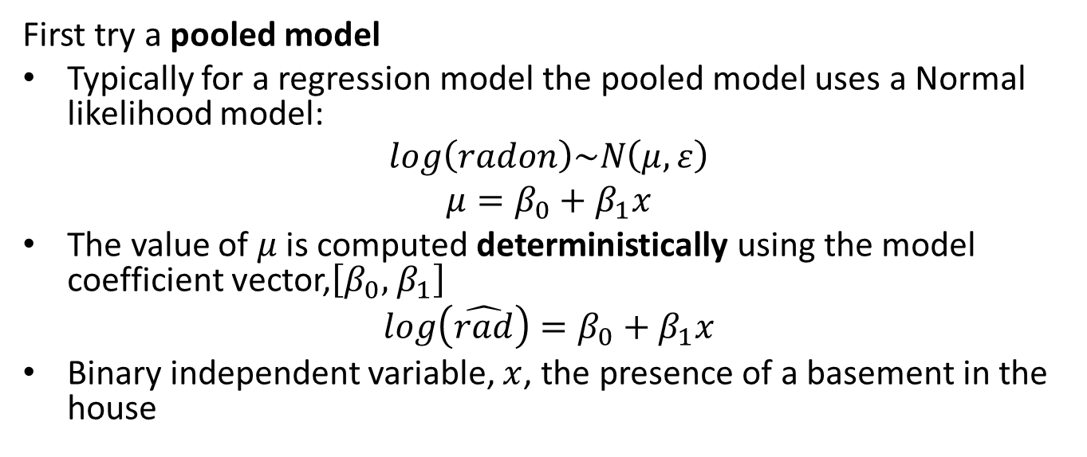
Pooled Model
First try a pooled model
Typically for a regression model the pooled model uses a Normal likelihood model:
$$log\left(radon\right)\sim N\left(μ,ε\right)$$
$$μ=β_{0}+β_{1}x$$
The value of $μ$ is computed deterministically using the model coefficient vector,$\left[β_{0},{ β}_{1}\right]$
$$log\left(\hat{rad}\right)=β_{0}+β_{1}x$$
Binary independent variable, $x$, the presence of a basement in the house

Slide 15
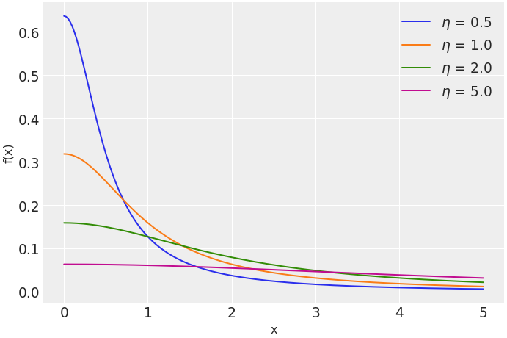
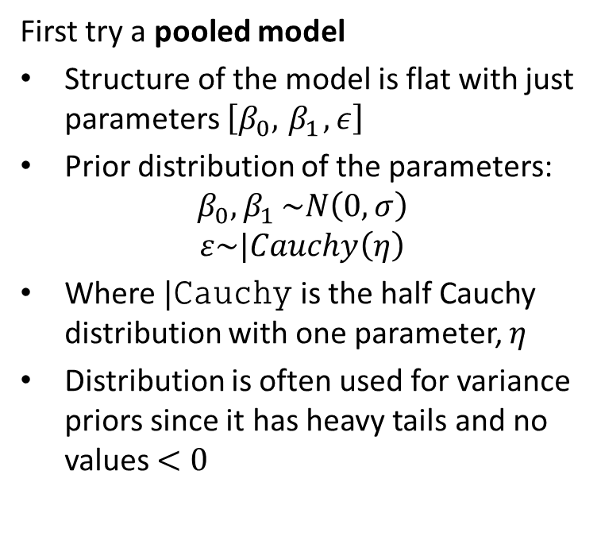
Pooled Model
First try a pooled model
Structure of the model is flat with just parameters $\left[β_{0},{ β}_{1}, ε\right]$
Prior distribution of the parameters:
$$β_{0}{,β}_{1}\sim N\left(0,σ\right)$$
$$ε\sim |Cauchy\left(η\right)$$
Where $|Cauchy$ is the half Cauchy distribution with one parameter, $η$
Distribution is often used for variance priors since it has heavy tails and no values $<0$

Slide 16
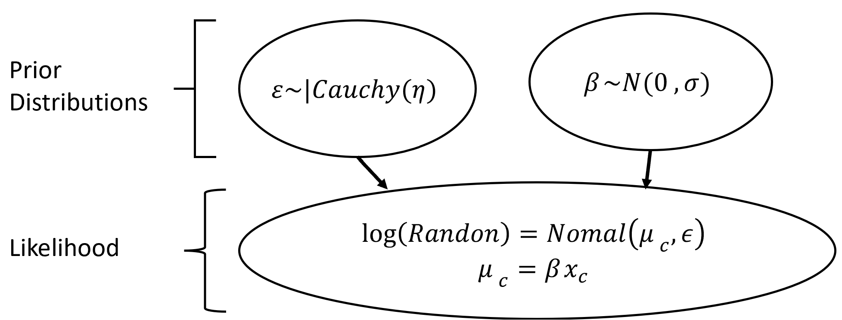
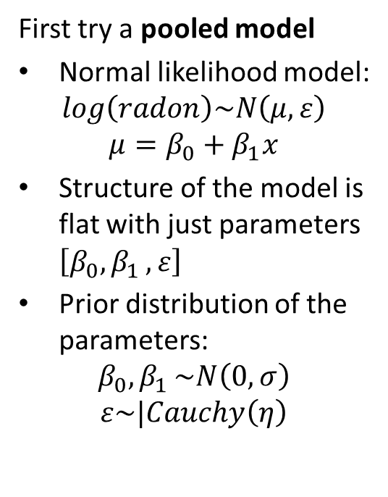
Pooled Model
First try a pooled model
Normal likelihood model:
$$log\left(radon\right)\sim N\left(μ,ε\right)$$
$$μ=β_{0}+β_{1}x$$
Structure of the model is flat with just parameters $\left[β_{0}{,β}_{1},ε\right]$
Prior distribution of the parameters:
$$β_{0}{,β}_{1}\sim N\left(0,σ\right)$$
$$ε\sim |Cauchy\left(η\right)$$

Slide 17
Defining and Sampling the Pooled Model
Sampling model defined by this code:
with pm.Model() as pooled_model: # Independent variable is just rumber of floors floor = pm.Data("floor", radon_data.floor.values) # Priors for unknown model parameters betas = pm.Normal("betas", mu=0, sigma=100, shape=2) sigma = pm.HalfCauchy("sigma", 5) # Deterministic expected value of outcome radon_est = betas[0] + betas[1] * floor # Likelihood (sampling distribution) of observations y = pm.Normal("y", mu=radon_est, sigma=sigma, observed=radon_data.log_radon)

Slide 18
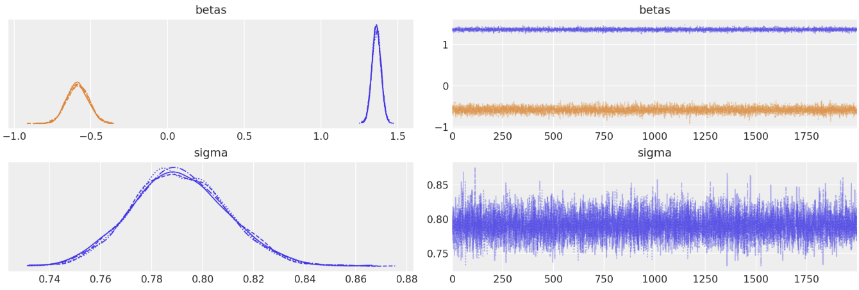
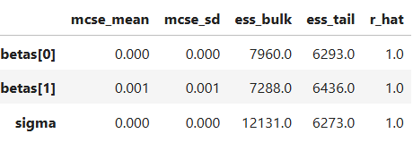
Sampling the Pooled Model
The sampling traces and statistics look reasonable for the three coefficients

Slide 19
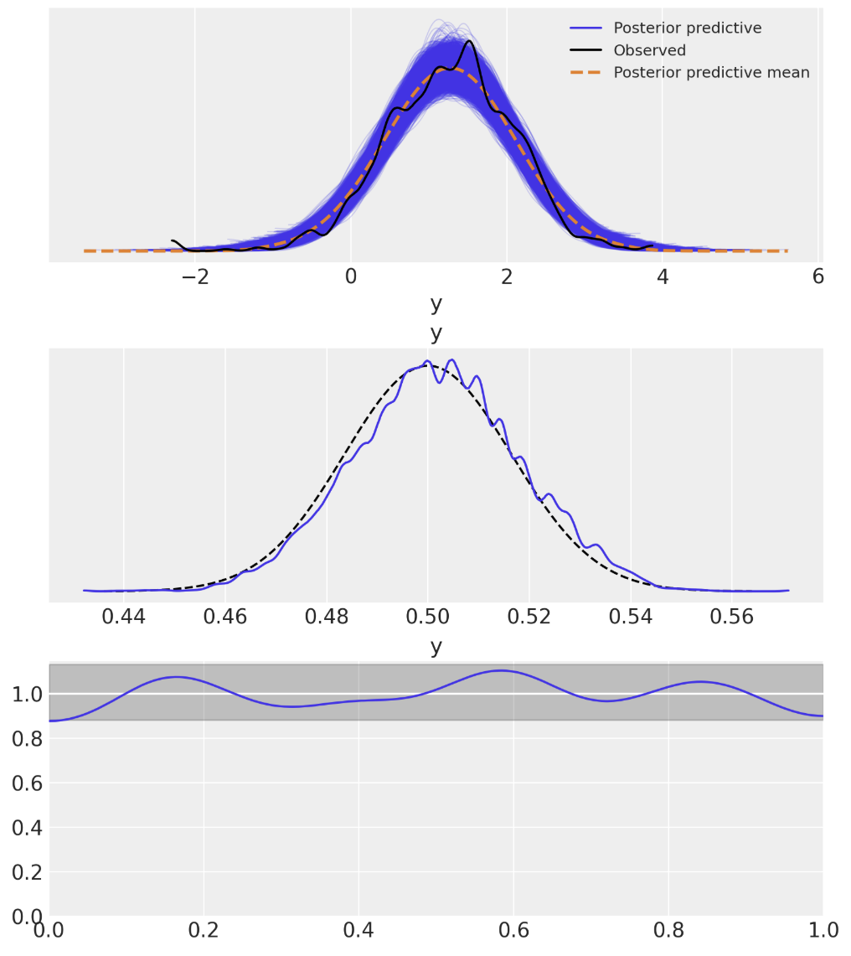
Posterior Predictive Checks for Pooled Model
Posterior predictive checks show good fit
Predicted close to the observed response
The Bayesian p-value shows some positive skew
Bayesian u-value is within credible interval of 1.0

Slide 20
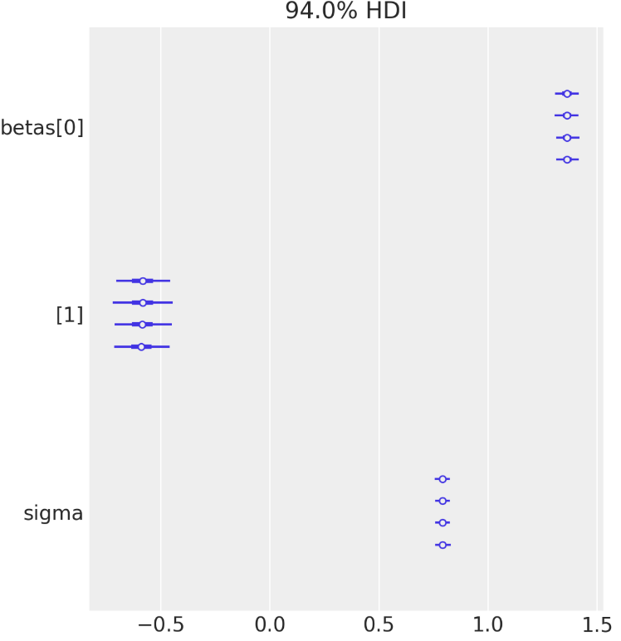
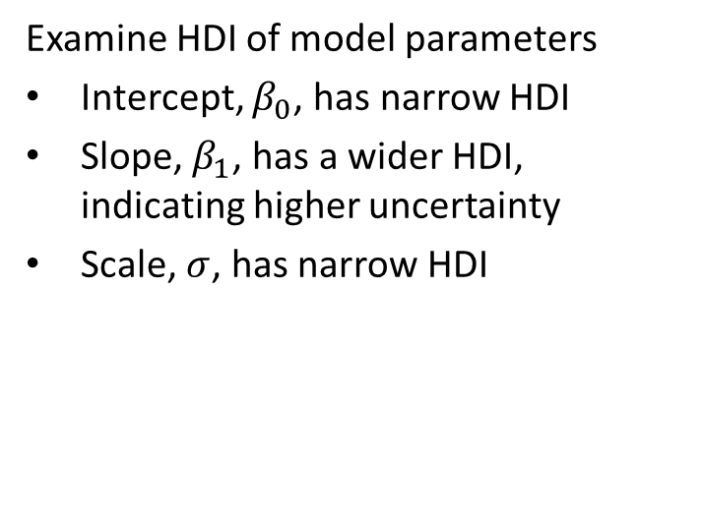
Inference on the Pooled Model Parameters
Examine HDI of model parameters
Intercept, $β_{0}$, has narrow HDI
Slope, $β_{1}$, has a wider HDI, indicating higher uncertainty
Scale, $σ$, has narrow HDI

Slide 21
Unpooled Model
Next we test an unpooled model
Unpooled model is a linear regression model of the log of Radon concentration
Each category level has independent model coefficients
Coefficient values are independently computed from the data for each county
Observations are iid within each county
We assume the observations within each county are exchangeable with each other, but not between counties
Can pool some coefficients, e.g. dispersion

Slide 22
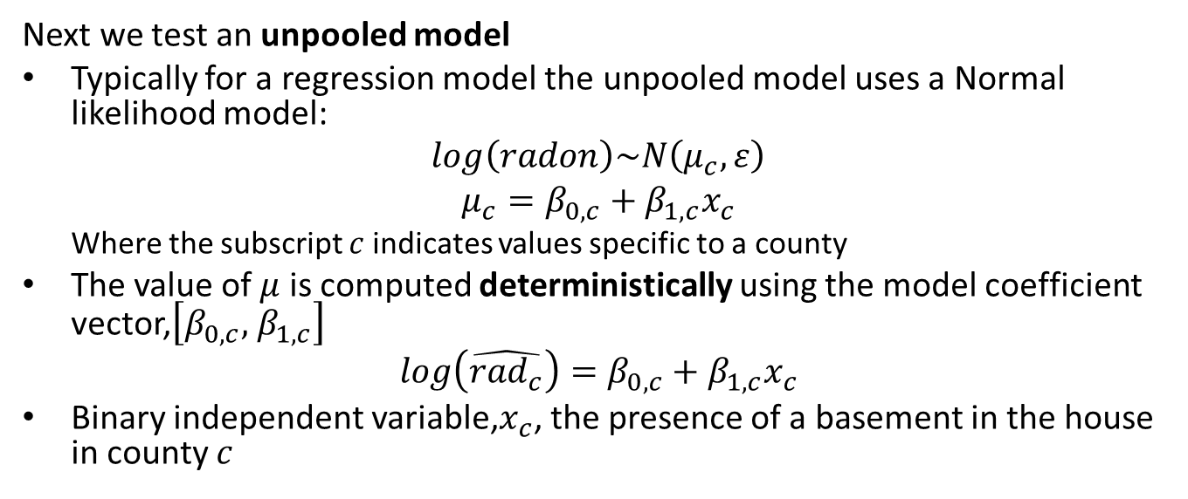
Pooled Model
Next we test an unpooled model
Typically for a regression model the unpooled model uses a Normal likelihood model:
$$log\left(radon\right)\sim N\left(μ_{c},ε\right)$$
$$μ_{c}=β_{0,c}+β_{1,c}x_{c}$$
Where the subscript $c$ indicates values specific to a county
The value of $μ$ is computed deterministically using the model coefficient vector,$\left[β_{0,c},{ β}_{1,c}\right]$
$$log\left(\hat{{rad}_{c}}\right)=β_{0,c}+β_{1,c}x_{c}$$
Binary independent variable,$x_{c}$, the presence of a basement in the house in county $c$

Slide 23
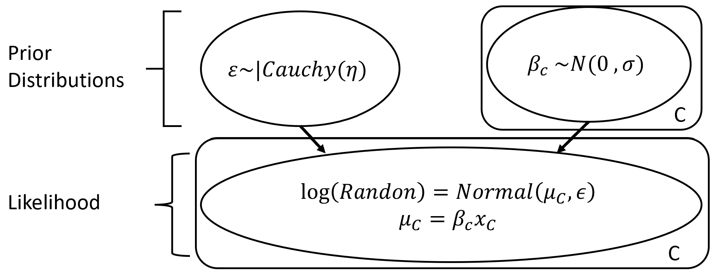
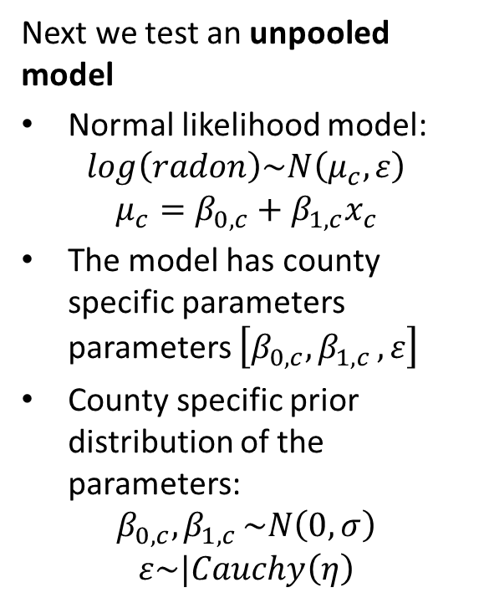
Pooled Model
Next we test an unpooled model
Normal likelihood model:
$$log\left(radon\right)\sim N\left(μ_{c},ε\right)$$
$$μ_{c}=β_{0,c}+β_{1,c}x_{c}$$
The model has county specific parameters parameters $\left[β_{0,c}{,β}_{1,c},ε\right]$
County specific prior distribution of the parameters:
$$β_{0,c}{,β}_{1,c}\sim N\left(0,σ\right)$$
$$ε\sim |Cauchy\left(η\right)$$

Slide 24
Defining and Sampling the Unpooled Model
Sampling model defined by this code:
with pm.Model(coords=coords) as unpooled_model:
# Independent parameters for each county
county_idx = pm.Data("county_idx", county_idxs, dims="obs_id")
floor = pm.Data("floor", radon_data.floor.values, dims="obs_id", mutable=True)
# Beta coefficient priors for each county
a = pm.Normal("a", 0, sigma=100, dims="county")
b = pm.Normal("b", 0, sigma=100, dims="county")
# Model error prior
eps = pm.HalfCauchy("eps", 5)
# Model prediction of radon level by county_idx translates to
#[0, 0, 0, 1, 1, ...], we link multiple household measures in a county
# to unpooled coefficients.
radon_est = a[county_idx] + b[county_idx] * floor
# Data likelihood
y = pm.Normal("y", radon_est, sigma=eps, observed=radon_data.log_radon, dims="obs_id")

Slide 25
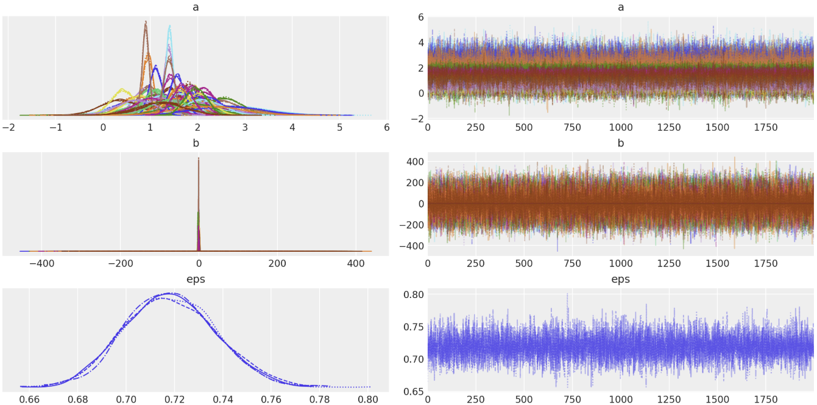
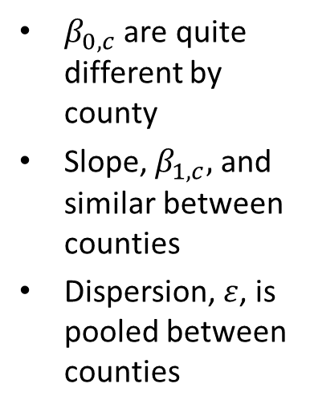
Sampling the Pooled Model
The sampling traces show independent values by county for two of three coefficients
$β_{0,c}$ are quite different by county
Slope, $β_{1,c},$ and similar between counties
Dispersion, $ε$, is pooled between counties

Slide 26
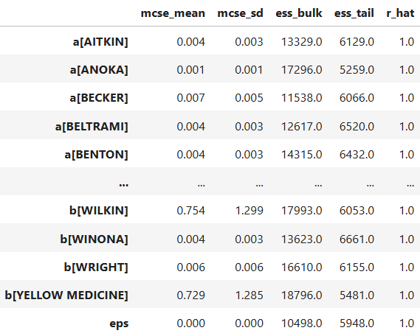
Sampling the Pooled Model
The sampling statistics are good for all coefficients

