Slide 1
Recap for 14.March 2017
Webinar by Beningo
RTOS Getting Started

Slide 2
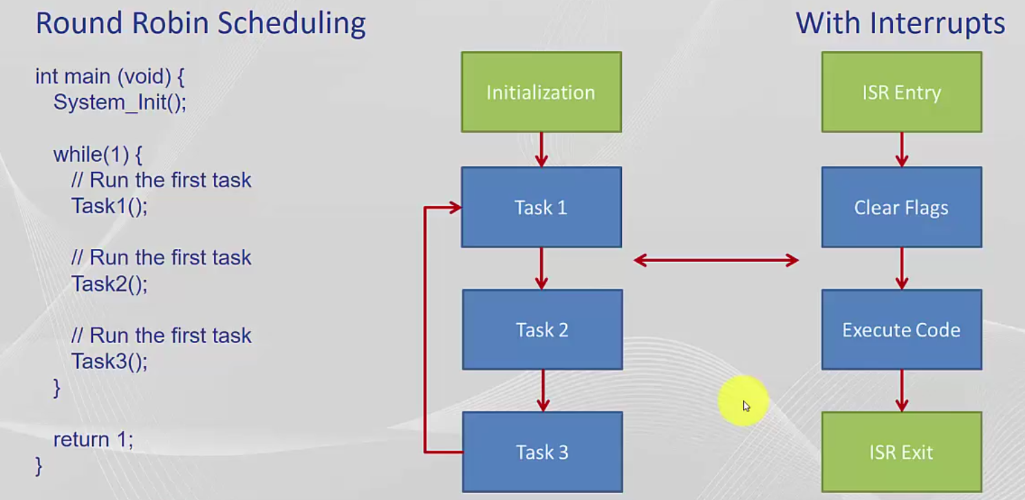
Bare-metal scheduling

Slide 3
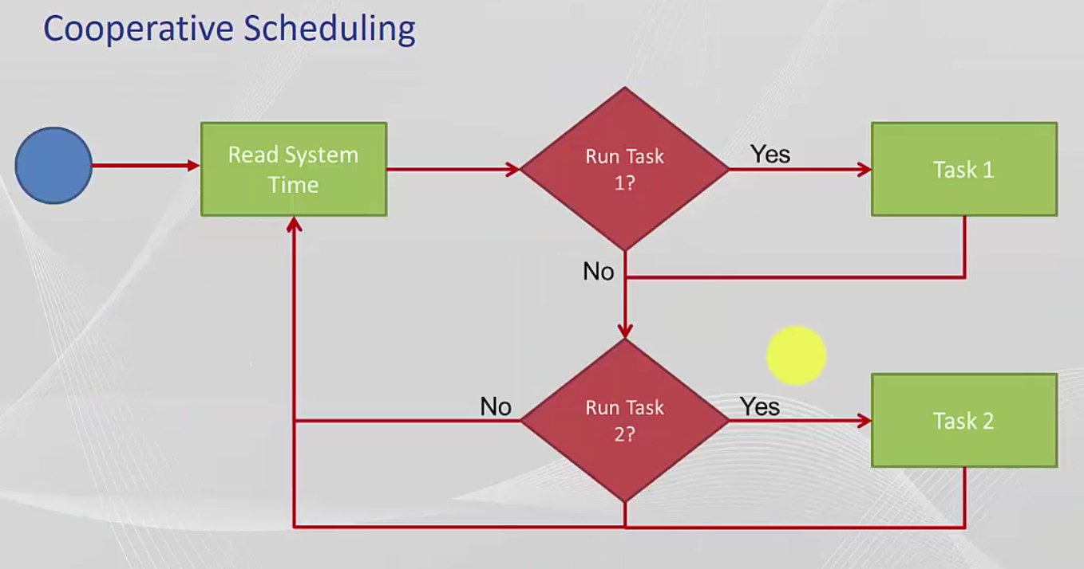
Cooperative Scheduling

Slide 4
Reasons to use a RTOS
Concurrency (Gleichzeitigkeit)
Pre-emption (Vorwehnahme) of an importatnt code section (Task)
If you have available RAM/Flash
Synchronize Tasks
3rd Party Software
Ease of use

Slide 5
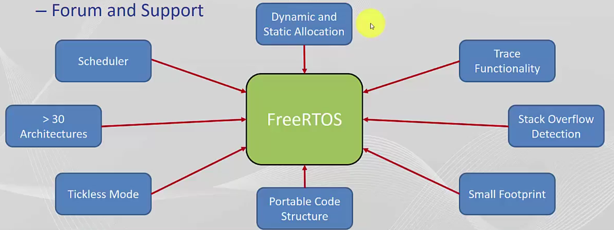
Features FreeRTOS

Slide 6
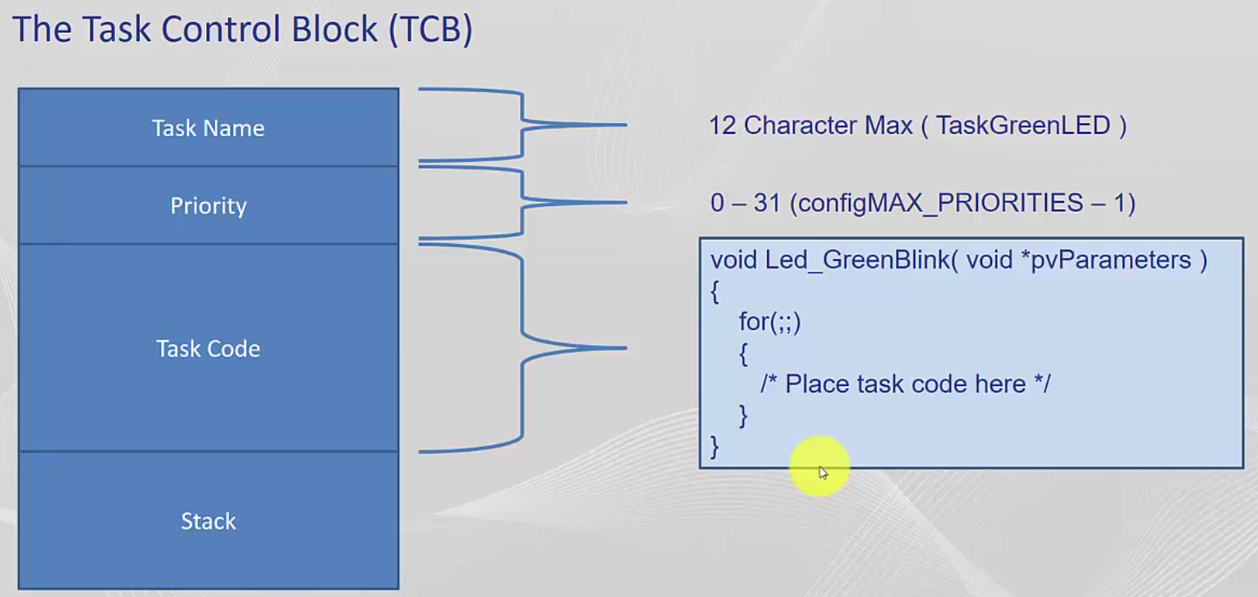
Task Control Block

Slide 7
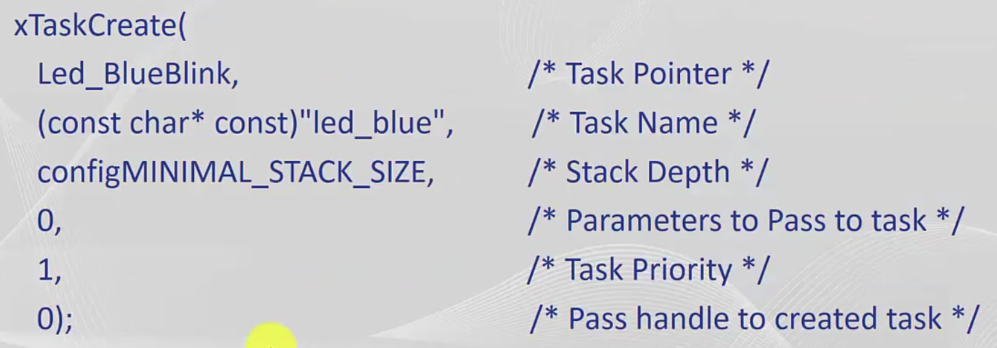
Create a Task

Slide 8
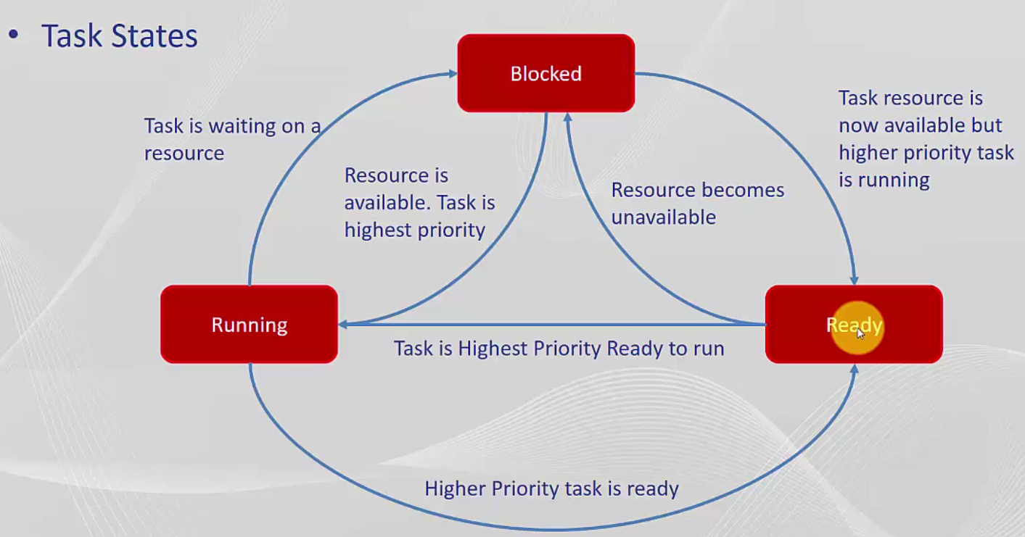
Task States

