Slide 1
Recap for 14.March 2017
Webinar by Beningo
RTOS Getting Started

Slide 2
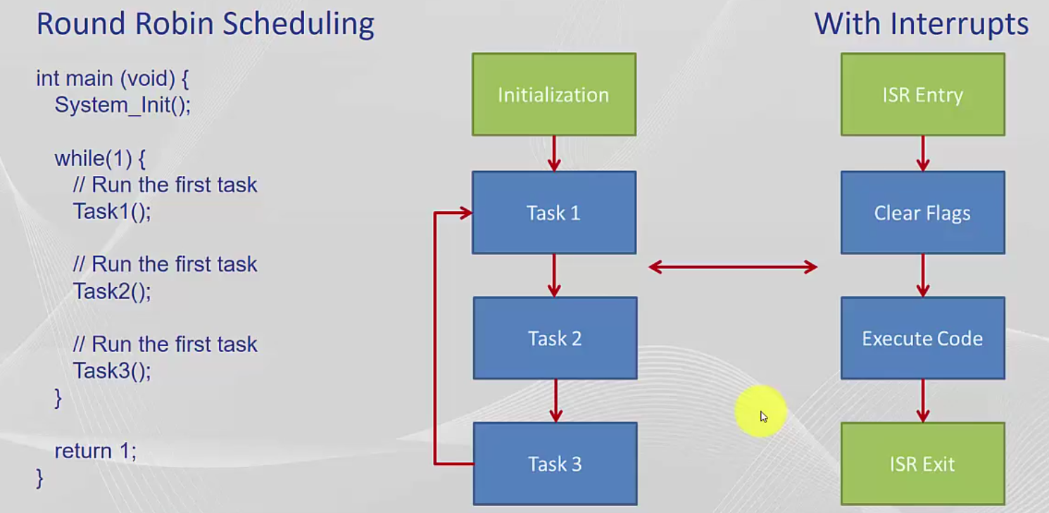
Bare-metal scheduling

Slide 3
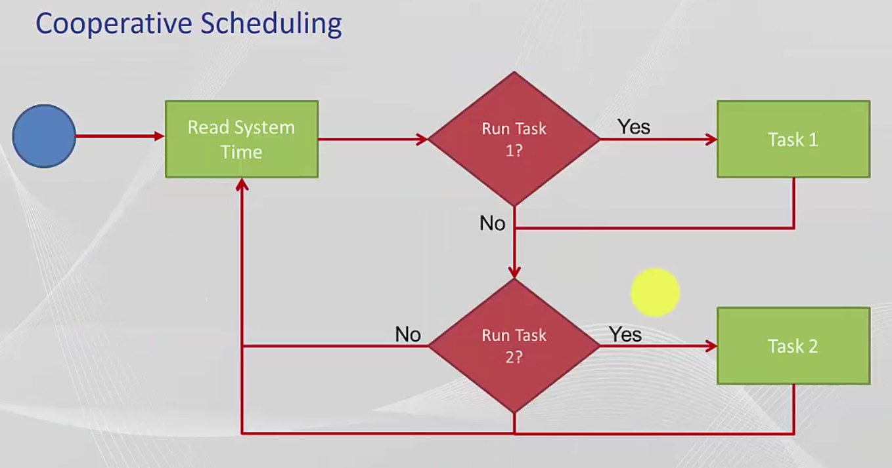
Cooperative Scheduling

Slide 4
Reasons to use a RTOS
Concurrency (Gleichzeitigkeit)
Pre-emption (Vorwehnahme) of an importatnt code section (Task)
If you have available RAM/Flash
Synchronize Tasks
3rd Party Software
Ease of use

Slide 5
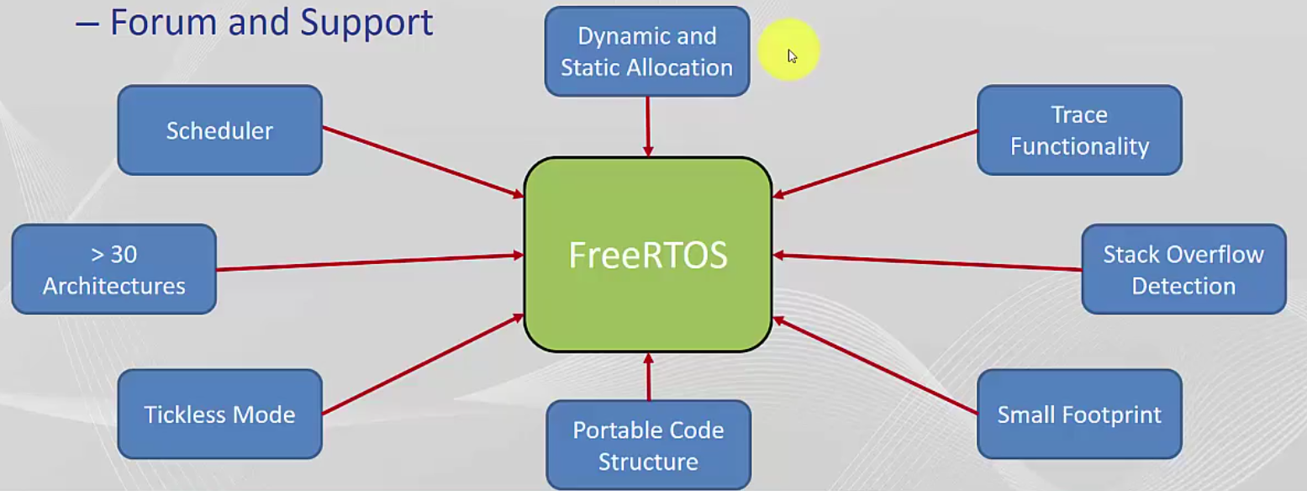
Features FreeRTOS

Slide 6
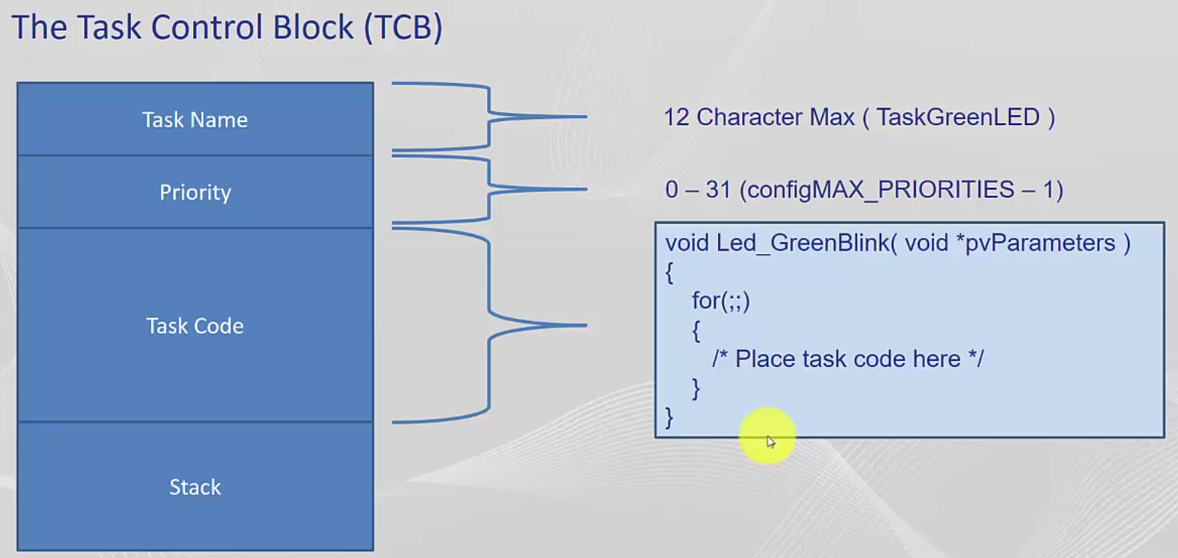
Task Control Block

Slide 7
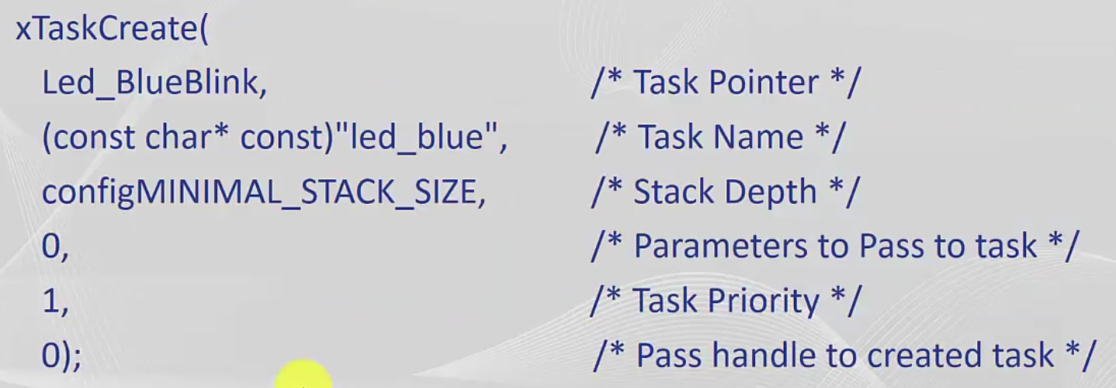
Create a Task

Slide 8
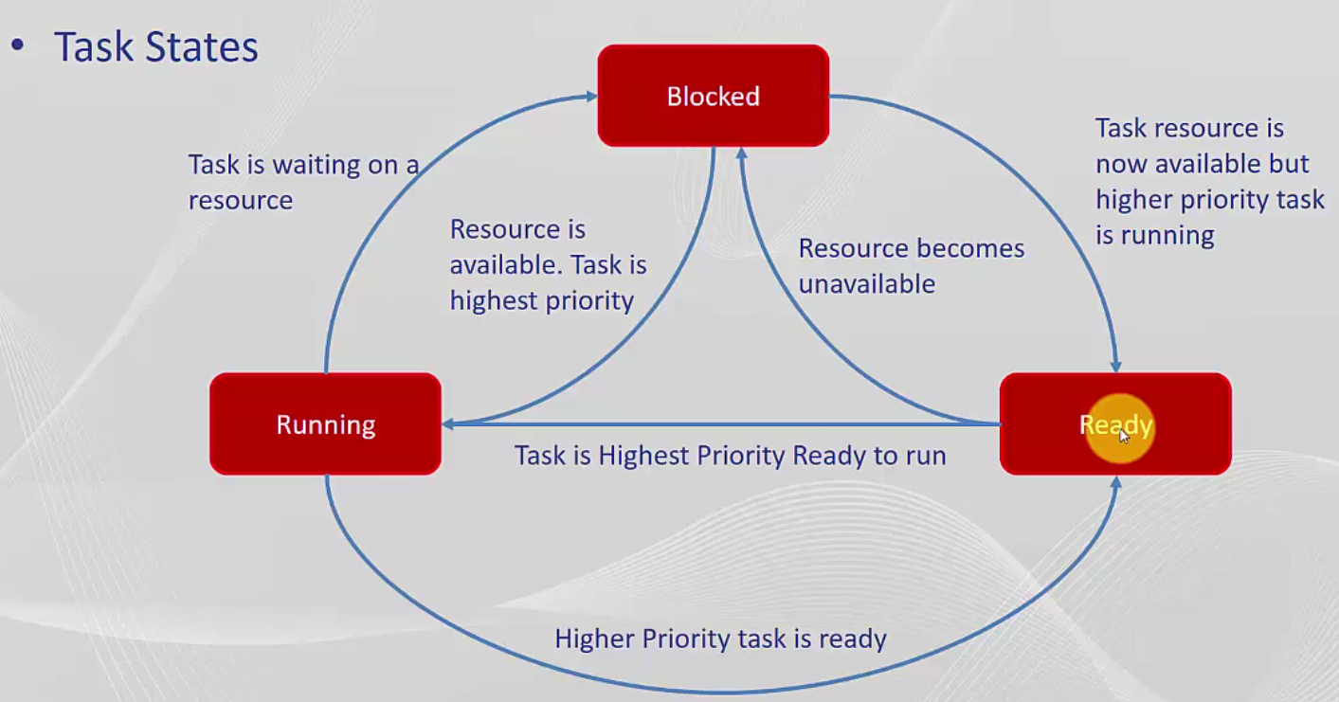
Task States

Slide 9
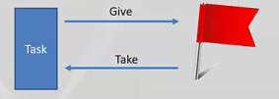

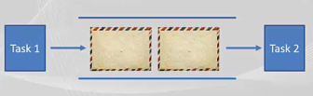
Synchronization Fundamentals
Semaphores (Sync and Notify)
Mutex (Mutual Exclusion)
Message Queues (Communication)

Slide 10
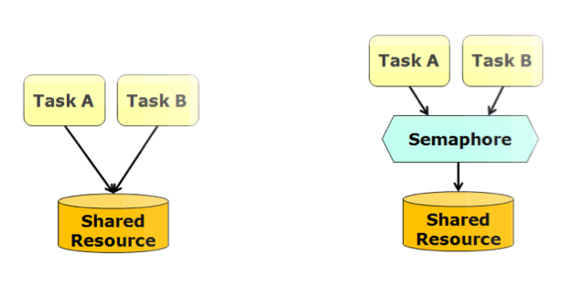
Semaphores
Snychronize Tasks / Notify that events have occurred
#include „semphr.h“
SemaphoreHandle_t = LEDSemaphore;
LEDSemaphore = xSemaphoreCreateBinary();
or
xSemaphoreCreateCounting();
xSemaphoreGive( LEDSemaphore );
xSemaphoreTake( LEDSemaphore );

Slide 11
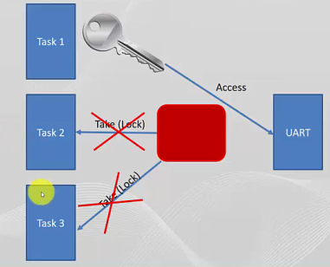
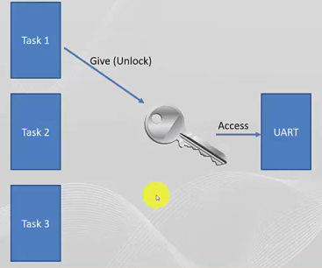
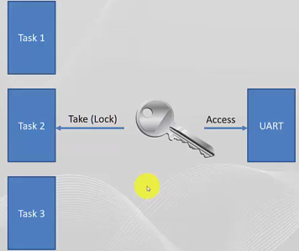
Mutex

Slide 12
Mutex
Priority Inheritance
#include „semphr.h“
SemaphoreHandle_t LEDMutex;
LEDMutex = xSemaphoreCreateMutex();
xSemaphoreTake( LEDMutex );
xSemaphoreGive( LEDMutex );

Slide 13
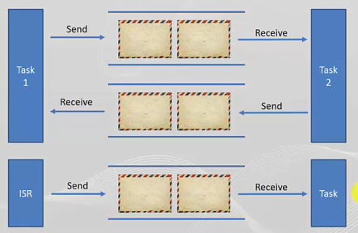
Message Queue Fundamentals
Tasks are able to interract with each other

Slide 14
Message Queue
Separate Queue for sending and receiving
#include „queue.h“
QueueHandle_t LEDQueue;
LEDQueue = xQueueCreate( MAX_ITEMS, sizeof( Message_t* ) );
xQueueSend( (void *)&MessagePtr );
xQueueReceive( LEDQueue , &(MessagePtr) );

Slide 15
Questions
What are the 3 possible States of a Task?
What is a main difference in using semaphore or mutex?
What does Priority Inheritance mean?

Slide 16
Answers
What are the 3 possible States of a Task?
Ready, Running and Blocked
What is a main difference in using semaphore or mutex?
If a Mutex is taken by a task the resource is locked and owned by this task until it‘s given back.
A semaphore is used to notify a task by giving the semaphore to another task which is pending for it. No giving back is required. The resource is not locked!
What does Priority Inheritance mean?
If a higher priority task needs a resource which is already locked by a lower priority task, the lower prio task is temporarly elevated to reach the same priority, to quickly get done his task and unlock the resource for the higher priority task.

