Slide 1
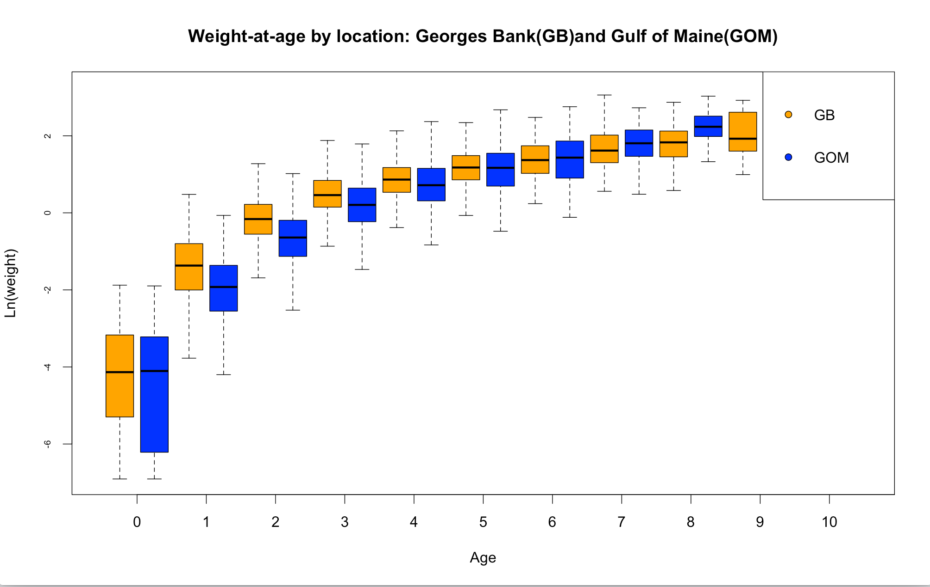
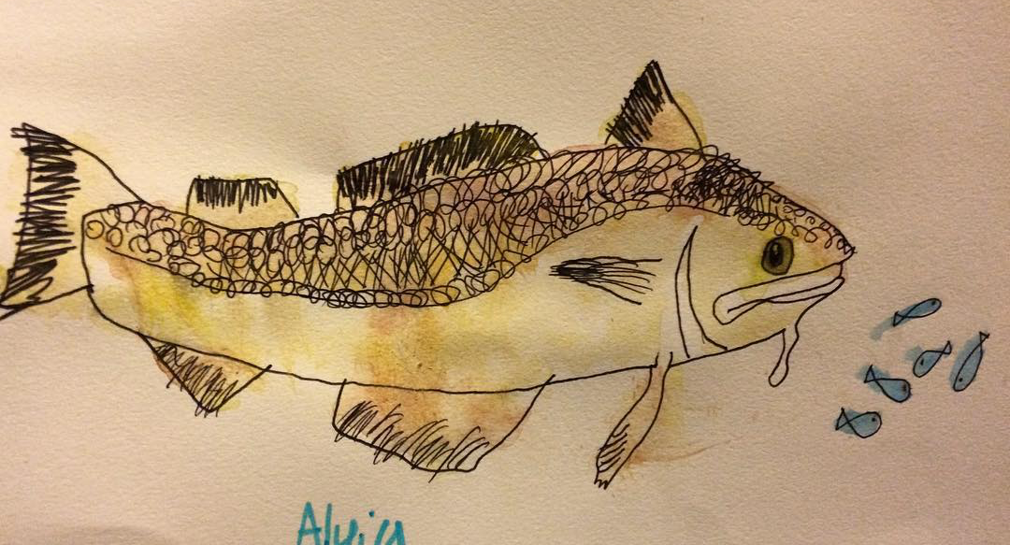

Factors influencing variability in weight-at-age and condition factor in cod
Liberty L. Schilpp, Gavin Fay
Department of Fisheries Oceanography, School of Marine Science, University of Massachusetts Dartmouth, Fairhaven, MA.
Objective:
Evaluate the relative effects of temporal, seasonal, demographic, geographic and environmental factors on observed variation in condition factor and weight-at-age for Gulf of Maine and Georges Bank Cod
Weight-at-age:
Demographic factors such as maturity have the greatest influence in variation, although the best additive model included all factors. The most important interaction term that we considered was between age and year.
Conclusions:
Seasonality contributes to variation in both condition factor and weight-at-age. Cod in spring show a negative trend over time in condition factor. In fall, interannual variability is more pronounced.
Demographic factors (eg maturity) account for most of the variation in weight-at-age
Season, location, cohort and year were also significant .
Location accounted for more variability in weight at age than condition factor.
Our work provides a pathway for identifying mechanisms for including such changes in models used to provide advice for management in the Northeast.
Future Directions:
Apply these models to other species in the Northwest Atlantic and compare results between species
Explore modeling some of the factors as random variables(year, cohort etc.)
Table 1. Weight-at-age model selection process
Background:
Variation in individual growth rates can affect fish population dynamics (ie larger size-at-age fish are generally more fecund)
Fish stocks with higher condition factor (K) may sustain higher levels of fishing than poorly conditioned stocks and can have higher recruitment at low Spawning Stock Biomass (SSB)
Variation in weight-at-age can have consequences for stock assessment model accuracy in terms of estimating biological parameters (Natural Mortality, etc.) and reference points
model | AIC | % deviance
LOGWT~AGE (null model) | 34088 | 0
LOGWT~AGE+LOCATION | 33345 | 0.04
LOGWT~AGE+YEAR | 33188 | 0.06
LOGWT~AGE+SEASON | 30302 | 0.2
LOGWT~AGE+COHORT | 32973 | 0.07
LOGWT~AGE+SEX | 32897 | 0.07
LOGWT~AGE+MATURITY | 31366 | 0.15
LOGWT~AGE+MATURITY+LOCATION | 30885 | 0.18
LOGWT~AGE+MATURITY+SEASON | 28181 | 0.3
LOGWT~AGE+MATURITY+COHORT | 30412 | 0.2
LOGWT~AGE+MATURITY+YEAR | 30556 | 0.19
LOGWT~AGE+MATURITY+SEX | 30020 | 0.22
LOGWT~AGE+MATURITY+SEASON+SEX | 26815 | 0.36
LOGWT~AGE+MATURITY+SEASON+SEX+LOCATION | 26022 | 0.39
LOGWT~AGE+MATURITY+SEASON+SEX+LOCATION+YEAR | 25142 | 0.42
LOGWT~AGE+MATURITY+SEASON+SEX+LOCATION+COHORT+YEAR | 24632 | 0.44
LOGWT~AGE+MATURITY+SEASON+SEX+LOCATION+COHORT+YEAR+AGE*LOCATION | 24272 | 0.45
LOGWT~AGE+MATURITY+SEASON+SEX+LOCATION+COHORT+YEAR+MATURITY*SEASON | 24252 | 0.45
LOGWT~AGE+MATURITY+SEASON+SEX+LOC+COHORT+YEAR+MATURITY*SEX | 24538 | 0.44
LOGWT~AGE+MATURITY+SEASON+SEX+LOC+COHORT+YEAR+SEX*SEASON | 24521 | 0.44
LOGWT~AGE+MATURITY+SEASON+SEX+LOC+COHORT+YEAR+SEAS/YEAR | 24223 | 0.45
LOGWT~AGE+MATURITY+SEASON+SEX+COHORT+LOC+YEAR+MATURITY*AGE | 24577 | 0.44
LOGWT~AGE+MATURITY+SEASON+SEX+COHORT+LOC+YEAR+SEX*AGE | 24319 | 0.45
LOGWT~AGE+MATURITY+SEASON+SEX+COHORT+LOC+YEAR+YEAR*AGE | 24081 | 0.47
LOGWT~AGE+MATURITY+SEASON+SEX+COHORT+LOC+YEAR+YEAR*AGE | 24382 | 0.45
Table 2. Condition Factor model selection
Figure 1. Weight-at-age for both locations. Investigation of various interaction terms was based on biological hypotheses and plots showing interactions such as this; location driven differences in weight-at-age are more pronounced in younger fish.
Data:
Data for aged cod obtained from NMFS Northeast US trawl survey database (NEFC,1988).
Location of samples aggregated into Gulf of Maine (GOM) and Georges Bank(GB)
Used Fulton’s Condition factor as derived from the length-weight equation : K = 100*W/ L³
Modeling Approach:
Linear models were used to quantify the effects of age, year, cohort, maturity ,sex, location, and season on body weight and condition factor.
Fitted models with all combinations of predictor variables and interaction terms using R (R Core Team, 2015).
‘Best’ model for each response variable selected using Akaike Information Criterion (AIC, Akaike 1974) while ensuring terms explained > 1% of the deviance.
Figure 2. Weight-at-age Year Coefficients for the “best” model
Condition Factor:
Used the same process as the weight-at-age models
The best model for condition factor included “zero” (whether or not the fish is a new recruit (age zero)), year, cohort, and season.
No interaction terms were significant
Location was not significant, unlike with the weight-at-age models
References:
Akaike, H. (1974). A new look at the statistical model identification. Automatic Control, IEEE Transactions on, 19(6), 716-723.
NEFC. 1988. An evaluation of the bottom trawl survey program of the Northeast Fishery Science Center. NOAA Technical Memorandum, NMFS-F/NEC-52. 83 pp.
R Core Team (2015). R: A language and environment for statistical computing. R Foundation for Statistical Computing, Vienna, Austria. URLhttps://www.R-project.org/.
Figure 3. Condition Factor Year Coefficients for the “best” model

