Slide 1
ENGI 301 PCB Project
Lily Scholnik

Slide 2
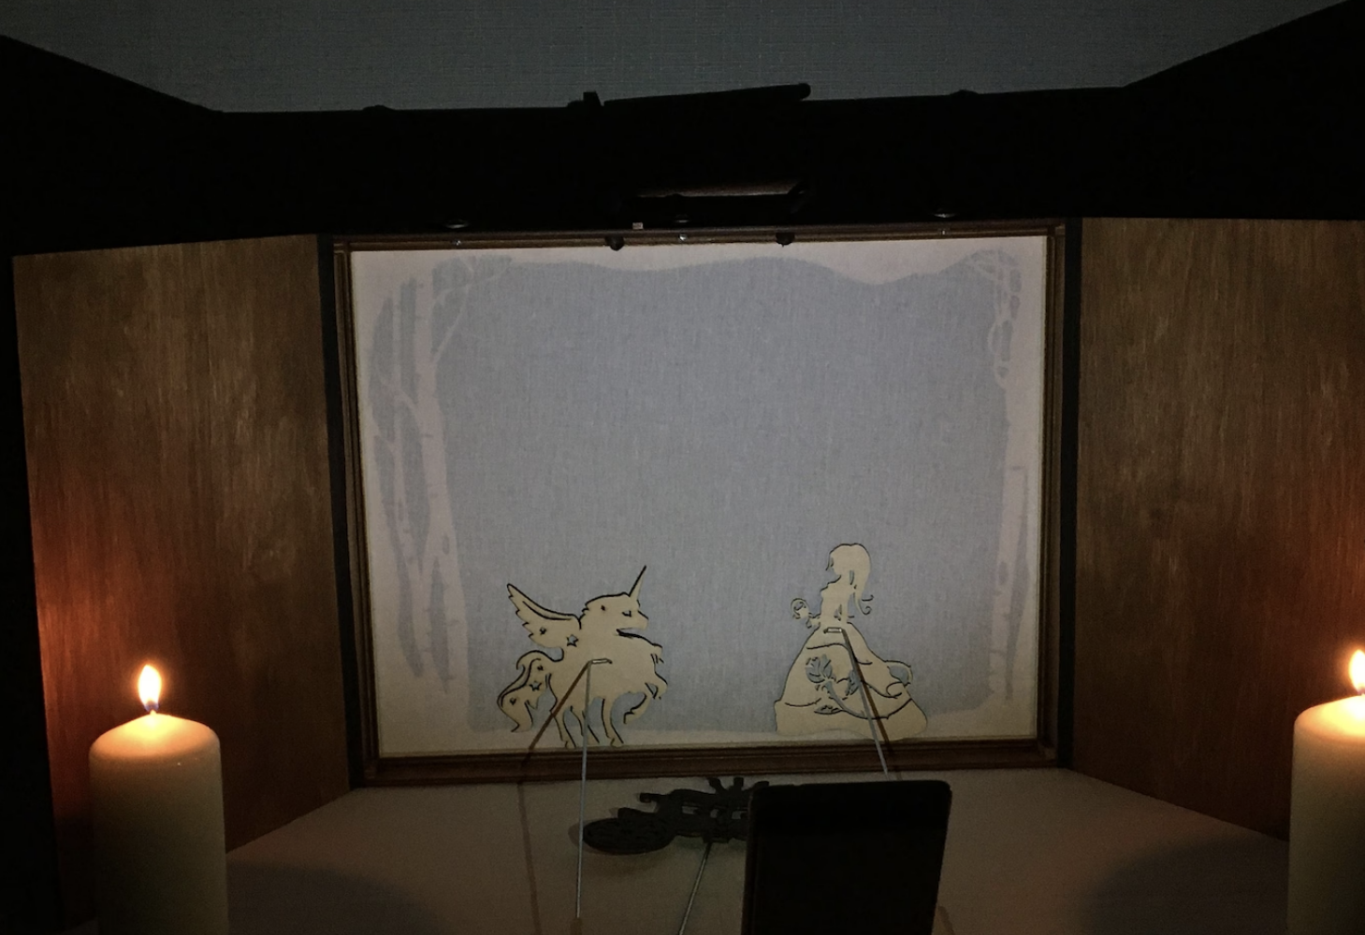
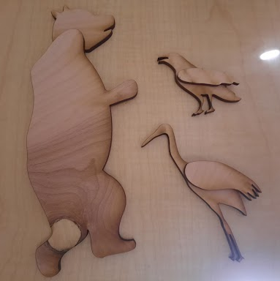
Background Information
PCB for mechanically actuated shadow puppets
Button activated, pre-programmed functionalities to support a single-operator shadow puppet theater production
Functionalities:
3 servo animated puppets
2 sound effects on a USB speaker
1 puppet moved using two joint arm (3 pre-programmed movement sequences) → emulating 2D plotter
Shadow puppet screen with manually controlled puppet examples
The three puppets to be animated with servos
Notes:
Doug Hebda’s PocketBeagle CNC Using BeagleG → https://www.hackster.io/dah8/pocketbeagle-cnc-using-beagleg-070f2f
Tyler Pitts’ 2D Plotter Using PocketBeagle → https://www.hackster.io/tjp4/2d-plotter-using-pocketbeagle-47db39
Samuel Sarver’s Robot VS Human Connect 4 → https://www.hackster.io/samuelmsarver/robot-v-s-human-connect-4-eca0b5

Slide 3
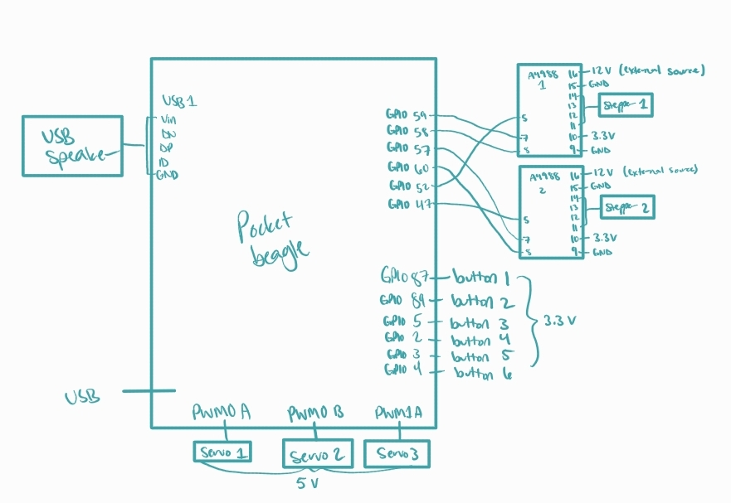
System Block Diagram

Slide 4
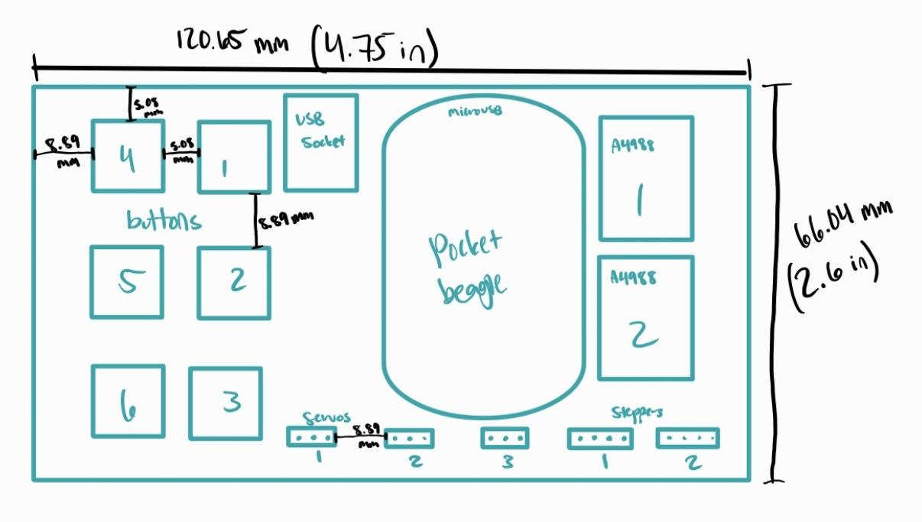
Mechanical Drawing
Complete For Project 2
See next slide for an example
FRONT
BACK

