Slide 1
Coursera: Applied Data Science Capstone by IBM
Capstone Project:
The Battle of the Neighborhoods

Slide 2
Introduction
NYC is a multi-ethic melting pot. The NYC food scene is vibrant, diverse and constantly changing. Restaurants change with each passing season. For someone new to NYC and homesick, it is difficult to find which neighbourhood will offer cuisine which is closest to home. Hence our target audience are people who are new to NYC and would like to find the neighbourhood with the most familiar food culture compared to their home city, and also help foodies discover new neighbourhood cuisines.

Slide 3
Data
We plan to leverage on Foursquare restaurant data as well as its menu data to identify neighbourhoods with most similar cuisine as our source city. From the list of neighbourhoods, we would extract the list of well-rated restaurants within a certain promixity to the center of the neighbourhood. We also extract the same information from the home city. We would then use that data to identify which NYC neighbourhood cuisine has the greatest similarity with the home city.

Slide 4
Methodology
The code will prompt the user to input their home city and confirm the location visually on a map. It would then extract the relevant restaurant information from Foursquare, and via K-means clustering, identify the cluster which the home city belongs to and plot the neighbourhoods in the same cluster on the map. The radius of the plots on the map is the actual area where the restaurant information is extracted from.
Plotted historgram of count of returned results for each neighbourhood to ensure the radius of the neighbourhood is sufficiently large so as to return enough results to rank top X types of restaurants but not so large as to materially overlap neighbouring neighbourhoods and hit the max of 100 results imposed by Foursquare which would reduce accuracy of representation.
Used K-means clustering based on top X types of restaurants to group neighbourhoods into clusters. Then identify the cluster which the home city belongs to and see which other neighbourhoods are in the same cluster. This is the result set. Lastly, because we don't have labels sets of neighbourhoods of similar cuisine for training so we could not used KNN algorithm.
Manually examine final cluster results for reasonableness of the fit and tweaked the following hyper-parameters and reran.
cluster size
top X ranked
search radius

Slide 5
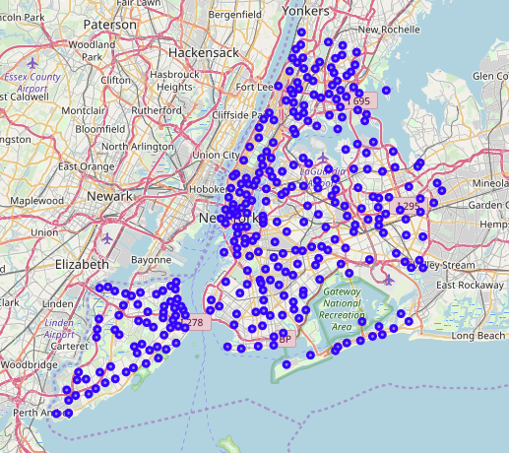
Map of NYC Neighborhoods
Plotted the center of all neighbourhoods and corresponding radii to check how much overlap and reasonableness of proximity to restaurants as well as the location of the center of the neighhourhoods.

Slide 6
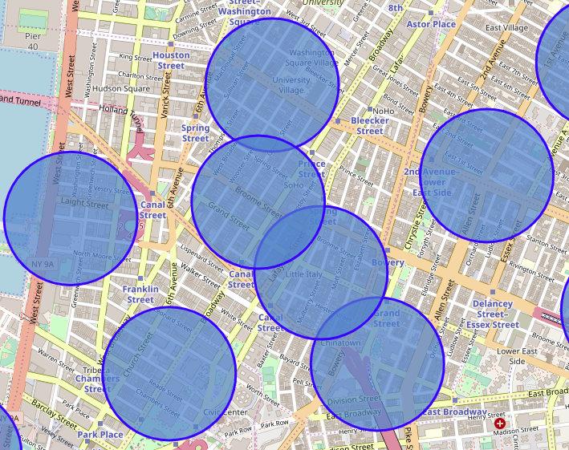
Search radius of neighbourhoods
The circles indicate the search radius of 350m.
Due to the density of neighborhoods in Manhattan, the radius was reduced to minimise on overlap.
However this meant that some neighborhoods which were widely spread returned fewer venues.

Slide 7
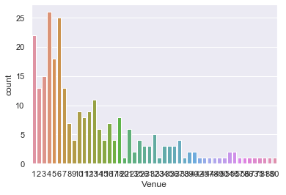
Distribution of number of venues
This is the distribution of venues returned by Foursquare. There are ~35 neighborhoods which returned less than 3 venues. This is due to the small search radius of 350m.

Slide 8
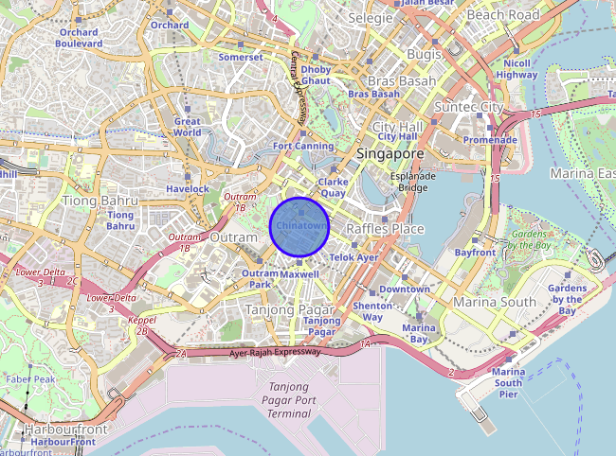
Target City
We tested using Chinatown, Singapore as the home city where there is a concentration Chinese, Food Court and Dim Sum restaurants. The circle shows where the venues were located.

Slide 9
Results
The ML algorithm successfully identified the big Chinatowns in Chinatown in Manhattan and Flushing in Queens as neighbourhoods of similar cuisine. This is a confirmation the algorithm works as expected.
It also identified other smaller but similar neighbourhoods in Bensonhurst in Brooklyn and Little Neck in Queens which were unexpected and new to me. This is confirmation that the algorithm helped me discover new neighbourhoods which similar cuisine.

Slide 10
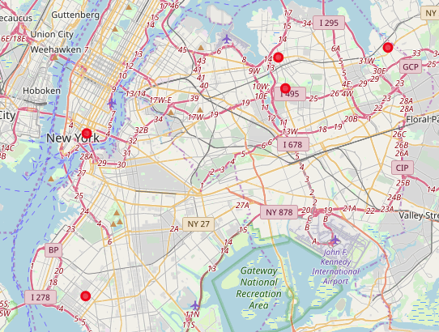
Map of Results
Plot of NYC neighborhoods with similar cuisine.

Slide 11
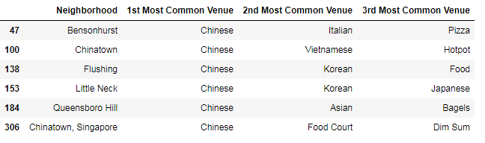
Other observations
Observations:
Reducing the top X used for clustering to 3 (from 10) greatly increased fit.
Reducing the radius to search to 350m generally increased fit as it better reflects the characteristics of the neighbourhood without overlap and without hitting the limit.
Increasing the cluster count to 100 generally increases fit without number of results.
Limitations and proposed recommendations:
Only 100 results per neighbourhood which reduces the accuracy of the representation of restaurants. Could be improved by extracting and mapping all restaurants in NYC.
Neighbourhood is defined as a circle of fixed radius which is not an accurate representation of reality where neighbourhoods are of different shapes and sizes. Could be improved by using actual neighbourhood perimeters.
Premium endpoint daily limit of 500 limits ability to pull menu information. Could be improved by clustering using menu keywords instead.
Clustering methodology places equal emphasis on all top 10. Could be improved by introducing different fit emphasis based on ranking.
NYC is dominated by cheap pizza locations which tends to skew the profiles. Could be improved by adding a price band filter to Foursquare queries.

Slide 12
Conclusion
The algorithm was successful in it goal of identify known neighbourhoods as well as discover previously unknown neighbourhoods of similar cuisine as the home city of Chinatown, Singapore.
In addition to the limitations and improvement observated in the results section, improvements can be made to automatically tweak the hyper-parameters and rerun depending on results and menu vocabulary and be used instead of broad restaurants types are even greater accuracy.

