Slide 1
Movie Recommender
Semantic Web Technologies
Fall Semester 2018
Patrick Heinze, Anh Le, Leon Schüller
4th December 2018
University of Mannheim

Slide 2
Agenda
Goals and vision for the recommender
Semantic movie datasets
Similarity measures and recommendation algorithm
Example results
Outlook
Lessons learned

Slide 3

Goals and vision for the recommender
Introduction
Use semantic web data to provide recommendations
Provide suggestions based on attributes other than user ratings, e.g.
director
subject
genre
actors
Combine weighted attributes with linear combination rule
Vision statement
Exciting recommendations that are sometimes main stream and sometimes surprising alternative movies.

Slide 4
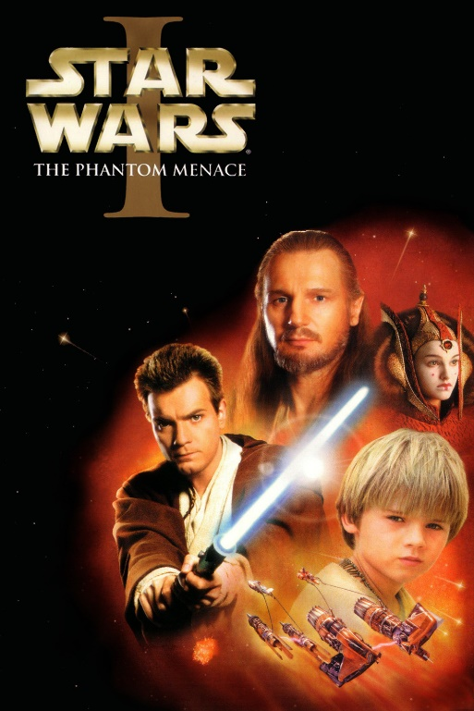
Similarity Measures
Cosine Similarity
Most popularly used to compare TF-IDF vectors
Compute TF-IDF scores on preprocessed abstract
Not included in app due to long computation times in Java
Jaro Winkler Distance
Our implementation of a fuzzy search for movie names
show the 10 most similar movies with descending similarity
Notes:
For Star Wars I the most similar movies solely based on the abstract are Star Wars II, Star Wars the film, Return of the Jedi, The Empire Strikes Back and The Big Fisherman.
Inception returns Inception as best fit and Infection, Incognito, Inchon and Inspector as closest movie names

Slide 5
Outlook
Provide recommendations for a set of movies
Quick win: Show overlap
Wanted: Handle no-overlap appropriately

Slide 6
Lessons learned
Java is a good fit for Jena and SPARQL
Use python for data science related tasks
Reuse of existing frameworks
Enable a machine learning based approach with auto-encoders

Slide 7
Conclusion and outlook
WHAT WE HAVE DONE:
OUTLOOK:

Slide 8
?
Questions
Patrick Heinze, Anh Le, Leon Schüller
4th December 2018
University of Mannheim

