Slide 1
Data Science

Slide 2
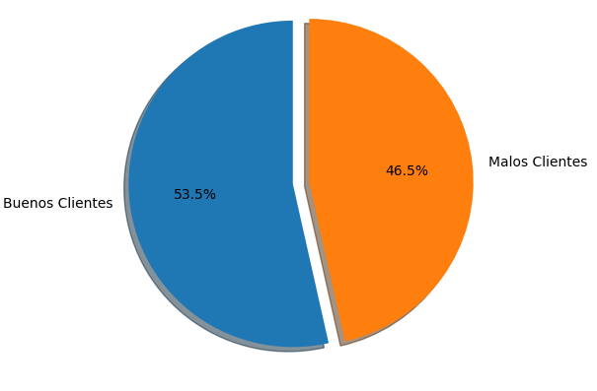
Initial Hypothesis
Bad clients have low monthly difference between
income and outcome.
Bad clients have low or negative surplus.
Bad clients have higher balance than credit limit.
Bad clients have high number of payments due.
Bad clients have high delinquency numbers.

Slide 3
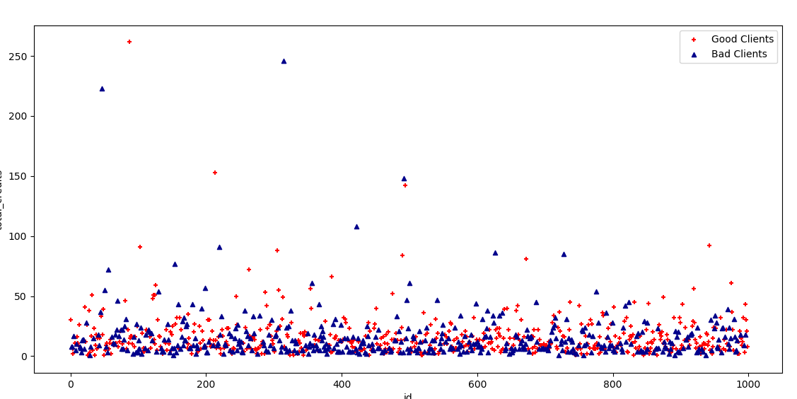
Total Credits per Client
No tendency is identificated by the total number of credit per client.

Slide 4
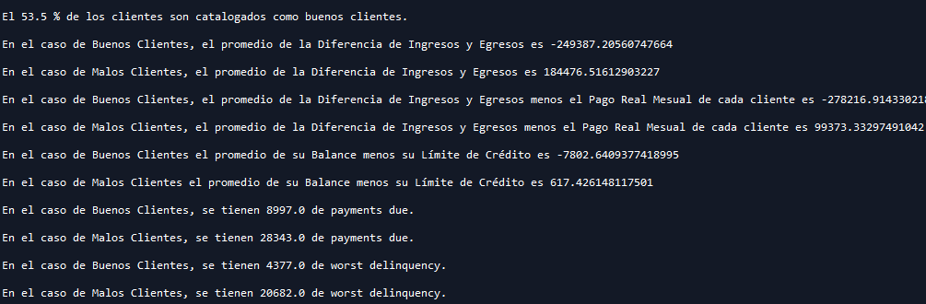
Hypothesis Testing
In a first quick approach, using only the value means, the hypothesis aren’t supported.
On the contrary, it seems, that a so called good client is the one that starts failing the payments and owing the bank, having an average to high income.
Machine Learning Modeling is required to have accurate predictions.

Slide 5
Models

Slide 6
Variables
Monthly_difference
Real_monthly_payment
Worst_delinquency
Worst_delinquency_past_due_balance
Current_accounts_percentage
Delinquency_accounts_percentage
maximum:_credit_limit
Maximum_number_of_payments

Slide 7
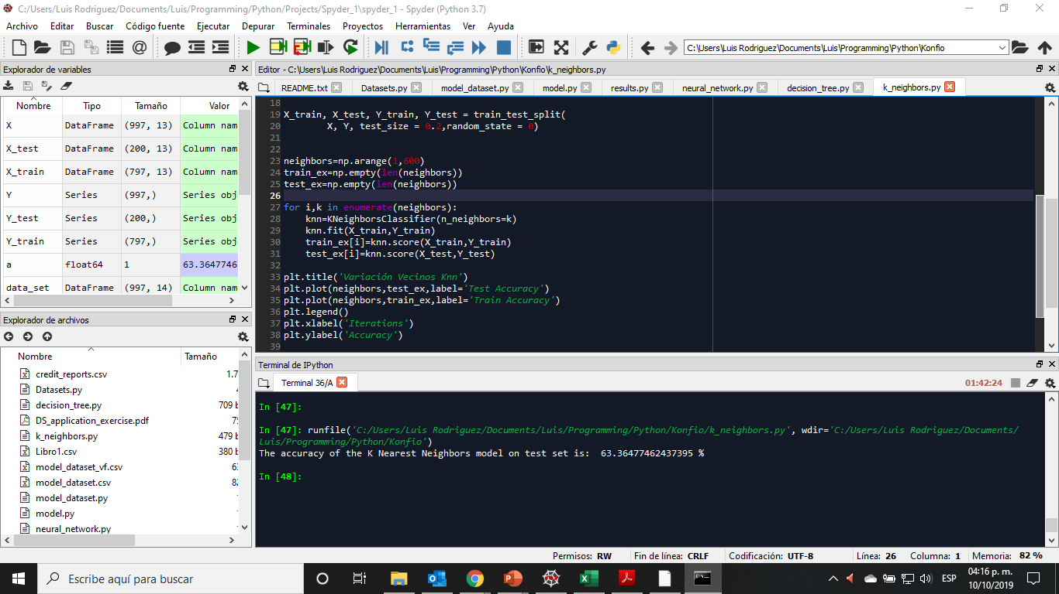
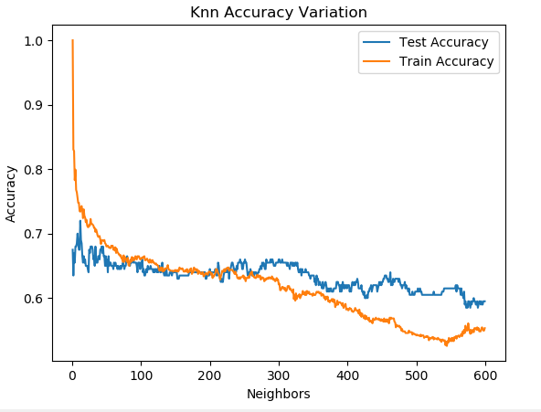
K Nearest Neighbors

Slide 8
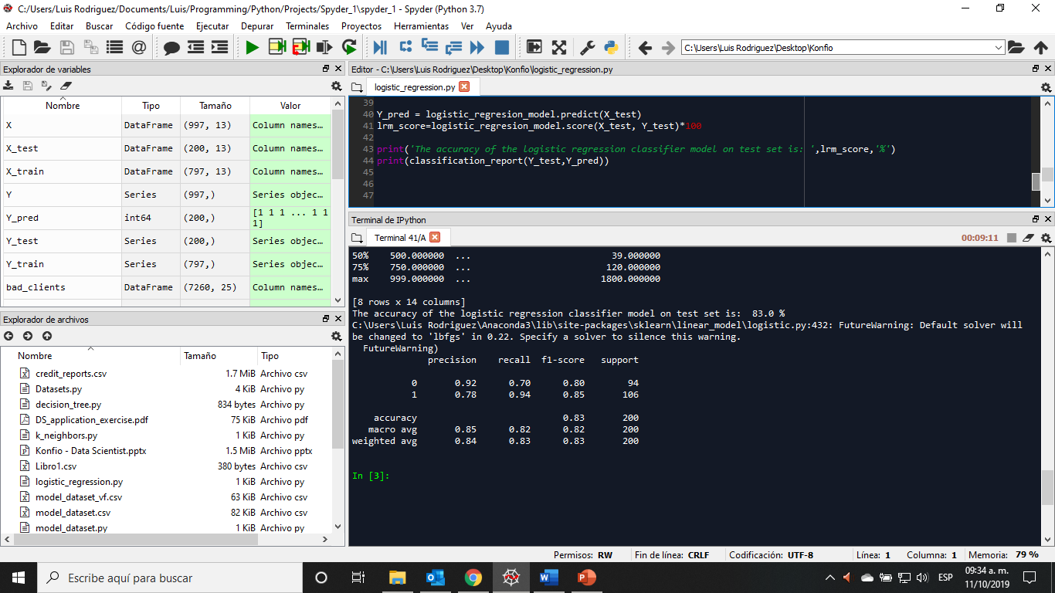
Logistic Regression Model

Slide 9
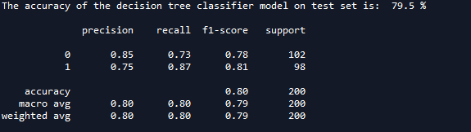
Decision Tree Model

Slide 10
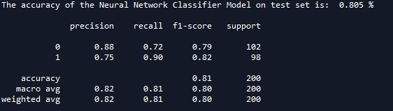
Neural Network
In the case of the neural network model, this was the highest accuracy value obtained after around 30 iterations of the model.

Slide 11
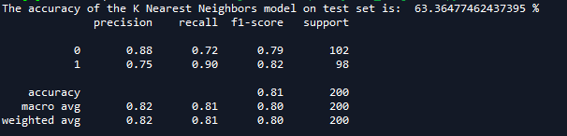
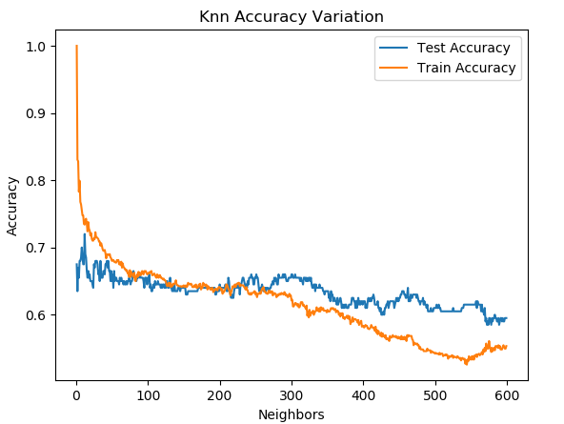
K Nearest Neighbors

Slide 12
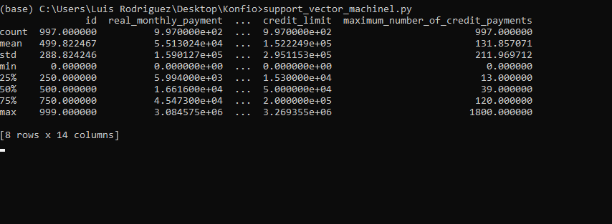
Support Vector Machine
A SVM with a linear kernel was tested, but the processing time didn’t allow me to obtein the model results.
Nevertheless, the code is contained in the deliverables, as ´support_vector_machinel.py´.

Slide 13
Model Selection
Logistic Regression was the selected model, since it is the one with a higher accuracy.
The following analisys will be developed with the predictions created with this model.

Slide 14
Deployment
The selected Best Clients are shown in the file named ´results.csv´.
The document also contains the Recommended Loan Term and Credit Limit for each selected client.
The file ´results.py´ contains the code for the generation of ´results.csv´, and it shows the considerations taken to get to the results.
In the case of the Anual Interest Rate, I believe I lack information, I cann’t determine a mínimum interest rate, without knowing Konfio’s operational costs for account management, as well as other related cost to each account.
I decided to show in ‘results.csv’, the minimum and maximum interest payment (using Condusef’s information regarding credits for small and médium companies), each client will pay at the end of the loan, considering the máximum recommeded payment per client, and the maximum credit term.

Slide 15
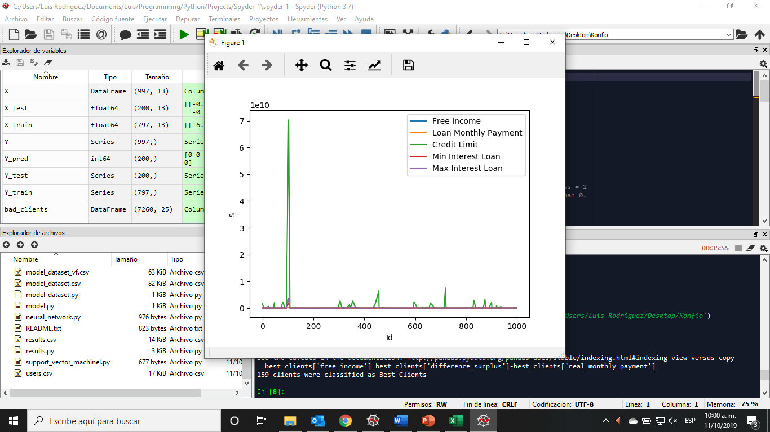
Conclusions
I believe, the model works fine, but just that.
For example, some data regarding account type “Sin Límite Preestablecido” and credit type “Línea de Crédito”, show some very high values in terms of loan term, so that gives us some very high valuesin the model (as shown in figure 1), and that affects the other results obtantion. (as show in figure 1)
The models were tested using different parameters, such as different distribution of Testing and Training Data, different type of solvers, diferente kernels, etc.
Validation of the models is missing, due to lack of time.
It would be interesting to analyze how other variables affect the model, such as account_type, credit_type, the different dates, etc., but it wasn’t done due to lack of time.
Figure 1.

