Slide 1
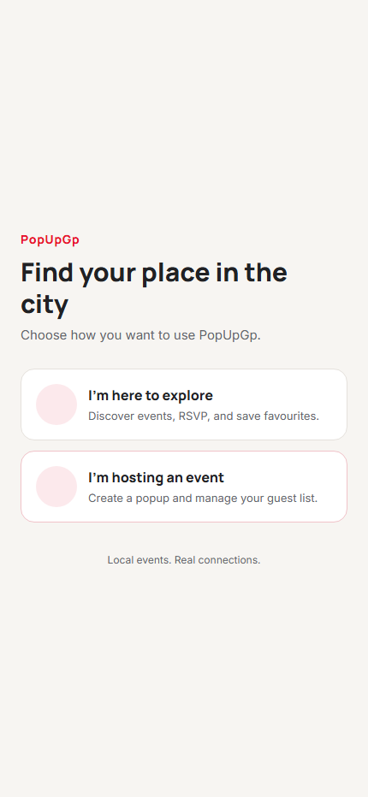
IT PROJECT 700 • 5 MINUTES
PopUpGp
Where the city comes alive
A platform for discovering, hosting and moderating pop-up events in Gauteng.
Problem • Solution • Proof • Live demo
Notes:
Timing: 15 seconds. Introduce PopUpGp as a complete role-based event platform. State the goal clearly: make it easier for people in Gauteng to find local pop-up events, while giving hosts a structured publishing flow and admins a moderation point. Say that this is a short overview followed by a live demo.

Slide 2
Problem statement and project goal
The project addresses a practical gap in the event journey.
ATTENDEE PROBLEM
HOST PROBLEM
PLATFORM PROBLEM
Local events are hard to discover in one trusted place.
Event creation needs structure and visibility.
Listings need review before they become public.
People need clear details, a simple RSVP and a way to revisit events.
Hosts need dates, location, capacity, price, image and event status in one flow.
An admin must approve, reject or cancel events to maintain quality.
Goal: one connected workflow from event submission to approved discovery and RSVP.
Notes:
Timing: 35 seconds. Explain the three problem statements. Avoid presenting them as quantified research findings; present them as the product problem the system is designed to solve. The objective is a connected event lifecycle: a host submits, an admin moderates, and an attendee discovers and RSVPs.

Slide 3
Solution: one platform, three focused roles
Each role gets a simple interface while sharing the same event lifecycle.
01
02
03
Attendee
Host
Admin
Discover approved events
Create and manage events
Moderate the platform
Browse, search, save events and RSVP to a free event.
Provide venue, date, capacity, price and an optional image.
Review pending events and control their published status.
Host submits → Admin approves → Attendee discovers and RSVPs
Notes:
Timing: 35 seconds. Move left to right. The attendee sees approved events only. The host creates and manages their own events. The admin is the quality gate. This demonstrates that the project is more than a user interface: it has an end-to-end role-based workflow.

Slide 4
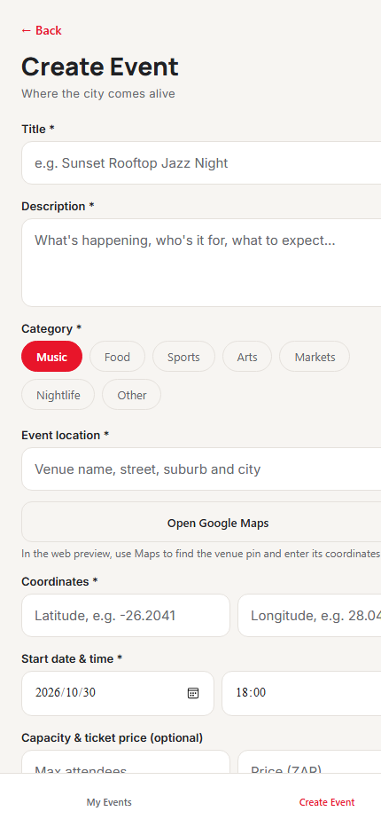
Implementation evidence: real mobile screens
The interface was refined for clear actions, feedback and role-based navigation.
Role selection and authentication
Users choose the attendee or host journey before signing in.
Better host event creation
The form captures the fields needed for a meaningful listing, including guided location support.
Profile and saved events
Users can edit their display name and return to saved upcoming approved events.
LOCAL WEB PREVIEW CAPTURES
Notes:
Timing: 35 seconds. These are actual screenshots taken from the project’s local web preview. Point to the role selector and the event creation form. Mention that the host form includes category, venue, coordinates, date/time, capacity and price. The system also implements profile editing, saved events, and optional event images. Do not focus on browser-only limitations here; those are covered on the verification slide.

Slide 5
Architecture and security
Two clients share Firebase services; critical RSVP and payment decisions happen server-side.
Expo 56 mobile app
→
Firebase Auth
Cloud Functions
Attendee + host journeys
Identity + role profile
Free RSVP + payment confirmation
→
React + Vite admin
→
Cloud Firestore
Storage + Stripe
Moderation and analytics
Users, events, saves, RSVPs
Event image + native checkout
SECURITY: ROLES + RULES + SERVER VALIDATION
Notes:
Timing: 40 seconds. Explain that the app is made of an Expo mobile app for users and hosts, and a React/Vite web app for admins. Firebase Authentication identifies users; Firestore stores data; Cloud Functions own sensitive RSVP and ticket confirmation changes. Firestore rules restrict profile, event and saved-event access by ownership and role. Image upload rules constrain host, file type and size. Stripe secrets stay on the server.

Slide 6
Testing results and honest project status
The assessment evidence separates verified behaviour from work that still needs a live service or device.
VERIFIED LOCALLY
NEXT VALIDATION
Build and quality checks
Native image flow
Functions build; mobile lint, TypeScript and web export; admin build and lint passed.
Needs a development build and a Firebase test project with Storage rules deployed.
Emulator smoke test
Stripe test mode
Covers profile ownership, saved events, host creation, moderation, free RSVP and capacity.
Native-only checkout is implemented but needs test keys and an end-to-end payment walkthrough.
Protected behaviour
Presentation demo
Direct RSVP writes are denied; a paid ticket cannot be removed using the free RSVP action.
Use a free event in the web preview; do not demonstrate paid checkout in the browser.
Repository evidence: README implementation status • Firestore rules • Functions emulator smoke test
Notes:
Timing: 40 seconds. This slide builds credibility. State what has been checked: automated Functions emulator smoke test, app and admin build/lint checks. The emulator verifies that profile and saved-event access is owner-only, free RSVP changes counts safely, capacity is enforced, and direct RSVP writes are rejected. Then be honest: image upload needs native device testing and Storage setup; Stripe needs test credentials and native end-to-end testing. The browser demo will use free RSVP only.

Slide 7
Live demo: three terminals, one workflow
Run these commands first. Then demonstrate the shortest complete free-event journey.
Firebase emulators
Mobile web app
Admin web app
1
2
3
cd functions
npm run serve
cd mobile-app
npx expo start --web --port 8083
cd admin-web
npm run dev -- --port 5174
Keeps Auth, Firestore, Functions and Storage local.
Open http://localhost:8083 for attendee and host.
Open http://localhost:5174 for moderation.
Demo order:
Host creates a free future event → Admin approves it → Attendee finds it and RSVPs.
Notes:
Timing: 60–90 seconds. Start the three terminals before presenting and keep them running. Terminal 1 starts the Firebase emulators once. Terminal 2 runs the mobile web app at localhost:8083. Terminal 3 runs the admin web app at localhost:5174. For the demo: sign in as host, create a FREE event in the future with valid Gauteng coordinates; sign in as admin and approve it; sign in as attendee, refresh Browse, open the event and RSVP. Keep ticket price at zero because browser preview does not support Stripe checkout. If the emulator data query fails, use the screenshots and explain that the verified emulator smoke test covers free RSVP and capacity.

Slide 8
CONCLUSION
PopUpGp delivers a complete event lifecycle.
Role-based
Attendee discovery, host operations and admin moderation.
Built with safeguards
Firebase rules and server-side Functions protect key actions.
Evidence-led
Build checks and emulator smoke tests support the core free-event flow.
Next validation: native images and Stripe test-mode checkout.
Thank you • Questions?
Notes:
Timing: 15 seconds. Close with the strongest claim you can support: PopUpGp implements the central event lifecycle across attendee, host and admin roles. It uses role-aware rules and server-side functions for core actions, and has local build and emulator evidence. State the next validation items briefly if asked: native image upload and Stripe test-mode checkout. Invite questions.

