Slide 1
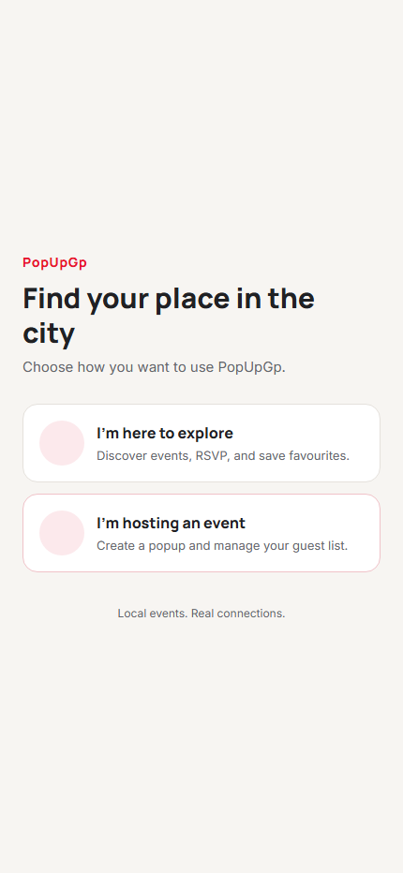
IT PROJECT 700
PopUpGp
Where the city comes alive
A Gauteng pop-up events platform for discovery, hosting and moderation.
12–15 minute project presentation
DISCOVER • HOST • MODERATE
Notes:
Welcome the audience. PopUpGp is a mobile-first platform focused on finding and running local pop-up events in Gauteng. The presentation covers the user journeys, system design, security boundaries, and what has been verified. Mention that the slide deck uses the project’s red, warm neutral, Manrope and Inter visual system.

Slide 2
The idea: make local events easier to find and run
Product intent, not a claim of completed market research
ATTENDEES
HOSTS
ADMINS
Find something nearby
Publish with confidence
Keep listings trustworthy
Browse approved events, check details, save favourites and RSVP.
Create and manage an event with venue, schedule, capacity, price and an optional photo.
Review submitted events and move them through approval, rejection or cancellation.
One workflow connects discovery → event operations → moderation.
Notes:
Introduce the three users and their need. Explain the design objective: put local discovery, host operations and moderation into one consistent workflow. The cards describe the intended product roles and implemented feature areas. They should not be presented as findings from a user study; no user research data is claimed here.

Slide 3
Three roles, one event lifecycle
Access is shaped by the role stored in the user profile
01
02
03
SUBMIT
REVIEW
Attendee
Host
Admin
Discover & RSVP
Create & manage
Review & moderate
Approved listings
Event form & venue details
Moderation dashboard
Event details & saved events
Capacity, schedule & price
Approve or reject submissions
Free RSVP / paid ticket path
My Events, edit and cancel
Status and analytics views
An approved event becomes discoverable; RSVP and ticket records are written server-side.
Notes:
Walk from left to right. Attendees browse and act on approved events. Hosts submit and maintain their own events. Admins review status. The lifecycle is enforced with role-aware Firestore rules and callable Functions for RSVP/payment actions. Mention that the admin web console is a separate React/Vite application, while attendee and host experiences use Expo Router.

Slide 4
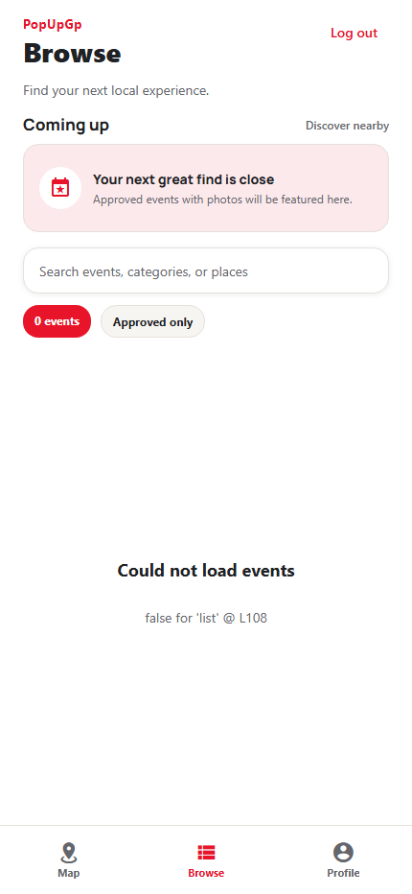
Discovery is built around a quick decision
Browse combines a featured area, search, event cards and map/list navigation
Featured event carousel
Up to five nearest upcoming approved events with photos; branded fallback if none qualify.
Useful discovery controls
Search by event, category or place, with clear approved-only results.
Map and list paths
Native MapLibre pins open a preview card; web uses a list-based fallback.
CAPTURED FROM LOCAL WEB PREVIEW
Preview data query showed an emulator listing error; see demo fallback in notes.
Notes:
This is an actual screenshot from the local browser preview. The discovery UI is visible, but the local emulator-backed query displayed an error (“false for list”); do not describe this capture as a successful event fetch. For a live demo, verify the approved event query against the prepared test data first. If the error persists, show the role flow and host form, then explain the discovery UI using the screenshot. The native map is not shown in the web build.

Slide 5
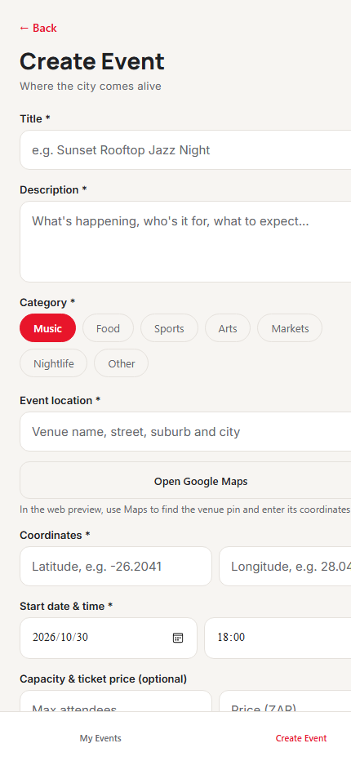
Hosts can create an event without guessing coordinates
A guided form brings venue, timing, capacity and ticket details together
Venue support
Enter an address and open Google Maps to find the pin and copy latitude/longitude.
Schedule controls
Date and time fields use platform-specific pickers; web shows browser-native inputs.
Event operations
Choose category, define capacity and a ZAR price, then track approval in My Events.
Optional photo
One image per event; JPEG, PNG or WebP up to 5 MB, with host-only Storage rules.
Image picker requires a native development build. The web preview accepts the core form.
Notes:
Point to the form fields. Hosts provide title, description, category, venue and coordinates, start time, capacity and price. If coordinates are not known, use the Google Maps action to find a pin and copy the coordinates. The optional event image flow uses Expo ImagePicker and Firebase Storage and requires a rebuilt native development client. Storage rules have been reviewed but not deployed to a live Firebase project.

Slide 6
Moderation is the quality gate
The admin console reviews submissions before they appear in discovery
MODERATION QUEUE / SCHEMATIC
Review
Pending events
Inspect event details and image before taking action.
Weekend Makers Market
PENDING
Decide
Markets · Gauteng
Approve, reject or cancel within permitted status transitions.
Sunset Jazz in the Park
PENDING
Music · Johannesburg
Track
Community Food Pop-up
APPROVED
Dashboard and analytics provide an overview of platform activity.
Food · Pretoria
Admin panel: React + Vite · Authenticated role: admin
Notes:
This panel is a schematic illustration, not a screenshot of a populated moderation queue. The actual admin console is implemented in React and Vite with sign-in, event moderation, analytics and profile screens. Event rules limit admins to valid status transitions. A fresh isolated preview showed an auth-loading state, so demo the real moderation flow only after the admin emulator account and emulator config are ready.

Slide 7
Architecture keeps client actions behind clear services
Mobile and admin clients share Firebase identity and data; sensitive operations go through Functions
Expo 56 app
Firebase Auth
Cloud Functions
→
Attendee + Host · iOS / Android / Web
Identity + role profile
RSVP + ticket confirmation
→
→
Cloud Firestore
Stripe + Storage
React + Vite admin
Users · Events · RSVPs · Saves
Native checkout · Event images
→
→
Moderation · Analytics · Profile
Native map: MapLibre + OpenFreeMap | Browser map fallback: event list
Notes:
Explain the two front ends and shared Firebase services. Firebase Authentication gives the user identity; role lives in the user document. Firestore stores events, RSVPs and saved-event references. Callable Functions own free RSVP mutations and paid-ticket creation/confirmation. Stripe secrets stay in Functions. Event image files are stored in Firebase Storage; the app has a web list fallback and native map.

Slide 8
Security follows ownership and role boundaries
The client can request actions, but rules and Functions decide whether they are allowed
PROFILE
Owner edits display name
Email and role protected
Admin role controlled
EVENTS
Host creates/edits own
Admin changes valid status
Approved listings readable
RSVP
Client cannot write RSVP
Callable checks status/capacity
Count updated transactionally
IMAGES
Host uploads to own event
Image type + 5 MB limit
Replace/delete cleanup hooks
RULES + SERVER CHECKS
Notes:
Describe the security model in plain language. Firestore rules restrict profile edits to displayName and stop direct RSVP writes. Hosts can edit their own event documents while admin status changes are limited. The Functions layer checks approval, price and capacity and applies RSVP count changes transactionally. Storage rules scope uploads to the host, check image content type and size, and Functions clean replaced or deleted images. Emulator tests have covered profile, saved-event ownership, event creation/moderation, RSVP write denial and Storage rule behavior.

Slide 9
Free RSVP is a reversible, capacity-aware action
One server transaction keeps the attendee record and event count in sync
01
→
02
→
03
→
04
User taps RSVP
Function checks event
Capacity checked
RSVP + count saved
EMULATOR VERIFIED
PROTECTED
Join · cancel · rejoin
No direct RSVP writes
Smoke test confirms count changes and no over-capacity RSVP.
Paid tickets cannot be cancelled with the free RSVP action.
Notes:
This flow is verified by the existing Functions emulator smoke test. It checks that direct RSVP writes are denied; an authenticated callable can add, cancel and re-add a free RSVP; capacity is enforced; and a failed full-capacity request does not change the count. It also verifies that a paid ticket is not removed by the free RSVP cancellation path. This is emulator verification, not a deployed-service test.

Slide 10
Paid tickets use native Stripe checkout
The backend confirms payment before a ticket is recorded
1
Create PaymentIntent
Server checks event, duplicate ticket, capacity and ZAR amount.
TEST MODE STATUS
2
Collect payment
Stripe PaymentSheet runs in the iOS / Android app.
Not end-to-end tested
3
Confirm and fulfill
Server retrieves Stripe status and validates metadata and price.
Stripe test credentials are placeholders; native checkout was not run.
4
Recover safely
On unfulfillable success, issue an idempotent refund or a clear support error.
Web preview does not support paid checkout.
Notes:
Be precise about verification. The native PaymentSheet client and server callables are implemented. Code checks duplicate purchases, event approval, capacity, amount in ZAR, PaymentIntent ownership metadata and succeeded status. The confirmation path uses an idempotent refund if payment succeeded but a ticket could not be fulfilled. However, this project has placeholder Stripe test keys and no Stripe test-mode end-to-end run has been performed. The emulator smoke test confirms checkout fails safely when Stripe is not configured. Never claim a real or test payment succeeded in this demo.

Slide 11
A clearer visual system supports every role
The same warm surfaces, red actions and locally bundled type are used across mobile and admin
Brand red
Text
Page
#E8152A
#202124
#F7F5F2
Manrope
Surface
Border
Soft red
Headings and event titles
#FFFFFF
#E5E1DC
#FCE9EC
Approved
Pending
Neutral
Inter
#217A50
#865700
#5A6572
Body text, labels and controls
LOCAL FONT FILES
Feedback states are inline and role-aware.
Notes:
Explain the red and warm-neutral palette and why it was applied across both products. Manrope is used for headings and prominent titles; Inter handles body copy and controls. Both fonts are bundled locally with the apps so UI typography does not depend on a network font request. Mention the visible loading/error/success feedback added in the UI improvement phases and the consistent status colors.

Slide 12
What is complete—and what still needs a real environment
Core code and emulator checks are useful progress; release readiness needs service and device validation
IMPLEMENTED / CHECKED
REMAINING VALIDATION
Core roles and event lifecycle
Prepared demo data
Host create/manage, admin moderation and approved event discovery.
Fix/rehearse the local Browse query error and validate host/admin accounts on the chosen test project.
Emulator smoke checks
Native and services
Auth/profile rules, saved-event ownership, free RSVP, capacity and safe Stripe-unconfigured failure.
Build native client; test image selection/upload; deploy reviewed rules only to an agreed test project.
Build checks
Stripe test walkthrough
Mobile lint/type checks/export and admin production build/lint passed in project phases.
Add test keys and verify success, cancel, duplicate, capacity and refund paths.
Notes:
This slide separates implemented code and emulator checks from validation that has not happened. Current local browser capture showed a Firestore listing error, so a presentation rehearsal should verify the browser query against working test data before promising a live attendee flow. Image upload needs a native development build and test Firebase Storage setup. Stripe secrets in the example file are placeholders; no Stripe test-mode payment walkthrough has been done. Keep test and live project credentials separate.

Slide 13
LIVE DEMO / 90 SECONDS
One event. Three roles.
01
Host
Open My Events → create a free event with a future date and venue.
Fallback
If emulator data is unavailable, use the screenshots and explain the verified RSVP smoke test.
02
Admin
Review the pending event and approve it.
03
Attendee
Find the approved listing, open details and RSVP.
PopUpGp
Where the city comes alive.
Notes:
Suggested short demo. Before class, sign into the test emulator and confirm Browse data queries work. First create a free event as the host. Next approve it from the admin console. Finally open the attendee app, find the listing and use the RSVP action. Keep paid checkout out of the web demo; Stripe runs only in a native development build and has not been test-mode verified. If event data or the emulator fails, show the screenshots and clearly state that emulator smoke tests verified free RSVP add/remove/capacity behavior. Close by restating the project’s three roles.

