Slide 1
Offensive Networking
Lachezar Uzunov

Slide 2
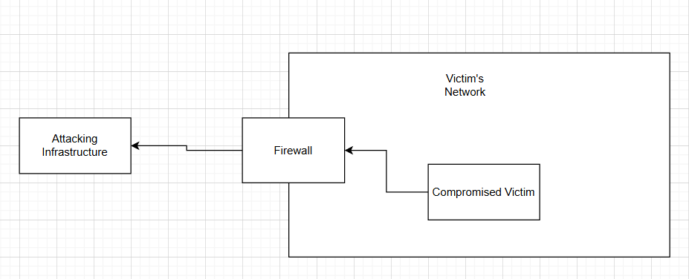
Why Networking?

Slide 3
Why Networking?
Schedule Implications
Schedule Implications
C2 Traffic
Privilege Escalation
Lateral Movement
Data Exfiltration
Live data transfer
Many more …
C2 Traffic in general.

Slide 4
What is a C2?

Slide 5
What Is a C2?
Core Functions
Establish connection.
Provide stability
Provide ease of management
Provide extended capabilities (like execute-assembly)
Provide ease of logging and reporting
Provide red teamwork
Provide evasion

Slide 6
Evasion
Endpoint Evasion – Out of Scope
Evade endpoint protection (AV / EDR)
Evade other endpoint protection systems (Applocker)
Malware development required
Network Evasion
Mission: Stay camouflaged (not invisible)
Evade:
Restrictive proxies
IDS / IPS
Firewall rules
Custom solutions
Evade rules before people

Slide 7
What is the blue arsenal?

Slide 8
What is the Red arsenal?

Slide 9
Red Arsenal
Core
Psychology
C2 framework (best customized)
LOLBAS for network analysis
Lab replication (if applicable)
Creative thinking
Tools perspective
Blue teamer’s perspective

Slide 10
Arsenal
C2 Frameworks
Mythic C2 – Great for customization and reporting
Havoc C2 – Great for endpoint evasiveness
LOLBAS
MobaXTerm (For network monitoring and tunnel)
SSH (For network tunnel)
Sysinternals (for everything)

Slide 11
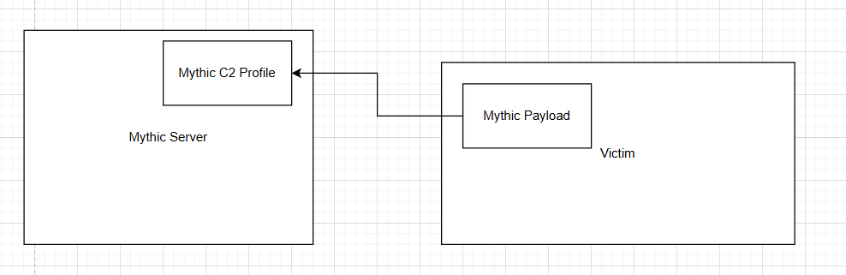
How Mythic C2 Works

Slide 12
Mythic C2 Profiles
Third Party Apps
Mainstream
Discord: https://github.com/MythicC2Profiles/discord
Slack: https://github.com/MythicC2Profiles/slack
Github: https://github.com/MythicC2Profiles/github
HTTP: https://github.com/MythicC2Profiles/http
Websocket: https://github.com/MythicC2Profiles/websocket
DNS: https://github.com/MythicC2Profiles/dns

Slide 13
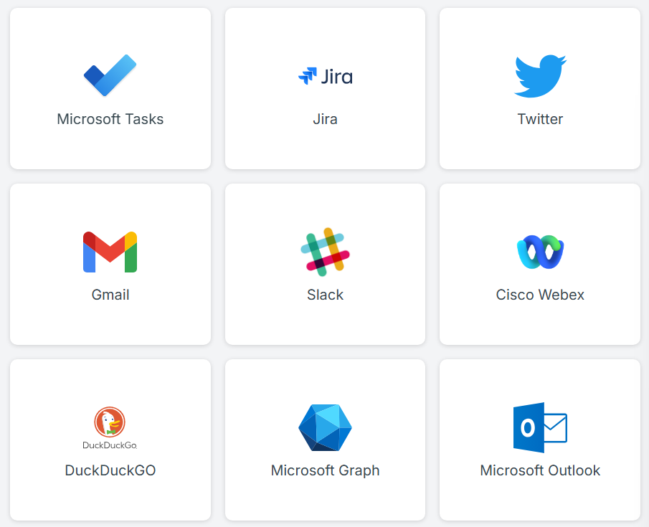
Side note
List of Third Party C2s:
LOLC2: https://lolc2.github.io/

Slide 14
Offensive Environment Setup Demo
Setup
Download
Mythic C2: https://github.com/its-a-feature/Mythic
Havoc C2: https://github.com/HavocFramework/Havoc
MobaXTerm (Portable): https://mobaxterm.mobatek.net/download-home-edition.html
Sysinternals: https://learn.microsoft.com/en-us/sysinternals/downloads/sysinternals-suite

Slide 15
How to be more evasive?

Slide 16
Blend in
C2 Frameworks
Custom agent configuration (headers and metadata)
Custom server configuration (headers and metadata)
Always use encrypted channels
Always use longer callback intervals
Always use randomized jitter timer
Always use trusted redirectors
Do NOT run noisy tools
Build payload with trusted proxy settings
Analyze the default traffic and try to blend in

Slide 17
Evasive Demo

Slide 18
Thank You
Lachezar Uzunov
Presiyan Yankulov

