Slide 1



Advanced Topics in Spring
CodeMash 2016
Pre-Compiler
Java: Beginner to Intermediate
David Lucas
Lucas Software Engineering, Inc.
www.lse.com
ddlucas@lse.com

Slide 2

Spring Framework: Core Annotations
DZone Reference Cards (very handy)
Spring Configuration
http://refcardz.dzone.com/refcardz/spring-configuration
Spring Annotations
http://refcardz.dzone.com/refcardz/spring-annotations

Slide 3





About: David Lucas
Lucas Software Engineering, Inc (www.lse.com)
https://www.linkedin.com/in/ddlucas
@DavidDLucas
https://github.com/lseinc
ddlucas@lse.com
Developing with Java since 1998
Focus on Enterprise Solutions
  Large Scale and Volume
  DevOPS
Worked in various industries:
military, insurance, financial, manufacturing, utilities
Provide software engineering, performance tuning, mentoring and training
Master Craftsman @ Manifest Bootcamp, working with Manifest Solutions since 2004

Slide 4
Assumptions
This session is for beginners wanting to expand their basic knowledge of Spring Framework
Will NOT go into scripting or domain specific languages
Will NOT dig into Spring Batch, Spring Big Data, Spring MVC or Spring XD
Will discuss JPA, JMS, JTA, and WebServices (SOAP and some REST-ish)
Will build examples using maven and STS
Examples are for informational purposes
Unit tests are NOT exhaustive

Slide 5
A Few Ground Rules
You will NOT hurt my feelings if you …
ask questions.
take your phone or text conversation outside.
leave because you are bored or need a break.
want me to change pace or speed.
participate.

Slide 6
Agenda
Setup Verification
Spring Overview
Labs
Spring Boot
Labs
What's Next ?

Slide 7


Setup Verification
Java JDK 1.8
Spring Tool Suite 3.7.2
GitHub repo or Zip download
  https://github.com/lseinc/spring-advanced
import projects into STS
Verify Setup (mvn clean install)

Slide 8


Slide 9
Spring Overview
IOC / DI ?
Containers: Why we don’t like them?
Frameworks: design patterns with default behaviors, life cycle
Decoupled: easier to configure and test
using since 2003, about ease of integration, replaced my own frameworks
Driven new Java Standards and JEE profiles

Slide 10
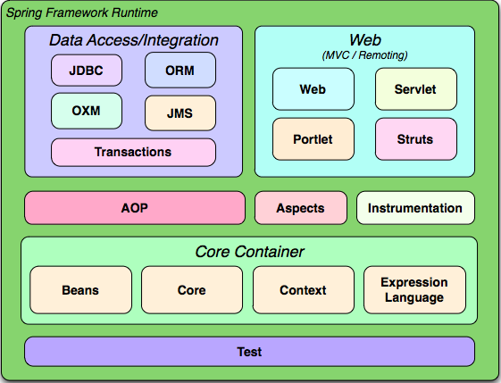

Slide 11
LAB 01
1) import project
2) mvn clean install
3) review some of Spring 3.x
Wait here until ready to move on…

Slide 13
3.x to 4.x
Wiring
<beans/>
<bean/>
<import />
Injections
<property/>
@Autowired
@Value
Component Beans
@Service
@Repository
@Component
Wiring
@Configuration
@Bean
@Import
Injections
@Autowired
@Value
Component Beans
@Service
@Repository
@Component

Slide 14
Spring Framework: 4.x
Bean Configurations
@Import
@Configuration
@ComponentScan
@PropertySource
@EnableAutoConfiguration
@EnableTransactionManagement

Slide 15
Spring Framework:
Releases
Version | Released | End of Life
2.5 | October 2008 | January 2013
3.x | January 2010 | December 2016
4.x | January 2014 | 2019 ?
5.x | 4Q 2016 ? | 2021 ?
Review Spring Notes

Slide 16
Spring Framework: Core Annotations
DZone Reference Cards (very handy)
Spring Configuration
http://refcardz.dzone.com/refcardz/spring-configuration
Spring Annotations
http://refcardz.dzone.com/refcardz/spring-annotations

Slide 17
Spring Framework: Data
Persistence
JDBC
Transactions
  -Local (JDBC)
  -Global (JTA)
ORM
  -Hibernate
  -MyBatis
  -JPA (example: EclipseLink / Hibernate)
  -NoSQL

Slide 18
Spring Framework: Data
JdbcTemplate uses DataSource provided by Spring Application Context
DAO uses JdbcTemplate to execute JDBC type commands and manages closing of connections, statements, and result sets
Results use a DataMapper to do manual mapping of each row to new entity object

Slide 19
Spring Framework: Data
@Repository configures DAO with common exception translation
JDBC Template (Spring JDBC)
iBatis SqlMapClient support
Hibernate Session API support
JPA supported entity manager (EJB)
    @PersistenceContext
    @PersistenceUnit

Slide 20
Spring Framework: Data
Transactions (TX)
Spring Framework provides Transaction Management integration
Leverages application container TMs:
WebLogic, WebSphere, JBoss, etc
Provides Local and Global support
JTA: Java Transaction API (XA support)
Spring provides consistent transaction management for multiple resources
  database (JDBC, JPA)
  messaging (JMS)
  RMI / IIOP

Slide 21
Simple Spring Configuration
@Configuration
@EnableTransactionManagement
@ImportResource(locations="classpath:spring-minimal.xml")
public class SpringConfiguration {
/* put special creation and wiring here */
}

Slide 22
LAB 02-A
import project
add SpringConfiguration class
2) mvn clean install
3) review some of Spring 4.x
Wait here until ready to move on…

Slide 24
Spring Framework: Data
Transactions
Simple DataSource TransactionManager
Not Two Phase Commit
Only Supports JDBC transactions
Local Transaction Support (not Global)
<!-- a PlatformTransactionManager is still required -->
<bean id="transactionManager"
class="org.springframework.jdbc.datasource.DataSourceTransactionManager">
<!-- (this dependency is defined somewhere else) -->
<property name="dataSource" ref="dataSource"/>
</bean>

Slide 25
Spring Framework: Data
Transactions
@Transactional annotation wraps methods with transaction control using transaction manager calls to begin / commit / rollback
  isolation and propagation level config
  read-only optimization option
  timeout (max time before rollback)
  applied at class or method level
@Transactional(readOnly = false, propagation = Propagation.REQUIRES_NEW)
public void updateFoo(Foo foo) {
// do something
}

Slide 26
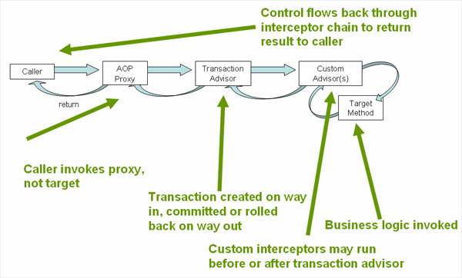

Slide 27
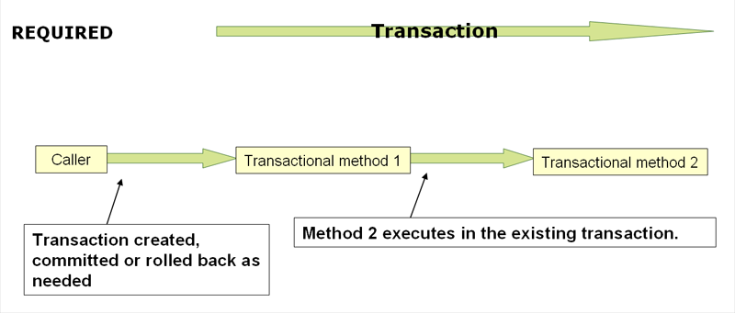

Slide 28
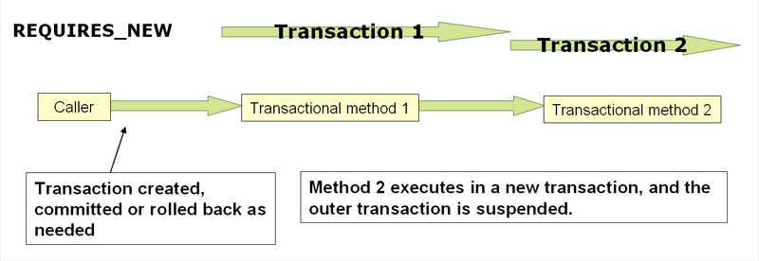

Slide 29
Spring Framework: Data Transactions
Unit Testing can utilize a third party Transaction Manager
Atomikos is open source and very stable
  Transaction Essentials (Apache License 2)
  DataSource wrappers for XA and non-XA connections
  Support for JMS

Slide 30
Spring Framework: Data
Transactions
Example XML Config
<bean id="dataSource" name="dataSource,datasource"
class="com.atomikos.jdbc.nonxa.AtomikosNonXADataSourceBean"
lazy-init="true" init-method="init" destroy-method="close" >
<property name="uniqueResourceName" value="NONXADBMS" />
<property name="driverClassName" value="${jdbc.driverClassName}" />
<property name="url" value="${jdbc.url}" />
<property name="user" value="${jdbc.username}" />
<property name="password" value="${jdbc.password}" />
<property name="readOnly" value="false" />
<property name="poolSize" value="1" />
<property name="maxPoolSize" value="4" />
<property name="minPoolSize" value="0" />
<property name="testQuery" value="select 1 from dual" />
</bean>
<bean id="atomikosTransactionManager"
class="com.atomikos.icatch.jta.UserTransactionManager"
init-method="init" destroy-method="close">
<property name="forceShutdown" value="true"/>
<property name="transactionTimeout" value="${transaction.timeout}" />
</bean>

Slide 31
Spring Framework: Data
Transactions
Example XML Config (cont)
<bean id="atomikosUserTransaction"
class="com.atomikos.icatch.jta.UserTransactionImp">
<property name="transactionTimeout" value="${transaction.timeout}" />
</bean>
<!-- Configure the Spring framework to use JTA transactions from Atomikos -->
<bean id="transactionManager"
class="org.springframework.transaction.jta.JtaTransactionManager">
<property name="transactionManager">
<ref bean="atomikosTransactionManager" />
</property>
<property name="userTransaction">
<ref bean="atomikosUserTransaction" />
</property>
</bean>
<!-- enable the configuration of transactional behavior based on annotations -->
<tx:annotation-driven transaction-manager="transactionManager"/>

Slide 32
LAB 02-B
1) modify Bank to create/update a transfer method
2) create an exception between credit and debit
3) what happened and how to fix it ?
Wait here until ready to move on…

Slide 34
Spring Framework: JPA Annotations
DZone Reference Cards (very handy)
Getting Started with JPA
http://refcardz.dzone.com/refcardz/getting-started-with-jpa
What's new with JPA 2.0 (2.1 is latest, but useful)
http://refcardz.dzone.com/refcardz/whats-new-jpa-20

Slide 35
Spring Framework: JPA
Major Players: Hibernate / EclipseLink
Spring provides hooks for each
Hibernate has more history and maturity
EclipseLink (OpenSource)
came from TopLink, Oracle owned
Both allow entity integration

Slide 36
Spring Framework: JPA
Add some dependencies
  spring-data-commons
  spring-data-jpa
  hibernate-jpa-2.1-api
  hibernate-entitymanager
  cglib

Slide 37
Spring Framework: JPA
@EnableJpaRepositories(basePackages = "com.lse.spring.example")
@Entity / @Table(name="ACCOUNT")
@Id / @Column(name = "ACCT_NUMBER")
@Transactional(dontRollbackOn = {EmptyResultDataAccessException.class})

Slide 38
LAB 03
1) copy lab 2 over to lab 3 named example-atm-jpa
2) edit pom.xml, change artifactId / name
add dependencies
3) modify Account as new Entity
4) add AccountDaoJPA JPARepository
public interface AccountDaoJPA extends AccountDao,
JpaRepository<Account,String> {
}
5) Profiles ???
Wait here until ready to move on…

Slide 40


Slide 41
Spring Boot
Builds upon Spring Framework success
        http://docs.spring.io/spring-boot/docs/1.3.x/reference/htmlsingle/
Create stand-alone, production-grade applications that just run Opinioned view of Spring, best of bread setup
Auto-configurations
Easy to get running !!!
Alot of free features by using starter framework and templates
NO XML Required !!!

Slide 42
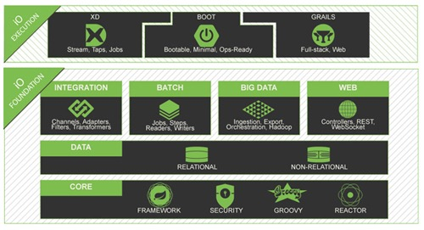

Slide 43




Slide 44
Spring Starter / InitializR
Provides easy boiler plates for starting apps
Support from STS
File->New->Spring Starter Project
http://projects.spring.io/spring-boot
Easy getting started with InitializR
select types of options (Web, JMS, JPA, etc)
generates boiler plate zip to download
http://start.spring.io

Slide 45
Spring Starter / InitializR
WAIT, LETS LOOK AT IT…
Spring Tool Suite Starter Project
http://start.spring.io
[Generates a project based on requirements]

Slide 46
Spring Framework: Initializr
Let’s build generate a project together…
maven project, spring boot 1.3.1
groupId: com.lse.spring.example
artifactId: example-audit-jms
actuator + actuator docs
artemis (JMS ActiveMQ)
data jpa
jta atomikos
Remote Shell CRASH
WS (Web Services)

Slide 47
Spring Framework: JMS
Now that you downloaded it, what next ?
Copy the zip to lab-04-jms or leave in STS workspace if done via eclipse
Oh, and now lets talk about JMS
JMS Client
JMS Listener (MDB)

Slide 48
Spring Framework: Core Annotations
DZone Reference Cards (very handy)
Spring Configuration
http://refcardz.dzone.com/refcardz/spring-configuration
Spring Annotations
http://refcardz.dzone.com/refcardz/spring-annotations

Slide 49
Spring Framework: JMS
Players: ActiveMQ / RabbitMQ / JMS++ more
Spring provides hooks for major configs
Others provide own integration artifact for spring
ActiveMQ has an embedded mode, not alone
JMS implementations should work with JTA

Slide 50
Spring Framework: JMS
Let’s build a simple audit notification listener
Send a simple String message to a listener so it can be logged using sl4j logging
private static final Logger log = LoggerFactory.getLogger(<theclass>.class);

Slide 51
Spring Framework: JMS
//JEE Message Drive Bean like using a “listener” pattern
@Component
public class AuditMessageListener {
public static final String MESSAGE_QUEUE = "example.audit.queue";
@JmsListener(destination = MESSAGE_QUEUE)
public void processMessage(String auditMessage) {
    //do stuff
}
}

Slide 52
Spring Framework: JMS
//Spring Client Template (again :-) )
@Component
public class AuditClient {
@Autowired
private JmsMessagingTemplate jmsMessagingTemplate;
@Autowired
@Qualifier("auditQueue")
private Queue queue;
public void audit(String msg) {
this.jmsMessagingTemplate.convertAndSend(this.queue, msg);
}
}

Slide 53
Spring Framework: JMS
//Spring Config
@Configuration
public class JMSConfig {
@Bean
public ActiveMQConnectionFactory jmsConnectionFactory() {
ActiveMQConnectionFactory amqFactory =
        new ActiveMQConnectionFactory(
        "vm://localhost?broker.persistent=false&broker.useJmx=false");
amqFactory.setSendTimeout(30000); //example of a factory setting
amqFactory.setMaxThreadPoolSize(10);
return amqFactory;
}
@Bean
public Queue auditQueue() {
return new ActiveMQQueue(AuditMessageListener.MESSAGE_QUEUE);
}
}

Slide 54
Spring Framework: JMS
//Spring Data Config for example
@Configuration
@EnableTransactionManagement
@EnableJpaRepositories(basePackages = "com.lse.spring.example")
public class JPAConfig {
@Value("${spring.datasource.driverClassName}") String dsDriverClassName;
@Value(“${spring.datasource.url}") String dsUrl;
@Value(“${spring.datasource.username}") String dsUsername;
@Value(“${spring.datasource.password}") String dsPassword;
@Bean(initMethod="init", destroyMethod="close") DataSource dataSource() {
System.setProperty("derby.system.home","./logs/derby-data");
AtomikosNonXADataSourceBean dataSource =
        new AtomikosNonXADataSourceBean();
    dataSource.setUniqueResourceName(
        "JTAResource-"+System.currentTimeMillis());
dataSource.setDriverClassName(dsDriverClassName);
dataSource.setUrl(dsUrl);
dataSource.setUser(dsUsername);
dataSource.setPassword(dsPassword);
dataSource.setMaxPoolSize(4);
dataSource.setTestQuery("VALUES(1)");
return dataSource;
}
}

Slide 55
LAB 04-A
after unzipping starter project…
copy over src/main/resources folder from setup
add datasource setup in a JPAConfig
add a JMS Listener and Client
Create a simple Unit Test to send a request without exception
Wait here until ready to move on…

Slide 57
Spring Boot: Starter
//Spring Boot Starter
@Component
public class AuditStartup implements CommandLineRunner {
@Override
public void run(String... args) throws Exception {
StringBuilder message = new StringBuilder();
if (args!=null && args.length>0) {
for (String arg : args) {
message.append(arg);
}
}
client.audit(message.toString());
}
}

Slide 58
LAB 04-B
1) now let’s create our own auto command line starter
2) Have it execute an audit notification that we started
Wait here until ready to move on…

Slide 60
Spring Actuator
Let’s take a tour of Actuator… DEMO
http://localhost:8080/docs
http://localhost:8080/info
http://localhost:8080/health
http://localhost:8080/metrics
http://localhost:8080/mappings
http://localhost:8080/configprops
http://localhost:8080/autoconfig
http://localhost:8080/beans
http://localhost:8080/info
http://localhost:8080/dump
http://localhost:8080/env
http://localhost:8080/trace

Slide 61
LAB 04-C
now let’s create our own Audit entity and
apply what we learned with JPARepository and store
the message when the listener receives it
2) Audit should have a UUID for the @Id
3) Audit should have a Date createdTs
4) Audit should have a String message
5) Create a JPARepository using Audit as the templated class and String as the Id
Wait here until ready to move on…

Slide 63
Spring Framework: JAX-WS
Spring supports multiple JAX-WS implementations
CXF is most popular, supports jax-ws and jax-rs implements (XML + JSON)
We will create a web service using standard JEE annotations

Slide 64
Spring Framework: JAX-WS
Need an interface to define the method and types
@WebService
@SOAPBinding(style= Style.DOCUMENT, use= Use.LITERAL)
public interface AuditWS {
@WebMethod
String audit(@WebParam(name = "message") String message);
}

Slide 65
Spring Framework: JAX-WS
Need an interface to define the method and types
@WebService
@SOAPBinding(style= Style.DOCUMENT, use= Use.LITERAL)
public interface AuditWS {
@WebMethod
String audit(@WebParam(name = "message") String message);
}

Slide 66
Spring Framework: JAX-WS
@EnableWs
@Configuration
public class WSConfig {
@Bean
public ServletRegistrationBean servletRegistrationBean(ApplicationContext context) {
CXFServlet jaxwsServlet = new CXFServlet();
jaxwsServlet.setBus(springBus());
return new ServletRegistrationBean(jaxwsServlet, "/jaxws/*");
}
@Bean(name = "cxf")
public SpringBus springBus() {
SpringBus bus = new SpringBus();
return bus;
}

Slide 67
Spring Framework: JAX-WS
@Bean public AuditWS auditWSService() {
AuditWSImpl svc = new AuditWSImpl();
return svc;
}
@Bean public Endpoint auditWSEndpoint() {
EndpointImpl endpoint =
        new EndpointImpl(springBus(), auditWSService());
endpoint.publish("/auditWS");
return endpoint;
}

Slide 68
Spring Framework: JAX-WS
@Bean Jaxb2Marshaller auditWSMarshaller() {
Jaxb2Marshaller marshaller = new Jaxb2Marshaller();
marshaller.setContextPath("com.lse.spring.example.ws");
return marshaller;
}
@Bean WebServiceTemplate auditWSClient() {
WebServiceTemplate wsc = new WebServiceTemplate();
wsc.setMarshaller(auditWSMarshaller());
wsc.setUnmarshaller(auditWSMarshaller());
return wsc;
}
}

Slide 69
Spring Framework: JAX-WS
For the client we need some maven dependencies:
<dependency>
<groupId>org.apache.cxf</groupId>
<artifactId>cxf-bundle</artifactId>
<version>3.0.0-milestone2</version>
</dependency>
<dependency>
<groupId>javax.xml</groupId>
<artifactId>jaxws-api</artifactId>
<version>2.0</version>
</dependency>

Slide 70
Spring Framework: JAX-WS
For the client we need some maven magic:
<plugin>
<groupId>org.springframework.boot</groupId>
<artifactId>spring-boot-maven-plugin</artifactId>
<configuration>
<executable>true</executable>
<layout>ZIP</layout>
</configuration>
</plugin>

Slide 71
Spring Framework: JAX-WS
More maven magic:
<plugin>
<groupId>org.codehaus.mojo</groupId>
<artifactId>build-helper-maven-plugin</artifactId>
<version>1.7</version>
<executions>
<execution>
<id>add-source</id>
<phase>generate-sources</phase>
<goals>
<goal>add-source</goal>
</goals>
<configuration>
<sources>
<source>${project.build.directory}/generated-sources</source>
</sources>
</configuration>
</execution>
</executions>
</plugin>

Slide 72
Spring Framework: JAX-WS
More maven magic:
<plugin>
<groupId>org.jvnet.jaxb2.maven2</groupId>
<artifactId>maven-jaxb2-plugin</artifactId>
<version>0.11.0</version>
<executions>
<execution>
<goals>
<goal>generate</goal>
</goals>
</execution>
</executions>
<configuration>
<verbose>true</verbose>
<debug>true</debug>
<!-- <packageName></packageName> -->
<generateDirectory>${project.build.directory}/generated-sources</generateDirectory>
<schemaDirectory>${project.basedir}/src/test/resources/wsdl</schemaDirectory>
<schemaIncludes>
<schemaInclude>**/*.wsdl</schemaInclude>
<schemaInclude>**/*.xsd</schemaInclude>
</schemaIncludes>
<bindingIncludes>
<bindingInclude>**/*.xjb</bindingInclude>
</bindingIncludes>
</configuration>
</plugin>

Slide 73
LAB 04-D
now lets expose our JMS Client via a Web Service
2) we need to first create the WSConfig
3) next we create the AuditWSService
4) now we need to add some maven magic
  to generate JAXB objects for our unit test
5) Our Integration Unit test will need to use the
  WebServiceTemplate
Wait here until ready to move on…

Slide 75
CraSH
Spring allows us to integrate an SSH server embedded in our Spring Boot app
Allows for setting of username / password values or use generated password stored in logs (reset each restart)
Allows for viewing internals of JVM
Allows creation of our own commands

Slide 76
CraSH
DEMO

Slide 77
CraSH
Crash allows for scripting (like groovy) to customize the experience
package crash.commands
import com.lse.spring.example.jms.AuditClient
import org.crsh.cli.*
import org.springframework.beans.factory.BeanFactory
import org.springframework.beans.factory.annotation.Configurable
@Configurable
@Usage("provide a way send an audit message event")
class audit {
@Command Object main(
@Man ("audit \"<message>\" ")
@Usage("the audit message to send, use quotes for whitespace.")
@Argument String message) {
if (message == null) {
message = "<empty>";
}
AuditClient client = fetchClient();
client.audit(message);
return "sent";
}
//…

Slide 78
CraSH
AuditClient fetchClient() {
BeanFactory beanFactory =
context.attributes['spring.beanfactory']
try {
return beanFactory.getBean(AuditClient)
} catch (Exception) {
return null;
}
}
}

Slide 79
LAB 04-E
add a crash command
2) log in via ssh
3) verify command runs
Wait here until ready to move on…

Slide 81
Spring Framework: Initializr
Let’s build generate a project together…
maven project, spring boot 1.3.1
groupId: com.lse.spring.example
artifactId: example-atm-app
actuator + actuator docs
data jpa
jta atomikos
Remote Shell CRASH
Jersey (jax-rs)

Slide 82
Spring Framework: JAX-RS
Now that you downloaded it, what next ?
Copy the zip to lab-05-jaxrs or leave in STS workspace if done via eclipse
Oh, and now lets talk about JAX-RS

Slide 83
REST Annotations
DZone Reference Cards (very handy)
REST
https://dzone.com/storage/assets/4019-rc129_010d-rest_0.pdf

Slide 84
Spring Framework: JAX-RS
Spring supports multiple JAX-RS implementations (CXF & Jersey)
Jersey is most popular from my point of view
We will create a web service using standard JEE annotations

Slide 85
Spring Framework: JAX-WS
@Component
@ApplicationPath("/rest")
public class ATMRestApplication extends ResourceConfig {
private static final Logger log = LoggerFactory.getLogger(ATMRestApplication.class);
public ATMRestApplication() {
register(ATMRestService.class);
register(JacksonFeature.class);
log.info("+++ ATMRestApplication started...");
}
}

Slide 86
Spring Framework: JAX-RS
@Path("/atm")
@Component
@Transactional
public class ATMRestService {
private static final Logger log = LoggerFactory.getLogger(ATMRestService.class);
@Inject
AccountDao dao;
@GET
@Path("/health")
@Produces(MediaType.APPLICATION_JSON)
public Response health() {
Response response = null;
try {
Map<String,String> info = new HashMap<>();
info.put("account_count",String.valueOf(dao.count()) );
response = Response.ok(info).build();
}
catch(Throwable t) {
log.error("balance error: {}",t.getMessage(),t);
response = Response.status(Status.INTERNAL_SERVER_ERROR).build();
}
return response;
}
}

Slide 87
LAB 05
lets implement an ATMRestService that will…
2) return a health check that it is running
3) return the balance amount
4) return an account
5) make sure you copy setup source for this one too
    (example unit test awaits you)
5) Our Integration Unit test will need to use the
  RestServiceTemplate to make a call
HINT: use the artifact example-atm-sf4 built earlier
Wait here until ready to move on…

Slide 89
Spring Boot and
Micro-Services

Slide 90
DEMO Spring Cloud

Slide 92
Advanced Spring 2016
Summary
Spring Framework has a lot of nice features you don’t have to build !
Spring Boot makes it easier to create opinioned solutions, but tuning will need to improve (lots of extras that you might not need, cpu/memory use)
There is so much we just scratched the surface
Read more at spring.io guides and documents
IT may not be for everyone, but if you want to focus on business solutions, you may want to give Spring and Spring Boot a try !
Watch out for Docker and Spring Boot microservices

Slide 93
Spring Framework: Resources
http://spring.io/docs
http://spring.io/guides
http://docs.spring.io/spring/docs/current/spring-framework-reference/htmlsingle/
http://www.theserverside.com/news/1364527/Introduction-to-the-Spring-Framework
http://www.javabeat.net/tutorials/8-spring-framework-beginners-tutorial.html
Books:
Spring In Action, Walls
Pro Spring, Harrop and Machacek

Slide 94
Spring Framework: Resources
http://refcardz.dzone.com/refcardz/spring-configuration
http://refcardz.dzone.com/refcardz/spring-annotations
http://refcardz.dzone.com/refcardz/core-spring-data
http://refcardz.dzone.com/refcardz/eclipse-tools-spring
http://refcardz.dzone.com/refcardz/spring-web-flow
http://refcardz.dzone.com/refcardz/expression-based-authorization
http://refcardz.dzone.com/refcardz/getting-started-with-jpa
http://refcardz.dzone.com/refcardz/whats-new-jpa-20
http://refcardz.dzone.com/refcardz/eclipselink-jpa
http://refcardz.dzone.com/refcardz/spring-integration
http://refcardz.dzone.com/refcardz/spring-batch-refcard
http://refcardz.dzone.com/refcardz/mockito

Slide 95
Spring Framework: Resources
https://dzone.com/storage/assets/487673-rc024-corejava.pdf
https://dzone.com/storage/assets/572027-rc221-docker.pdf
https://dzone.com/storage/assets/293353-rc215-microservices.pdf
https://dzone.com/storage/assets/3012-rc003-eclipse_online.pdf
https://dzone.com/storage/assets/4506-rc094-020d-git_2.pdf
https://dzone.com/storage/assets/4019-rc129_010d-rest_0.pdf
https://dzone.com/articles/debug-and-maintain-your-spring-boot-app
https://dzone.com/storage/assets/4388-rc050-010d-scrum_2.pdf
https://dzone.com/storage/assets/4595-rc008-designpatterns_online.pdf
https://dzone.com/storage/assets/413450-rc218-cdw-jenkins-workflow.pdf

Slide 97
Thank You !!!
Any feedback appreciated to help the next sojourner !!!
I can’t get any better if you don’t tell me what you like and dislike. :-)
David Lucas
Lucas Software Engineering, Inc (www.lse.com)
https://www.linkedin.com/in/ddlucas
@DavidDLucas
https://github.com/lseinc
ddlucas@lse.com

